Slide 1
WiringRobot.ConnectionPointDetector
Finding wire entry points on terminal blocks, straight from the CAD file
Bora Bayrakci
R&D RAS | Friedhelm Loh Group | 14 August 2026
ENCLOSURES
POWER DISTRIBUTION
CLIMATE CONTROL
IT INFRASTRUCTURE
SOFTWARE & SERVICE
FRIEDHELM LOH GROUP
WiringRobot.ConnectionPointDetector | BORA BAYRAKCI | R&D RAS · 14.08.2026
1

Slide 2
What It Does
The problem
What my system does
• A wiring robot has to know where to push the wire in.
• Today someone teaches every terminal type by hand.
• There are thousands of types in the catalogue. That does not scale.
• You give it one CAD file. Nothing else.
• It returns every wire opening: where it is, which way it points, how deep.
• It takes seconds, and it gives the same answer every time.
Why a simple CAD script cannot do this
• A wire opening and a screwdriver opening have the same shape. Only their purpose differs, and shape alone cannot tell you the purpose.
• The manufacturer marks the contact seat, which sits 5 to 25 mm inside the part. The robot needs the mouth on the surface. My system converts one to the other.
ENCLOSURES
POWER DISTRIBUTION
CLIMATE CONTROL
IT INFRASTRUCTURE
SOFTWARE & SERVICE
FRIEDHELM LOH GROUP
WiringRobot.ConnectionPointDetector | BORA BAYRAKCI | R&D RAS · 14.08.2026
2

Slide 3
The Pipeline
STEP file
CAD input
Tessellation
gmsh, 0.5 mm
Remesh
6 000 vertices
Segmentation
4 x DiffusionNet
Find openings
connected components
Wire / tool filter
random forest
Robot output
point + signed axis + depth
>
>
>
>
>
>
Blue boxes are learned. The rest is fixed geometry.
• Remesh: I rebuild every CAD surface at the same point density the network was trained on. Before I did this, the model did not work on real CAD files at all. This one step is what made it work.
• Wire / tool filter: the network can find an opening but cannot say whether a wire or a screwdriver goes in. So I trained a second, small model just for that. It raised precision from 61% to 75%.
• Everything else is deterministic: same file in, same coordinates out.
• Pose and direction correction: once the gate has decided, I move each point sideways onto the opening axis and fix which way the wire goes in. Two small models do that. Without this step I have an opening, not a coordinate.
ENCLOSURES
POWER DISTRIBUTION
CLIMATE CONTROL
IT INFRASTRUCTURE
SOFTWARE & SERVICE
FRIEDHELM LOH GROUP
WiringRobot.ConnectionPointDetector | BORA BAYRAKCI | R&D RAS · 14.08.2026
3

Slide 4
The Models I Used
Component
Method
Function
Training data
Segmentation
DiffusionNet
labels every surface vertex
102 labelled parts
Ensemble
4 models, combined
recovers openings one model misses
4 training runs
Opening extraction
connected components
groups vertices into one opening
none
Insertion axis + pose
ray probing + learned heads
gives the approach vector, then corrects sideways offset and insertion sign
6 330 matched candidates
Wire / tool gate
Random Forest
removes openings that take no wire
1 906 parts
Regime router
Random Forest
selects settings per part
1 906 parts
Two different kinds of training data
• 102 labelled parts are hand-painted vertex by vertex. That is the only way to train this kind of network, and it costs hours per part.
• 1 906 catalogue parts are point lists from the manufacturer. They train the gate and carry every score in this deck.
ENCLOSURES
POWER DISTRIBUTION
CLIMATE CONTROL
IT INFRASTRUCTURE
SOFTWARE & SERVICE
FRIEDHELM LOH GROUP
WiringRobot.ConnectionPointDetector | BORA BAYRAKCI | R&D RAS · 14.08.2026
4

Slide 5
The Words I Use in This Presentation
Term
Definition
Metric
Definition
Connection point (CP)
one wire opening: position + direction
Precision
of the openings I report, how many are real
Mesh / vertex
the 3D surface as triangles; a vertex is a corner
Recall
of the real openings, how many I find
Segmentation
labelling every vertex with what it is
F1
precision and recall combined into one score
Remeshing
rebuilding the surface at a chosen point density
IoU
how well my labels overlap the correct ones
Ensemble
several models voting together
Dice
same idea as IoU, scored a little more softly
Signed axis
the direction the wire goes IN, not just the line
Two words about how I test
• Out-of-fold: a part is only ever scored by a model that never saw it in training.
• Hold-out: a set of parts I locked away before training and opened once, at the end. I did not tune anything against it.
ENCLOSURES
POWER DISTRIBUTION
CLIMATE CONTROL
IT INFRASTRUCTURE
SOFTWARE & SERVICE
FRIEDHELM LOH GROUP
WiringRobot.ConnectionPointDetector | BORA BAYRAKCI | R&D RAS · 14.08.2026
5

Slide 6
Compared to the Master Thesis
Master thesis
My system
Mean IoU (sealed 11-part test)
51.4%
68.0%
Classes over the 50% usable bar
not reported per class
5 of 5
Training data
synthetic plus a little real
1 906 real catalogue parts
Testing
one split
out-of-fold, families kept apart, locked hold-out
What comes out
a labelled surface
point, axis, approach direction, depth
Connection-point F1
not measured, and not measurable from IoU
78.1% detection / 50.4% robot-ready
How I got from the thesis result to mine
• 1. I rebuilt every mesh at one fixed density. The thesis trained and tested on similar meshes; real CAD files look different, and that gap was the whole problem.
• 2. I replaced CAD-derived labels with real catalogue data. CAD labels only agree with a human 46% of the time, so they capped the result.
• 3. I grew the data from 914 to 1 753 parts and added the wire / tool filter, which the thesis does not have at all.
• Why my headline looks lower than 68.0%: the thesis measures one step, I measure four. Surface labelling 68.0% IoU, then find the opening 78.1%, then give an axis 59.0%, then give the axis the right SIGN 50.4%. Each step is a harder question than the one before, and the thesis never asks any of them.
• On the one step we share, I am 16.6 points ahead. The rest is not a worse result, it is a different question.
ENCLOSURES
POWER DISTRIBUTION
CLIMATE CONTROL
IT INFRASTRUCTURE
SOFTWARE & SERVICE
FRIEDHELM LOH GROUP
WiringRobot.ConnectionPointDetector | BORA BAYRAKCI | R&D RAS · 14.08.2026
6

Slide 7
What the Thesis Does Not Solve for a Product
• No coordinates for the robot. The thesis outputs a labelled surface. A robot cannot drive to a colour. I derive the opening mouth, the insertion axis, the approach vector and the depth, so the output is an instruction the robot can execute.
• Wire and tool openings are one class by design. The thesis class Contact covers both the contact and the screwdriver slot. A robot following it would push wire into a tool opening. I added a separate classifier for exactly this decision: precision 60.7% to 75.1%.
• The model does not survive real CAD files. Training and test meshes in the thesis look alike; production STEP files do not. I rebuild every surface at one fixed vertex density before inference, and that is what made the model transfer at all.
• One split can hide a leak. Terminal variants differ by millimetres, so a sibling part on the other side of a random split inflates the score. I group by product family, score out-of-fold, and keep a hold-out that was opened once.
• The product metric is never measured. The thesis reports IoU only, which says how well the surface is labelled, not whether the openings are found. I measure CP-F1 against manufacturer data on 1 906 parts: 76.0%.
• A perfect surface label would still not be enough. I measured where the remaining error sits: it is where the point lands, not which class the vertex got. Ignoring direction entirely buys far less than tightening the position.
ENCLOSURES
POWER DISTRIBUTION
CLIMATE CONTROL
IT INFRASTRUCTURE
SOFTWARE & SERVICE
FRIEDHELM LOH GROUP
WiringRobot.ConnectionPointDetector | BORA BAYRAKCI | R&D RAS · 14.08.2026
7

Slide 8
The Settings I Run With
Geometry parameter
Value
Decision parameter
Value
Tessellation deflection
0.5 mm
Ensemble members
4
Vertices per part after remesh
6 000
Votes required to keep a candidate
1
Spectral basis (k_eig)
96
Gate rule: score vs the best in the part
50% of the part maximum
Minimum opening size
4 vertices
Gate rule: absolute floor
20%
Vertex confidence mask
30%
Auto-accept gate score
60%
Terminal merge radius
1.0 mm
Matching tolerance
6% of part diagonal
• I did not pick these thresholds by eye. I searched them with the part families kept apart, so the search could not cheat. It landed on the value already in the product in 5 out of 5 folds.
ENCLOSURES
POWER DISTRIBUTION
CLIMATE CONTROL
IT INFRASTRUCTURE
SOFTWARE & SERVICE
FRIEDHELM LOH GROUP
WiringRobot.ConnectionPointDetector | BORA BAYRAKCI | R&D RAS · 14.08.2026
8

Slide 9
Segmentation: How Well It Labels the Surface
Mean IoU (metric used by the master thesis)
Score
Difference
Master thesis
51.4%
-
My model, on the sealed 11-part test
68.0%
+16.6 points
Weighted by class size
76.1%
-
Class (sealed 11-part test)
IoU
Above 50%
What the 50% line means
Housing (the body)
78.9%
yes
• 50% IoU is the bar the thesis itself calls usable: above it, the labelled area matches the true area more than it misses it.
• All 5 of my classes clear it. The weakest is SnapPoint, the clip that holds the terminal on the rail, at 52.3%.
• CableEntry, the class the robot actually depends on, sits at 64.8%. Contact, its neighbour, is at 78.7%.
Contact (metal contact)
78.7%
yes
LabelSurface (label area)
65.2%
yes
CableEntry (wire opening)
64.8%
yes
SnapPoint (rail clip)
52.3%
yes
Accuracy 85.8% · Dice 80.5%
• Same classes and same metric as the thesis. This is the sealed 11-part test: three human raters, majority vote, opened once.
ENCLOSURES
POWER DISTRIBUTION
CLIMATE CONTROL
IT INFRASTRUCTURE
SOFTWARE & SERVICE
FRIEDHELM LOH GROUP
WiringRobot.ConnectionPointDetector | BORA BAYRAKCI | R&D RAS · 14.08.2026
9

Slide 10
Connection Points: How Well It Finds the Openings
Evaluation frame
CP-F1
Definition
Detection (does it find the opening)
78.1%
known brand, unseen model [73.8-82.3]
Robot-ready, SIGNED axis (2 mm + 10 deg)
50.4%
what the robot can act on [41.7-58.9]
Robot-ready, axis only (unsigned)
59.0%
the number usually quoted; I quote the signed one [52.4-65.4]
Ceiling: candidate within 10 mm
78.2%
measured: a correctly-aimed candidate is already there
What the wire / tool filter is worth
• Precision went from 60.7% to 75.1% and recall barely moved (68.4% to 65.1%). So three out of four picks are now correct instead of three out of five.
• I report the hold-out number, not the development one. Development numbers in this field run about three times too optimistic, and mine did too.
ENCLOSURES
POWER DISTRIBUTION
CLIMATE CONTROL
IT INFRASTRUCTURE
SOFTWARE & SERVICE
FRIEDHELM LOH GROUP
WiringRobot.ConnectionPointDetector | BORA BAYRAKCI | R&D RAS · 14.08.2026
10

Slide 11
Where It Works Well, and Where It Does Not
Low CP density fewer than 8 connection points
High CP density 8 connection points or more
Share of catalogue
89.5%
10.5%
Representative types
single- and double-level feed-through
distribution and marshalling blocks
CP-F1
78.3%
71.9%
Limiting factor
precision: openings that carry no wire
recall: fewer openings fire at all
Operating mode
automatic
automatic with review
• Low CP density covers 89.5% of the catalogue, so the system is usable across most part numbers today.
• The high-density deficit had an arithmetic cause. 82.7% of those openings occupied fewer than 30 mesh vertices while the extraction filter required 30. Lowering the threshold for this regime moved it from 55.0% to 77.1%.
• Scores are weighted by the true catalogue distribution. An unweighted average over my test sample would have overstated the result by up to 10 points.
ENCLOSURES
POWER DISTRIBUTION
CLIMATE CONTROL
IT INFRASTRUCTURE
SOFTWARE & SERVICE
FRIEDHELM LOH GROUP
WiringRobot.ConnectionPointDetector | BORA BAYRAKCI | R&D RAS · 14.08.2026
11

Slide 12
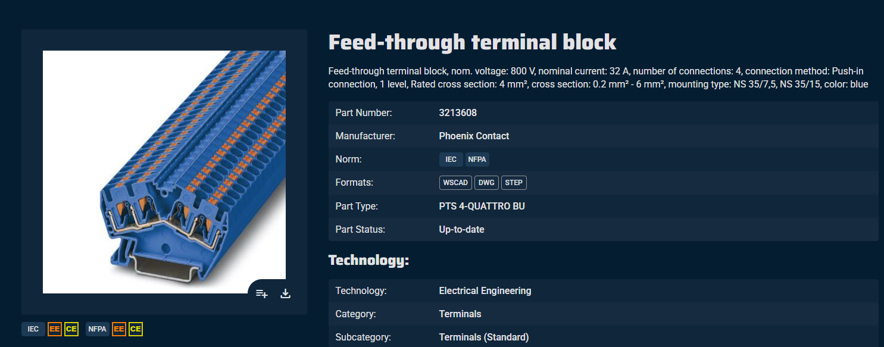
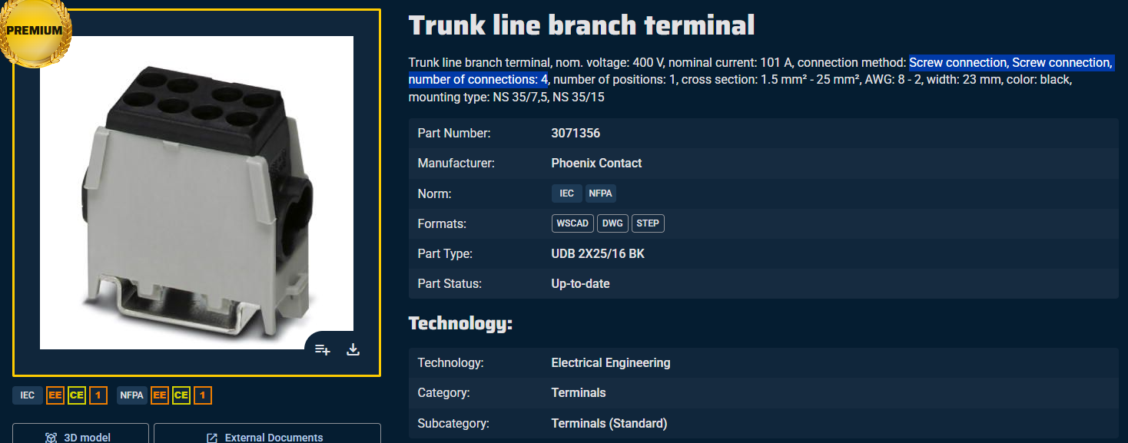
One Part It Gets Right, One It Gets Wrong
Right: PXC 3213608
Wrong: PXC 3071356
• 4 openings out of 4 found, and all 4 pass the robot test. One extra pick. F1 88.9%.
• Position and direction are both inside the robot tolerance on every one of the four.
• Round, recessed openings on one face, well separated.
• 1 opening out of 4 found, and 5 wrong picks. F1 20%.
• Spring-clamp openings with no round hole. The network does not react to them.
• All six picks came back as review, none as automatic. The system knows it is unsure here.
• Because I know how it fails. Three of the four are simply not seen; the wrong picks are openings that take no wire. Neither is random.
• And I checked that it is not a lack of data. Letting the model train on the exact parts it is tested on only gains 0.3 points.
ENCLOSURES
POWER DISTRIBUTION
CLIMATE CONTROL
IT INFRASTRUCTURE
SOFTWARE & SERVICE
FRIEDHELM LOH GROUP
WiringRobot.ConnectionPointDetector | BORA BAYRAKCI | R&D RAS · 14.08.2026
12

Slide 13
What I Would Do Next
Next step
Expected effect
Status
Gate acceptance rule: 50% -> 60% of part max
+2.0 points robot-ready, three samples
done
Pose and direction heads (now shipped)
measured end to end, shipped
shipped
Ensembles and augmentation variants
measured; none cleared the noise band
measured, below gate
Higher / lower mesh resolution
re-measured: lower worse, higher inside noise
measured, dropped
Per-vertex offset voting for the opening centre
direction learned; magnitude still shrinks
trained, needs longer
Data from manufacturers not in training
largest single gap; catalogue exhausted
next
Rebuild the high-CP path end to end
four stale steps fixed; selector still from July
one day
Three matched runs per segmentation arm
single runs flipped sign four times
two days
And what I will not claim
The ceiling I can still reach is 78.2%. For that share of the openings a correctly-aimed candidate is already within 10 mm; what is missing is the last few millimetres of position, not the opening itself.
• Threshold tuning is finished, and so is more data from this catalogue. Of 873 parts I was missing, only 7 are published as STEP; the rest exist only in a format a mesh pipeline cannot read. What is left is a new kind of signal.
ENCLOSURES
POWER DISTRIBUTION
CLIMATE CONTROL
IT INFRASTRUCTURE
SOFTWARE & SERVICE
FRIEDHELM LOH GROUP
WiringRobot.ConnectionPointDetector | BORA BAYRAKCI | R&D RAS · 14.08.2026
13

