Slide 1



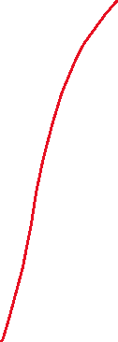

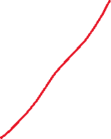
Shallow copy ver.
point
Rectangle
upper
1
7000
1
5000
8000
lower
9
org
9
Rectangle
upper
7000
5000
8000
cpy
lower

Slide 2






Deep copy ver.
1
upper
1
Rectangle
7000
8000
9
5000
lower
9
org
Rectangle
upper
1
7000
1
5000
8000
cpy
9
lower
9

