Slide 1
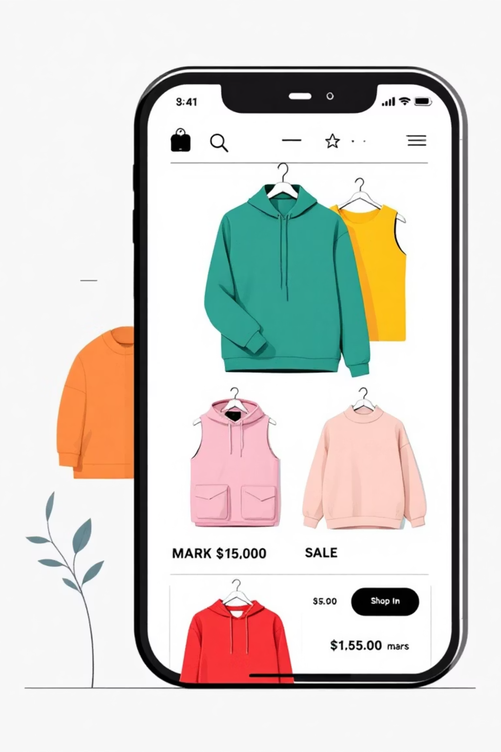
Myntra Fashion Data Analysis
Understanding trends and customer preferences through data-driven insights from 526,000+ fashion products

Slide 2

The Challenge
The Problem
E-commerce companies struggle to understand customer preferences and identify popular products due to massive data volumes. Proper analysis is needed to uncover trends and drive growth.

Slide 3





Project Objectives
Analyze Product Data
Price & Discount Insights
Brand Performance
Study Myntra's fashion product dataset to identify key patterns
Examine relationships between pricing, discounts, and customer ratings
Identify popular brands and product categories across segments
Customer Preferences
Business Intelligence
Understand fashion choices based on gender and demographics
Provide actionable insights for strategic decision-making

Slide 4
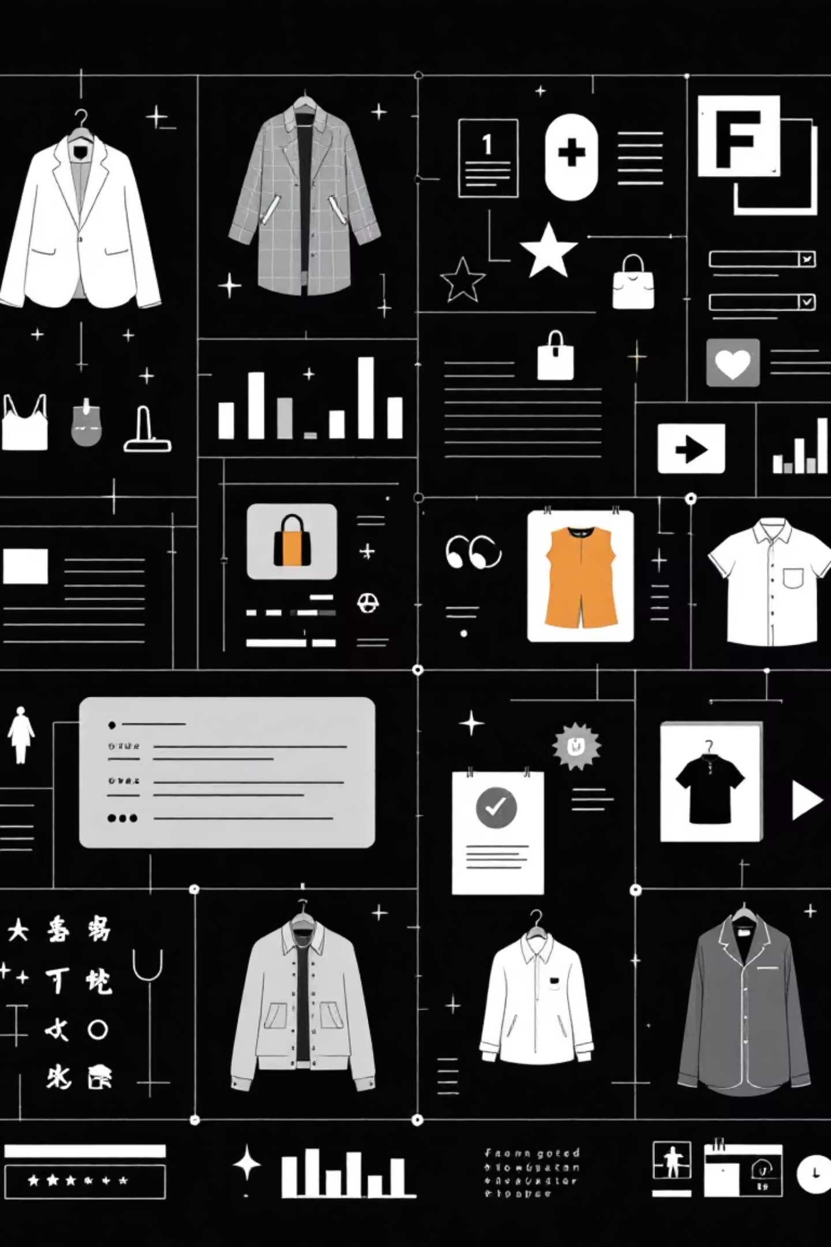
Dataset Overview
526K
13
Total Products
Key Features
Fashion items analyzed across all categories
Data points per product record
The Myntra Fashion Clothing Dataset includes Product ID, Brand Name, Category, Gender, Original Price, Discounted Price, Discount Percentage, Available Sizes, Product Rating, and Number of Reviews.

Slide 5





Our Methodology
Data Collection
Load the comprehensive Myntra dataset
Data Cleaning
Remove missing values and duplicate records
Preprocessing
Convert price, discount, and rating values into proper formats
Exploratory Analysis
Analyze brands, categories, pricing, and rating patterns
Insight Generation
Extract actionable business and customer behavior insights

Slide 6
Key Findings
Men's Fashion Dominates
Brand Concentration
Sweet Spot Pricing
Men's fashion products are the most common category in the dataset, representing the largest segment
Certain brands have significantly more products and customer reviews, indicating market leaders
Medium-priced products receive the most customer attention and engagement
Discount Impact
Size Availability Matters
Discounts strongly influence customer interest and purchase decisions
Products available in more sizes consistently perform better in sales and ratings

Slide 7





Business Applications
Product Recommendations
Sales Analysis
Customer Insights
Build intelligent recommendation systems based on customer behavior patterns
Conduct comprehensive business and sales performance analysis
Understand and predict customer preference patterns
Pricing Strategy
Inventory Management
Optimize pricing and discount planning for maximum impact
Improve stock planning and inventory optimization

Slide 8

Limitations & Considerations
No Demographic Data
Dataset lacks customer personal and demographic information
Rating Limitations
Ratings don't fully capture complete customer opinions and experiences
Static Dataset
Data is not updated in real-time, limiting current trend analysis

Slide 9
Future Opportunities
ML Recommendations
1
Build advanced recommendation systems using machine learning algorithms
2
Sentiment Analysis
Perform deep sentiment analysis on customer reviews and feedback
Demand Prediction
3
Use ML to predict product demand and customer ratings
4
Interactive Dashboards
Create real-time dashboards using Power BI or Tableau
Live Data Collection
5
Implement web scraping for continuous data updates

Slide 10

Conclusion
Data analysis is transforming the fashion e-commerce industry. By studying Myntra's product data, we uncovered critical patterns in pricing, discounts, and customer preferences.
These insights empower companies to enhance product planning, boost customer satisfaction, and accelerate sales growth. This project establishes a foundation for advanced machine learning applications and intelligent recommendation systems.

Slide 11

Data Cleaning & Analysis Project
A comprehensive guide to cleaning, analyzing, and retrieving product data using Excel functions and best practices.

Slide 12
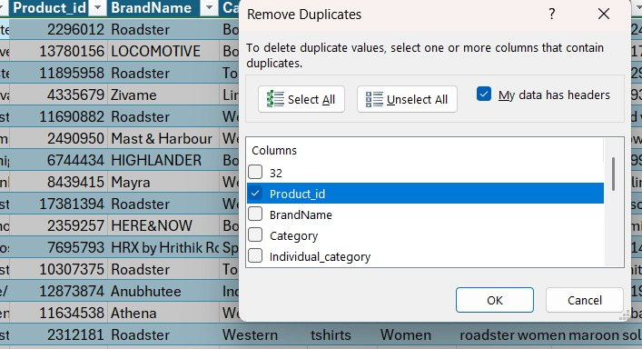
Project Overview
01
Data Cleaning & Preparation
Remove duplicates, standardize formats, and handle missing values to ensure data quality.
02
Data Analysis
Uncover patterns and trends through calculations and categorization.
03
Data Retrieval & Lookup
Master Excel functions to efficiently find and extract specific product information.

Slide 13

Data Cleaning & Preparation
Transform raw data into a reliable foundation for analysis through systematic cleaning processes.

Slide 14



Essential Cleaning Steps
Remove Duplicates
Standardize Discounts
Check the dataset for repeated rows and delete them so each product appears only once.
Convert all discount values into one common format (all in percentage).
Handle Missing Prices
Fix Size Options
Fill missing DiscountPrice using the average discount price of that product's category.
Replace all empty values in the SizeOption column with "Not Available".

Slide 15
Data Analysis
Key Analytical Tasks
1
Average Original Price
2
High-Discount Products
Calculate the average original price of products with ratings greater than 4.
Count how many products have a discount offer greater than 50%.
3
Size M Availability
Find the total number of products available in size "M".
4
=COUNTIF(Table1[Size Option], "*M*") NOW, IN THIS FORMULA, THERE’S A SLIGHT CHANGE. HERE I’VE WRITTEN “*M*” , NOW IN RESULTS, IT’LL ALSO SHOW THE NUMBER OF PRODUCTS AVAILABLE IN OTHER SIZES WITH “M” SIZE (i.e 308460)

Slide 16
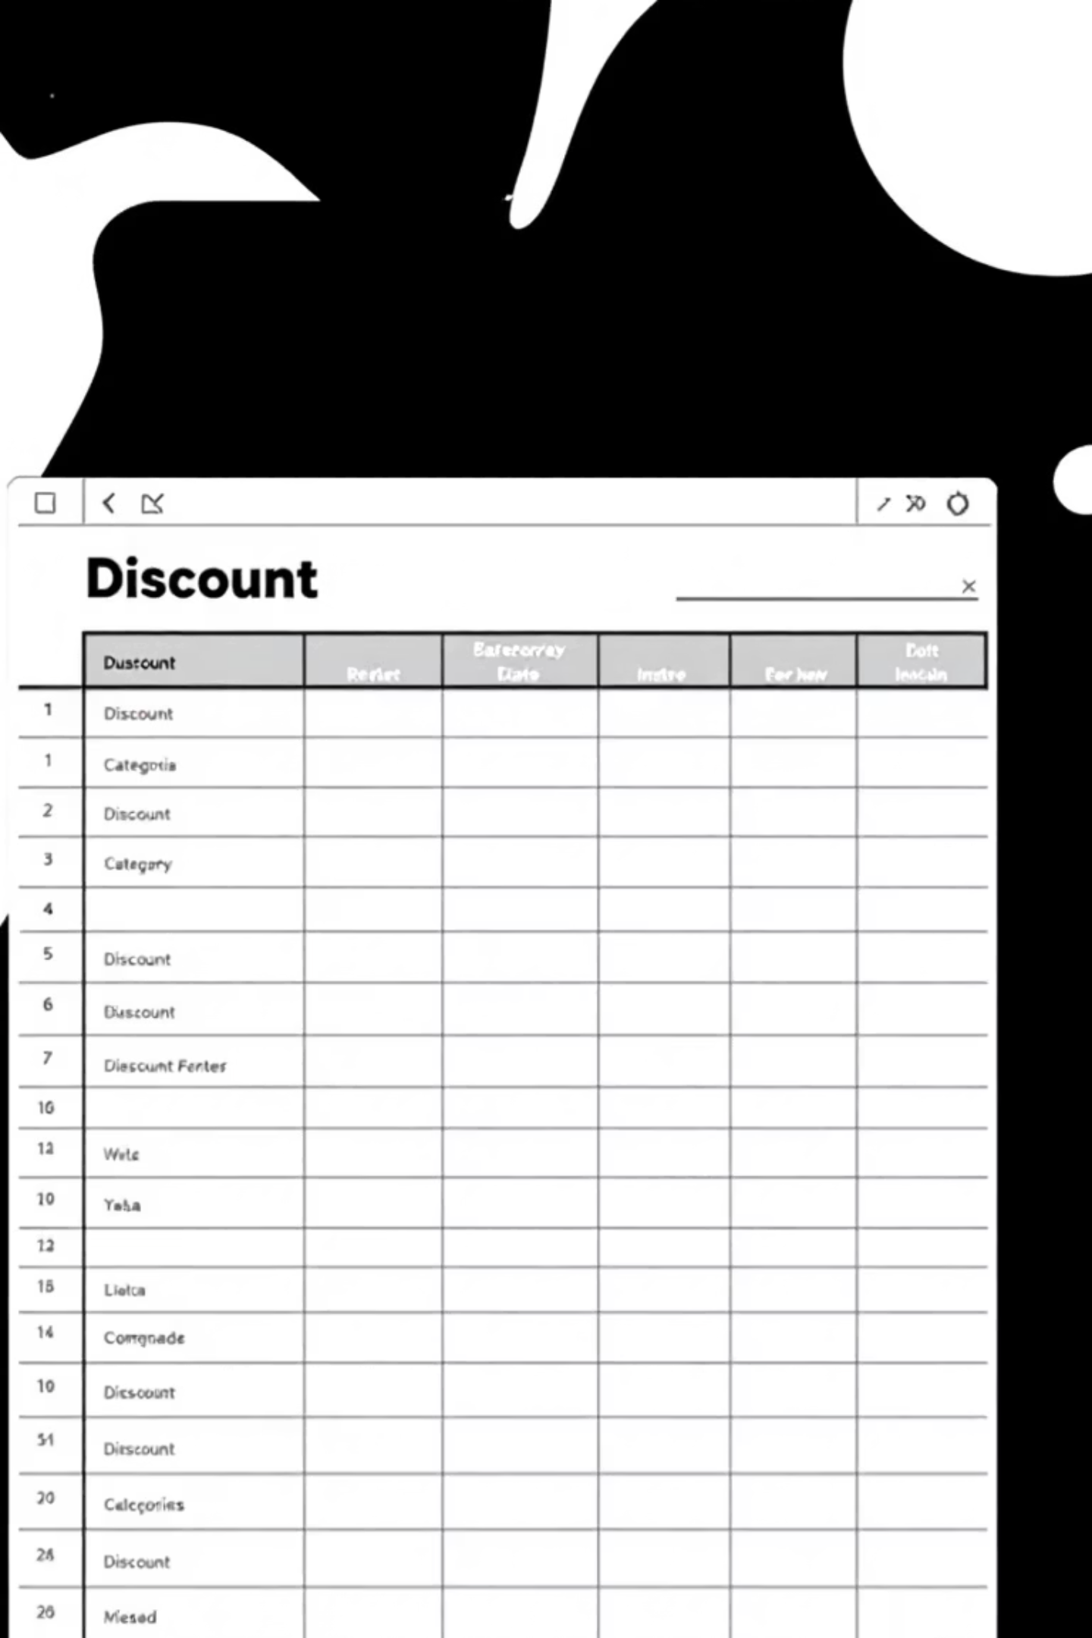



Creating Discount Categories
Add New Column
Create a column named "Discount Type"
Apply Logic
If discount > 50% → High Discount
Label Results
Otherwise → Low Discount

Slide 17
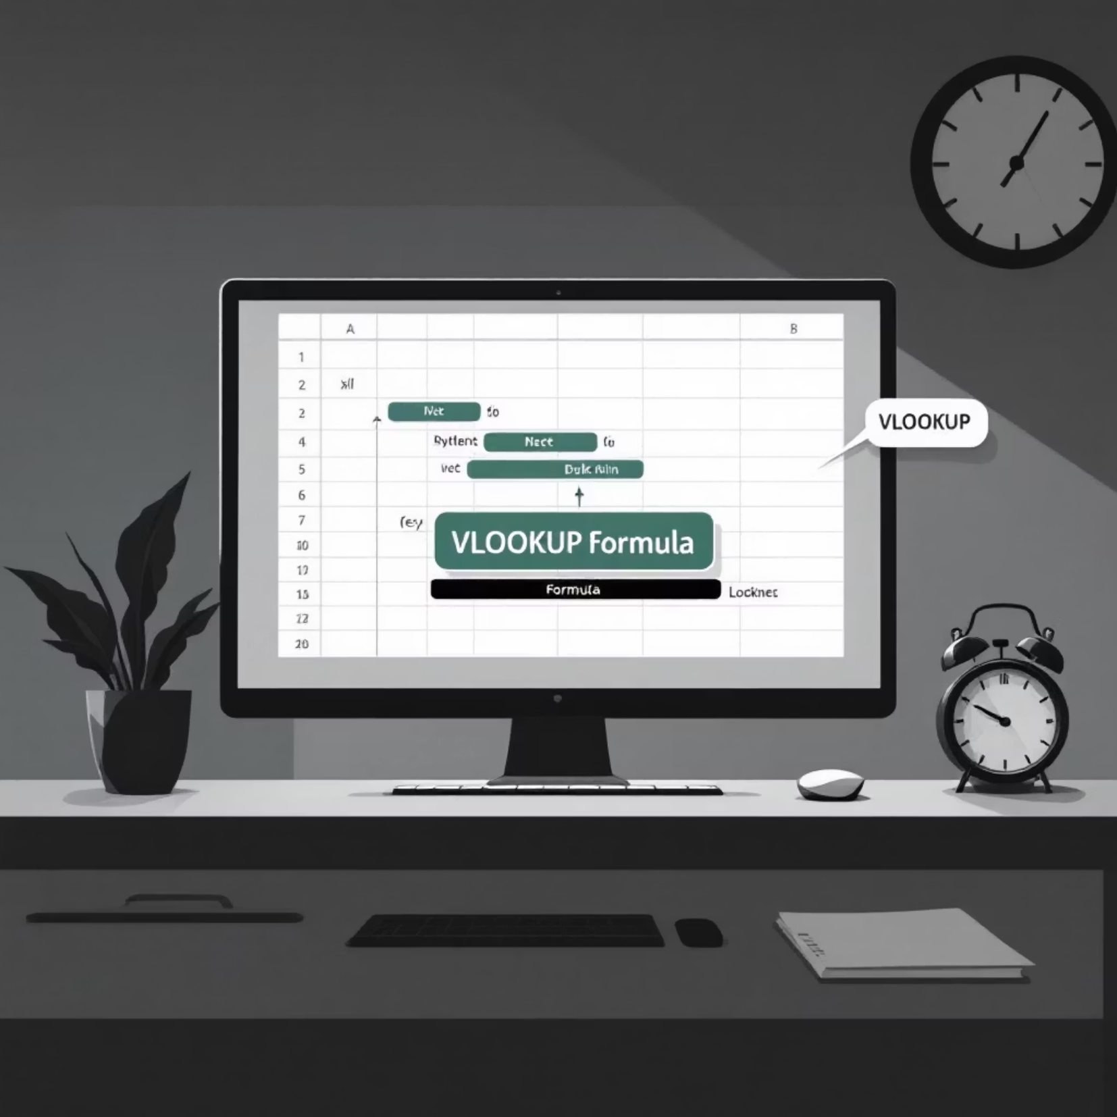

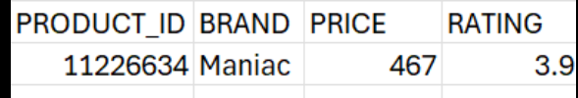
VLOOKUP Function
Find Product Details
Use VLOOKUP or XLOOKUP to retrieve brand name, price, and rating for Product ID 11226634.
VLOOKUP searches vertically through the first column to find matching values and returns data from specified columns.

Slide 18
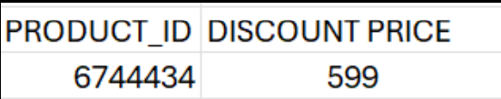
Advanced Lookup Techniques
Formulas :-
Index& Match :- =INDEX(Table1{Discount Price(in Rs)},MATCH(6744434,Table1{Product_id},0))
1
2
INDEX & MATCH
Nested XLOOKUP
Use INDEX and MATCH functions together to find the DiscountPrice for Product ID 6744434.
Use nested XLOOKUP to retrieve any required detail of a product using its Product ID.
More flexible than VLOOKUP
Combines multiple lookups
Can search in any direction
Handles complex data structures

Slide 19

Project Complete
3
8
100%
Major Phases
Core Tasks
Data Quality
Cleaning, Analysis, and Retrieval
From duplicates to lookups
Clean, analyzed, and accessible
This is my project link
https://1drv.ms/x/c/4422143b3a6018de/IQDTx0LUF763Tr6tTitsCAJkAfvzUQwjqQ05wDDa8PvZSS8?e=hI1ecf

