Slide 1
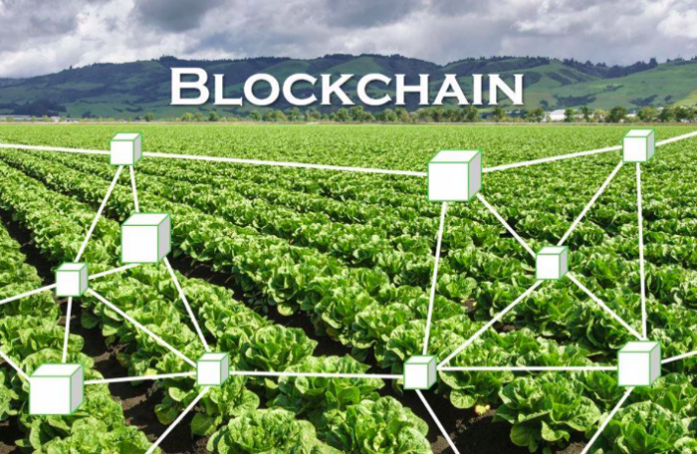
Farmer’s Market Smart Contract
Vanya Boranova, Weidong Li, Carey Liu, Brett Aucoin, Eric Siebert
November 23, 2020
Technologies used: Solidity, Ethereum, Metamask, IPFS, Python, Web3, APIs

Slide 2

Agenda
Business Problem
Product Overview & Business Value
Architecture
Demo
Personas
Features & Workflows
Product Demo

Slide 3

Business Problem
Providing a more transparent and accurate supply chain model for farmers markets.
Critical Key Element
Providing a decentralized immutable record of products so that it is possible to track them from beginning of production through the delivery to the end-user/customer

Slide 4



Product Overview & Value Statements
Summary of the product
How does this product create value?
Are there features of blockchain technology that influenced solution design?
A decentralized app for local market owners to host farmers markets and farmers to sell products directly to customers
It provides an immutable record of the products at market so that customers could have more trust in the quality of the items that they are purchasing
Immutability
provide confidence that the quality of the products are what the farmers promote
Easy to maintain and lower entry cost
no need to purchase servers or employ a full-time database administrator

Slide 5
Architecture
Farmer
Smart Contract
(on public blockchain)
Market Owner
Conduct transaction
User interface
User/Customer
Using Web3
Python
Using ERC 721 standard
Solidity
Push vendor and product info to storage using Pinata
Return vendor or product info upon customer request
IPFS

Slide 6
Architecture
Farmer
Smart Contract
(on public blockchain)
Conduct transaction
User interface
User/Customer
Using Web3
Python
Using ERC 721 standard
Solidity
Push vendor and product info to storage using Pinata
Return vendor or product info upon customer request
Market Owner
User interface
IPFS
Python

Slide 7
Personas
Market Owner
What problems do they care about?
Getting more vendors/customers to participate in their market
What should they find that is novel?
Fully automated record keeping, Inventory mgmt, ability to authenticate vendors
Farmer
What problems do they care about?
Proving the quality/history of the food that is brought market, money straight into their pocket, inventory mgmt, demand planning, access to more customers
What should they find that is novel?
Simplified inventory mgmt, paid directly from consumers immediately, ledgers of what was sold
Buyer
What problems do they care about?
Ability to pre-order, single place to buy from multiple vendors, visibility to product quality/history
What should they find that is novel?
Interface to make purchases, buy directly from the farmer, view of product quality/history

Slide 8
Workflows
Market Owner
Owner Registers Farmer’s Market
Transaction
Fee
Register Farmer/Vendor
Register Product
Contract Payment
Vendor Notified
Farmers
Update Product
Update Product History
Vendor Ships Product
Buyers
View Registered Vendors
Make Purchase of Product
Buyer Receives Product
View Products
View Product history

Slide 9
Workflows (original)
Market Owner
Owner Registers Farmer’s Market
Register Home
Avail for rent
Rental starts
Rental stops, Avail for rent
Search Rentals
Rent Home
Contract payment
Farmerz
Rent Assets
Notice to businesses
Offer to renters
Buyer

Slide 10
How to show workflows? This is just a series of python functions during the demo
This is as simple as having a python function that takes the inputs and demonstrates outputs that represent what a given persona should experience.
In our rental example - we would walk through a set of Python functions in an order, and tell us which Persona you are representing, and with it, the inputs you are providing, describe the logic that is transpiring, and then describe the expected output, and then show the output fired as expected. This portion of the overall presentation should be a script, much like you would demo software to a client / investor. Example flow below:
Homeowner:
should be able to register, then
add a home and
prove they can list it.
Renter -
search for a home
Rent the home
Homeowner:
Prove their home is rented and they have received money
This behavior is demonstrated by firing off functions from python and showing the outputs in python (show list of houses, send money to owner, then owner can pull account to show incoming funds).
Pull this slide for your presentation

Slide 11

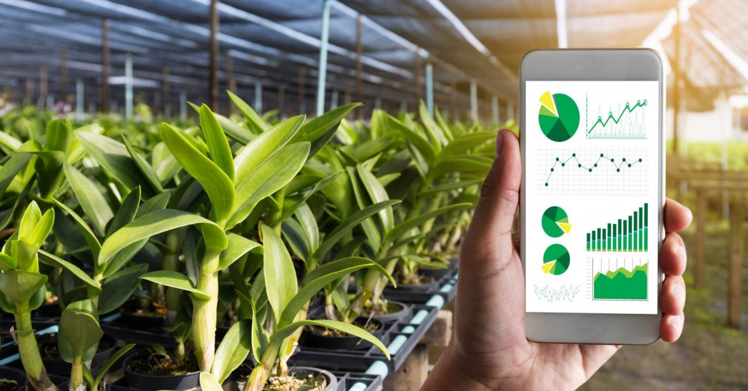
Demo

Slide 12
Product Demo Presentation tips
Orient to Value Quickly
Any product demo centers around the business problem and business value being offered.
Each additional slide becomes more granular, ending with a walk-through of the product that demonstrates the value being created.
There is an equal balance of presentation duties …(everyone speaks).
Architecture
This is more about data flow, and why certain functions were chosen to be placed within certain points of the architecture. Why is certain data stored within IPFS, etc.
Topics should speak to efficiency of data storage.
Length
The slides walk-through should be about 10 min, and the demo should be about another 10 min, and plan for 5 min of class Q&A.

