Slide 1
Analysis of Twitter posts for Cape Town, South African Users

Slide 2
Brief Introduction
This is a simple program that analysis the Cape Town, South Africa tweets posts. We grouped the data based on location and the program then use the location to find the most frequency words users used on Twitter. Furthermore, we can used the analysis to find users ID and we predict the different emotions attached to the text. However, in this report we consider using the user id,location,text.

Slide 3
Experimental Overview
This program data was pre-processed using pandas, NLTK, gensim, and numpy libraries within the Python virtual environment. Plots were created using plotly.
Project Setup Environment Overview:
1. Python Virtual Environment; e.g. Anaconda
2. Used Python Libraries and Jupyter Notebook; egg pandas, NLTK, gensim, and numpy libraries within the Python
3. GitHub; versioning control

Slide 4
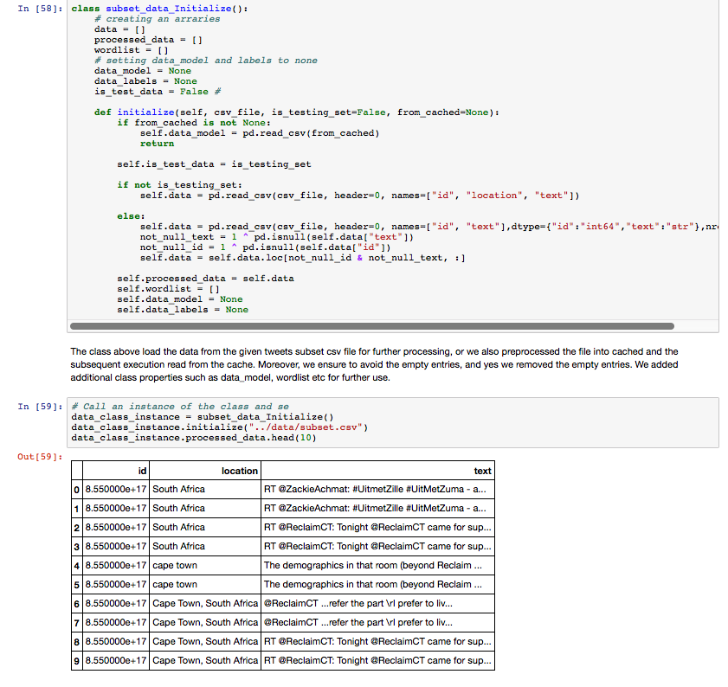
Implementation Overview: Scripts
Preprocessing steps of the Program
The following show the steps of the program. Data were cleaned and then we find by creating and grouping words of the most frequent used. The steps are as follows:
Data Cleansing
Remove URLs
Remove usernames
Remove tweets with empty column
Remove special characters
Remove numbers
Text processing
Tokenize
Transform to lowercase
Build word list for Words
Cleansing the tweets subset datasets
In this program, the subset_data_Cleanuper class was created. The class consists of methods or functions that allow task execution in the list. This is shown below. Most of those is done using regular expressions. The class exposes it's interface through iterate() method - it yields every cleanup method in proper order.

Slide 5
Schematic Overview: Class Modules
This program uses an "object oriented programming" to structure the program as shown below;
TwitterData_Wordlist
subset_data_Initialize
Tokenization
build_wordlist(arg….)
initialize(arg….)
tokenize(arg….)
Preprocess ( )
subset_data_Cleanuper
Data_Cleansing
remove_by_regex ( )
remove_urls ( )
cleanup(arg….)
remove_special_chars( )
remove_usernames ( )
remove_numbers ( )

Slide 6
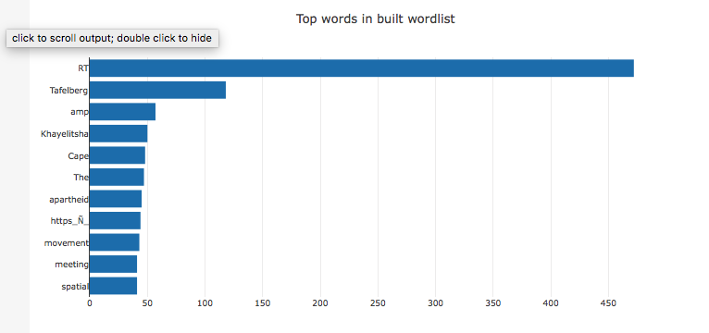
Result Overview: Data Representation Graphically
The most common words (as expected) are the typical English stop words. We filter them out, and as purpose of this analysis is to determine words like ”Cape Town" and ”South African". Having this in mind, these words are represented in the graph.
To access the graph interactively, click the following links; https://plot.ly/~boraton/3/

Slide 7
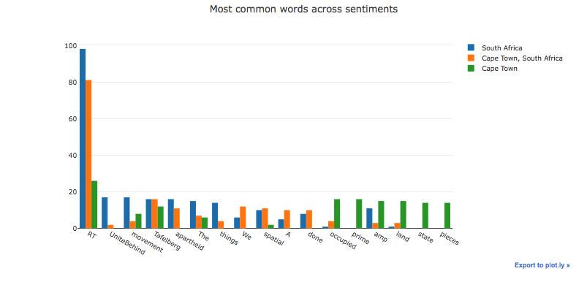
Result Overview: Data Representation Graphically
Some of the most common words show high distinction between classes like retweets and apartheid and other are occurring in similar amount for every class. The most common words hashtag (Retweets, RT) is unique in South African in general. At this point, it's clear that words across several locations are challenges.
To access the above graph interactively; click the following link: https://plot.ly/~boraton/1/

Slide 8
Summary
We showed that certain text is a non-trivial task can be parse further for machine learning. Moreover, the huge data require thorough preprocessing and algorithm to simulate the most frequent tweets in Cape Town, South. This analysis require further and advance processing.

Slide 9
Project Repository
This post is compiled version of Jupyter Notebook, which can be download here:
https://github.com/boratonAJ/CT_Tweets_Analysis_Report.git

Slide 10
References
Website References:
https://github.com/bonzanini/nlp-tutorial
https://marcobonzanini.com/2015/03/09/mining-twitter-data-with-python-part-2/
https://github.com/bonzanini/Book-SocialMediaMiningPython
https://stackoverflow.com/questions/35074222/python-read-csv-into-dataframe-cant-convert-object-into-float
https://stackoverflow.com/questions/31729288/pandas-dataframe-and-u-u2019
https://stackoverflow.com/questions/38134643/data-frame-object-has-no-attribute
https://regexone.com/references/python

