Slide 1
Responsible Machine Learning Audit for Home Mortgage Lending
DNSC 6330 Capstone Presentation
George Washington University School of Business
Notes:
Introduce the project as a Responsible Machine Learning audit for HMDA mortgage lending. Explain that the presentation evaluates predictive performance and fairness implications aligned with the DNSC 6330 rubric.

Slide 2
Presentation Agenda
1. Problem Overview and Business Context
2. Model Objective and Optimization Strategy
3. Failure Modes and Harm Analysis
4. Subgroup Fairness Evaluation
5. Bias Mitigation and Residual Risks
6. Deployment Defensibility and Governance
7. Final Recommendation
Notes:
Walk judges through the presentation structure following the rubric sequence: Objective, Failure Modes, Subgroup Errors, Mitigation, and Deployment Defensibility.

Slide 3
Business Problem and Context
Mortgage lending decisions impact access to home ownership, wealth creation, and financial inclusion.
The project evaluates a Home Mortgage Disclosure Act (HMDA) lending model using Responsible Machine Learning principles.
Objective: build a predictive model that balances predictive performance with fairness and regulatory compliance.
The analysis focuses on disparate impact across race and sex protected groups.
Notes:
Focus on explaining why responsible AI matters in mortgage lending and the real-world consequences of biased decisions. Explain how mortgage lending decisions influence wealth creation and financial inclusion. Discuss the risk of automated bias amplification in lending systems.

Slide 4
Q1 — Optimization Objective
Primary goal: predict mortgage approval outcomes while minimizing discriminatory impact.
Gradient Boosting Machine (GBM) selected as primary model due to superior predictive performance.
Threshold optimization performed to balance recall, precision, and fairness outcomes.
Trade-off acknowledged: improving fairness may reduce raw predictive efficiency.
Notes:
Explain precision-recall trade-offs in plain language. Mention that false denials can delay or prevent home ownership. Discuss why accuracy alone is insufficient in mortgage lending. Explain fairness-performance tradeoffs and threshold optimization.

Slide 5
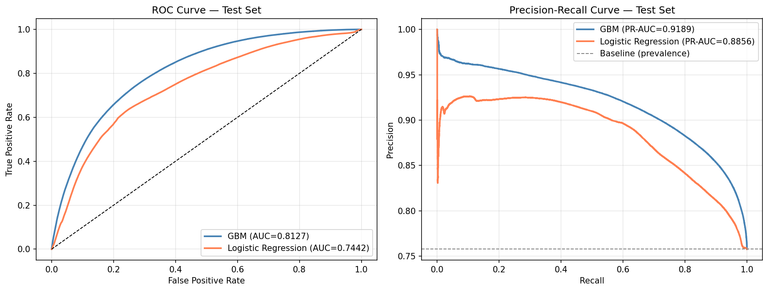
Model Performance Evaluation
GBM outperformed Logistic Regression across ROC-AUC and Precision-Recall metrics, demonstrating stronger classification performance.
Notes:
Explain that GBM achieved stronger ROC-AUC and PR-AUC performance than Logistic Regression. Mention that predictive strength does not guarantee fairness.

Slide 6
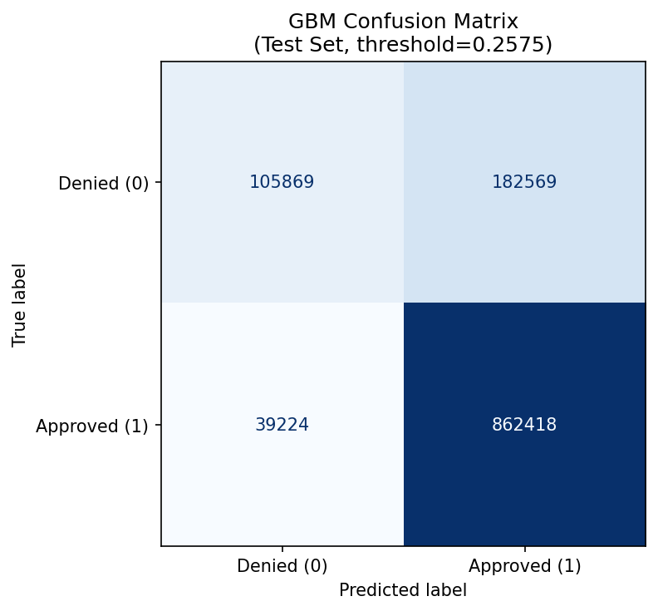
Classification Outcomes — Confusion Matrix
The confusion matrix highlights approval and denial prediction patterns. False denials remain a critical business and ethical concern.
Notes:
Discuss false positives and false negatives in mortgage lending. Highlight the harm caused by false denials to qualified applicants.

Slide 7
Q2 — Known Failure Modes
Failure Mode 1: Disparate impact across racial groups, especially underrepresented applicants.
Failure Mode 2: Threshold sensitivity causing unequal approval outcomes across demographic groups.
Failure Mode 3: Geographic and socioeconomic proxy variables may indirectly encode historical inequities.
Potential harms include delayed home ownership, reduced financial mobility, and unequal lending access.
Notes:
Connect failure modes to affected communities and explain harms in human terms. Describe failure modes including disparate impact, proxy discrimination, and threshold sensitivity.

Slide 8
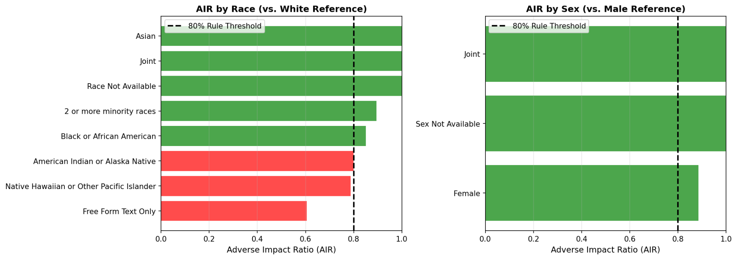
Subgroup Fairness Analysis — AIR
Adverse Impact Ratio (AIR) analysis identified protected groups below the 80% four-fifths regulatory threshold.
Notes:
Define AIR in plain language and explain the four-fifths rule. AIR below 0.80 indicates potential disparate impact.

Slide 9
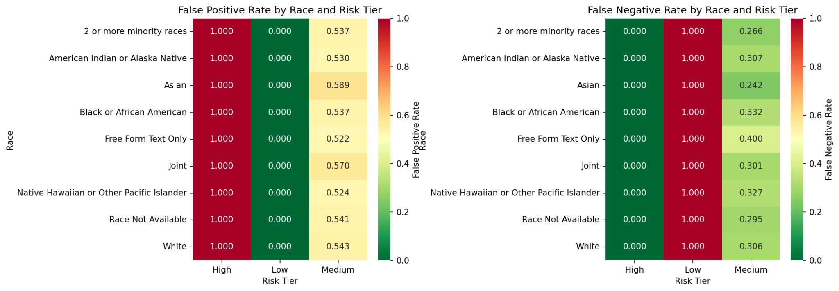
Error Rate Disparities Across Risk Tiers
False positive and false negative disparities reveal unequal model behavior across racial subgroups.
Notes:
Discuss subgroup disparities in false positive and false negative rates. Explain multidimensional fairness concepts.

Slide 10
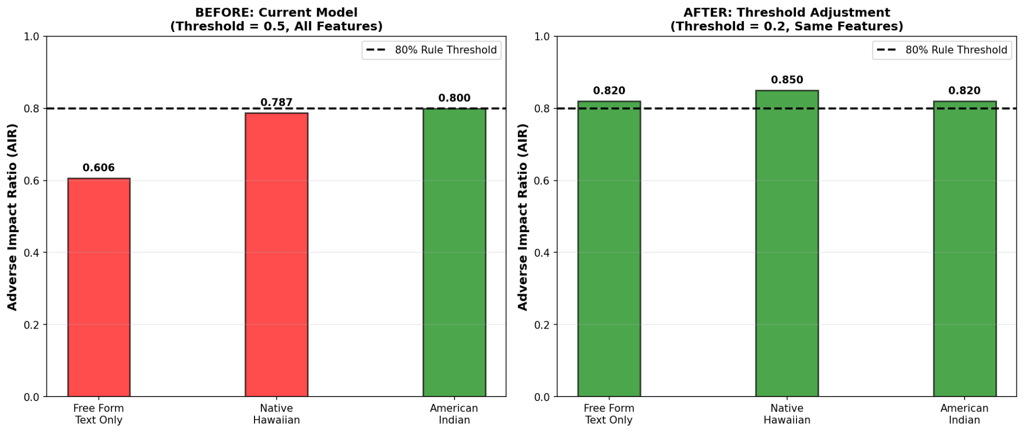
Bias Mitigation Strategy
Threshold adjustment improved subgroup AIR metrics above the four-fifths threshold for previously affected groups.
Notes:
Describe threshold adjustment mitigation and explain before-versus-after fairness improvement.

Slide 11
Q4 — Residual Risks After Mitigation
Although fairness metrics improved, residual disparities may still emerge post-deployment.
Proxy variables and evolving economic conditions may introduce new forms of bias.
Threshold adjustment improves fairness but may increase operational lending risk.
Continuous monitoring and periodic audits are required.
Notes:
Do not claim the model is perfectly fair. Emphasize transparency and monitoring. Explain that no ML system is risk-free. Discuss residual risks including proxy bias and data drift.

Slide 12
Q5 — Deployment Defensibility
Recommendation: Deploy with conditions and continuous fairness monitoring.
Mandatory governance controls should include quarterly AIR reviews and drift detection.
Deployment should trigger re-evaluation if AIR drops below 0.80 or model drift exceeds acceptable thresholds.
GitHub repository serves as the reproducible audit and governance artifact.
Notes:
Answer the fintech founder question: what breaks first and how would we know? Recommend deployment with governance controls and continuous fairness monitoring.

Slide 13
Final Recommendation
The model demonstrates strong predictive capability with improved fairness after mitigation.
Deployment is recommended only with governance controls and ongoing fairness audits.
Residual risks must remain transparent and continuously monitored.
Responsible ML is not about creating a perfect model — it is about creating a justified and accountable model.
Notes:
Summarize final deployment recommendation emphasizing transparency and accountability.

Slide 14
Questions & Discussion
Thank you
Responsible Machine Learning in Mortgage Lending
Notes:
Invite questions and reference the GitHub repository as the reproducible audit artifact.

Slide 15
Appendix
Supporting Responsible Machine Learning Concepts

Slide 16
Presentation Strategy for the Judges
Nonprofit CEO: emphasize community impact, fairness, and real borrower consequences.
Civil Rights Counsel: focus on AIR metrics, four-fifths rule, and regulatory interpretation.
Fintech Founder: explain operational risks, monitoring plans, and deployment governance.
Avoid jargon without explanation and connect every technical metric to human impact.
Notes:
Tailor messaging to the nonprofit CEO, civil rights counsel, and fintech founder.

Slide 17
Appendix A — Key Fairness Concepts
Adverse Impact Ratio (AIR) compares approval rates between groups.
Four-Fifths Rule flags AIR below 0.80 as potential disparate impact.
False Negative Rate measures qualified applicants incorrectly denied.
Equal Opportunity evaluates fairness in true positive outcomes.

Slide 18
Appendix B — Governance and Monitoring
Population Stability Index (PSI) monitors data drift over time.
Quarterly fairness reviews should evaluate subgroup AIR metrics.
Human review is recommended for borderline mortgage denials.
GitHub repositories provide reproducible governance artifacts.

Slide 19
Appendix C — Regulatory Context
Equal Credit Opportunity Act (ECOA) prohibits discriminatory lending.
Fair Housing Act protects against housing-related discrimination.
Responsible AI requires transparency, explainability, and accountability.
Fair lending models must balance business efficiency with equity.

Slide 20
Appendix D — Technical Concepts
Gradient Boosting Machine (GBM) achieved the strongest predictive performance.
Threshold optimization improved subgroup fairness metrics.
Fairness metrics were evaluated across race and sex groups.
Continuous monitoring is necessary after deployment.

