Slide 1
DNSC 6330 · CAPSTONE
RESPONSIBLE MACHINE LEARNING AUDIT
Home Mortgage Lending Model Audit
COURSE
DNSC 6330 Capstone Presentation
INSTITUTION
George Washington University School of Business
HMDA lending model evaluated for predictive performance, disparate impact, residual risk, and deployment defensibility.
GROUP 5 · DNSC 6330 · GWU

Slide 2
OPTIMIZATION OBJECTIVE
Metric, threshold, and trade-off
METRIC
THRESHOLD
RANKING
F1 = 0.8861
0.2575
AUC 0.8127
Validation-optimized balance of
precision + recall
Operational approval cutoff
Test set ranking quality
DECISION RULE
Approve if P(approval) ≥ 0.2575. Rejected otherwise — this is where false denials become the key ethical harm.
RESPONSIBLE ML HMDA AUDIT

Slide 3
METRIC & THRESHOLD
Specification
CRITERION
SPECIFICATION
Metric
F1 Score ≥ 0.886
Threshold
0.2575 (cutoff probability for approval prediction)
Optimization Approach
F1-maximization on validation set (balanced precision-recall)
Decision Rule
IF P(approval) ≥ 0.2575 THEN approve; ELSE deny
WHY THIS THRESHOLD?
The validation set was sorted by predicted probability, and the threshold that maximizes F1 was selected. This differs from the common 0.5 default because F1 prioritizes finding the sweet spot between false positives (lender losses) and false negatives (applicant exclusion).
RESPONSIBLE ML HMDA AUDIT

Slide 4
BUSINESS RATIONALE
Two sides of the F1 balance
FOR LENDERS
FOR APPLICANTS & FAIRNESS
Mortgage lending requires minimizing credit risk (false positives) — lending to unqualified borrowers who default is costly
The U.S. mortgage market is critical infrastructure for wealth-building; wrongful denials = long-term economic exclusion
F1 helps balance this by maintaining high precision (91% of approved applicants actually repay)
HMDA regulations (12 CFR 1003) require lenders to avoid discrimination based on protected attributes
THIS MODEL CONNECTS LENDING DECISIONS TO APPLICANT CONSEQUENCES
Approved (~81% of applicants)
Denied (~19% of applicants)
Access to credit, homeownership pathway, generational wealth
Exclusion from mortgage market, forced into subprime/rental markets, household financial instability
RESPONSIBLE ML HMDA AUDIT

Slide 5
BUSINESS CONTEXT
Mortgage decisions are high-stakes ML decisions
The harm is not only statistical: lending errors affect access to housing, credit, and wealth creation.
HMDA
RACE + SEX
4/5 RULE
Public mortgage-lending context
Protected groups audited
AIR < 0.80 red flag
A WRONG DENIAL CAN MEAN
AUDIT QUESTION
Delayed homeownership
Higher borrowing costs
Reduced credit access
Lost wealth-building opportunity
Regulatory and reputational risk
Can this model support mortgage decisions without creating unjustified disparate impact — and can it be defended to community, legal, and fintech stakeholders?
RESPONSIBLE ML HMDA AUDIT

Slide 6
THE CORE TENSION
Accuracy is not fairness
F1 optimization balances lender safety and overall accuracy, but does not ensure fairness . A model can be accurate on average while systematically harming specific groups.
RESPONSIBLE ML HMDA AUDIT

Slide 7
TRADE-OFF ANALYSIS
Who pays the cost, and what the metrics show
GROUP
COST OF MODEL
METRIC EVIDENCE
Low-risk applicants
Wrongful denials → excluded from credit market
129,152 wrongfully denied in low-risk tier; 42% false negative rate
(entire population)
Racial minorities
Disparate impact → systemic exclusion by race
38.2% approval gap: Joint (80.3%) vs. Free Form Text Only (42.0%); Black (63.3%) vs. White (78.3%)
(Black/African American, Native Hawaiian, "Free Form Text Only")
Female applicants
Gender-based exclusion → compounding disadvantage
11.2% lower approval rate (Women 70.6% vs. Men 74.3%); 33% false negative rate
Lenders
Credit risk from false positives
~30K wrongfully approved in high-risk tier; potential loan losses
RESPONSIBLE ML HMDA AUDIT

Slide 8
AUDIENCE & FRAMING
Who is affected, and what counts as failure
STAKEHOLDERS & HARM ASYMMETRY
Applicants
Lender
Regulators
Brokers / vendors
Bear the dominant harm. Protected-class applicants disproportionately so.
A wrongful denial blocks credit for a qualified borrower.
Carries institutional risk: bad loans approved, regulatory exposure, reputational damage from disparate-impact findings.
CFPB, HUD, OCC examine the lender. Fair-lending exam cycles focus on FNR by protected class.
Influence input integrity. Income/DTI gaming and census-data corruption are documented threat vectors.
A false negative — denying a qualified applicant — is the worst outcome and the metric fair-lending exam cycles focus on. We lead the audit with that harm metric.
TAKEAWAY
GROUP 5 · DNSC 6330 · GWU

Slide 9
MODEL OVERVIEW
How the prediction system is audited
INPUT
FEATURES
MODEL
DECISION RULE
AUDIT OUTPUTS
HMDA applications
30 model inputs
GBM model
Approve if
AIR, ME, SMD
Processed test set 1,190,080 rows
Non-protected + operational
Approval probability
Score meets threshold
FPR/FNR + Drift
RESPONSIBLE ML HMDA AUDIT

Slide 10
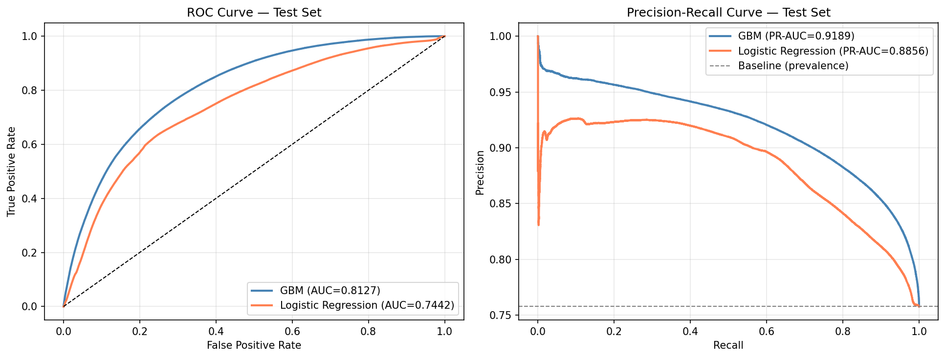
PERFORMANCE EVIDENCE
GBM selected because it performs best overall
The performance claim is specific, measured, and tied to the model choice.
ROC-AUC
0.8127
Stronger ranking than Logistic Regression
PR-AUC
0.9189
Strong precision-recall performance
NOT ENOUGH
Aggregate performance still requires subgroup audit
RESPONSIBLE ML HMDA AUDIT

Slide 11
FOUR FINDINGS
What the audit found
A strong model can still create legally and ethically meaningful subgroup harm.
1
2
3
4
The GBM performs well overall
Average performance hides harm
Fair-lending red flags exist
Deployment is conditional
ROC-AUC = 0.8127 and
PR-AUC = 0.9189; chosen over Logistic Regression.
At threshold 0.2575, 39,224 approved applicants are predicted as denied.
AIR < 0.80 for three race groups under the baseline fairness audit.
Threshold mitigation improves AIR, but residual risk requires governance and monitoring.
RESPONSIBLE ML HMDA AUDIT

Slide 12
KNOWN FAILURE MODES
Where the model breaks down, who is harmed, and why
1
Wrongful denials
HARM
EVIDENCE
Creditworthy applicants face delayed homeownership and reduced financial mobility.
39,224 false denials at threshold 0.2575; low-risk tier contains 129,152 approved borrowers predicted denied.
2
Disparate impact
HARM
EVIDENCE
Protected groups receive lower approval access relative to White applicants.
AIR < 0.80 for Free Form Text Only, Native Hawaiian or Other Pacific Islander, and American Indian or Alaska Native applicants.
3
Threshold sensitivity
HARM
EVIDENCE
Fairness depends on a governance decision, not only model performance.
Subgroup AIR changes materially when the approval cutoff moves from 0.50 to 0.20.
EVIDENCE

Slide 13
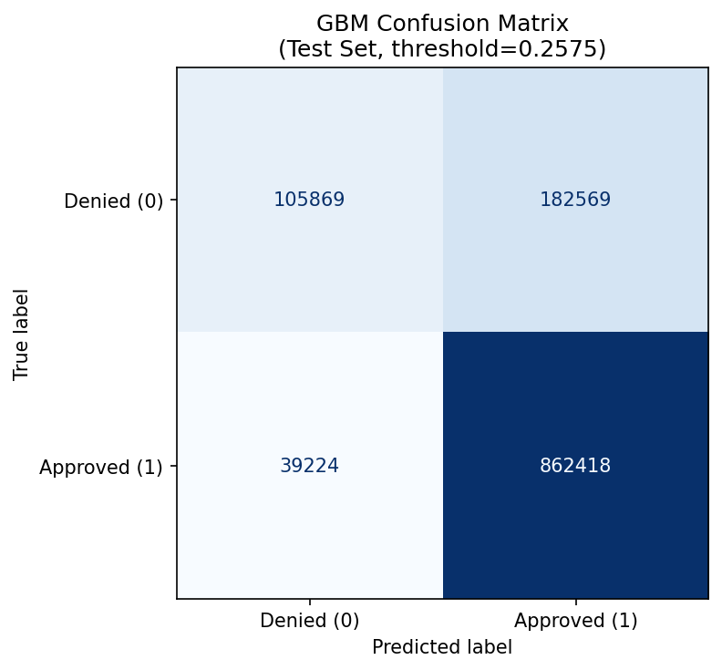
CLASSIFICATION OUTCOMES · AT THRESHOLD = 0.2575
False denials are the central ethical harm
39,224
false denials: actually approved, predicted denied
182,569
false approvals: actually denied, predicted approved
862,418
true approvals
105,869
true denials
RESPONSIBLE ML HMDA AUDIT

Slide 14
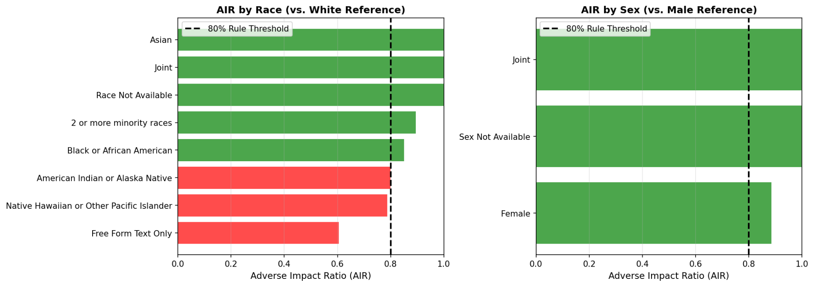
SUBGROUP FAIRNESS EVALUATION
AIR flags the most important fair-lending risk
AIR = group approval rate ÷ White approval rate
AIR < 0.80 is a four-fifths-rule red flag.
Lowest AIR = 0.606 for "Free Form Text Only". This group receives only about 61 approvals for every 100 White-reference approvals.
FLAGGED GROUPS
"Free Form Text Only"
AIR 0.606
Native Hawaiian / Pacific Islander
AIR 0.787
American Indian / Alaska Native
AIR 0.800
FAIRNESS

Slide 15
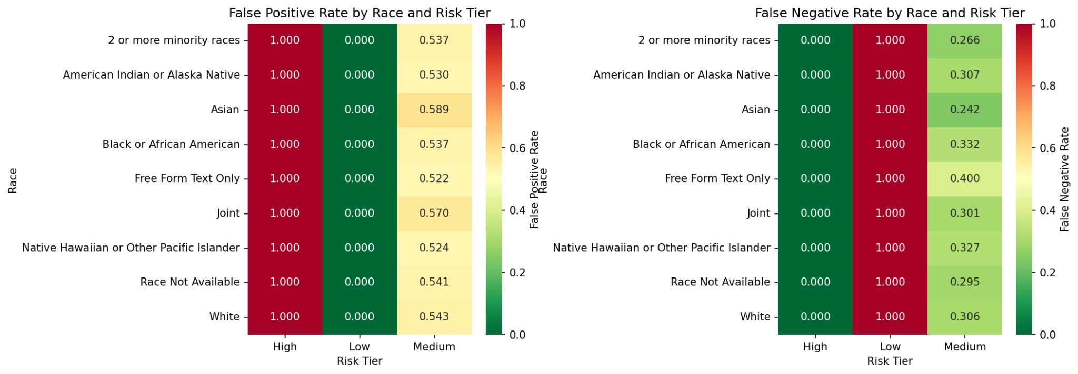
ERROR-RATE DISPARITIES BY RISK TIER
Average model quality hides subgroup-level behavior
Risk-tier and subgroup cuts show whether model errors are concentrated rather than evenly distributed.
EVIDENCE

Slide 16
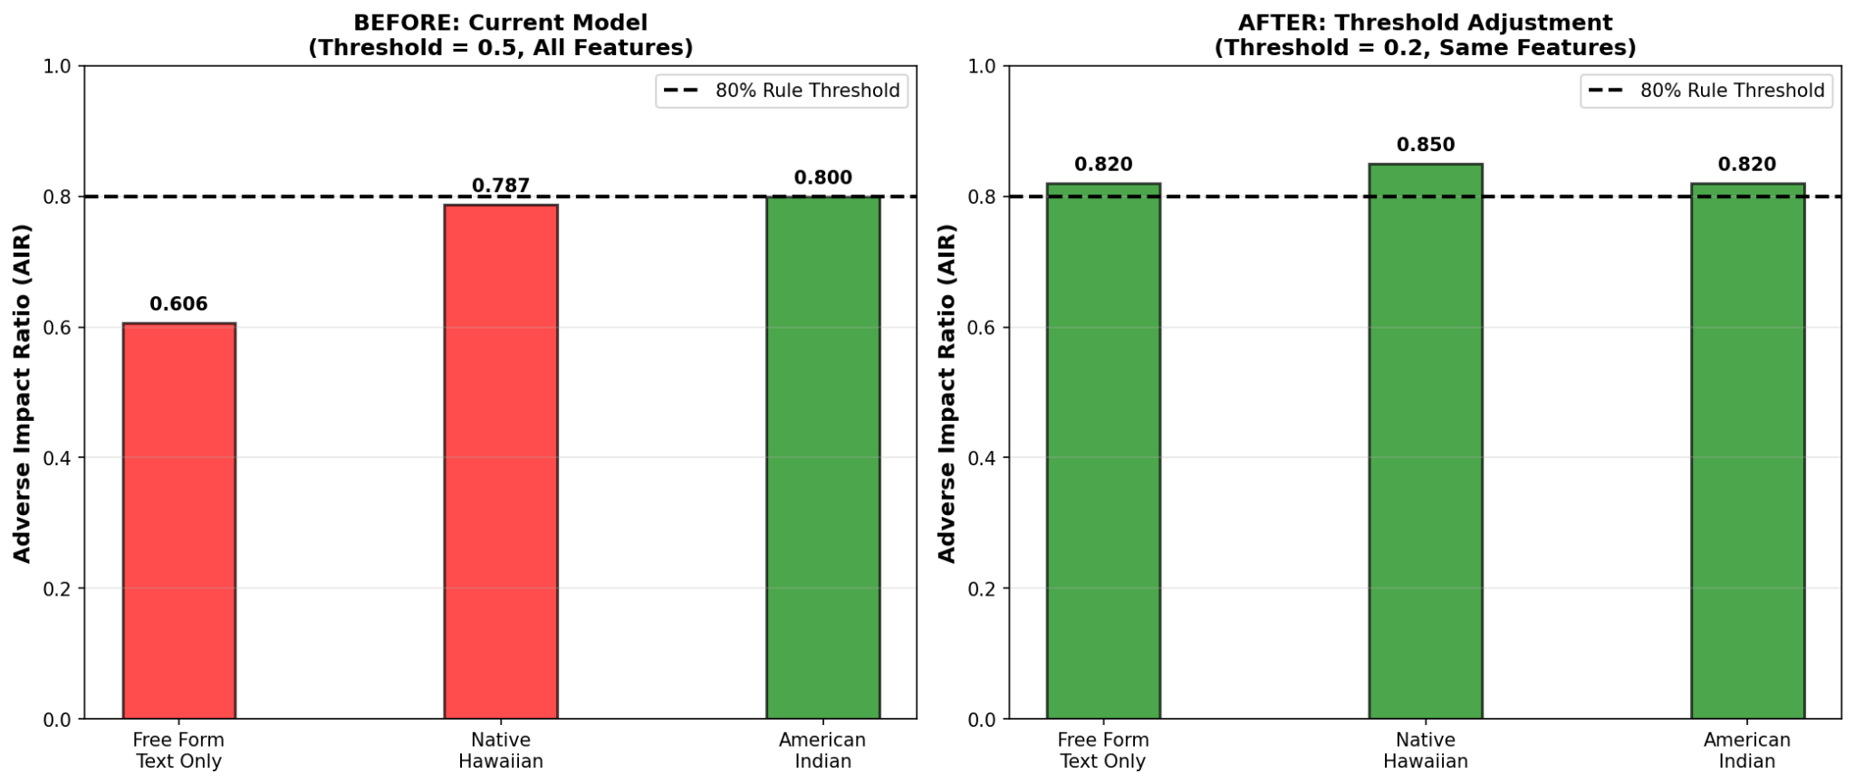
BIAS MITIGATION EVIDENCE
Threshold adjustment improves AIR but increases lender risk
BEFORE → AFTER
0.606 → ≥0.820
Minimum AIR improves above 0.80
THRESHOLD
0.20
Fairness-pass threshold tested
COST
19.1% FPR
Lender risk increases
MITIGATION

Slide 17
RESIDUAL RISKS AFTER MITIGATION
What remains even after the fairness fix?
An exemplary audit names residual risks and the conditions under which they are acceptable.
Reduced predictive power
Remaining correlated features
Data quality differences
Demographic drift
Intersectional harm
Threshold adjustment increases false approvals and lender credit risk.
Applicant-supplied fields may vary by employment type or documentation access.
Applicant population may shift after deployment.
Race × sex combinations can remain disadvantaged even if aggregate AIR improves.
Income, DTI, and geography may still encode historical inequality.
ACCEPT IF LOSSES STAY WITHIN RISK APPETITE.
NOT ACCEPTABLE LONG-TERM WITHOUT MONITORING.
ACCEPT ONLY WITH COMPLETENESS AUDITS.
RETRAIN IF DRIFT EXCEEDS TRIGGER.
QUARTERLY INTERSECTIONAL AUDIT REQUIRED.
RESIDUAL RISK

Slide 18
DEPLOYMENT DEFENSIBILITY
Recommendation: deploy with conditions
BEFORE LAUNCH
MONITORING
AUDIT RECORD
PULL / RE-EVALUATE TRIGGERS
VERDICT
Risk committee approval
Compliance/legal sign-off
Human review for borderline denials
Monthly AIR review
Quarterly demographic drift Annual retraining decision
GitHub repo as reproducible evidence
Versioned code, outputs, and model card
DEPLOY WITH CONDITIONS
AIR < 0.80 in monitoring
PSI > 0.25 or Wasserstein > 0.05
AUC drops below 0.75
Loan losses exceed risk appetite
Regulatory inquiry or civil-rights complaint
Not autonomous denial; use with governance.
GOVERNANCE

Slide 19
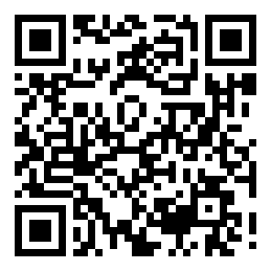
FINAL RECOMMENDATION
A justified model with documented risks
Responsible ML is not about claiming perfection; it is about accountability, transparency, and control.
APPROVE CONDITIONAL DEPLOYMENT ONLY IF:
Fairness-pass threshold is approved by risk/compliance
VERDICT
01
Deploy with conditions
02
Monthly AIR monitoring and quarterly drift checks are active
03
Borderline denials receive human review
GitHub audit record is maintained and versioned
Pull if fairness, drift, performance, or regulatory triggers are breached.
04
05
Shutdown/retraining triggers are enforced
FINAL RECOMMENDATION

