Slide 1
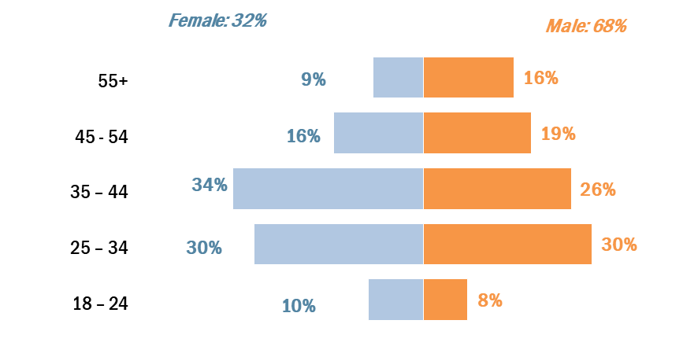

EXPLORATORY ANALYSIS
Young males looking for security
A lot of interest!

Slide 2
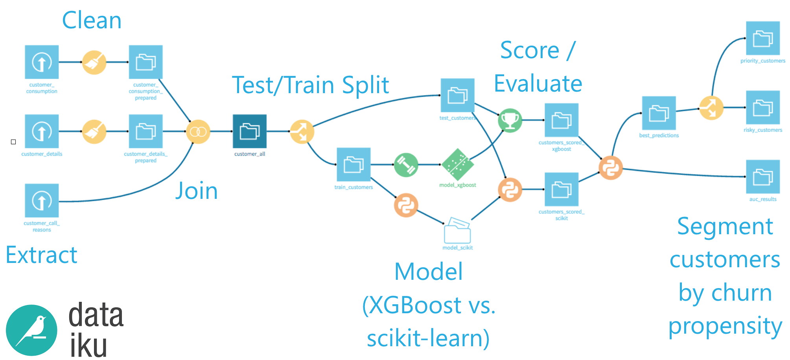
Customer Churn Prediction
Generating d3js Motion Charts from rCharts
Notes:
Customers are considered one of the most important assets for a business
In a competitive market, companies in which the customers have numerous choices of service providers they can easily switch a service or even the provider.
Such customers are referred to as churned customers
MVP
API for Xgboost: for the features (Exploratory analysis)
19th of July,
Interpretable ML
Five examples of customers that are likely to churn.
Churned Customer
Customers or subscribers who stop using a company's service.

Slide 3
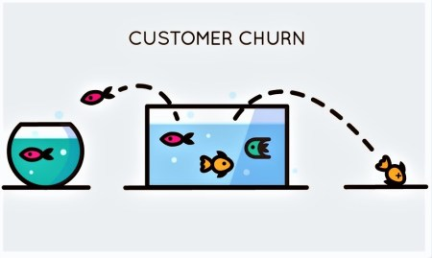
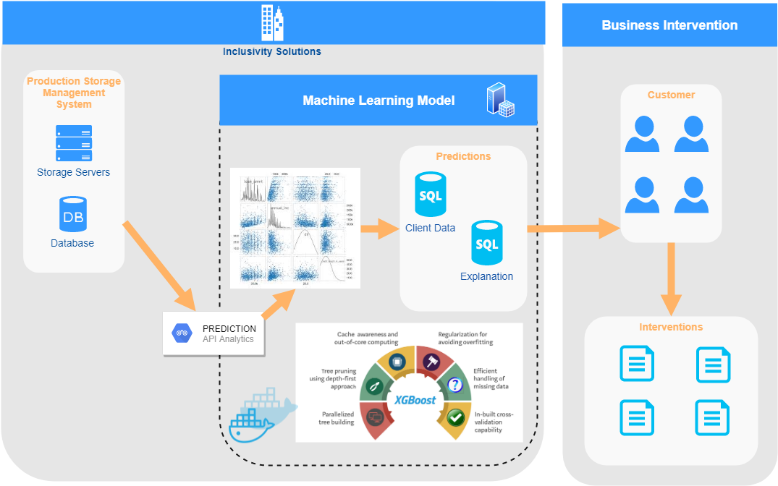
MACHINE LEARNING IMPLEMENTATION
Incorporating not only predictive modeling in the churn modeling but using interpretable machine learning methods to better understand WHY
Example:
If the modeling is predicting a customer to churn because their mobile spending has decreased in the last few months – can we intervene by given the customer 1 month grace?

