Slide 1
A Gamified Digital Campaign to foster water-saving LIFESTYLE as the new normal in Cape Town
By DRWARRIORS TEAM:
Ajayi Olabode
Thomas Fihla
Dr. Veronica Allen
Ines Niragira
Ninette Irakoze
Notes:
A Gamified Digital Campaign to foster water-saving LIFESTYLE as the new normal in Cape Town

Slide 2
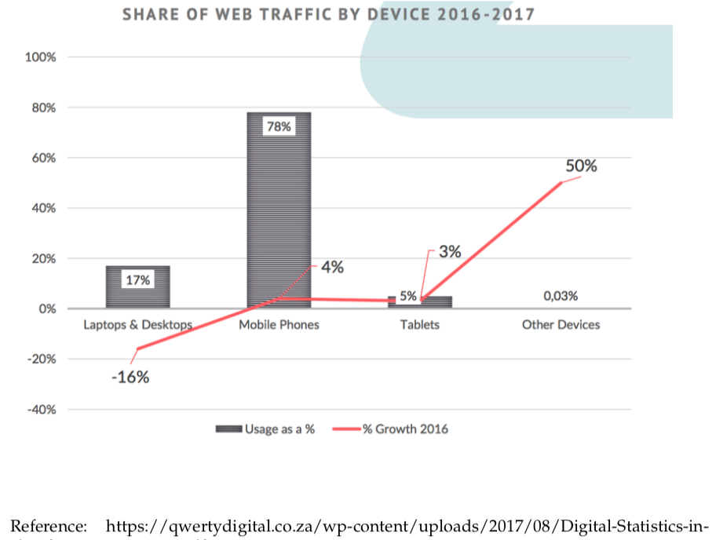
Reference: https://qwertydigital.co.za/wp-content/uploads/2017/08/Digital-Statistics-in-South-Africa-2017-Report.pdf
Notes:
BRC published the estimated listenership's of
39 commercial radio stations and 233 community stations across the country, using a sample of 53,396 listeners. The BRC estimates that there are
approximately 38.3 million radio listeners in South Africa
60% living in urban areas and 20% each across small urban and rural areas
Radio broadcast penetration and pervasiveness is across the country, even the lowest tune-in rate (such as Northern Cape) still being at 80%.

Slide 3
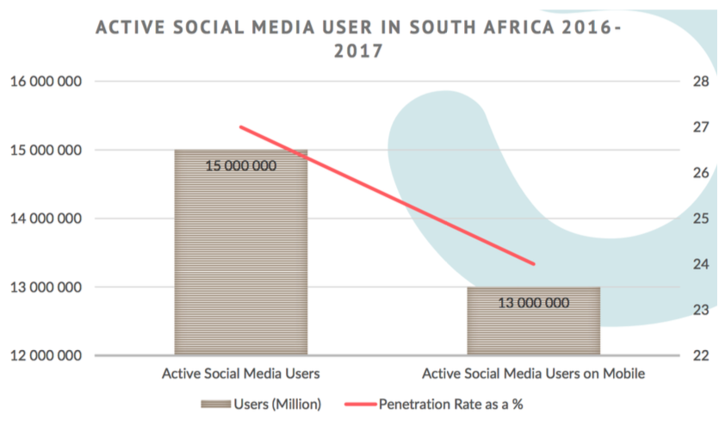
Reference: https://qwertydigital.co.za/wp-content/uploads/2017/08/Digital-Statistics-in-South-Africa-2017-Report.pdf
Notes:
BRC published the estimated listenership's of
39 commercial radio stations and 233 community stations across the country, using a sample of 53,396 listeners. The BRC estimates that there are
approximately 38.3 million radio listeners in South Africa
60% living in urban areas and 20% each across small urban and rural areas
Radio broadcast penetration and pervasiveness is across the country, even the lowest tune-in rate (such as Northern Cape) still being at 80%.

Slide 4
People listening to South Africa’s most Popular Radio Stations Per Provinces
Reference: Broadcast Research Council in South Africa (BRC)
Notes:
BRC published the estimated listenership's of
39 commercial radio stations and 233 community stations across the country, using a sample of 53,396 listeners. The BRC estimates that there are
approximately 38.3 million radio listeners in South Africa
60% living in urban areas and 20% each across small urban and rural areas
Radio broadcast penetration and pervasiveness is across the country, even the lowest tune-in rate (such as Northern Cape) still being at 80%.

Slide 5
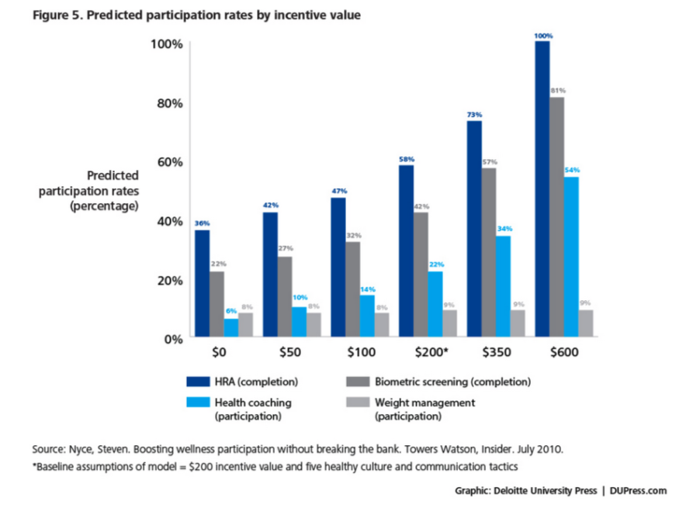
How Incentive Are Leading People To Behavior Change
Notes:
BRC published the estimated listenership's of
39 commercial radio stations and 233 community stations across the country, using a sample of 53,396 listeners. The BRC estimates that there are
approximately 38.3 million radio listeners in South Africa
60% living in urban areas and 20% each across small urban and rural areas
Radio broadcast penetration and pervasiveness is across the country, even the lowest tune-in rate (such as Northern Cape) still being at 80%.

Slide 6

Point of View
John (a 40 year old, petrol station attendant) needs a way to understand how water is allocated in Cape Town because interestingly in his world, the Water Crisis is a Scam.

Slide 7
How might we inform John on water allocation, in awareness of the reality of the water crisis in Cape Town?

Slide 8
ROLE PLAY

Slide 9
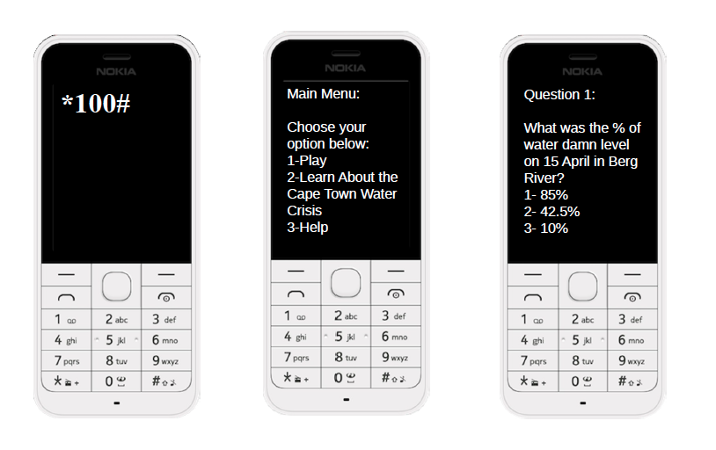
The solution

Slide 10
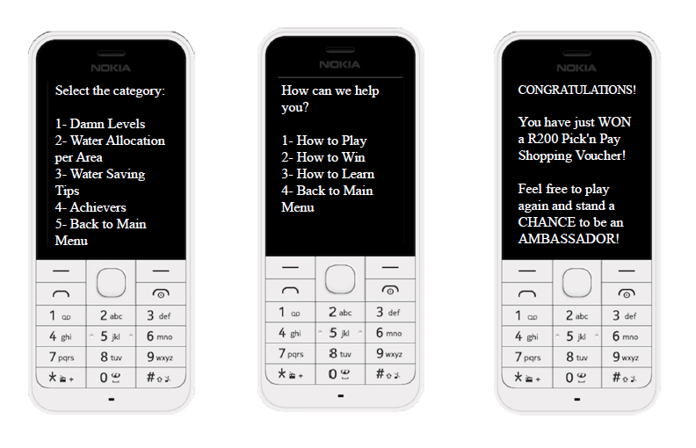
The solution

Slide 11
HOW THE SOLUTION WORKS
People can dial the USSD short code *100#
People will then choose to play or learn
People are given a welcome prize when participating for the 1st time
People may also participate via a phone call to a live show on radio
People are made aware of the solution via various medias (radio stations, newspapers)

Slide 12
ADVANTAGES
Free – accommodate all groups of the socio-economic spectrum
Suitable for all age groups (>12)
Smartphone and feature phone compliant
Language in layman’s terms – all are able to understand
Provides support

Slide 13
HOW WE helpED John
Human Desirability
Easy to use
Business Viability
Reusable
Cost effective
Innovative solution
Gamified USSD Application
Technology Feasibility
Simple solution
Built on ubiquitous platform

Slide 14
HOW WE helped John
Avail information on accessible platforms (Radio, mobile device)
Incentivised to participate (Welcome prize + Award when winning)
Has support of the City
Driven to spread the word

Slide 15
ACKNOWLEDGEMENTS
The CiTi
Our coach Shuhei
The City of Cape Town

Slide 16
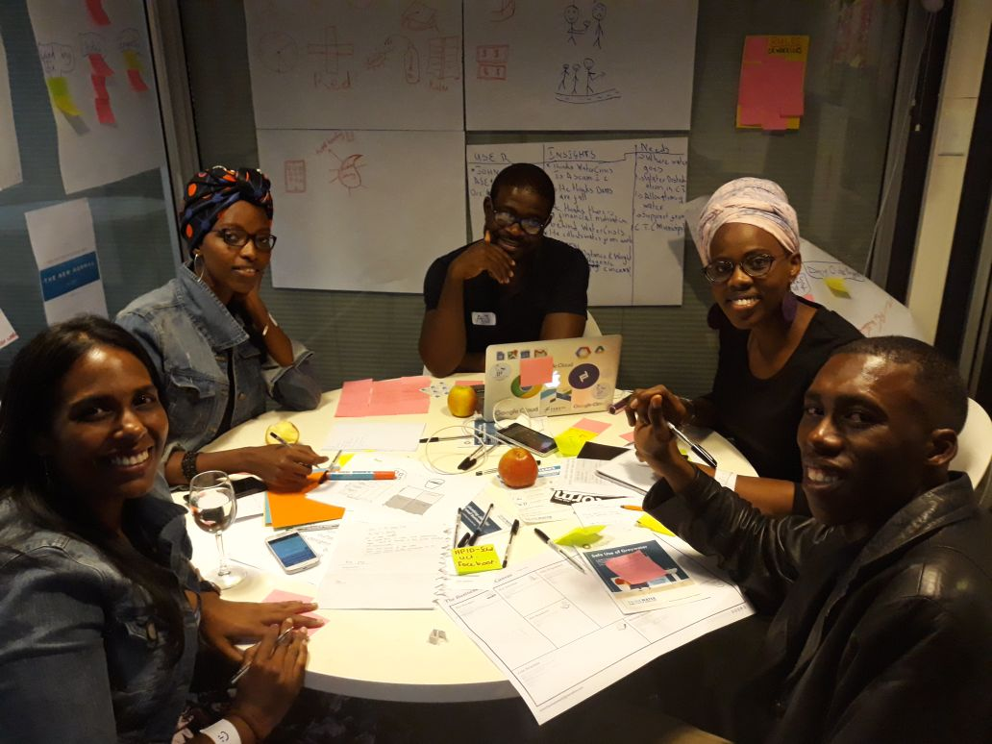
END!

