Slide 1
People listening to South Africa’s most Popular Radio Stations Per Provinces
Reference: Broadcast Research Council in South Africa (BRC)
Notes:
BRC published the estimated listenership's of
39 commercial radio stations and 233 community stations across the country, using a sample of 53,396 listeners. The BRC estimates that there are
approximately 38.3 million radio listeners in South Africa
60% living in urban areas and 20% each across small urban and rural areas
Radio broadcast penetration and pervasiveness is across the country, even the lowest tune-in rate (such as Northern Cape) still being at 80%.

Slide 2
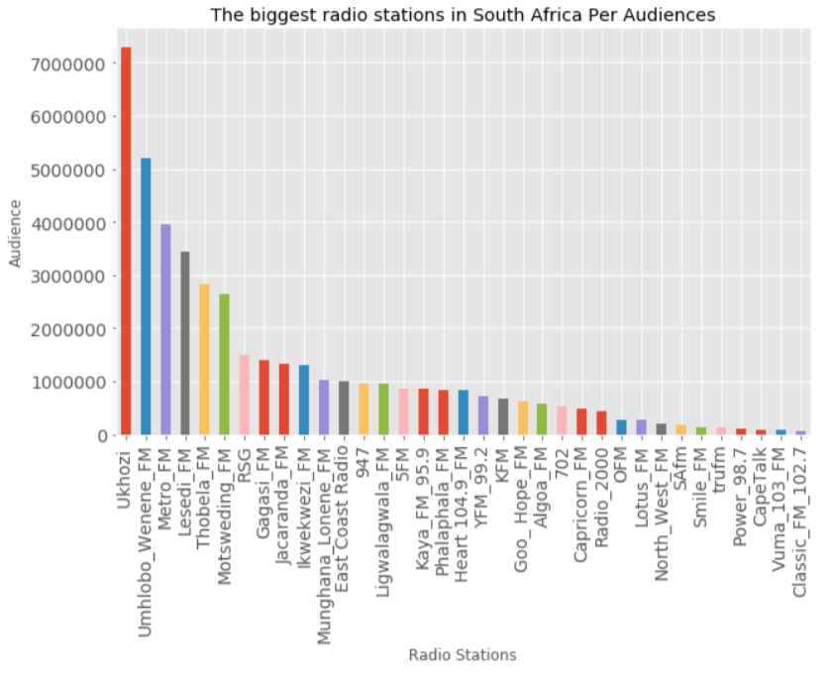
Notes:
BRC published the estimated listenership's of
39 commercial radio stations and 233 community stations across the country, using a sample of 53,396 listeners. The BRC estimates that there are
approximately 38.3 million radio listeners in South Africa
60% living in urban areas and 20% each across small urban and rural areas
Radio broadcast penetration and pervasiveness is across the country, even the lowest tune-in rate (such as Northern Cape) still being at 80%.

Slide 3
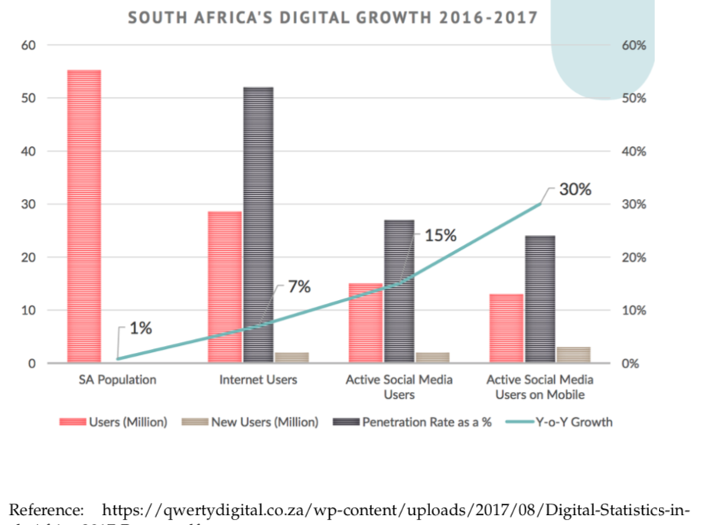
Notes:
BRC published the estimated listenership's of
39 commercial radio stations and 233 community stations across the country, using a sample of 53,396 listeners. The BRC estimates that there are
approximately 38.3 million radio listeners in South Africa
60% living in urban areas and 20% each across small urban and rural areas
Radio broadcast penetration and pervasiveness is across the country, even the lowest tune-in rate (such as Northern Cape) still being at 80%.

Slide 4
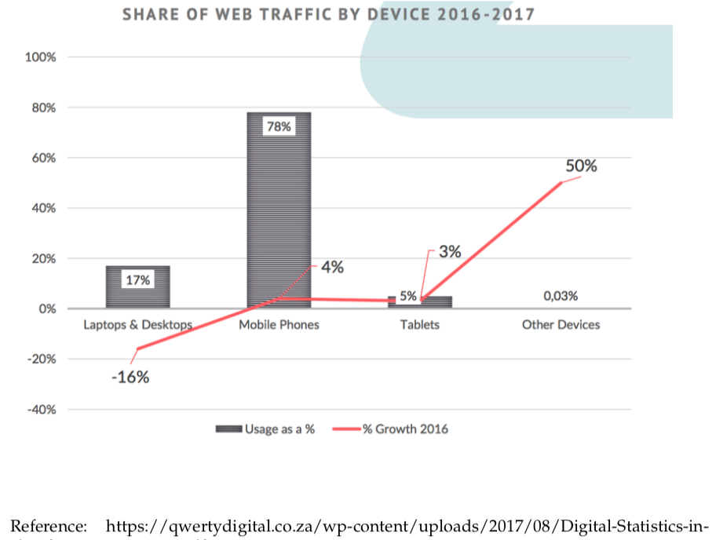
Notes:
BRC published the estimated listenership's of
39 commercial radio stations and 233 community stations across the country, using a sample of 53,396 listeners. The BRC estimates that there are
approximately 38.3 million radio listeners in South Africa
60% living in urban areas and 20% each across small urban and rural areas
Radio broadcast penetration and pervasiveness is across the country, even the lowest tune-in rate (such as Northern Cape) still being at 80%.

Slide 5
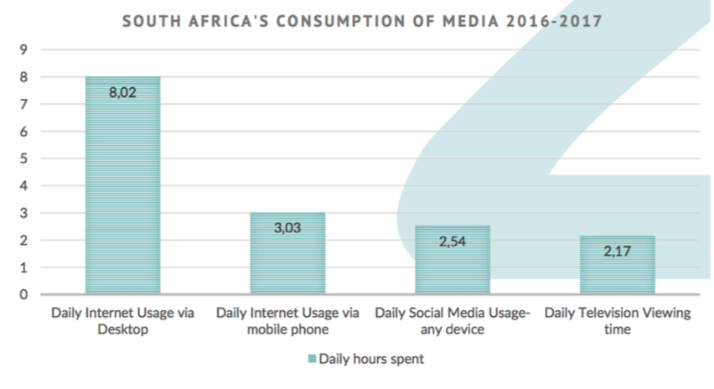
Notes:
BRC published the estimated listenership's of
39 commercial radio stations and 233 community stations across the country, using a sample of 53,396 listeners. The BRC estimates that there are
approximately 38.3 million radio listeners in South Africa
60% living in urban areas and 20% each across small urban and rural areas
Radio broadcast penetration and pervasiveness is across the country, even the lowest tune-in rate (such as Northern Cape) still being at 80%.

Slide 6
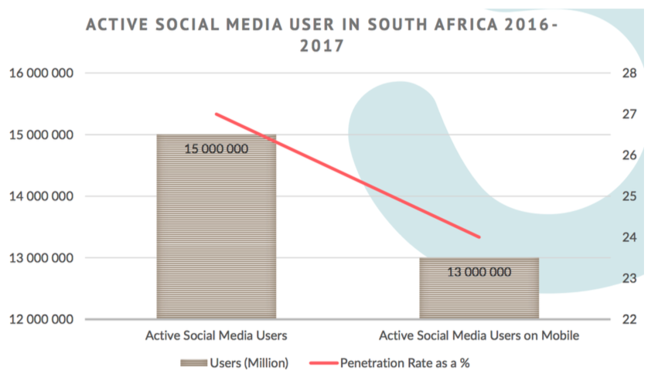
Notes:
BRC published the estimated listenership's of
39 commercial radio stations and 233 community stations across the country, using a sample of 53,396 listeners. The BRC estimates that there are
approximately 38.3 million radio listeners in South Africa
60% living in urban areas and 20% each across small urban and rural areas
Radio broadcast penetration and pervasiveness is across the country, even the lowest tune-in rate (such as Northern Cape) still being at 80%.

Slide 7
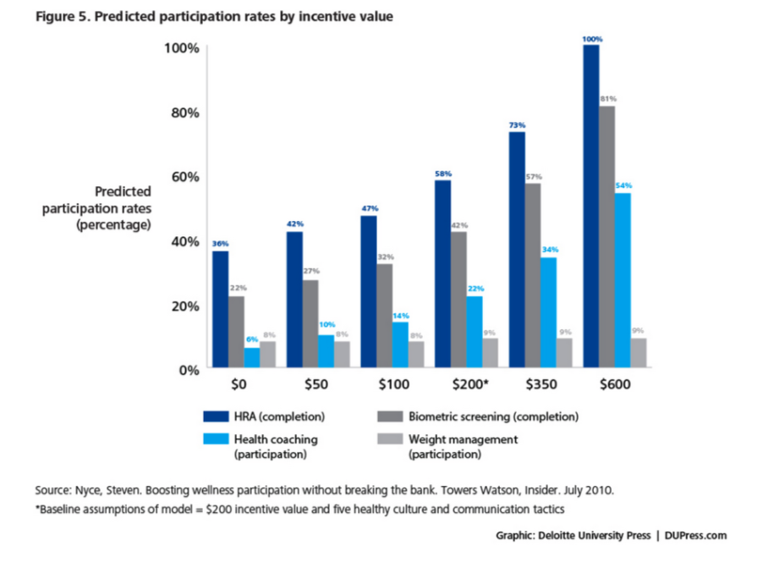
Notes:
BRC published the estimated listenership's of
39 commercial radio stations and 233 community stations across the country, using a sample of 53,396 listeners. The BRC estimates that there are
approximately 38.3 million radio listeners in South Africa
60% living in urban areas and 20% each across small urban and rural areas
Radio broadcast penetration and pervasiveness is across the country, even the lowest tune-in rate (such as Northern Cape) still being at 80%.

