Slide 2
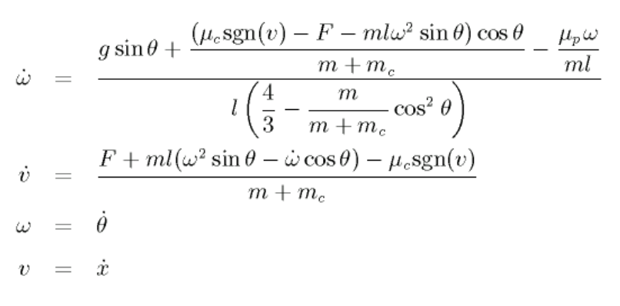
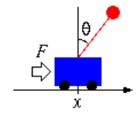

Slide 3

Network Out
F
Feedback
Interact with Env.
Environment
Actor
Critic
State
(x, v, θ, ω)
δ(t)

Slide 4
Actor
Critic
State(x, v, θ, ω)
δ(t)
V(t+1)
State(x, v, θ, ω)
Full-Connected(32)
w
Full-Connected(32)
w
b
b
ReLU
ReLU
Full-Connected(5)
w
Full-Connected(1)
w
b
Output (π(t))
－
Output (V(t))
δ(t)
□²

