Slide 1

Beyza Özgür & Bora Yörük & Birkan Sarıbacak & Kubilay Kalkan 6/17/2021

Slide 2
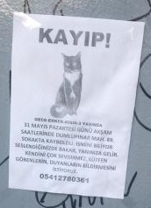
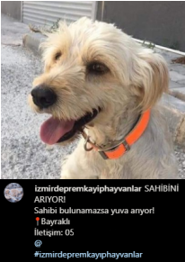
OUR MOTIVATION
STREET
INSTAGRAM

Slide 3
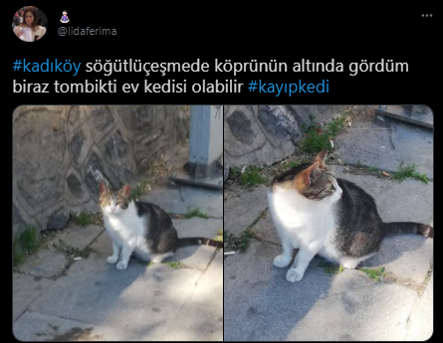
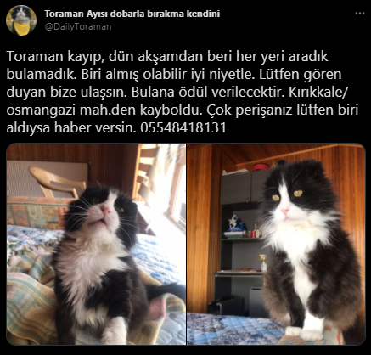
FOUND CAT ON TWITTER
LOST CAT ON TWITTER

Slide 4
OUR AIMS
Helping pet owners to find their lost pets.
Creating an easy to use mobile application for all missing reports so that people do not have to use other seperated platforms.
Increasing awareness on stray animals by sharing links of reliable animal associations for donations.

Slide 5
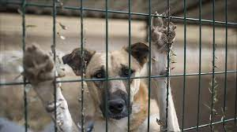
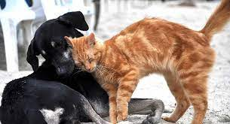
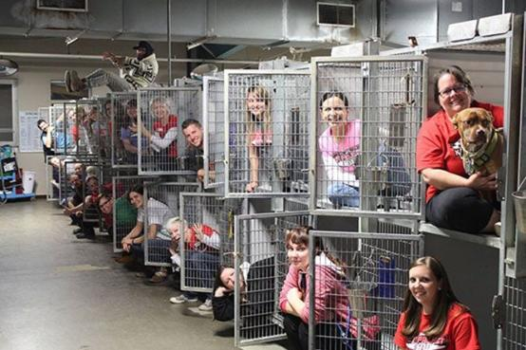
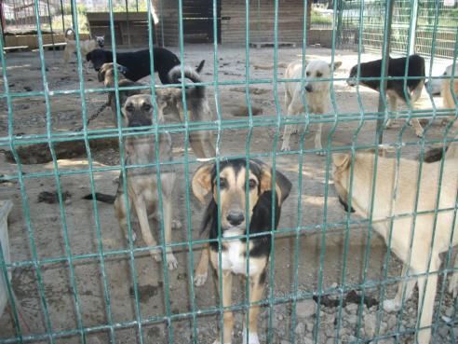
BY YOUR DONATIONS…

Slide 6
HOW DO WE PLAN TO ACHIEVE OUR AIMS WITH OUR MOBILE APPLICATION «HOME AGAIN»?
Registration
Creating posts
Communicating via ‘’Direct Message’’
Updating/deleting posts, deleting account
Accessing donation links of reliable animal associations

Slide 7
We believe that it will be easier and it will take less time to find lost pets, and save them from the danger since they are not used to live on streets.

Slide 8
THANK YOU FOR LISTENING!

