Slide 1
GraphQL La alternativa a las APIs REST
Mario Borbalás

Slide 2
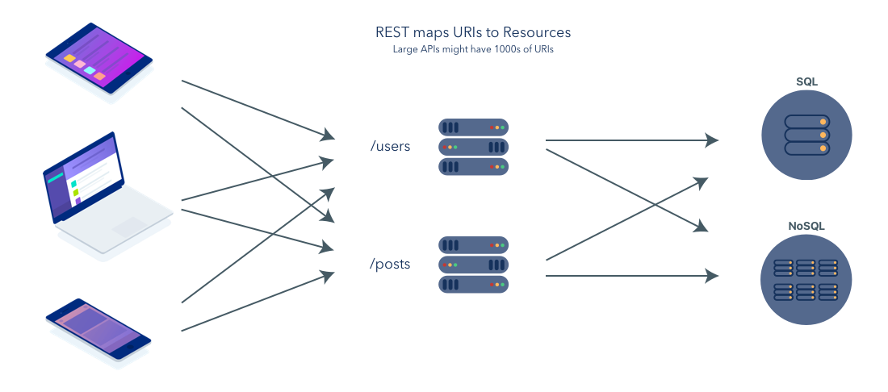
API REST

Slide 3
API REST: Problems
Overfetching: too much data!
Underfetching: hit n+1 endpoints for getting the expected data
Documentation: outside definiton
http://json-schema.org.
https://swagger.io/
Versions: Handling different versions of a API → spaguetti code / duplicated code
http://myrestapi/v2/customers/1/addresses/
http://myrestapi/v1/customers/1/name/

Slide 4

API REST: https://pokeapi.co/
Use case:
We want to get all the Pokémon abilites. For each ability we need to know which Pokémons have that ability. Information required:
Ability
Id, Name, Description, Generation and Pokemons
Pokemon
Name, abilities, sprites and types

Slide 5

Demo App

Slide 6
API REST: https://pokeapi.co/
Getting data
https://pokeapi.co/api/v2/ability/ →List of Ability name and URL
https://pokeapi.co/api/v2/ability/1/ → Specific data for Ability 1
https://pokeapi.co/api/v2/ability/2/ → Specific data for Ability 2
https://pokeapi.co/api/v2/ability/3/ → Specific data for Ability 3
…
n + 1 calls from your APP ☹
Overfetching / Underfetching / Documentation

Slide 7
API REST: https://pokeapi.co/
Getting Pokémon data
https://pokeapi.co/api/v2/ability/1/ → Name, Description, Pokémons → List of name and URL
https://pokeapi.co/api/v2/pokemon/44/
https://pokeapi.co/api/v2/pokemon/88/
https://pokeapi.co/api/v2/pokemon/89/
n + 1 calls from your APP again!! ☹!!!!
Overfetching / Underfetching / Documentation

Slide 8
API REST: https://pokeapi.co/
From ability you want:
{
"id": 1,
"name": "stench",
"description": "Has a 10% chance of making target Pokémon flinch with each hit.",
"generation": "generation-iii",
"pokemons": […]
}
What you get always is: https://pokeapi.co/api/v2/ability/1

Slide 9
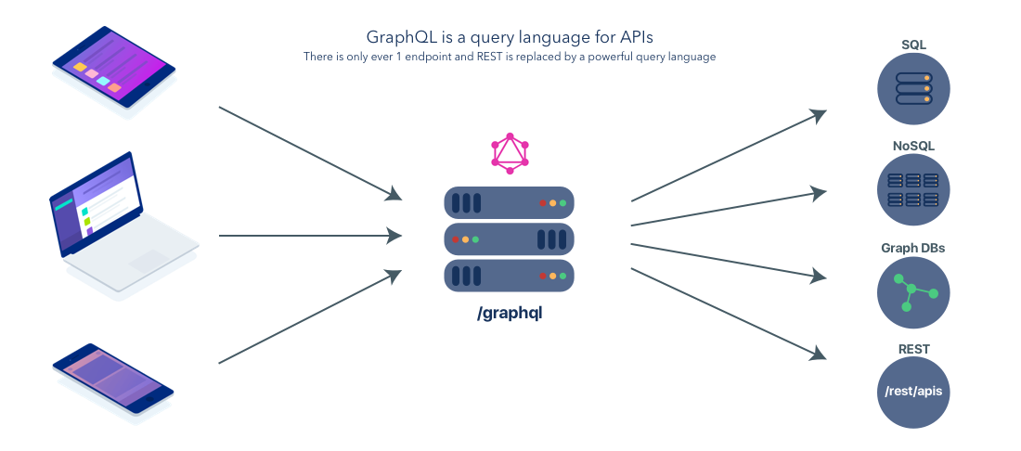
GraphQL

Slide 10

GraphQL
A query language for your API
Ask for what you need. No over fetching
Schema based
Get many resources on one single request
Single end point for your Apps
Describe your data
Ask for what you want
Get predictable results

Slide 11
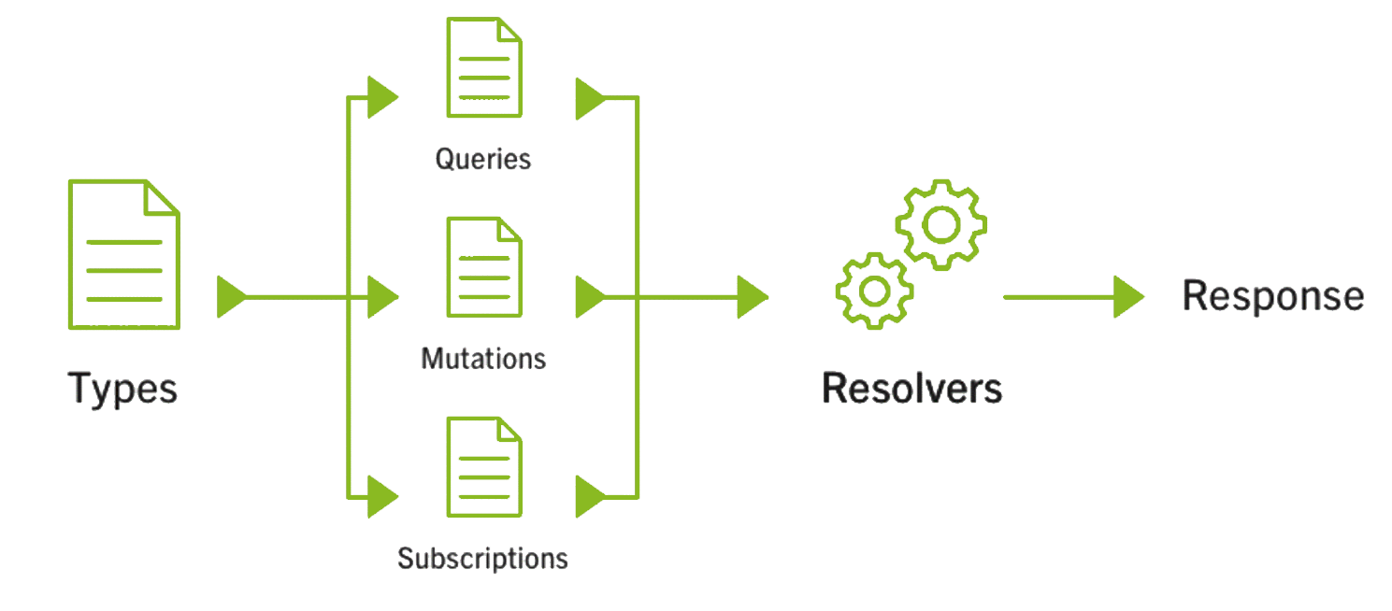
GraphQL: Schema

Slide 12
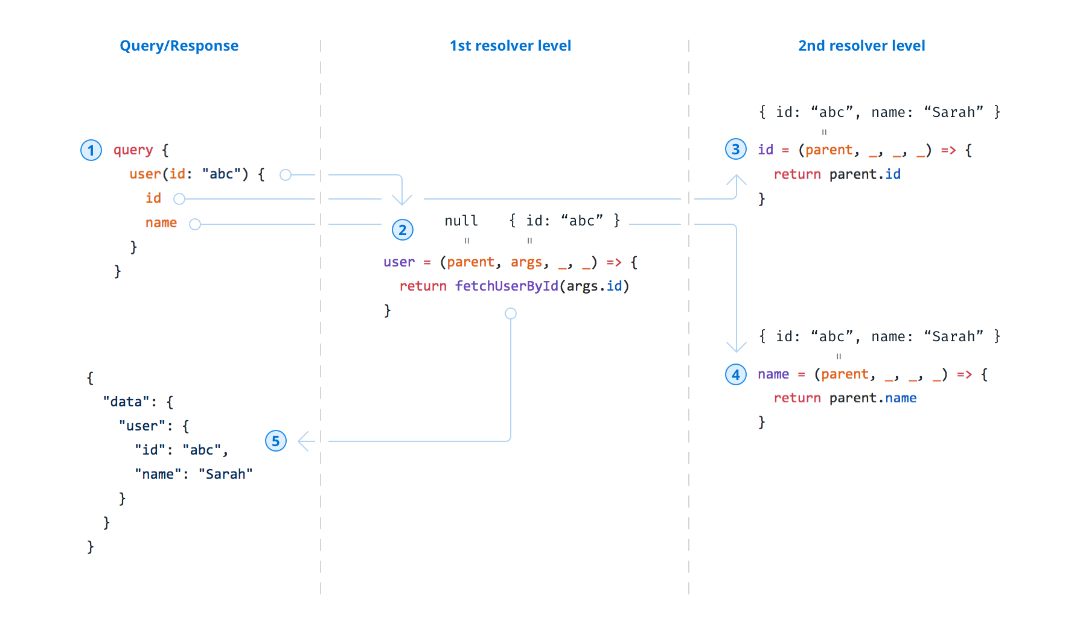
GraphQL: Resolvers

Slide 13
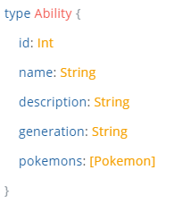
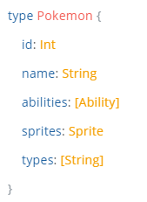
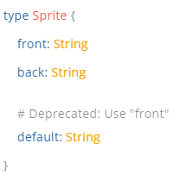

GraphQL: Schema definiton (SDL)
Query Types
{
abilities {
id
name
description
generation
pokemons {
name
abilities {
id
name
}
sprites {
front
back
}
types
}
}
}
https://github.com/borbalas/graphql-south-tech-week

Slide 14
GraphQL: Solutions
Overfetching / Underfetching → Get want you want. Predictible results. One go
Versions → GraphQL handles the complexity / Deprecation instead
Documentation –> Schema based with documentation
See Code example!

Slide 15

Who is using GraphQL
https://graphql.org/users/

Slide 16
Q&A

Slide 17
Links
https://graphql.org/
https://principledgraphql.com/
https://www.apollographql.com/why-graphql
https://www.sitepoint.com/rest-2-0-graphql/
https://medium.com/search?q=GRAPHQL
https://blog.apollographql.com/three-ways-to-represent-your-graphql-schema-a41f4175100d
https://github.com/borbalas/graphql-south-tech-week

Slide 18
Thank you

