Slide 1
Starševska pričakovanja glede otrokovega razvoja v predšolski vzgoji in varstvu: Instrument, različne paradigm in vplivi okolja
Bor Bregant
Tina Štemberger
Sonja Čotar Konrad
Karmen Drljič
Notes:
Lepo pozdravljeni. Predstavil vam bom raziskavo, ki se ukvarja s tem, kakšna pričakovanja imajo starši do predšolske vzgoje – natančneje, do različnih razvojnih področij otrok – in kateri dejavniki te razlike v pričakovanjih oblikujejo.

Slide 2
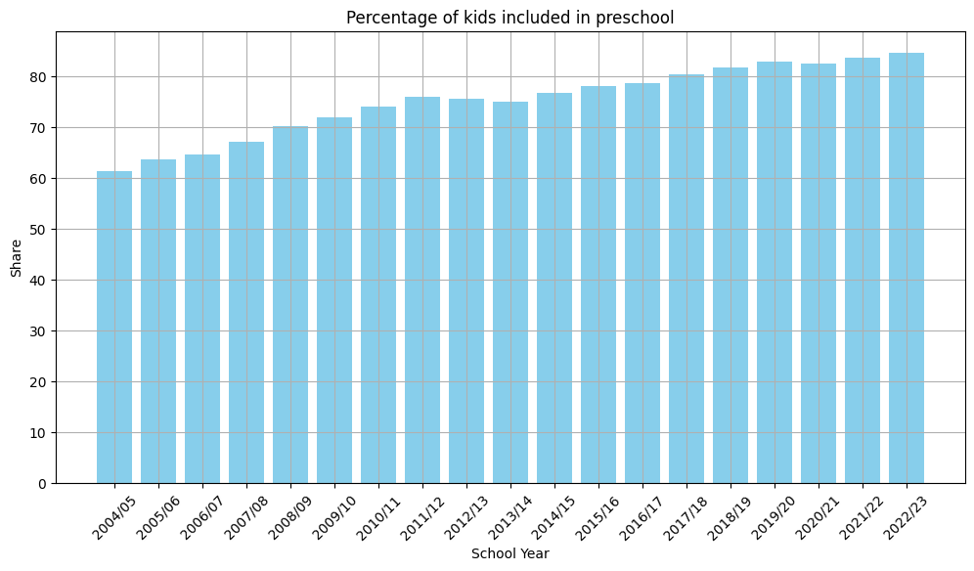
Ozadje
Vrtec pozitivno vpliva na otrokov razvoj
Vpliv pričakovanj staršev
Notes:
V zadnjih desetletjih se je potrdilo, da kakovostna predšolska vzgoja močno prispeva k celostnemu razvoju otrok – tako kognitivno, socialno kot tudi čustveno in telesno. Vendar pa ima pomembno vlogo tudi to, kaj starši od vrtca pričakujejo. Sploh pri socialno ogrozenih, short and long term effects, slovenija 93%

Slide 3
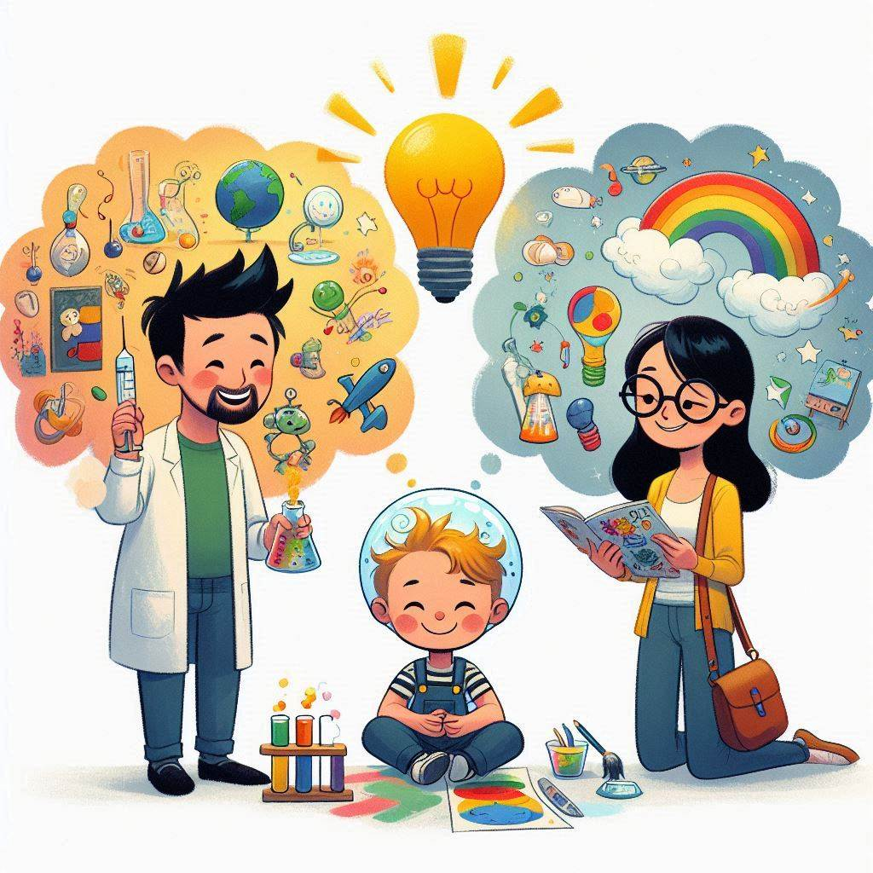
Starševska pričakovanja
Holistični razvoj kot cilj
Starši cenijo: varnost, individualnost, sodelovanje z vzgojitelji, …
Kaj sestavlja dobro predšolsko vzgojo?
Visoka pričakovanja v razvoju jezika, motorike, čustvenem razvoju, …
Notes:
Starši imajo pogosto zelo različna pričakovanja, a pogosto iščejo celostni razvoj: varnost, individualni pristop, sodelovanje z vzgojitelji. Zelo visoko vrednotijo tudi področja, kot so govor, gibanje in čustveni razvoj… ne samo učenje ampak tudi varnost, sodelovanje… starsi niso pasivni uporabniki!

Slide 4
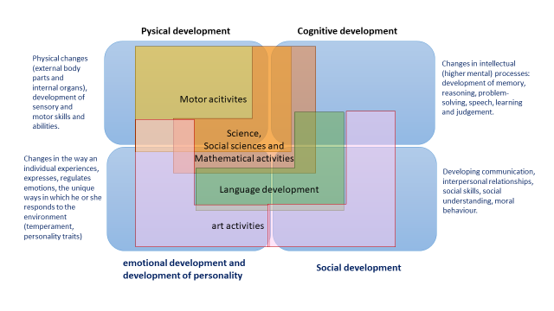
Kurikulum in razvoj
Kurikulum za vrtce = osnova kakovosti
Gibalno
Družba (socialno)
Umetnostno
Jezikovno
Narava (znanstveno)
Matematično
Področja kurikuluma
Telesno
Kognitivno
Čustveno
Socialno
Področja razvoja otroka
Notes:
V Sloveniji imamo nacionalni kurikulum za vrtce, ki določa šest področij dejavnosti: gibanje, jezik, umetnost, družba, narava, matematika. Ta področja sovpadajo z razvojnimi dimenzijami otroka: telesno, kognitivno, čustveno in socialno

Slide 5
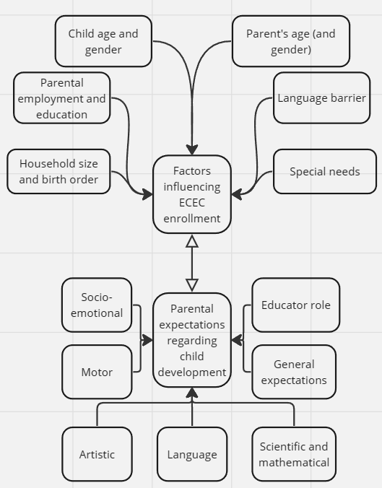
Namen raziskave
Raziskati pričakovanja staršev glede različnih razvojnih področij
Povezava z okoljskimi dejavniki
Preveriti veljavnost instrumenta

Slide 6
Metode
Neeksperimentalna študija
519 odgovorov od 826 anketirancev iz 28 vrtcev
Naključno večstopenjsko vzorčenje. Iz vsake od 12 statističnih regij.
2022
Statistična analiza z jezikom Python

Slide 7
Instrument
10 lestvic: gibanje, jezik, umetnost, znanost, matematika…
Primer: pričakovanja o vlogi vzgojitelja
Notranja konsistentnost večinoma > 0.7 razen SoD2 (socialni razvoj)
Socialno (x2) SoD
Socio-emocionalno SED
Gibalno MoD
Umetnostno ArD
Jezikovno LaD
Znanstveno ScD
Matematično MaD
Splošno GeE
Vzgojitelj EdR

Slide 8
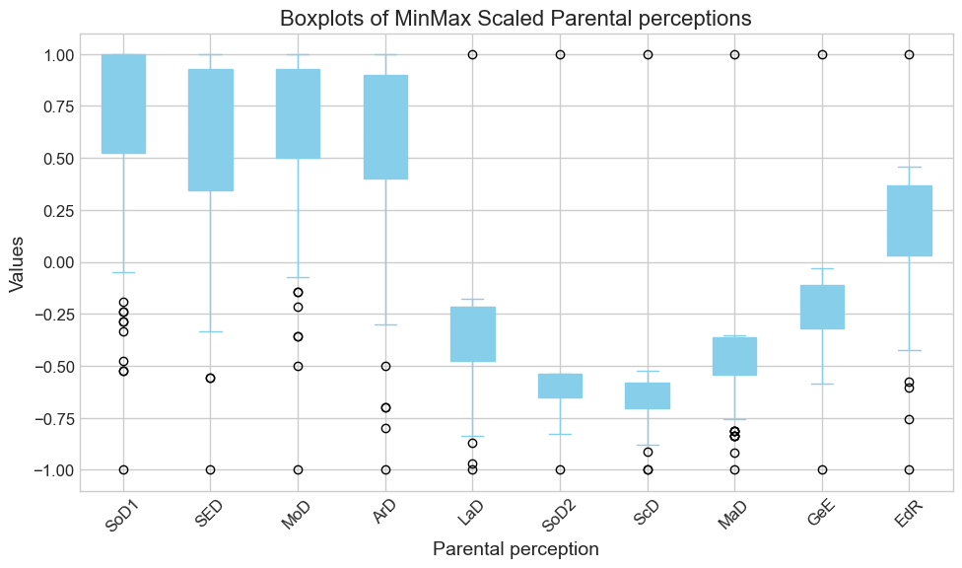
Rezultati

Slide 9
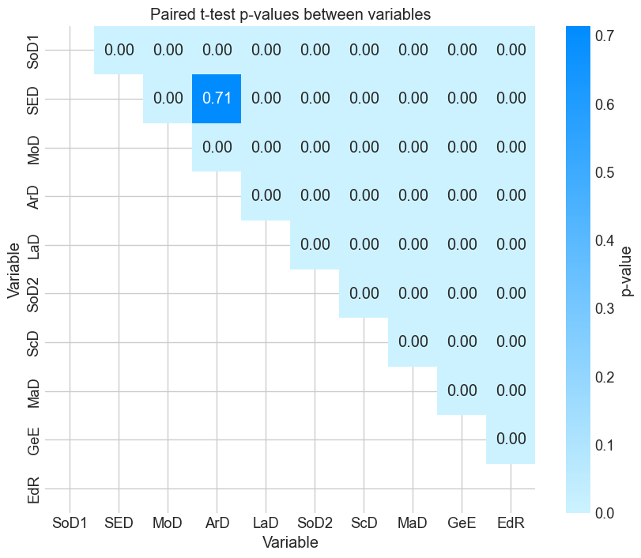
Rezultati

Slide 10
Rezultati
Vpliv | Vpliv
Velikost gospodinjstva | 0.20
Status matere | 0.15
Izobrazba matere | 0.14
Izobrazba očeta | 0.12
Zaporedni otrok | 0.12
Jezik | 0.10
Spol otroka | 0.09
Spol starša | 0.05
Status očeta | 0.04

Slide 11
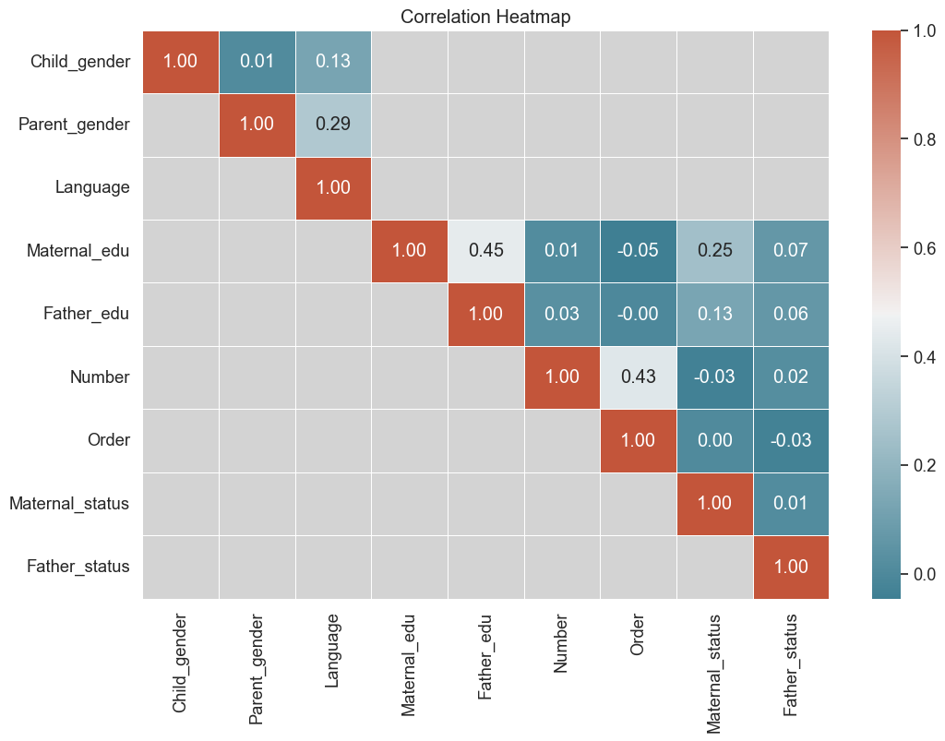
Rezultati

Slide 12

Diskusija
Vpliv materinih značilnosti → večji od očetovih
Pričakovanja = usmerjajo odločitve o vpisu v vrtec
Potrebna boljša komunikacija med vrtci in starši
Instrument uporaben za prihodnje raziskave
Starši pričakujejo celosten razvoj
Okoljski dejavniki pomembno oblikujejo pričakovanja
Vprašanja / diskusija?
Notes:
Starši imajo raznolika pričakovanja – vrtci naj jih poznajo.
Okolje (SES, izobrazba, jezik) oblikuje te razlike.
Instrument ima velik potencial za nadaljnje raziskave.

Slide 13
SoD1
I decided to enroll my child in kindergarten because I believe that participation in kindergarten significantly influences the child:
...interacting with other children.
...playing with other children.
...communicating with peers.
...learning to engage and participate in a group.
...learning something new.
...gaining new experiences.
...becoming independent.
...believing in themselves.
...learning to share things with peers.
...learning to help others.
...learning to be a good friend to peers.
...expressing emotions.
...recognizing their own emotions.
...regulating and controlling the expression of their emotions.

Slide 14
SED
I decided to enroll my child in kindergarten because I believe that participation in kindergarten significantly influences the child:
...recognizing the emotions of peers.
...understanding that they can influence others' emotions.
...trusting adults outside the family as well.
...resolving conflicts with peers.
...adapting to new environments (peers and kindergarten rules).
...learning to express their needs, desires, and opinions.
...developing empathy.
...developing social skills through digital tools and play.

Slide 15
MoD
I decided to enroll my child in kindergarten because I believe that participation in kindergarten influences the child's motor development. It is important for the child's development to:
...be aware of their motor abilities.
...develop their motor skills.
...experience pleasure in movement.
...gain confidence in their body and motor skills.
...learn about and adopt the basic characteristics of various sports genres.
...understand the importance of collaboration, respect, and appreciation of differences.
...through individual motor computer games, promote and develop certain motor patterns.

Slide 16
ArD
I decided to enroll my child in kindergarten because I believe that participation in kindergarten influences the child's development in the artistic field. It is important for the child's development to:
...explore different types of art, e.g., music, dance, drama, visual arts, film art.
...develop aesthetic perception.
...develop expression through art.
...foster creativity in the artistic field.
...use digital tools for creating artistic products.

Slide 17
LaD
I decided to enroll my child in kindergarten because I believe that participation in kindergarten influences the child's language development. It is important for the child's development to:
...develop awareness of the existence of their own and other languages.
...listen to and experience language.
...encounter fundamental literary works for children.
...develop verbal communication skills.
...develop non-verbal communication skills.
...enrich their vocabulary.
...learn about letters.
...understand story sequences (beginning, middle, end).

Slide 18
SoD2
I decided to enroll my child in kindergarten because I believe that participation in kindergarten influences the child's social development. It is important for the child's development to:
...participate equally in activities and daily life regardless of their age, gender, and social or economic background.
...form basic life habits and understand the habits of other social groups.
...become aware of and develop sensitivity to cultural, traditional, and environmental diversity.
...learn about a safe and healthy way of life

Slide 19
ScD
I decided to enroll my child in kindergarten because I believe that participation in kindergarten influences the child's development in the field of natural sciences. It is important for the child's development to:
...recognize and develop a respectful and responsible attitude toward living and non-living nature.
...develop various approaches to understanding nature as well as techniques and technical subjects.
...use digital tools for categorizing things in nature.
...use digital tools for problem-solving

Slide 20
MaD
I decided to enroll my child in kindergarten because I believe that participation in kindergarten influences the child's development in the field of mathematics. It is important for the child's development to:
...get acquainted with mathematics in everyday life.
...develop mathematical expression (e.g., naming numbers).
...develop mathematical thinking (e.g., observing and creating symmetric elements, spatial orientation).
...develop mathematical skills (e.g., counting, classifying, sorting, weighing).
...experience mathematics as a pleasant experience.
...learn to understand sequences (numbers, steps, data) using digital tools

Slide 21
GeE
It is important for the child's development that:
The kindergarten ensures the holistic development of the child.
The kindergarten will respect the child's rights and ensure development in all areas of the curriculum.
The kindergarten also provides individual attention to children, early detection of developmental peculiarities.
The kindergarten provides childcare for parents.
The kindergarten ensures the safety of children.
By entering kindergarten, the child improves their immune system - resistance before entering school.
Educators and parents collaborate and work together for the child's well-being.

Slide 22
EdR
I decided to enroll my child in kindergarten because I believe that participation in kindergarten influences the child's development, as the educator:
...communicates well and collaborates with parents.
...involves parents in planning the child's program.
...involves parents in implementing the child's program.
...involves the child in planning the program.
...involves the child in implementing the program.
...plans and implements the program in a way that meets the needs of children.
...plans and implements the program in a way that considers children's desires.
...communicates well with children.
...takes good care of discipline within the group.
...teaches children about order.
...establishes rules of life in kindergarten together with the children.
...has professional knowledge for the upbringing and education of the child, which parents may not have

