Slide 1
Well come
to
Our presentation

Slide 2
Group Member Names
Disha Sonani
Yashasvi Borda
Khushboo Gajera
Vanita Baraiya
Bhakti Meroliya
Isha

Slide 3
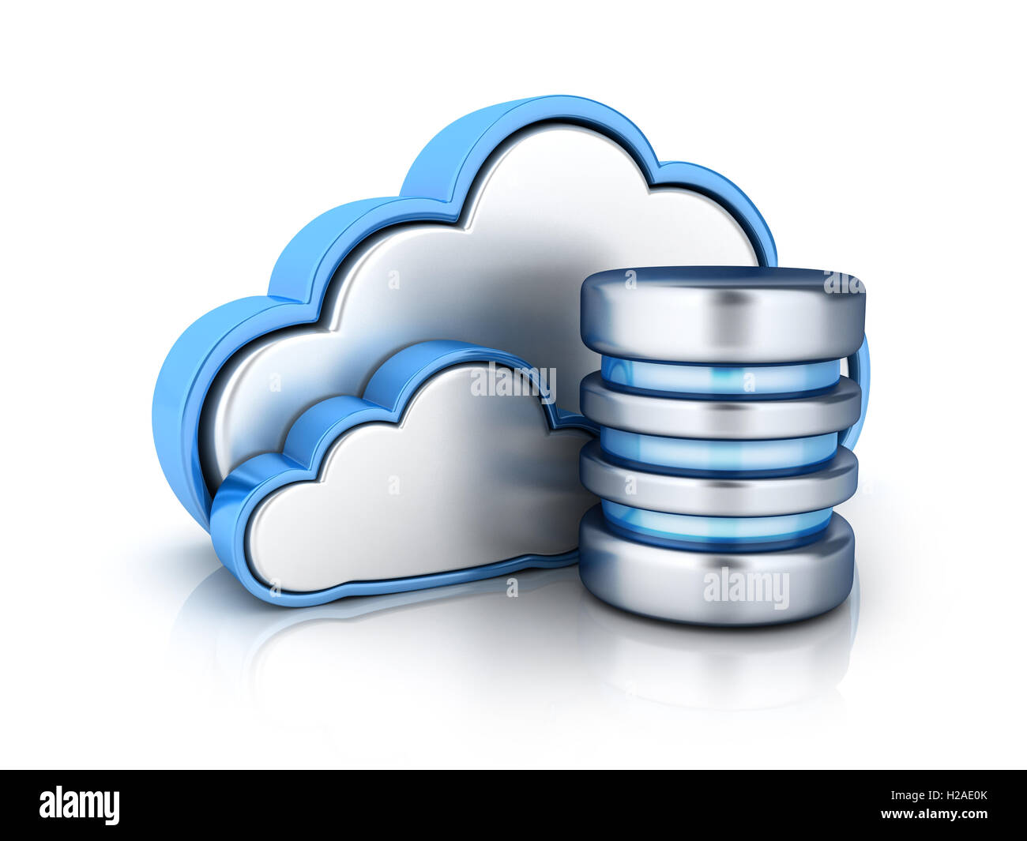
Data Base
A cloud database is a database that typically runs on a cloud computing platform,access to it is provided as a sevice such as Amazon EC2 and Rack space
The cloud databases was conceived for the purpose of online data management by using a variety of distributed servers.

Slide 4
Methods to run a databases in a cloud :
There are two primary methods to run a databases in a cloud:
1) Virtual machine image
2) Databases-as-a-service

Slide 5
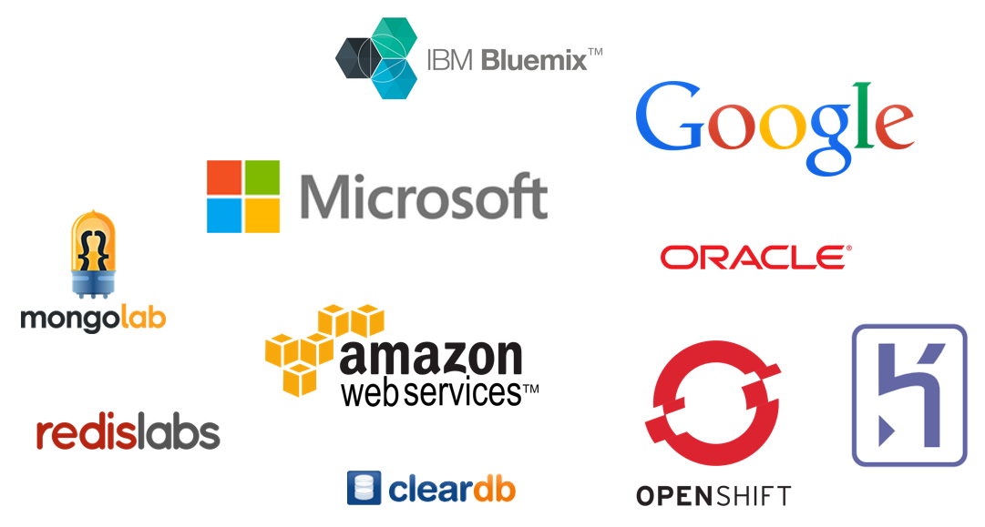
1) Virtual machine image
Cloud platforms allow users to purchase virtual-machine instances for a limited time and one can run a databases on such virtual machines.
2) Databases-as-a-service
With a databases as a service model application owners do not have to install and maintain the databases themselves.

Slide 6
Advantages Database eliminates the redundancy of data by integrating them. Data consistency is increased Additional information can be derived from same data
ADVANTAGES AND DISADVANTAGES
DISADVANTAGES
Complex software
It requires more memory
Multiuser DBMS can be more expensive

Slide 7
INTRODUCTION :
. Cloud computing provides as a mean by which we can be we access the applications as utilities over the internet. It allows us to create configure and customize application online.
.

