Slide 1
Data analysis project
Neuronal activity from calcium microscopy recordings
in the hippocampus of a freely-roaming mouse
Goals:
Process independent recordings to allow their common analysis.
Reveal the relationship between the hippocampal cells activities and the position of the mouse in an open field.
Datasets:
Preprocessed calcium imaging data of multiple neurons.
Spatial data extracted from camera recording of a mouse’s freely-roaming behavior in a square open field.
Time points of the frames recorded with the calcium miniscope.
Time points of the frames recorded with the camera.

Slide 2
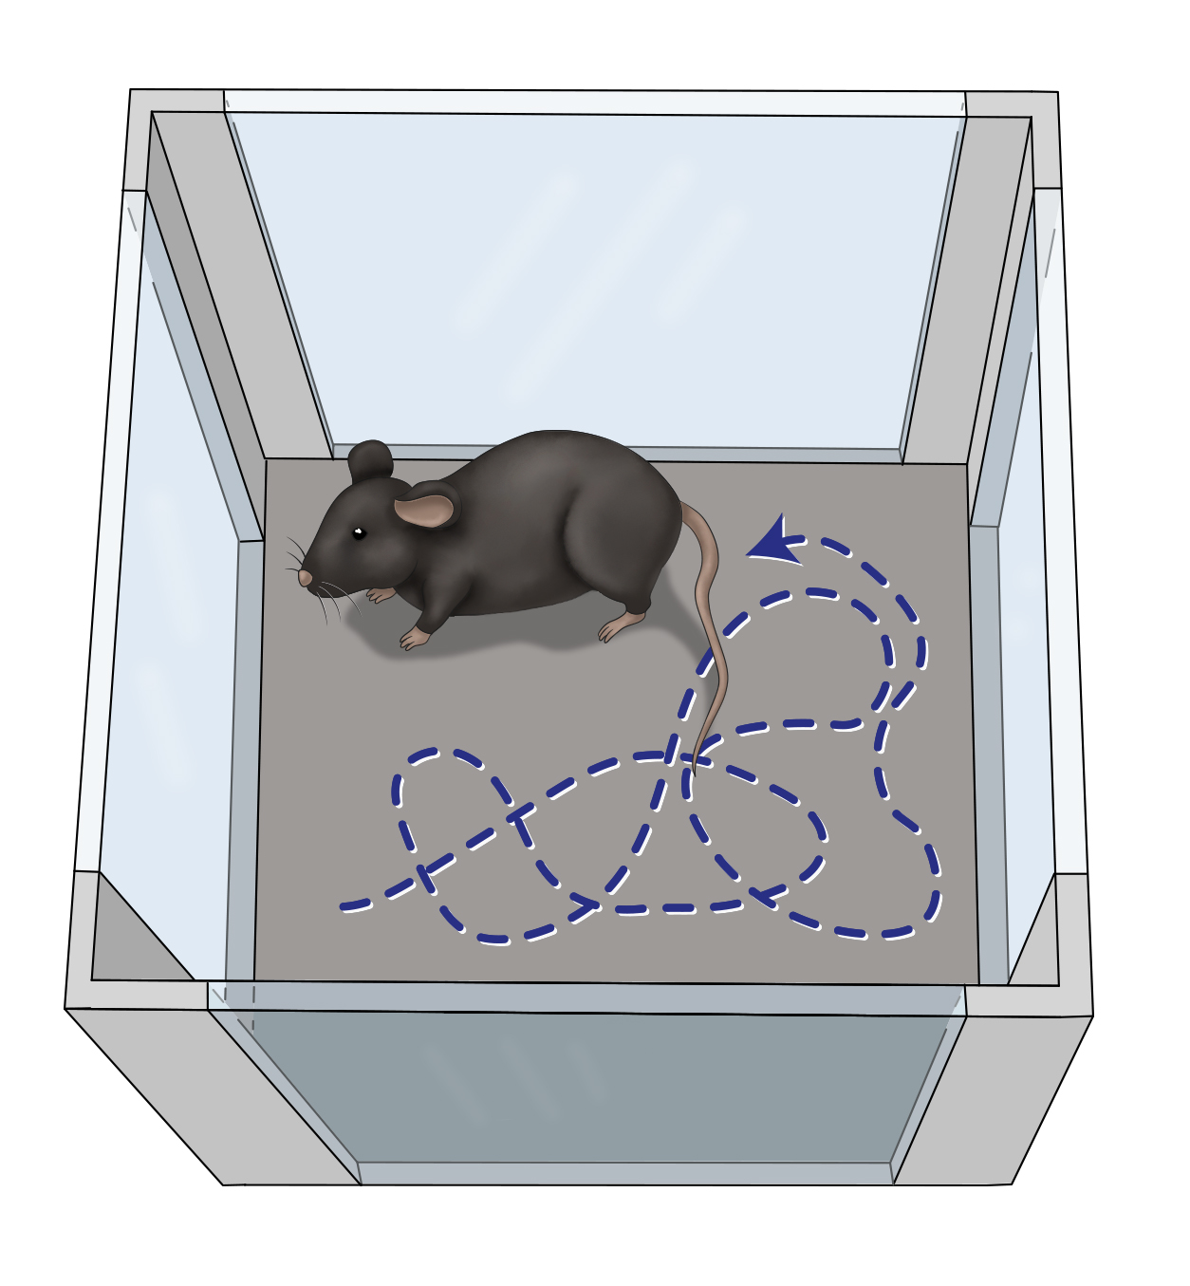

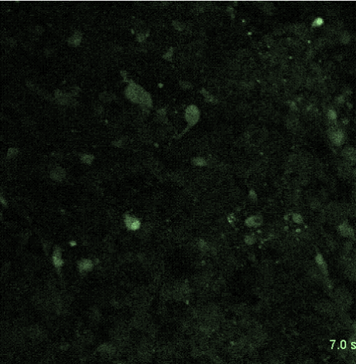
Freely-moving mouse
Camera
recording
Frame by frame position extraction
X | Y
15.2 | 78.9
15.7 | 81.6
18.4 | 84.2
… | …
time
0.050
0.075
0.100
…
Calcium imaging
Frame by frame area average fluorescence
n1 | 1.2 | 8.2 | 0.6 | …
n2 | 1.7 | 3.9 | 5.0 | …
n3 | 0.4 | 0.2 | 3.9 | …
… | … | … | … | …
Neuron identification
time | 0.10 | 0.15 | 0.20 | …

