Slide 1


Introduction to Python – Creating your final reports
Computational Neuroscience Crash Course | July 2021
Eduarda Centeno
Thursday, 8th of July

Slide 2
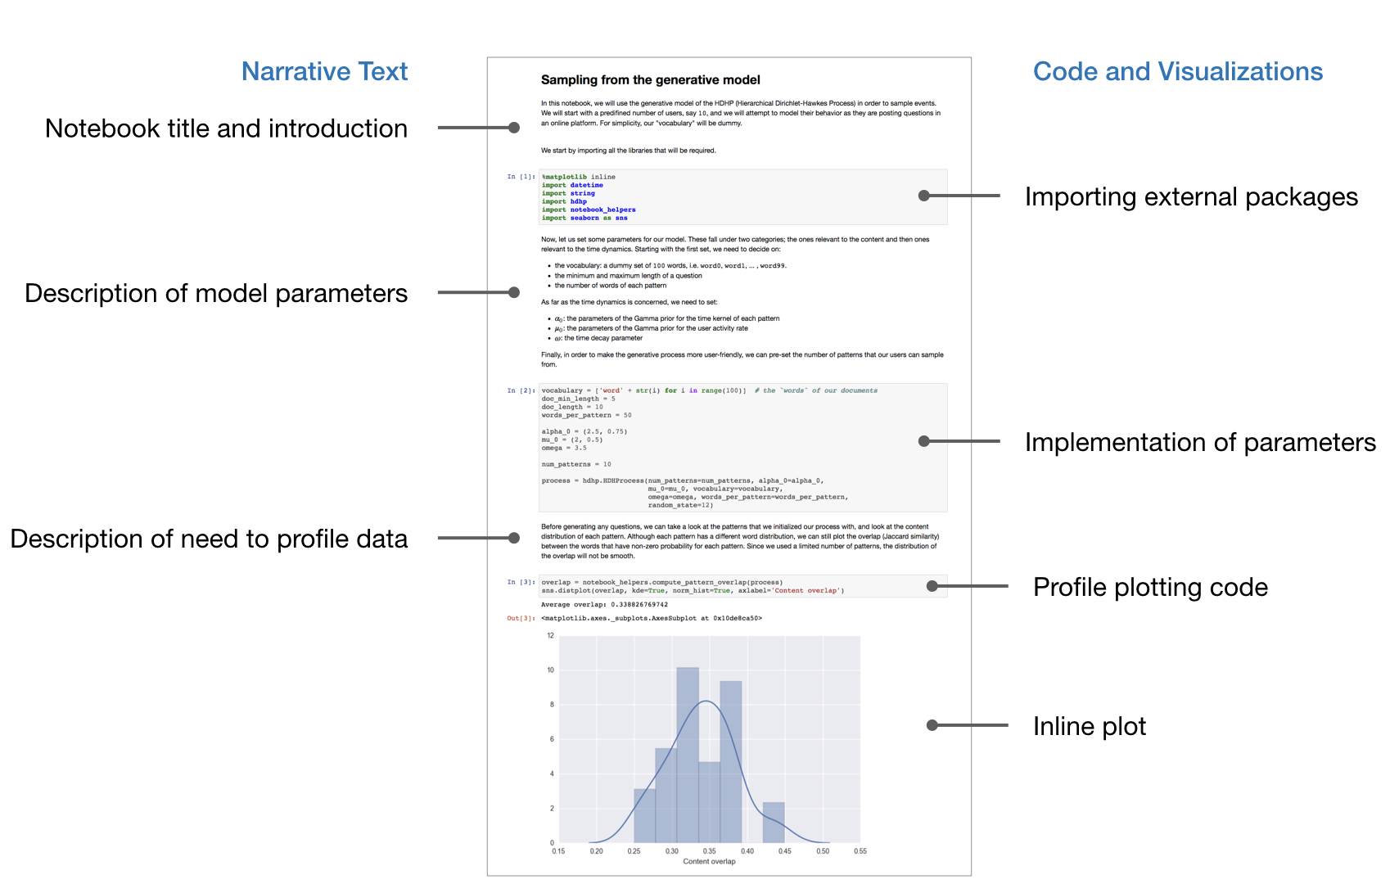
Jupyter Notebooks

Slide 3

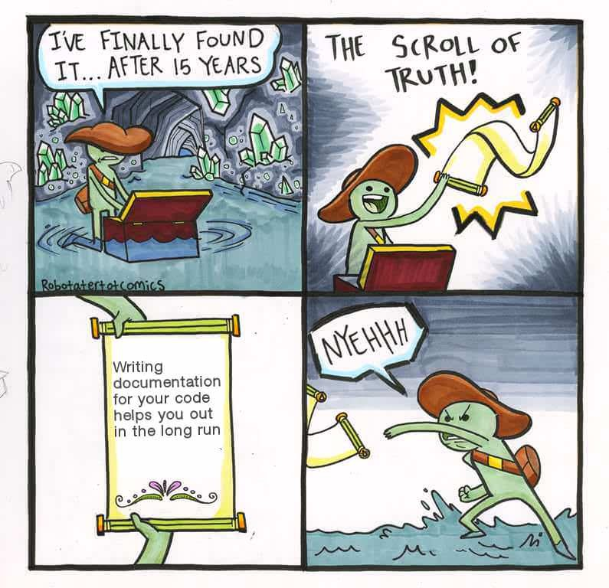
Code documentation: What is it?
The not executable strings that are part of your code. Their main purpose is to explain how your script works.
It’s key for reproducible science!
Don’t take it for granted!

Slide 4
Ten simple rules for writing and sharing JNs
1. Tell a story for an audience
2. Document the process, not just the results
3. Use cell divisions to make steps clear
4. Modularize code
5. Record dependencies
6. Use version control
7. Build a pipeline
8. Share and explain your data
9. Design your notebooks to be read, run, and explored
10. Advocate for open research
https://doi.org/10.1371/journal.pcbi.1007007

Slide 5
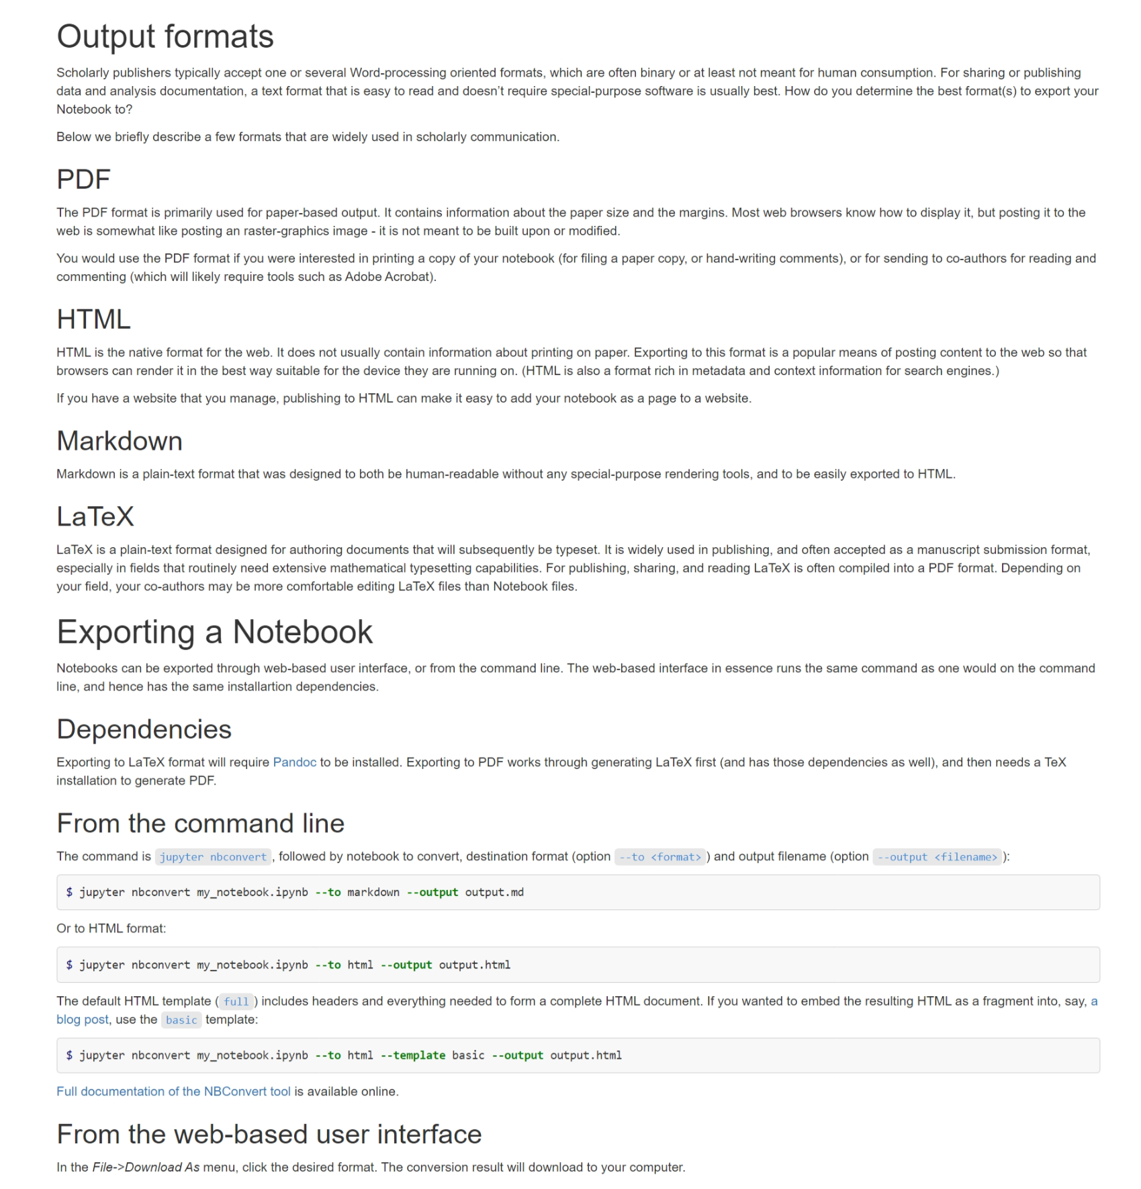
How to export your report?
+ .py !

Slide 6

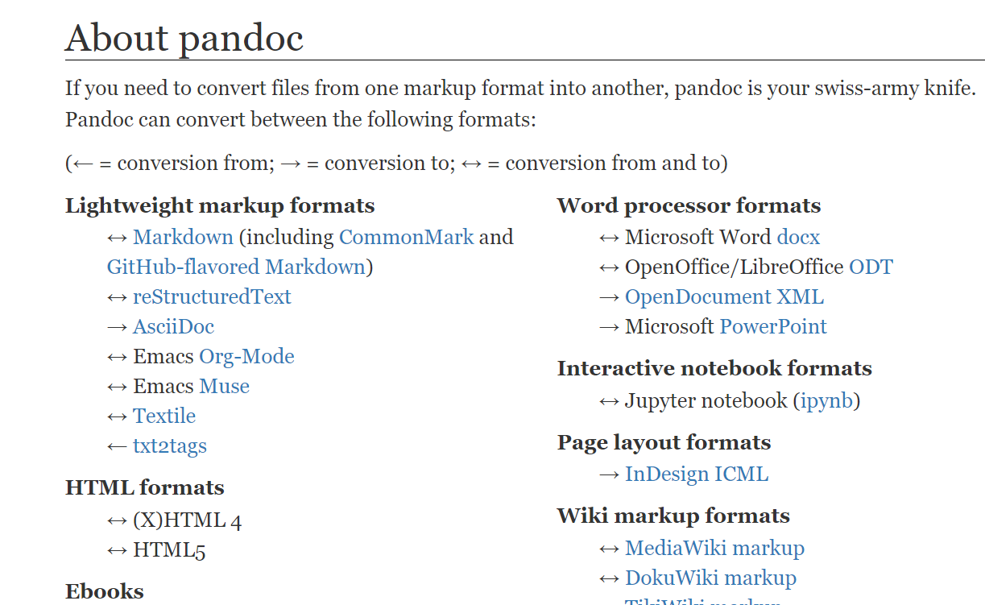
What is behind it? pandoc

Slide 7
The goal
To create a well-documented / enriched report
Ideally in PDF or HTML, but we are flexible
Add whatever you think was missing from us (feedback!)
Tomorrow we’ll match different pairs, and you will show your report to each other
To finish the course, we’ll pick up 2 or 3 different solutions and have a general discussion!

Slide 8
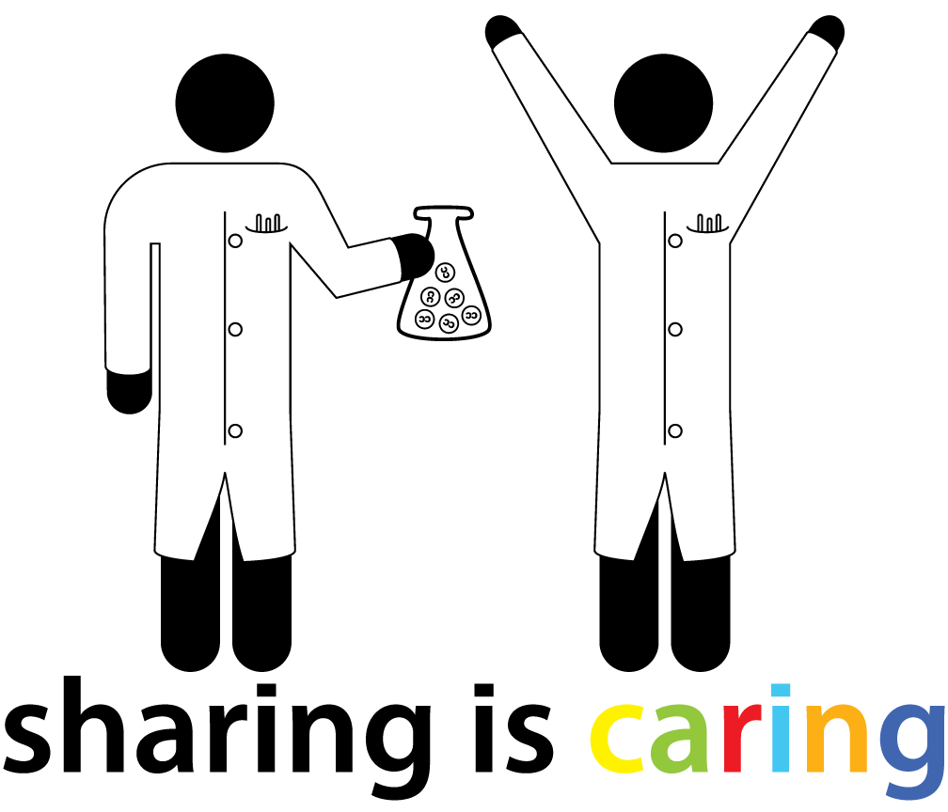

Thank you !
@BordeauxTea

