Slide 1


Introduction to Python – Matplotlib & Scipy
Computational Neuroscience Crash Course | July 2021
Eduarda Centeno
Tuesday, 6th of July

Slide 2
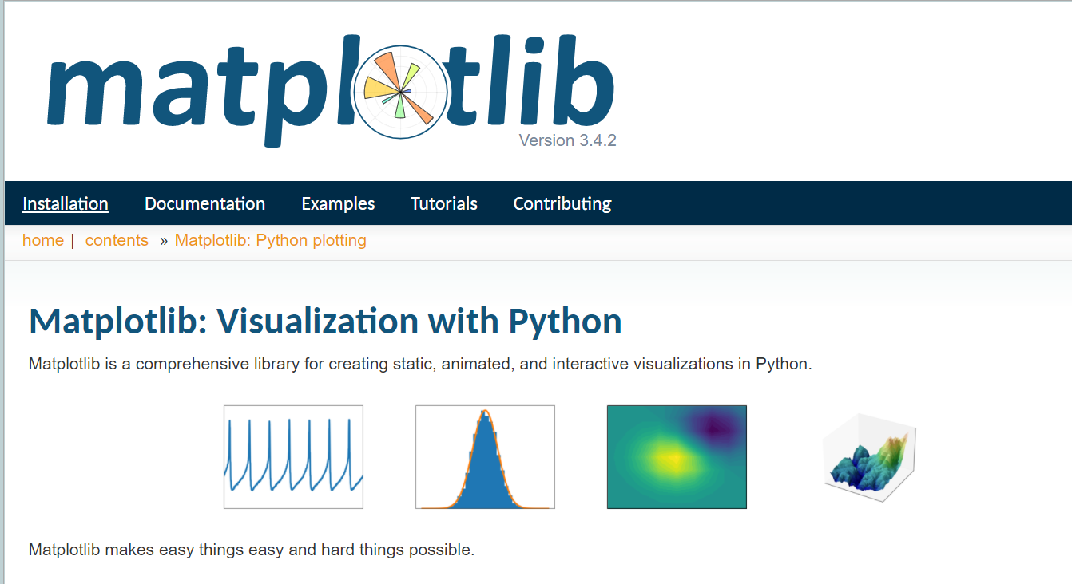

Matplotlib & the importance of data visualization!
The library:
https://matplotlib.org/stable/
https://github.com/rougier/matplotlib-tutorial
Nicolas (Researcher)

Slide 3
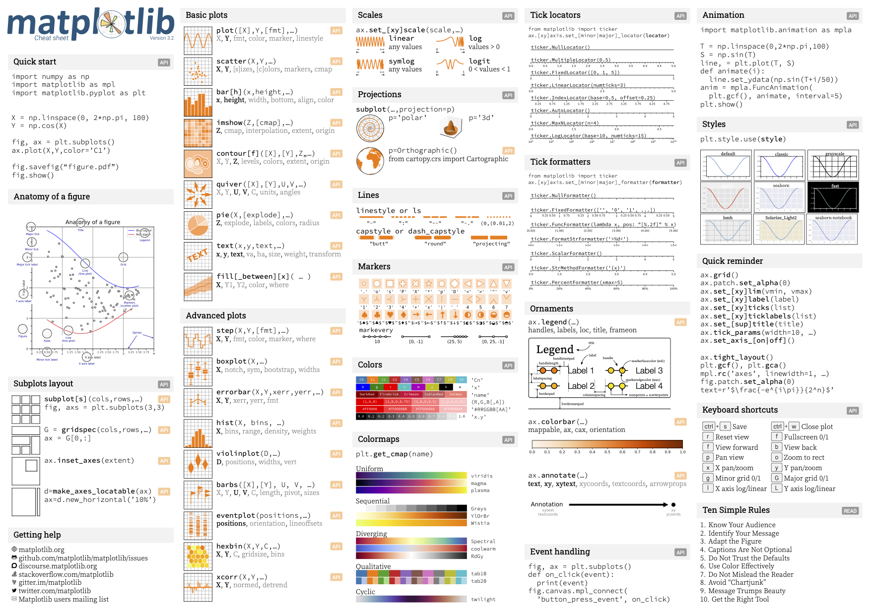
Matplotlib & the importance of data visualization!
Nicolas (Researcher)
https://github.com/matplotlib/cheatsheets

Slide 4
Ten simple rules for better figures
1. Know your audience
2. Identify your message
3. Adapt the figure to the support medium
4. Captions are not optional
5. Do not trust the defaults
6. Use color effectively
7. Do not mislead the reader
8. Avoid “chartjunk”
9. Message trumps beauty
10. Get the right tool
Nicolas (Researcher)
https://doi.org/10.1371/journal.pcbi.1003833

Slide 5
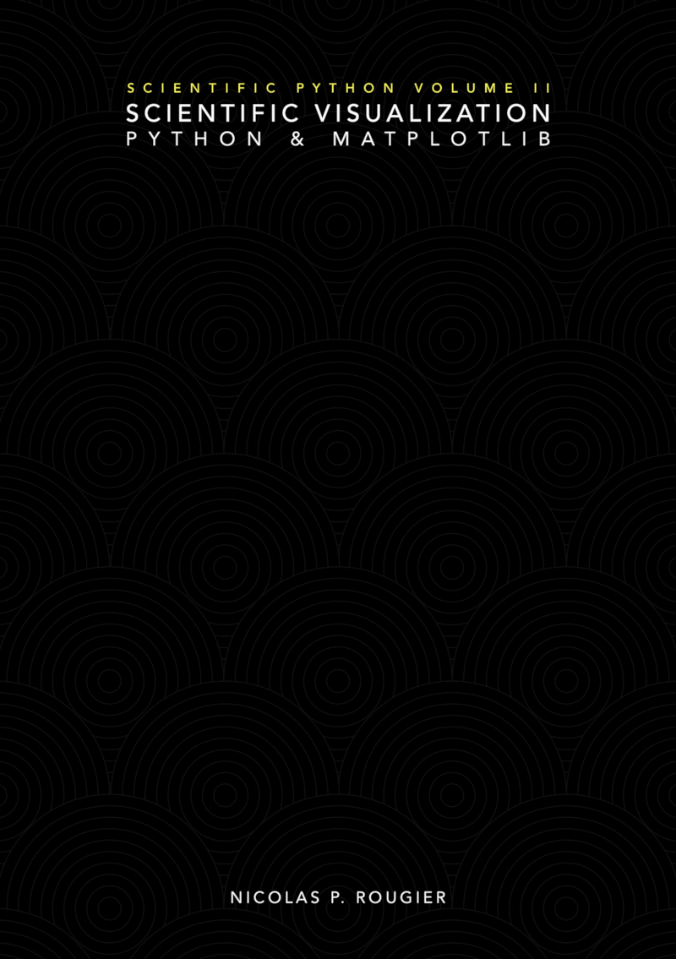
Matplotlib & the importance of data visualization!
Open access book!
https://github.com/rougier/scientific-visualization-book
Nicolas (Researcher)

Slide 6
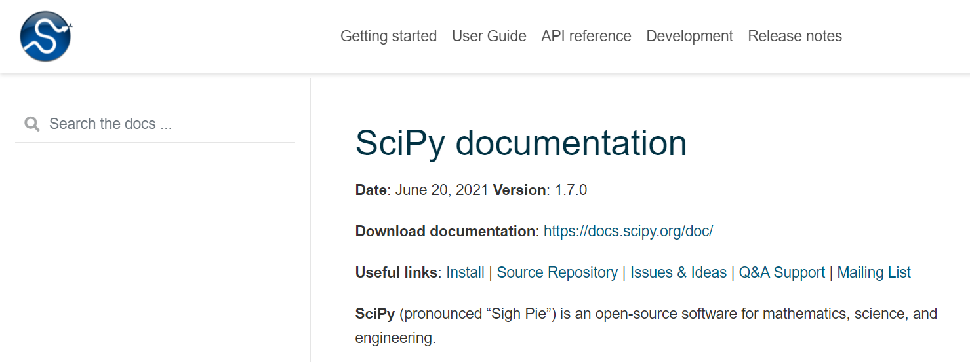
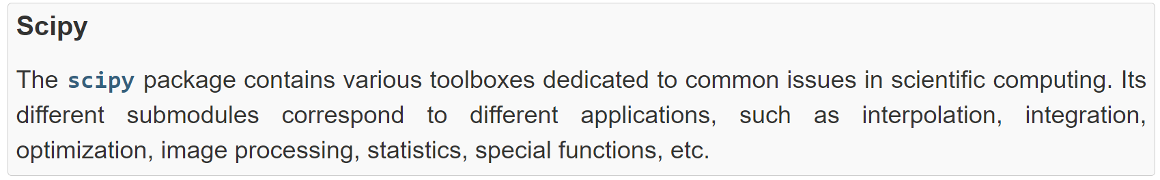
Scipy for scientific computing
The library:
https://docs.scipy.org/doc/scipy/reference/index.html
http://scipy-lectures.org/intro/scipy.html

Slide 7
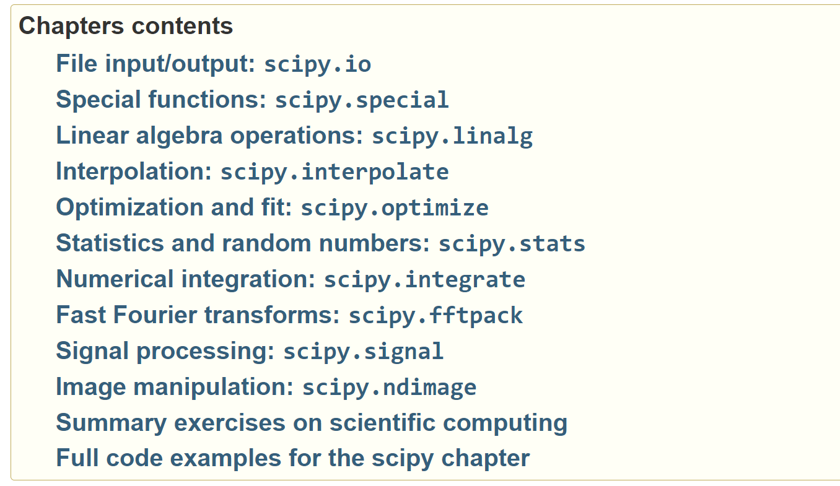
Scipy for scientific computing
http://scipy-lectures.org/intro/scipy.html

Slide 8
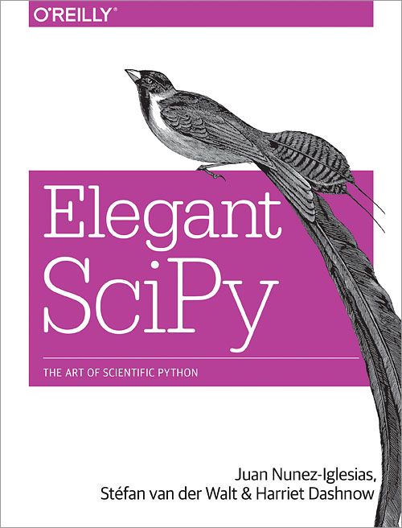
Scipy for scientific computing
Open access book!
https://github.com/elegant-scipy/elegant-scipy

Slide 9
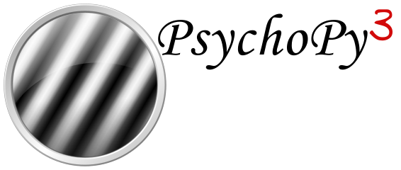

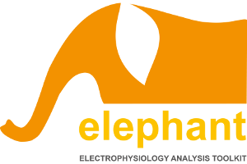

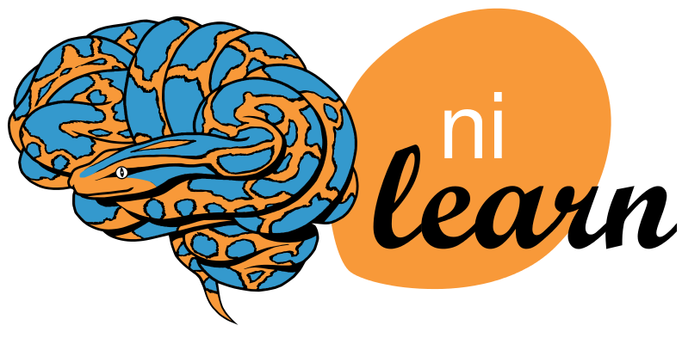
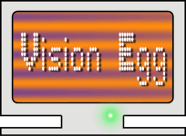
Neuroscience libraries

Slide 10
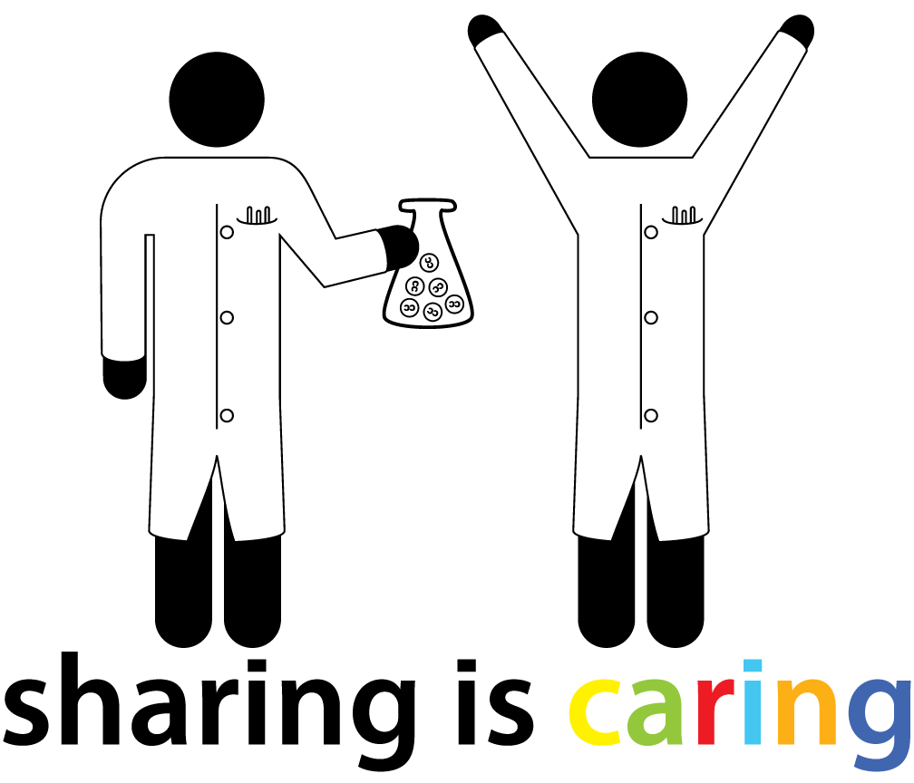

Thank you !
@BordeauxTea

