Slide 1


Introduction to the course
Introduction to Experimental Neuroscience: Neurocomputation| July 2021
Eduarda Centeno
Monday, 26th of July

Slide 2


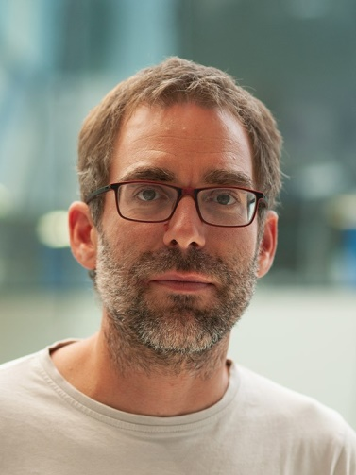
Course’s overview
The team:
Eduarda (PhD student)
Fjola (PhD student)
Arthur (Researcher)

Slide 3
Course’s overview
Week-long course
We start each day with a Q&A / Recap (approx. 30 min)
We will provide you with some maths and programming lectures
You have predefined tasks per day
You will be divided in pairs (pair programming)
We provide the tasks’ solutions by the end of each day
On Friday you will have the time to work on your presentation

Slide 4
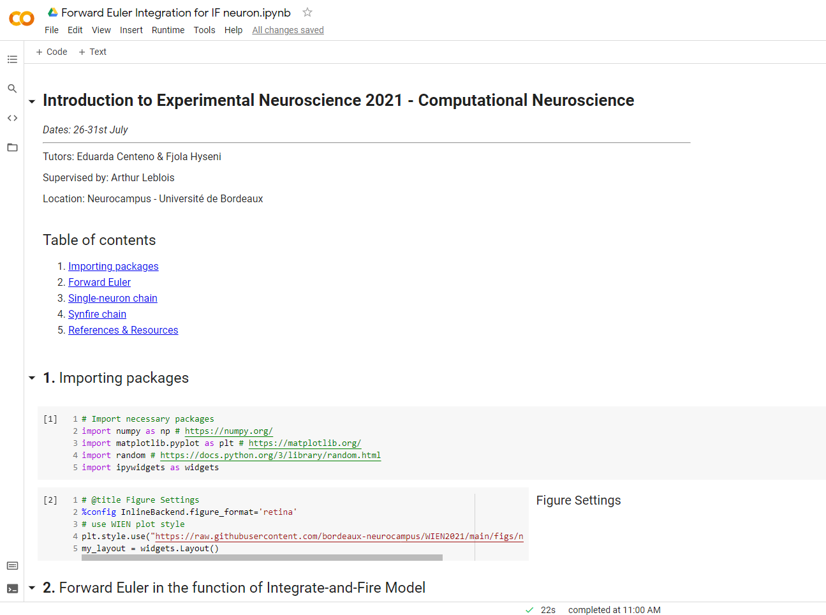
Course’s overview

Slide 5
Course’s main goals
Introduce you to Python
Introduce you to basic concepts on neuronal modelling
Produce a modelling pipeline which will go from single neurons to a synfire chain
We come from a lab that works on songbirds, so you’ll get to learn a bit about that as well ☺
And we will introduce you to Open Science

Slide 6
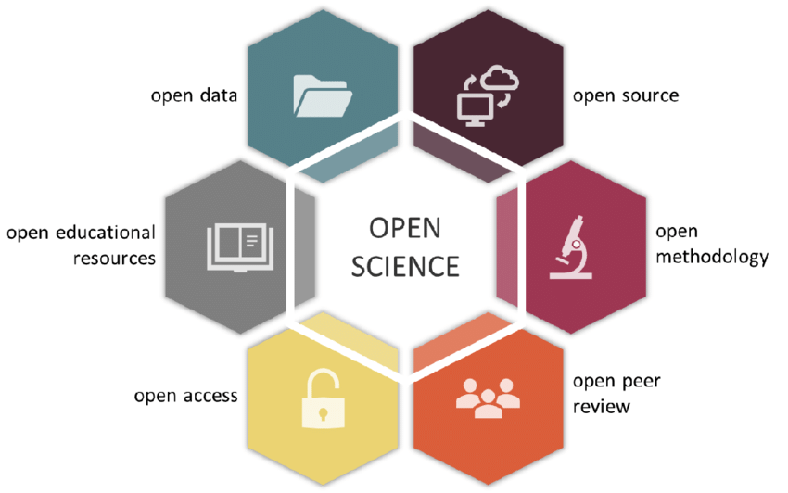
Open Science
doi: 10.32942/osf.io/kac45

Slide 7
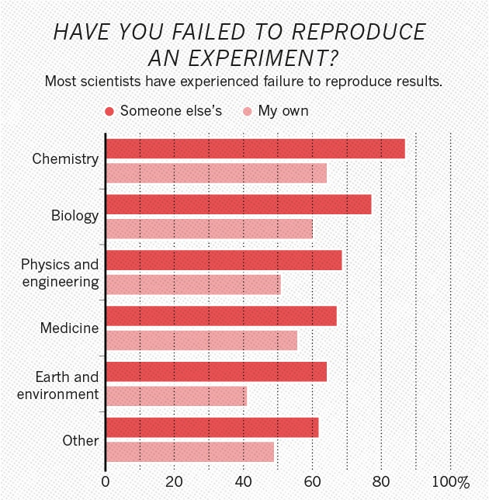
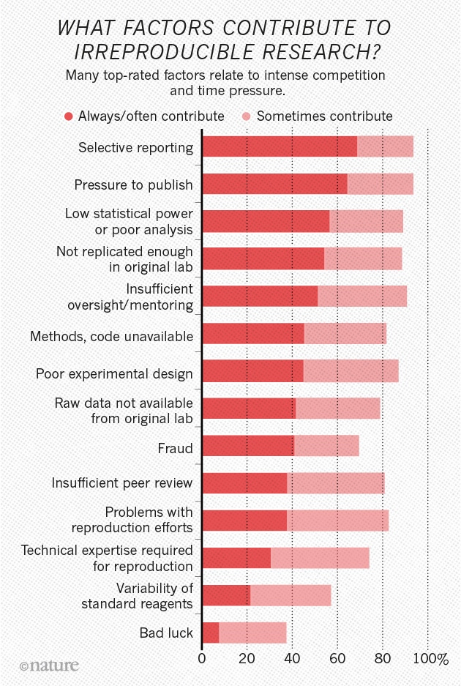

Why Open Science?
Baker, M. 1,500 scientists lift the lid on reproducibility. Nature 533, 452–454 (2016).
Context in the scientific world – The crisis
https://doi.org/10.1038/533452a

Slide 8
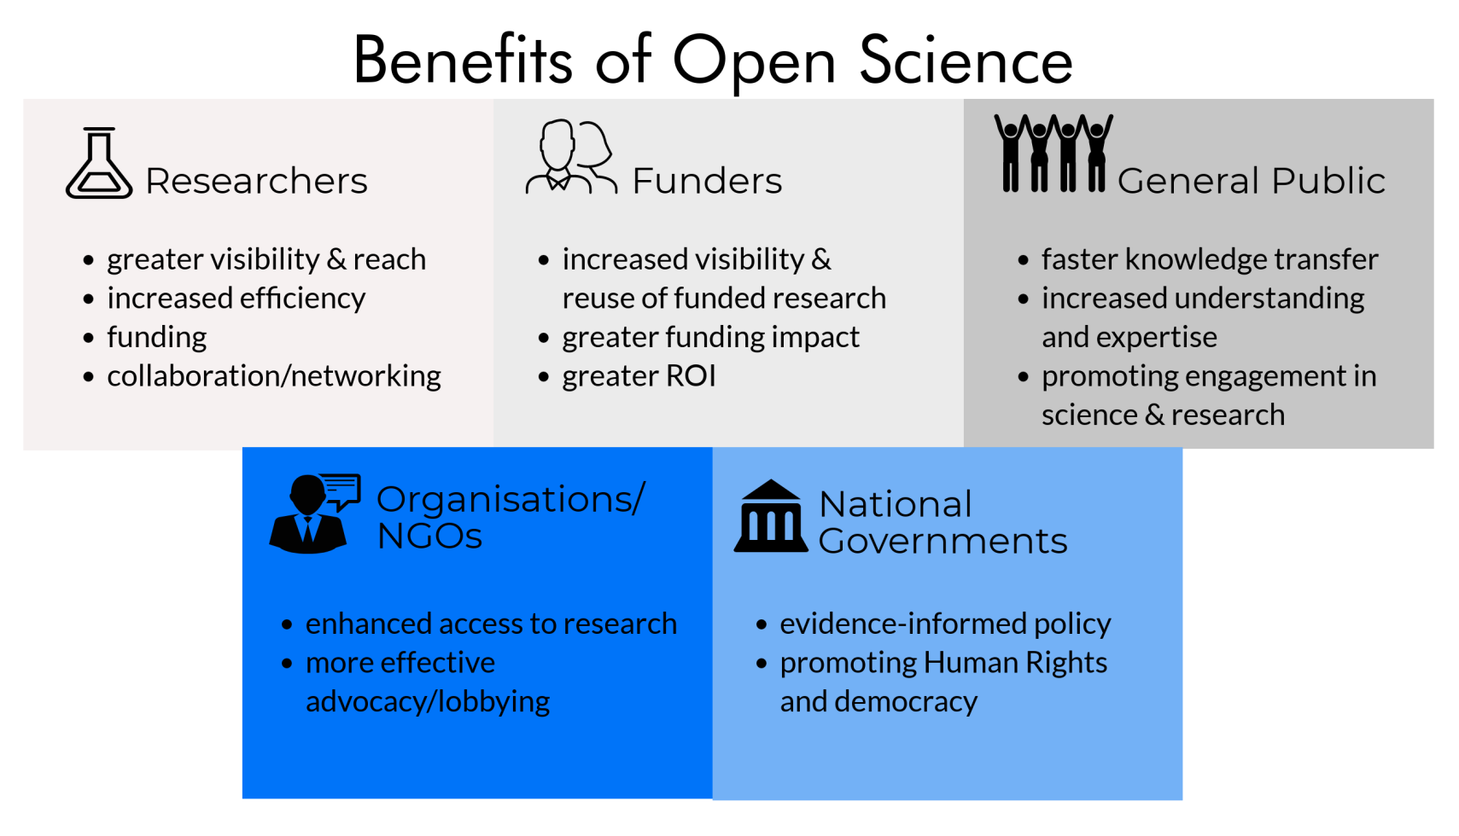
Benefits of Open Science
openaire.eu

Slide 9
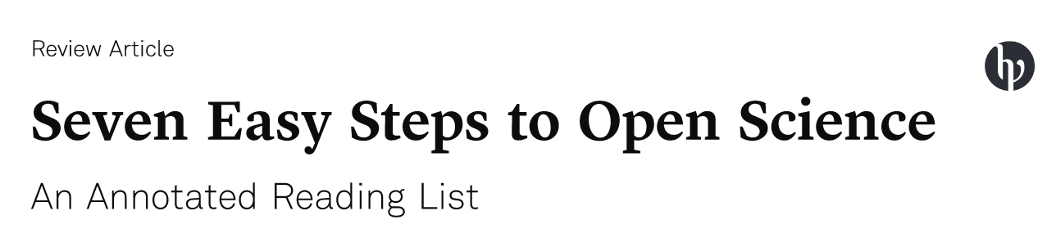


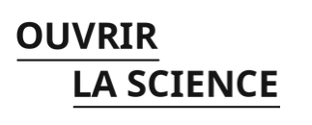

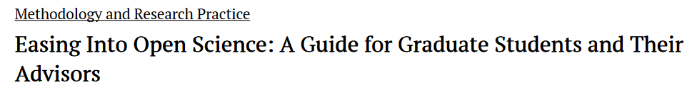
How to learn about Open Science

Slide 10
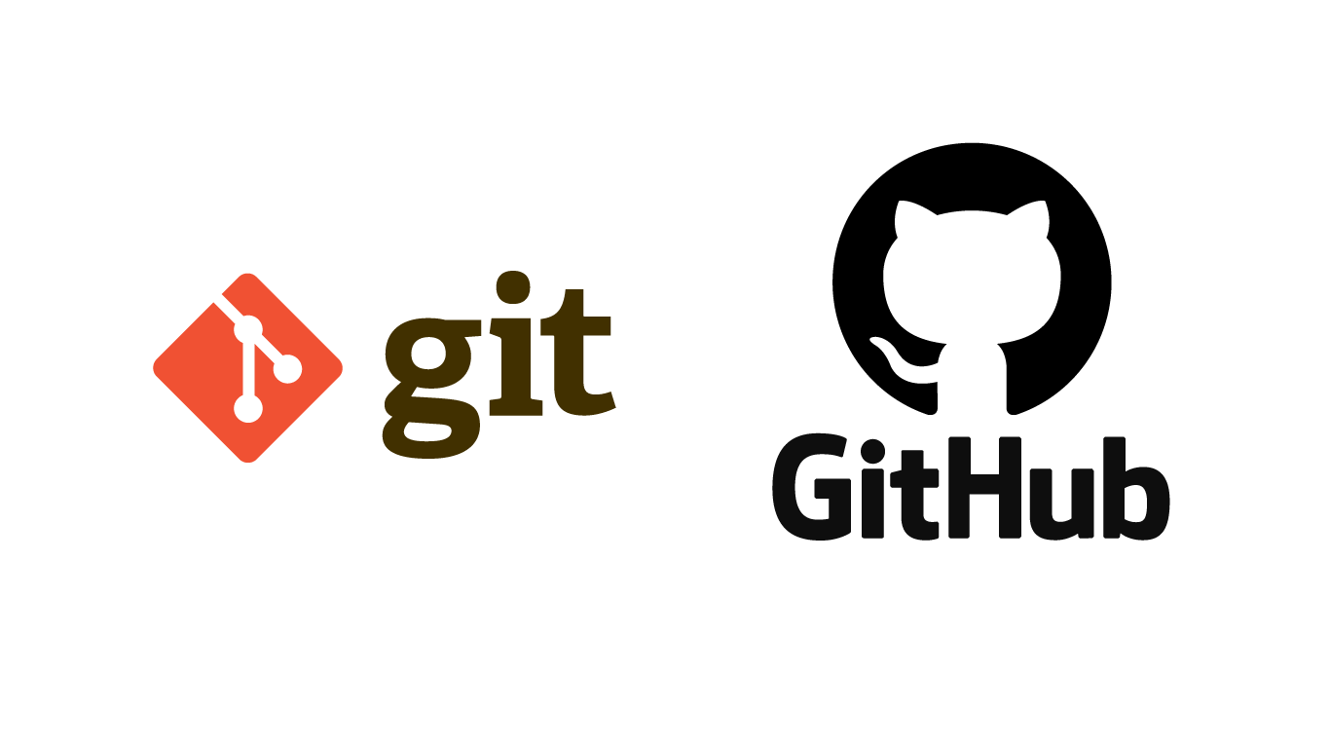




Open Science in this course

Slide 11
Python & Anaconda: What are they?
An open-source high-level general-purpose programming language.
A distribution for Python (and R) that simplifies package management and deployment.

Slide 12
Git & GitHub: What are they?
An open-source version control system that allows you to…
Record changes to repositories/files over time
Rewind to any previous version of your files
Easily collaborate with other programmers
A cloud-based (user-friendly) website that allows you to…
Host your git repositories/projects
Easily share your git repositories/projects
Create a social network between collaborators

Slide 13

Jupyter notebooks: What are they?
“Open-source web application that allows you to create and share documents that contain live code, equations, visualizations and narrative text.”

Slide 14
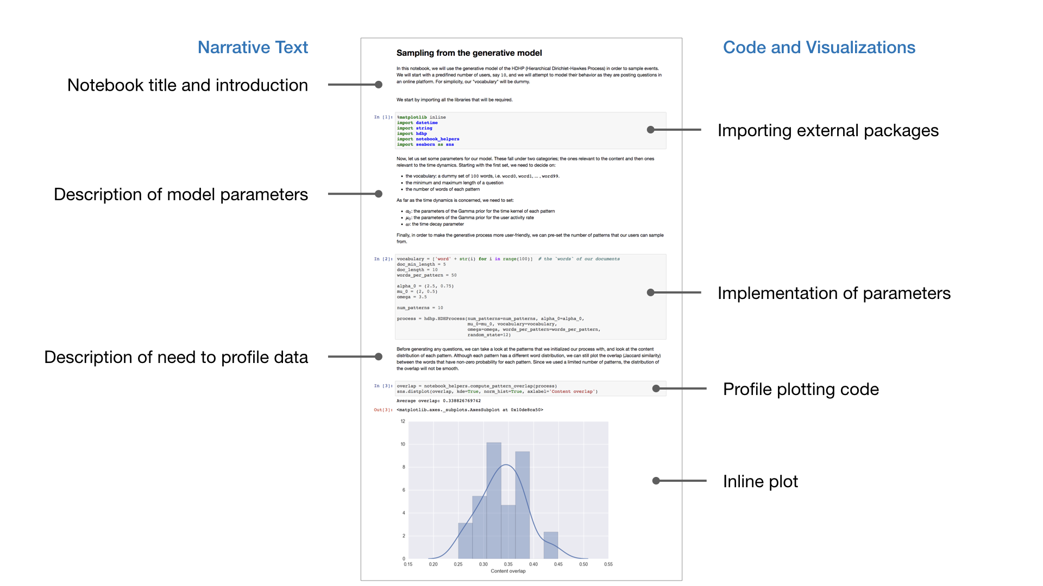

Slide 15
More info about the course:
https://github.com/bordeaux-neurocampus/WIEN2021

Slide 16
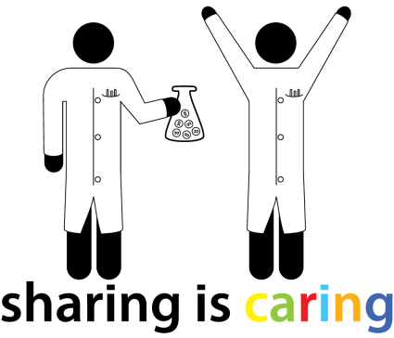

Thank you !
@BordeauxTea

