Slide 1


Introduction to Python – Code documentation
Introduction to Experimental Neuroscience: Neurocomputation| July 2021
Eduarda Centeno
Tuesday, 27th of July

Slide 2

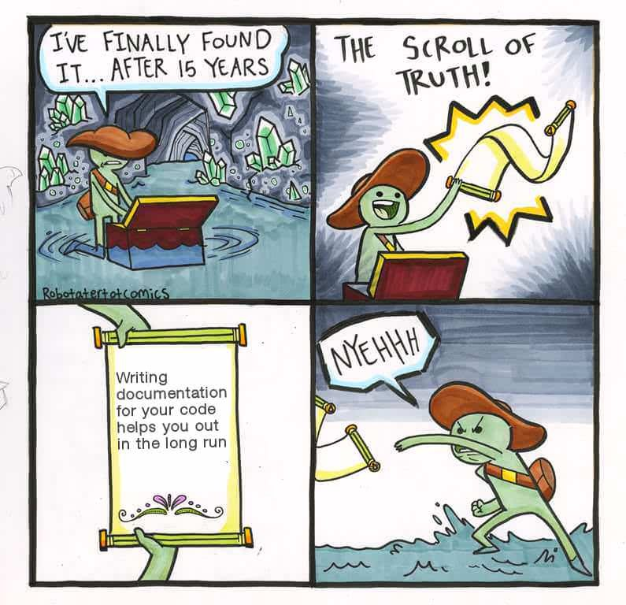
Code documentation: What is it?
The non-runnable part of your code that aims to explain how your code works.
It’s key for reproducible science!
Don’t take it for granted!

Slide 3
Code documentation: What is it?
It’s important to differentiate…
There are different templates…
Comments: brief statements using hashtag (#)
Documentation: docstrings (three double-quote """)
Google docstrings, reStructured text, Numpy/Scipy docstrings, etc.. (chose one and stick to it!)
Have a read: https://www.python.org/dev/peps/pep-0257/

Slide 4
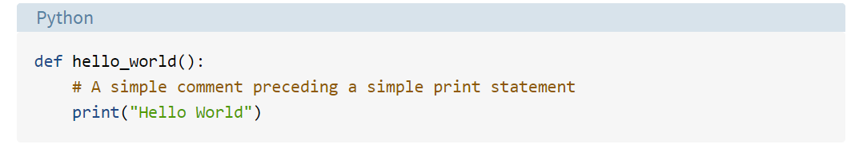
Code documentation: Some examples
https://realpython.com/documenting-python-code/

Slide 5
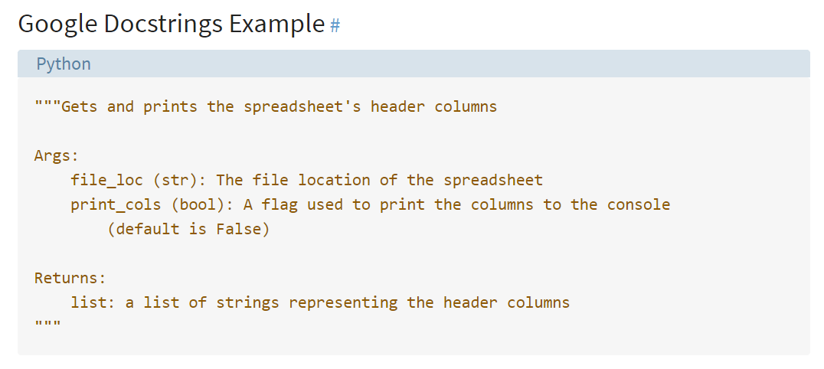
Code documentation: Some examples
https://realpython.com/documenting-python-code/

Slide 6
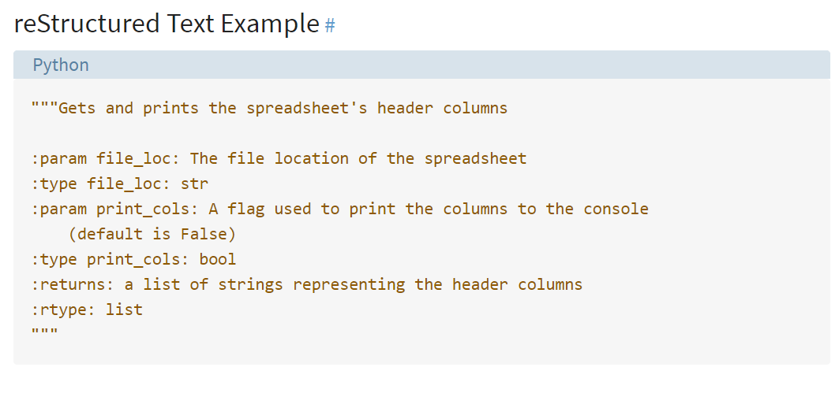
Code documentation: Some examples
https://realpython.com/documenting-python-code/

Slide 7
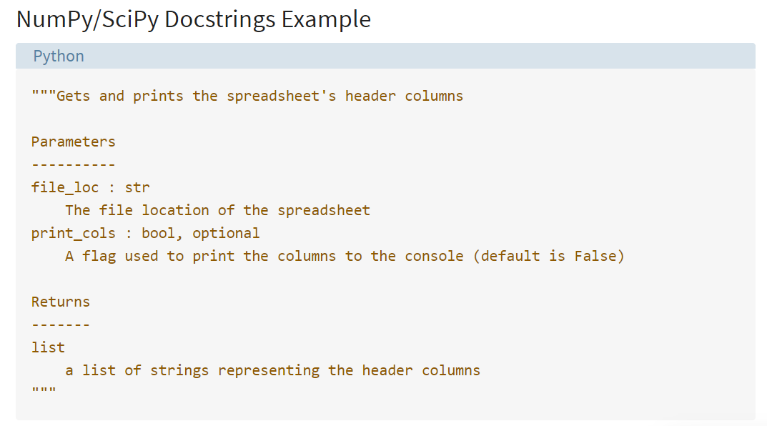
Code documentation: Some examples
https://realpython.com/documenting-python-code/

Slide 8
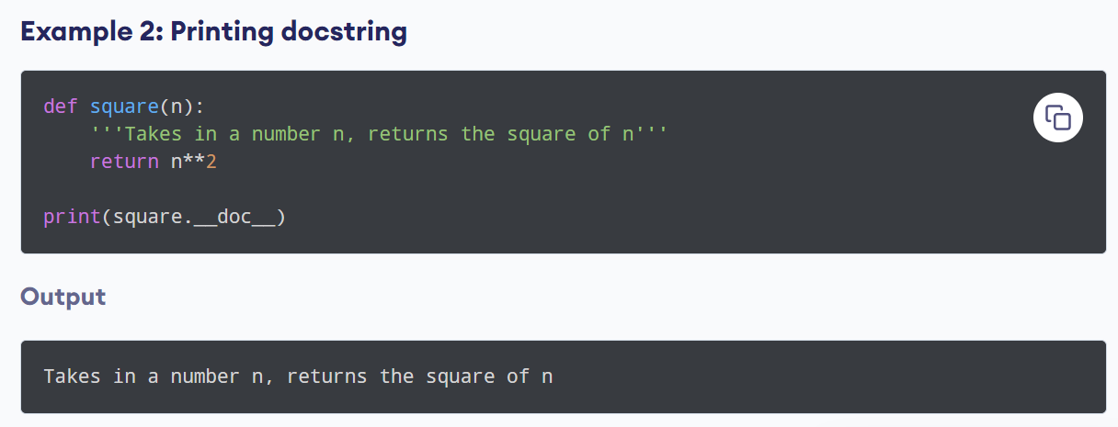
Code documentation: Some examples
https://www.programiz.com/python-programming/docstrings

Slide 9


Code documentation: Which tools to use?
Generators:
Tools for writing software reference documentation.
They provide you an output HTML/Latex files to publish your documentation (e.g., as website).
Can give visibility to your work!

Slide 10
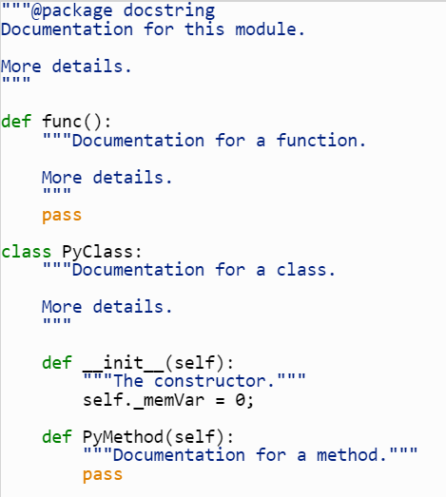
Code documentation: How to use generators?
http://www.doxygen.nl/manual/index.html

Slide 11
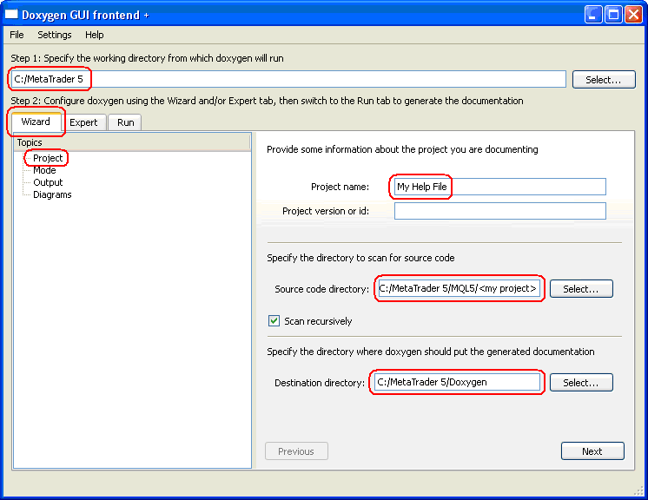
Code documentation: How to use generators?
http://www.doxygen.nl/manual/index.html

Slide 12
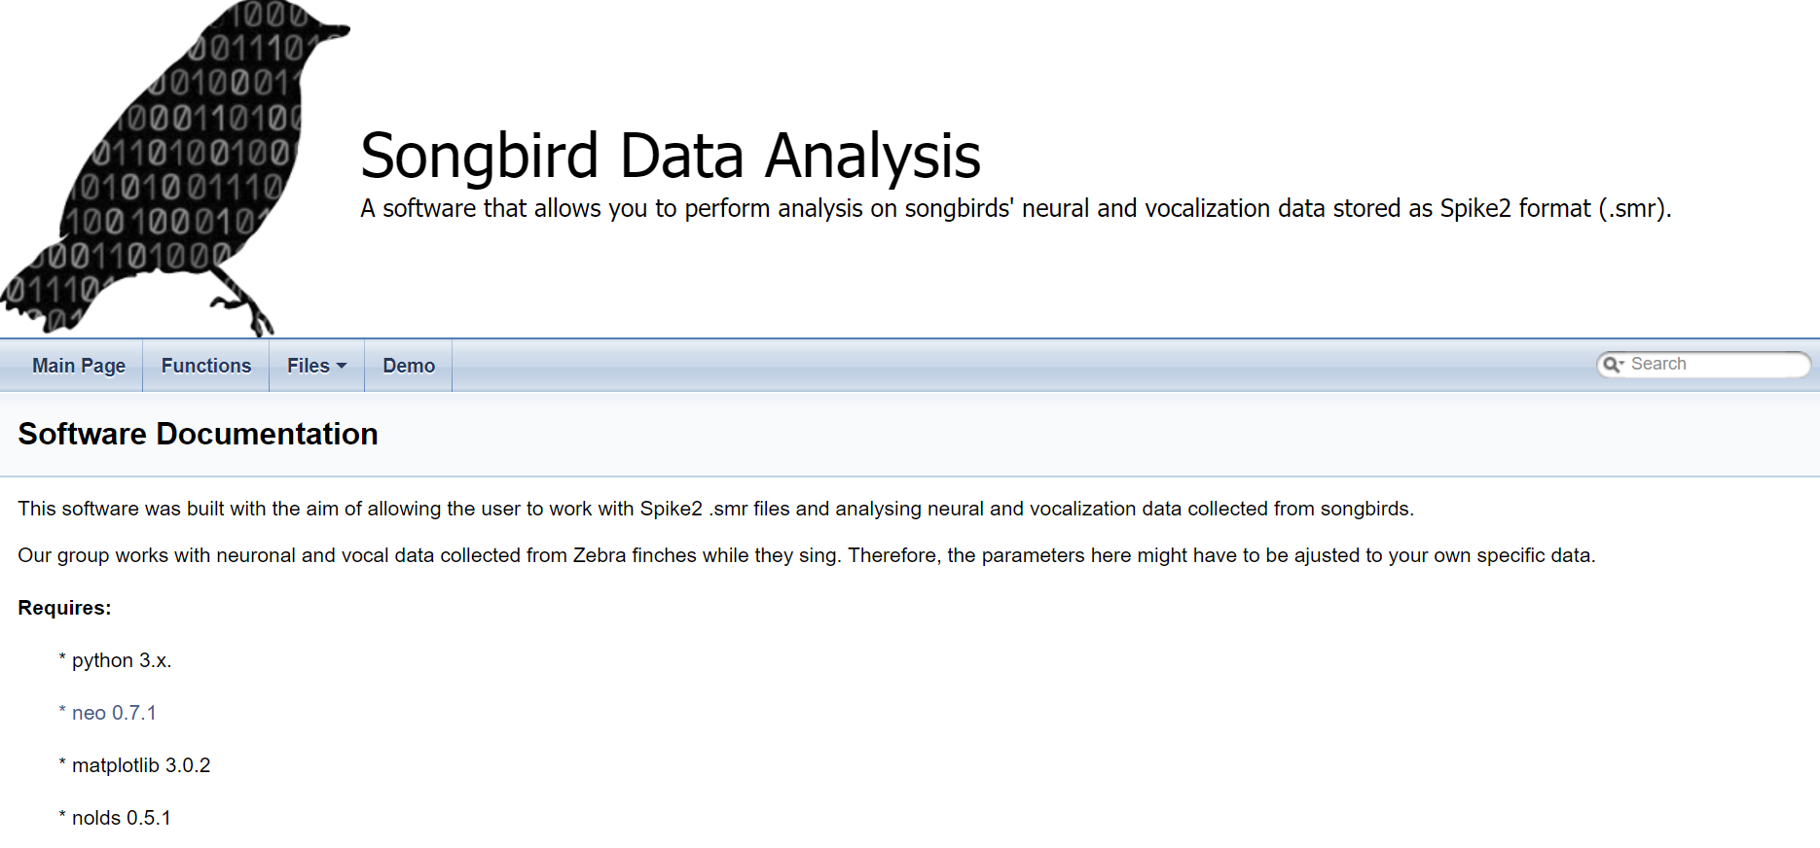
Code documentation: How to use generators?
https://aleblois.github.io/SongbirdNeuralDataAnalysis/
http://www.doxygen.nl/manual/index.html

Slide 13
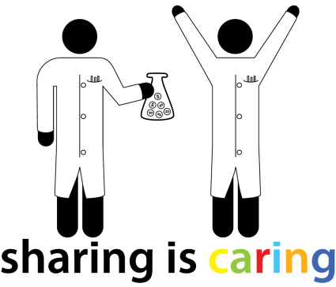

Thank you !
@BordeauxTea

Slide 14
Part 2
@BordeauxTea

Slide 15
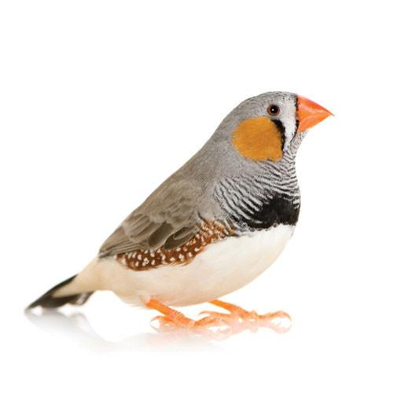
Neural correlates of vocal behavior in zebra finches
Eduarda Centeno

Slide 16
Introduction - Speech
- Complex sensorimotor skill
- Involves more than 100 muscles
Mimicking and hearing -dependent
Obadah Nakawah, Mohammad & C. Lai, Eugene, 2016

Slide 17
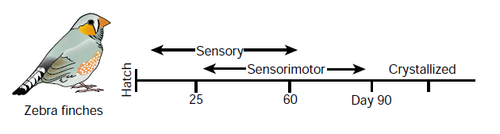
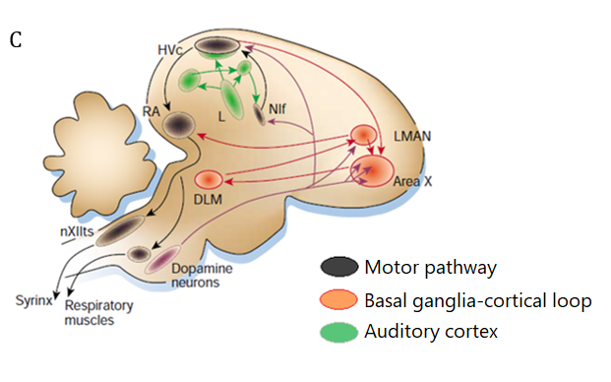
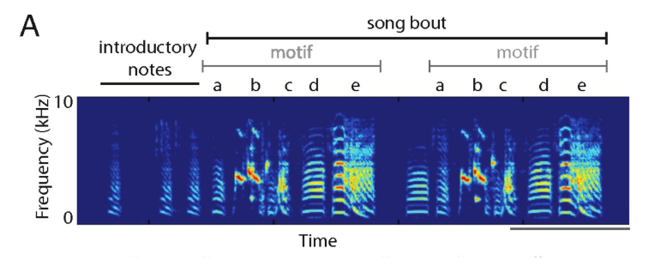

Introduction – Zebra finches as models
The song system
Brainard & Doupe, 2002
Brainard & Doupe, 2002
Chen, Matheson and Sakata, 2016
Notes:
Relate to humans, auditory regions (analogous to auditory cortex)

Slide 18
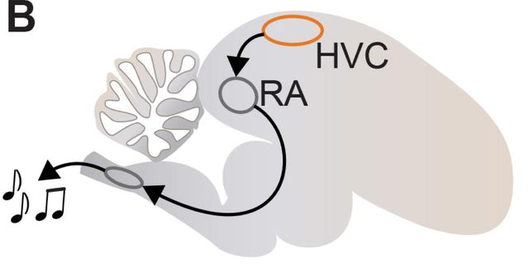


Introduction – HVC (high vocal center)
“HVC-RA projection neurons produce from one to several 5–10 ms bursts of action potentials during each motif, time locked to song acoustics with millisecond precision .”
Hahnloser, 2002; Troyer, 2016
Provides temporal information in song production?
What model could be used to explain timing and its variability? Synfire Chains?
Egger et al, 2019
Notes:
Relate to humans, auditory regions (analogous to auditory cortex)

