Slide 1
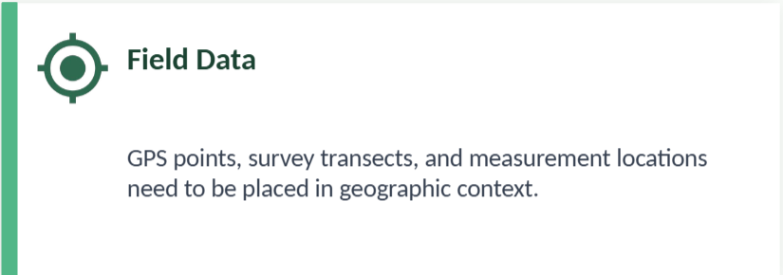
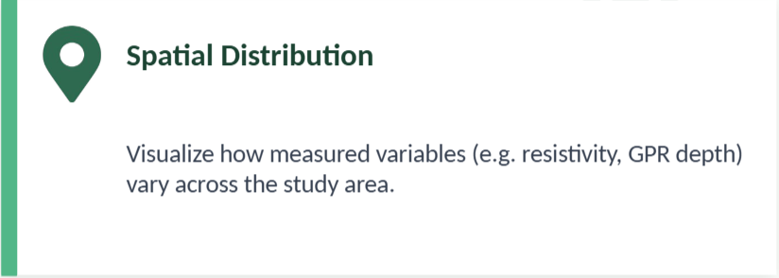
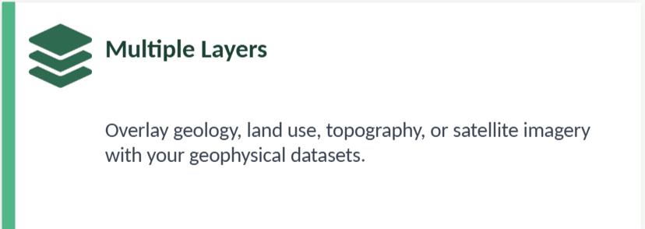
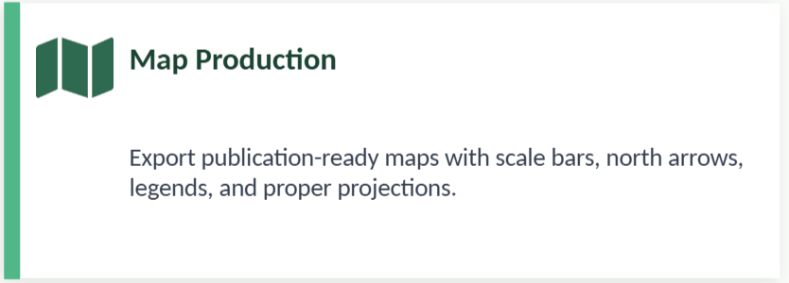
Why do we need GIS?
Work with QGIS in the Field and in the Lab
GIS (Geographic Information System) is a technology used to visualize, analyze, and manage spatial or geographic data.
QGIS is a free and open-source GIS software that allows us to create maps, analyze spatial data, and represent georeferenced information.
We are going to use QGIS to:
Load GPS points
Represent measurement profiles (e.g., from fieldwork or lab)
Visualize and export maps with scale bars, north arrows, and labels
Combine spatial data with analysis tools
Advanced Geophysical Methods in Natural Resource Investigation

Slide 2
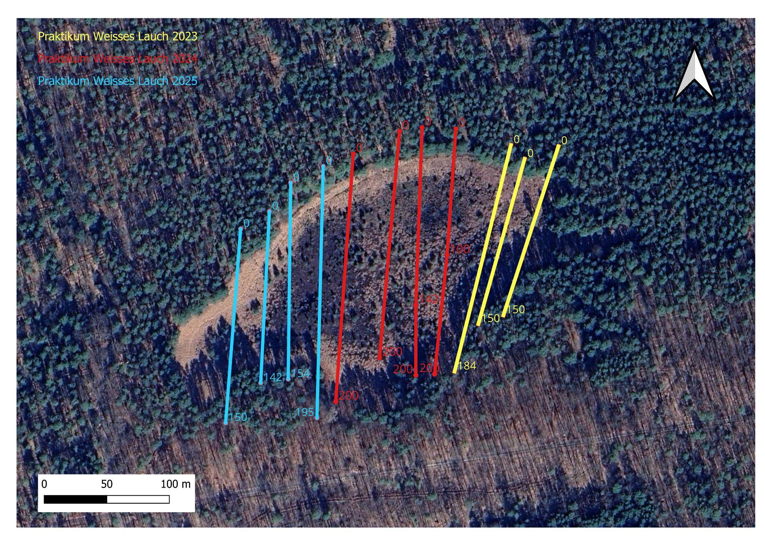
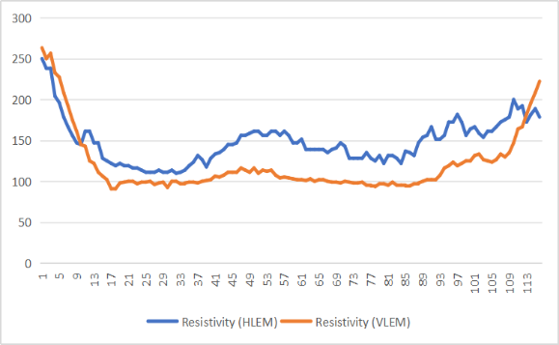
Why map measurement values over a basemap?
EM
Example 1 — EM/ERT survey, Weisses Lauch
Each field measurement (resistivity, conductivity, TMI…) has a geographic location.
Loading those values into QGIS and displaying them over a basemap reveals spatial patterns: which zones are anomalous, where to focus next.
EM → conductivity (x)
Advanced Geophysical Methods in Natural Resource Investigation

Slide 3
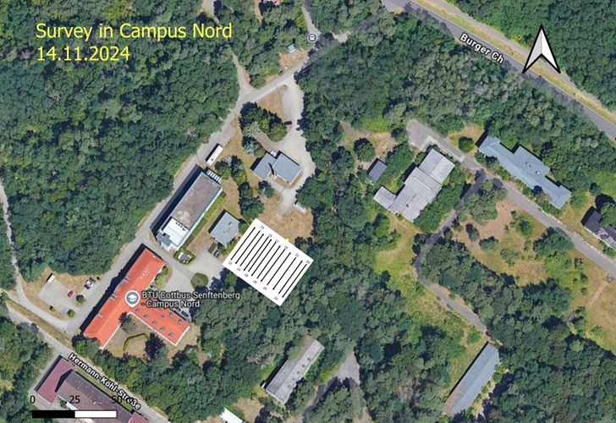
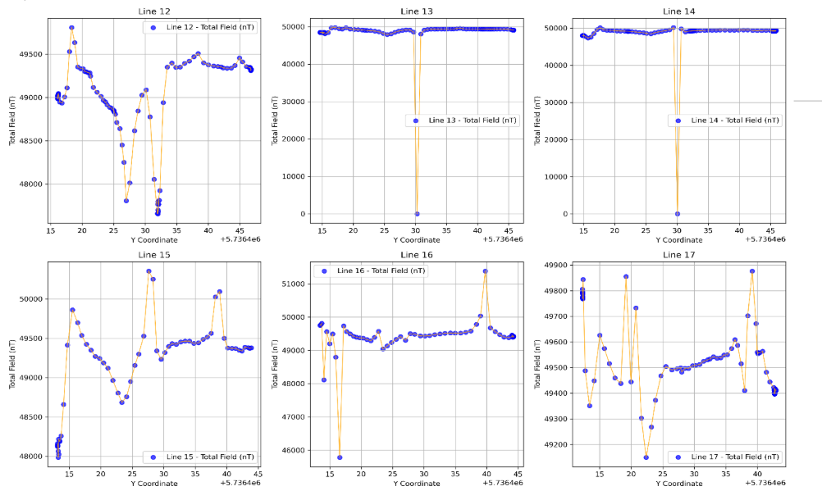
Why map measurement values over a basemap?
EM
Example 2 — Magnetometry, BTU Campus Nord
Each field measurement (resistivity, conductivity, TMI…) has a geographic location.
Loading those values into QGIS and displaying them over a basemap reveals spatial patterns: which zones are anomalous, where to focus next.
Magnetometer → Total Magnetic Intensity (x)
Advanced Geophysical Methods in Natural Resource Investigation

Slide 4
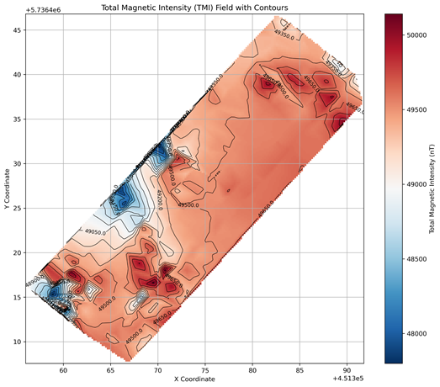
Why map measurement values over a basemap?
EM
Example 2 — Magnetometry, BTU Campus Nord
Each field measurement (resistivity, conductivity, TMI…) has a geographic location.
Loading those values into QGIS and displaying them over a basemap reveals spatial patterns: which zones are anomalous, where to focus next.
Magnetometer → Total Magnetic Intensity (x)
Advanced Geophysical Methods in Natural Resource Investigation

Slide 5
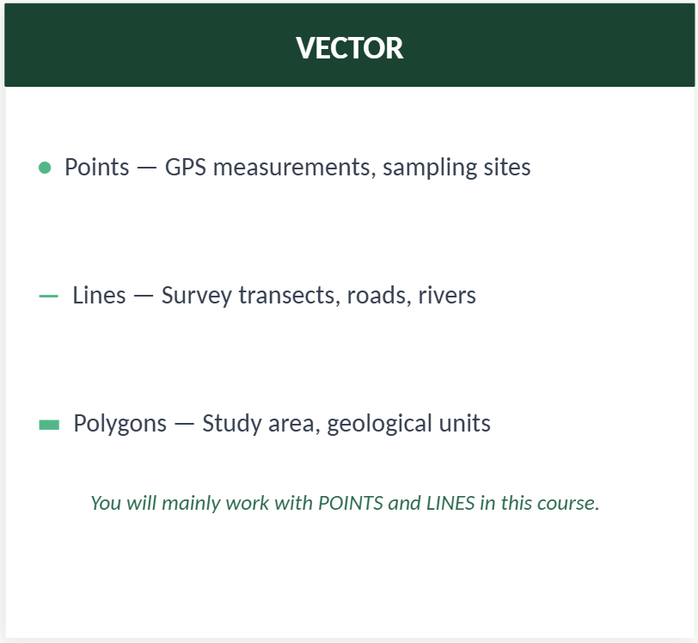
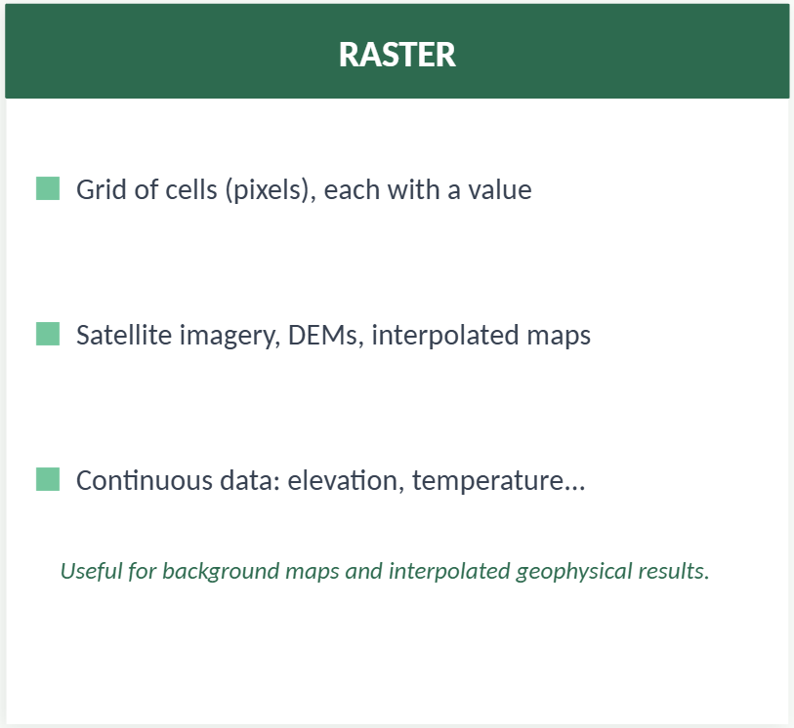
Types of GIS data
Work with QGIS in the Field and in the Lab
Advanced Geophysical Methods in Natural Resource Investigation

