Slide 1
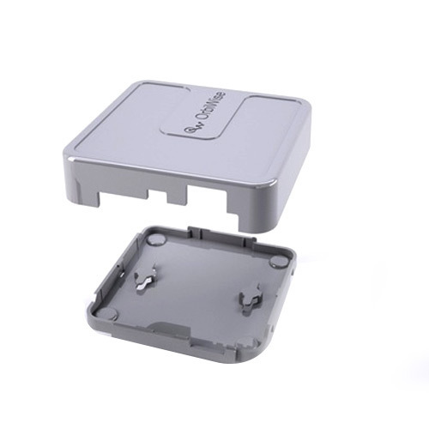
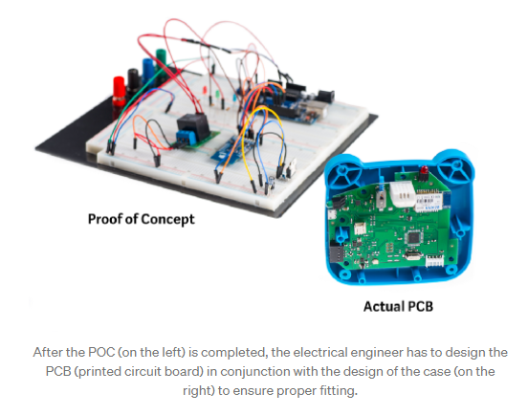
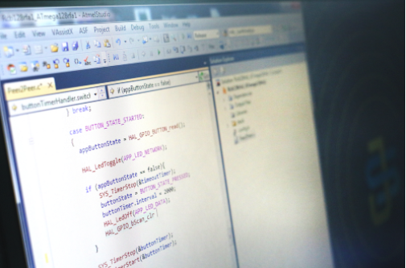
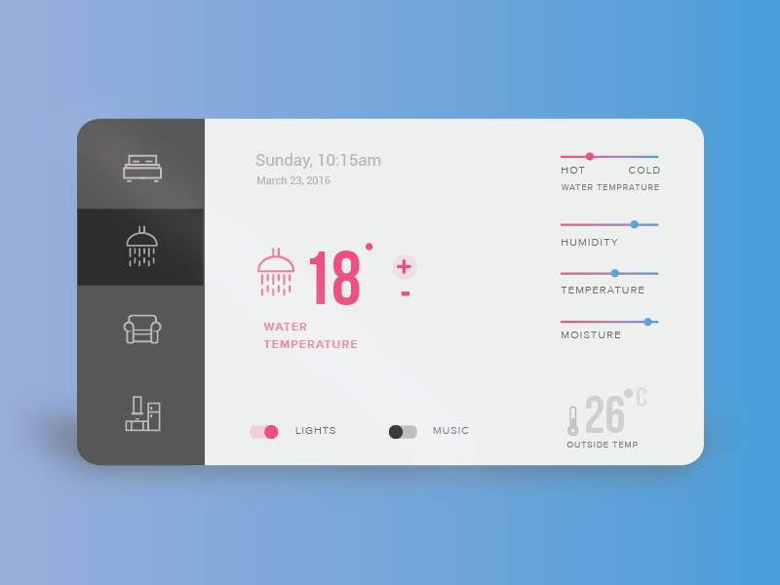
Workshop : Electronic Prototype with microPython
Typical development activities
1.Mechanical Part , e,g enclosure
2.Electronic Circuits
3. Firmware
4. Software

Slide 2
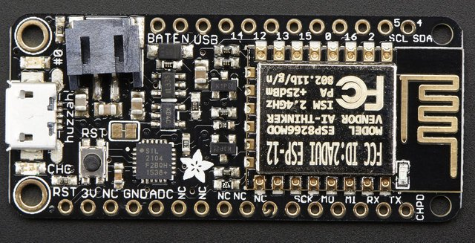
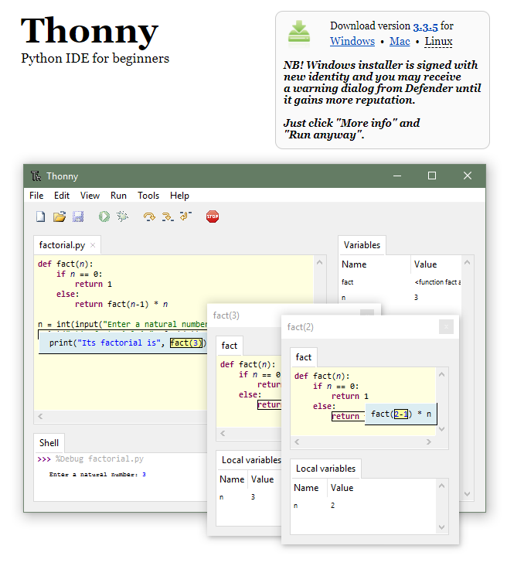
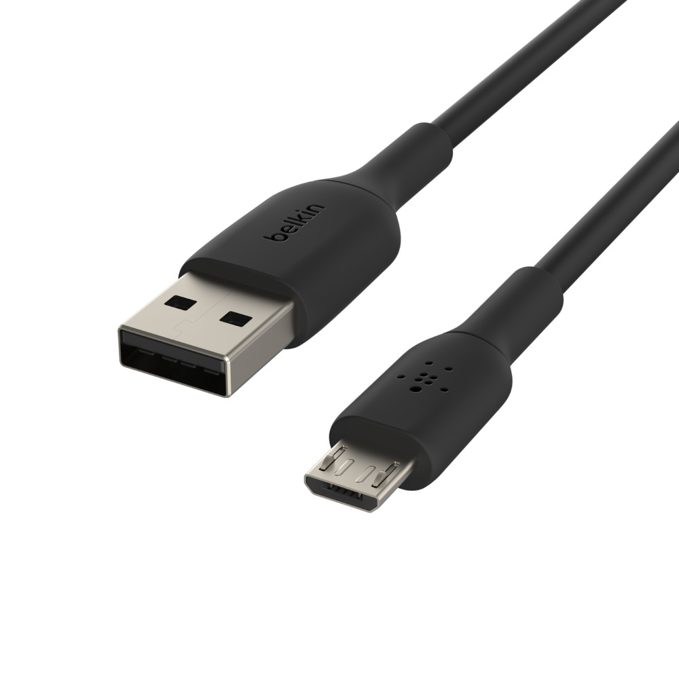
Workshop : Prerequisites
Download Thonny from Thonny website.
Esp8266 board
https://thonny.org/
Micro USB cable

Slide 3
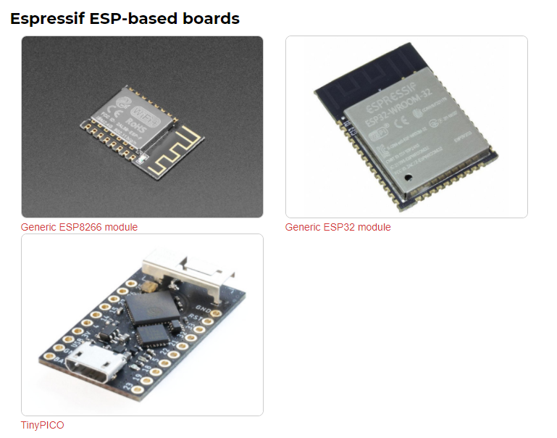
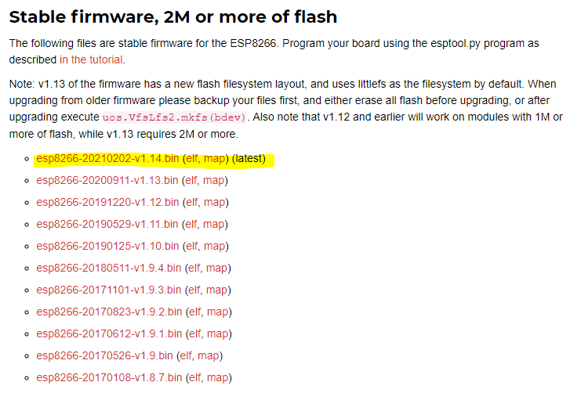
Workshop : Setup
Download esp-8266 firmware from micropython website
V1.14 is the latest stable firmware (March 2021).
http://micropython.org/download/#esp8266

Slide 4
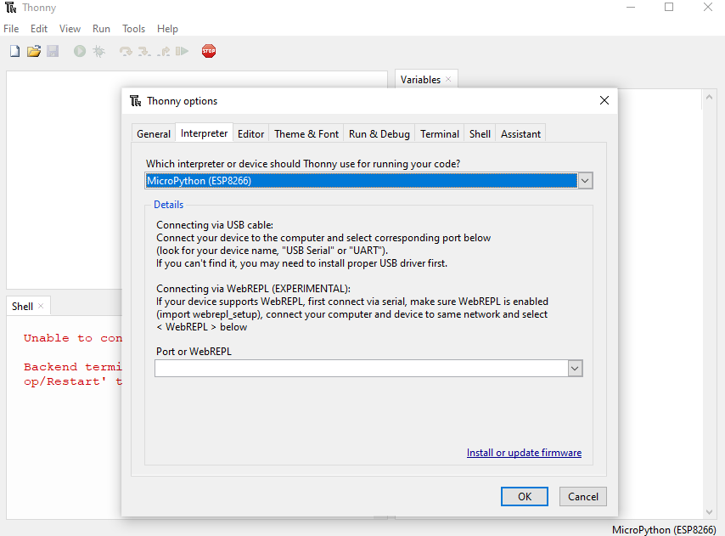
Workshop : Setup
Select interpreter.
Start Thonny > Tools > Option > Interpreter

Slide 5
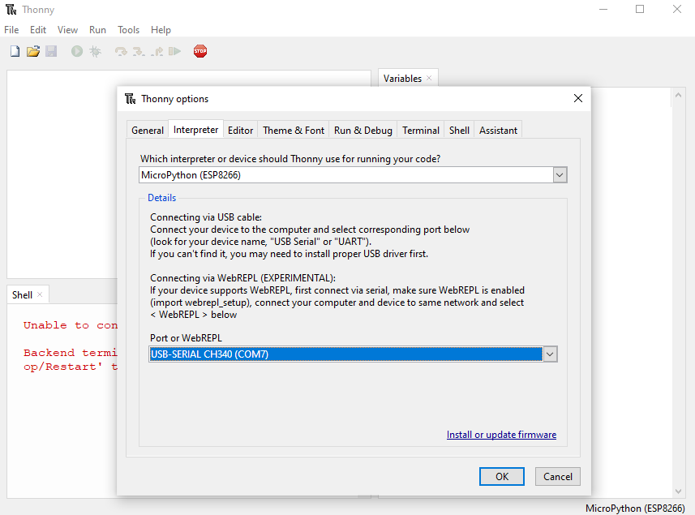
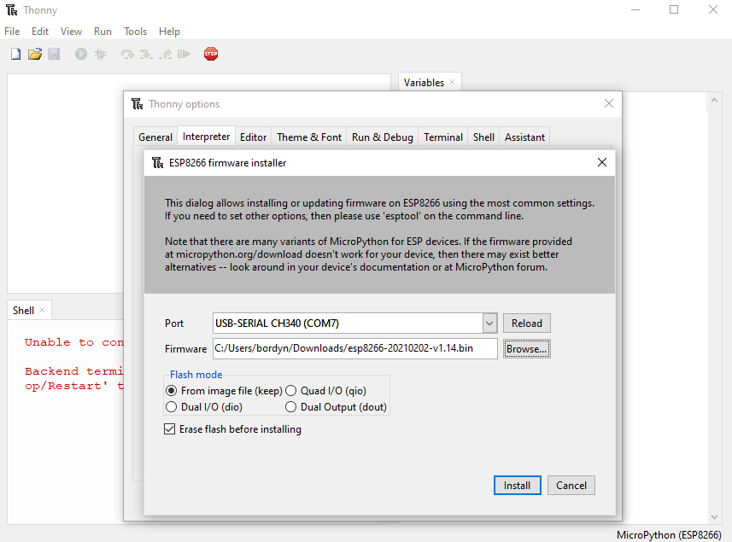
Workshop : Setup
Select the USB serial port.
Port should be shown automatically.
Select the downloaded firmware file then install.

Slide 6
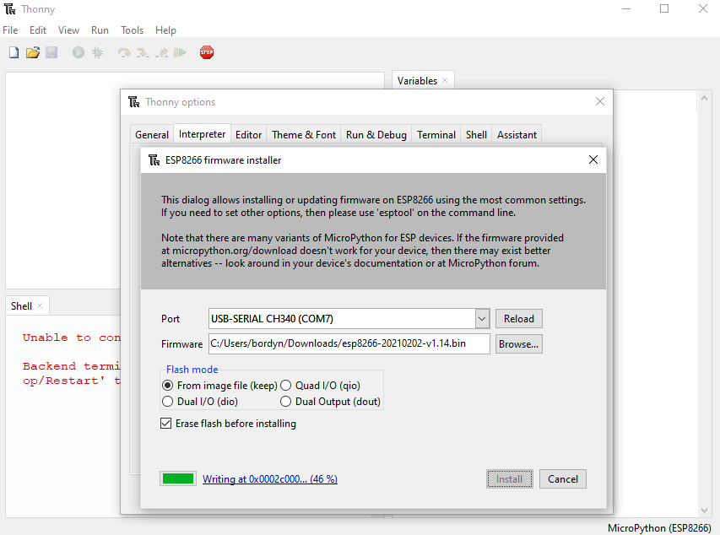
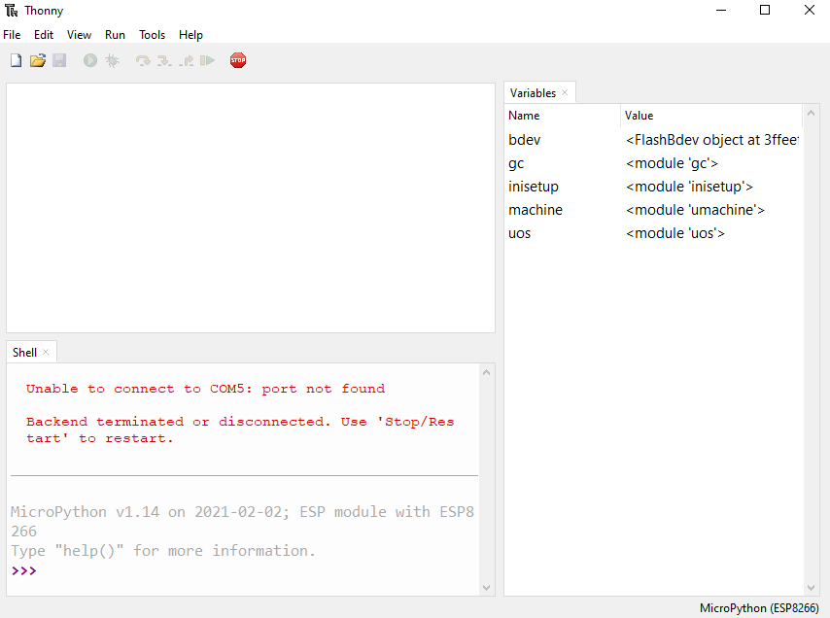
Workshop : Setup
Wait until the flash memory writing is completed.
MicroPython console is shown then you are good to go.

Slide 7
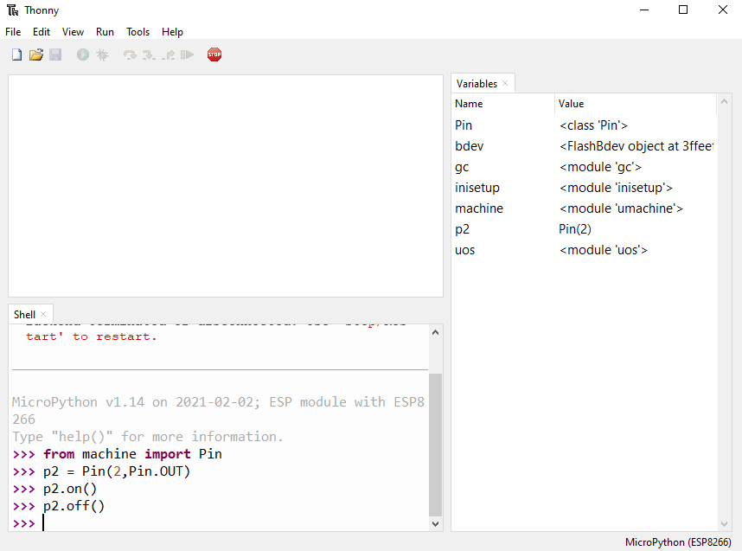
Workshop : Basic Test
Type the following code and key enter by end of the line.
The LED on board should change accordingly with on() off() command.

Slide 8
Workshop : Python vs MicroPython
Differences By design.
 | Python | MicroPython
Library | Support Python Standard Library. | Does not support high memory consumption (e,g sqlite3).
Multi-Process | Yes | No
Data type | All Python supported Data types. | only core datatypes.
Differences in Syntax and Implementation.
https://docs.micropython.org/en/latest/genrst/index.html

Slide 9
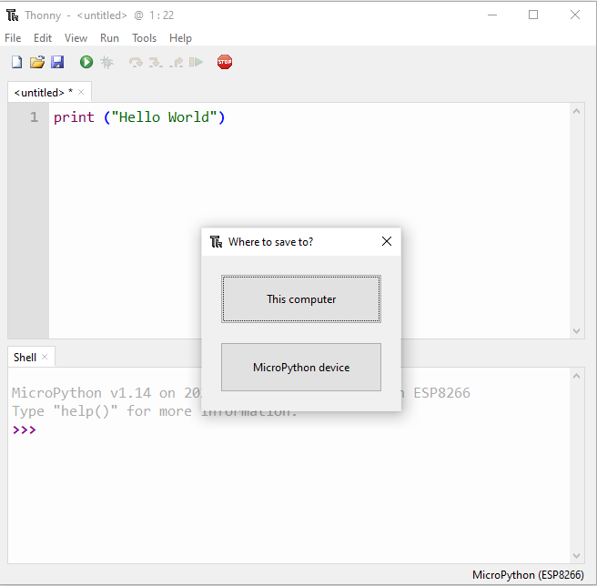
Workshop : Basic Test
Save
First_program.py
to your computer to any folder

Slide 10
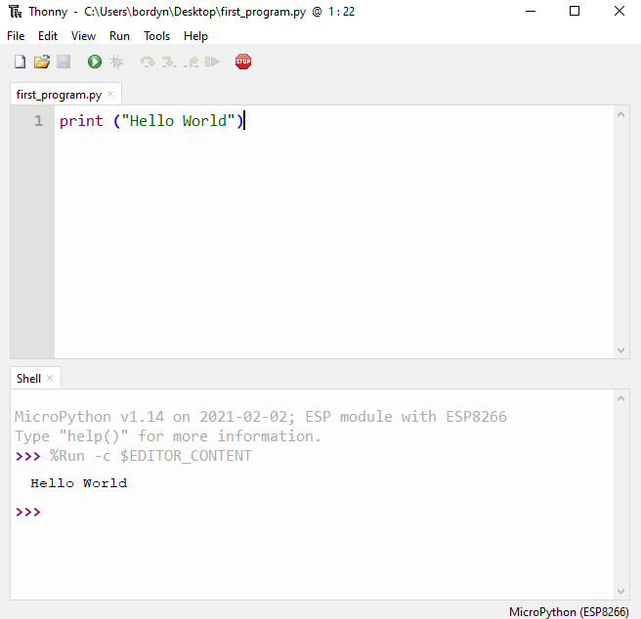
Workshop : Basic Test
run
First_program.py
The printing result will be shown below.

