Slide 1
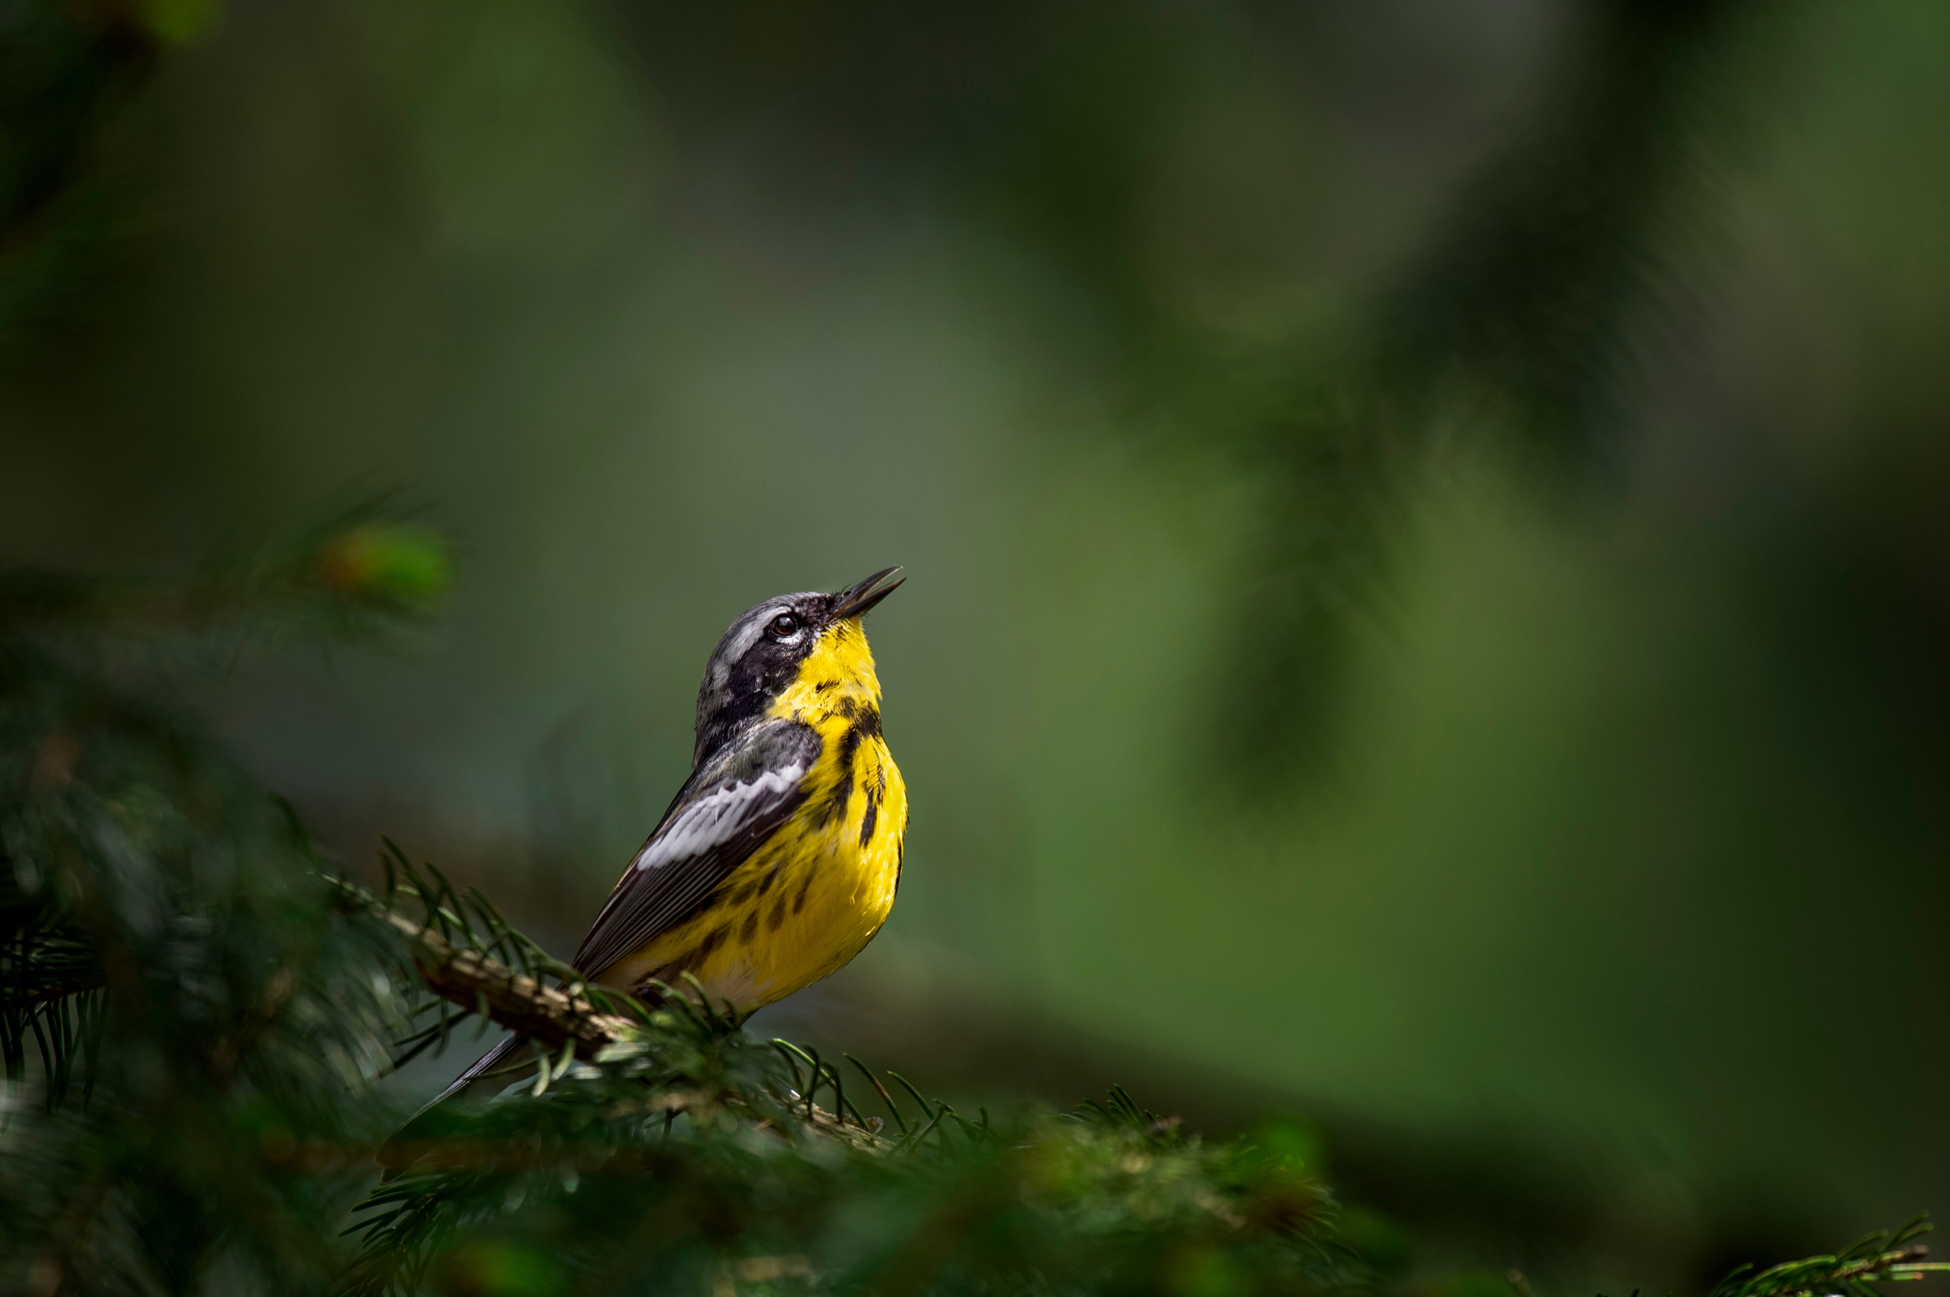
BAM Landbird Models Explorer

