Slide 1
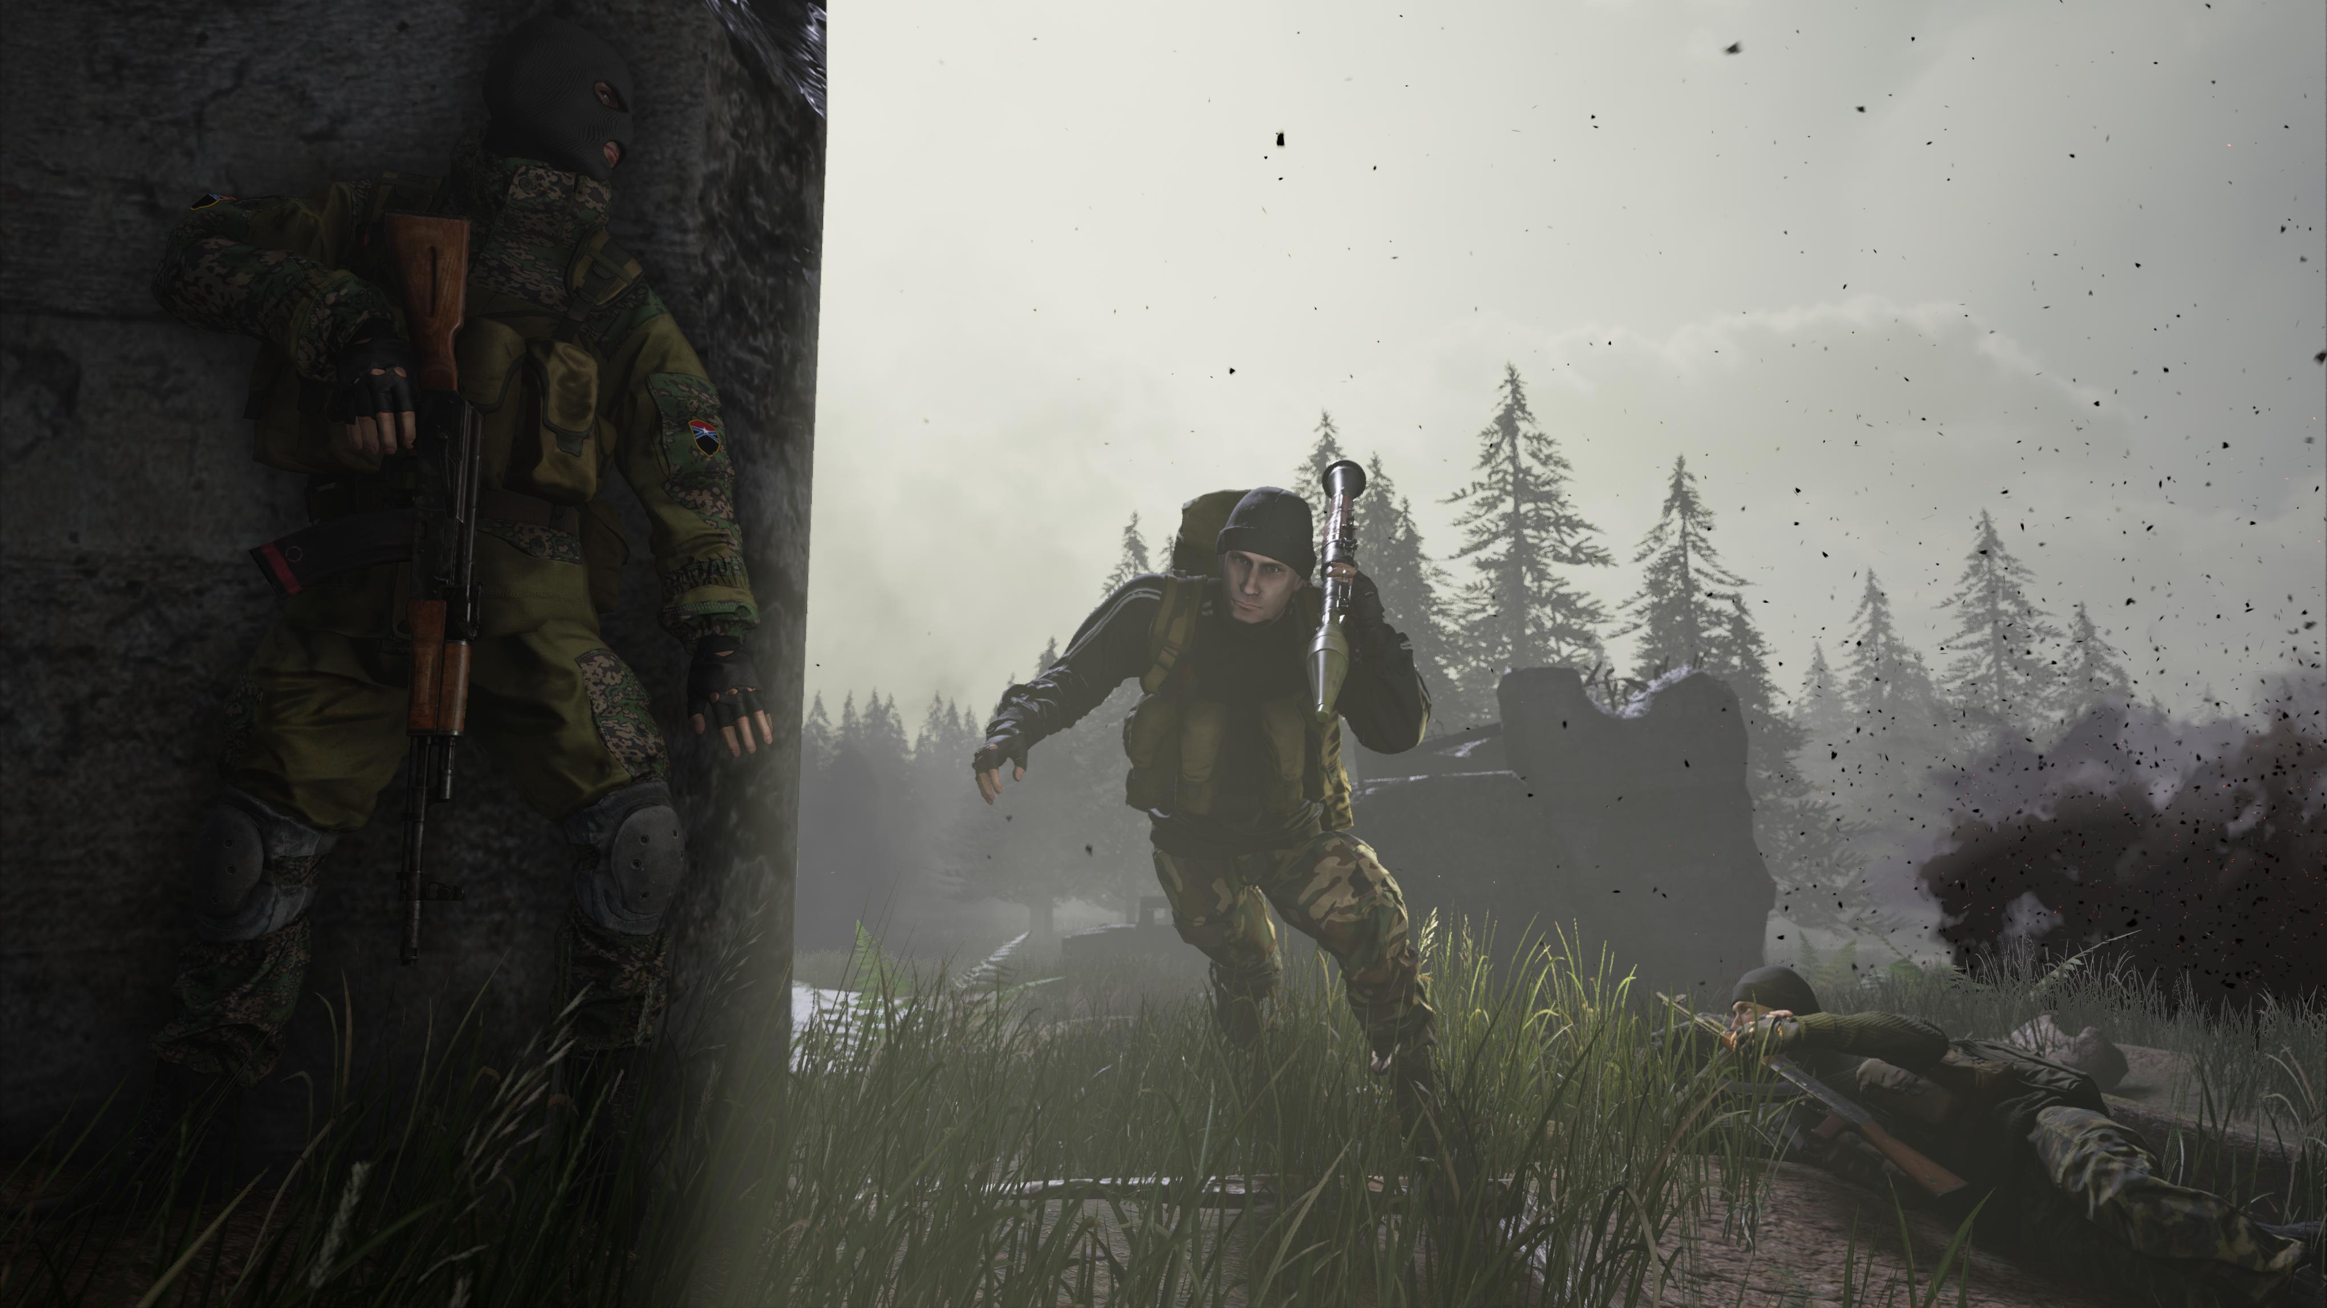
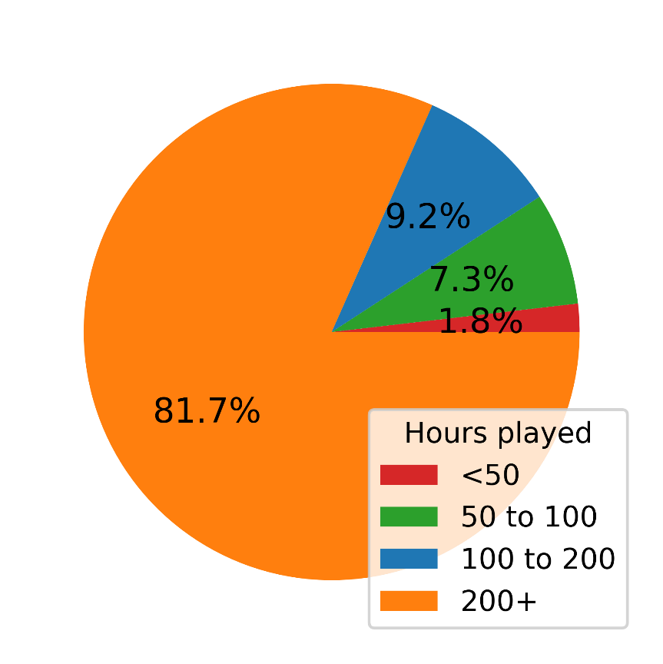
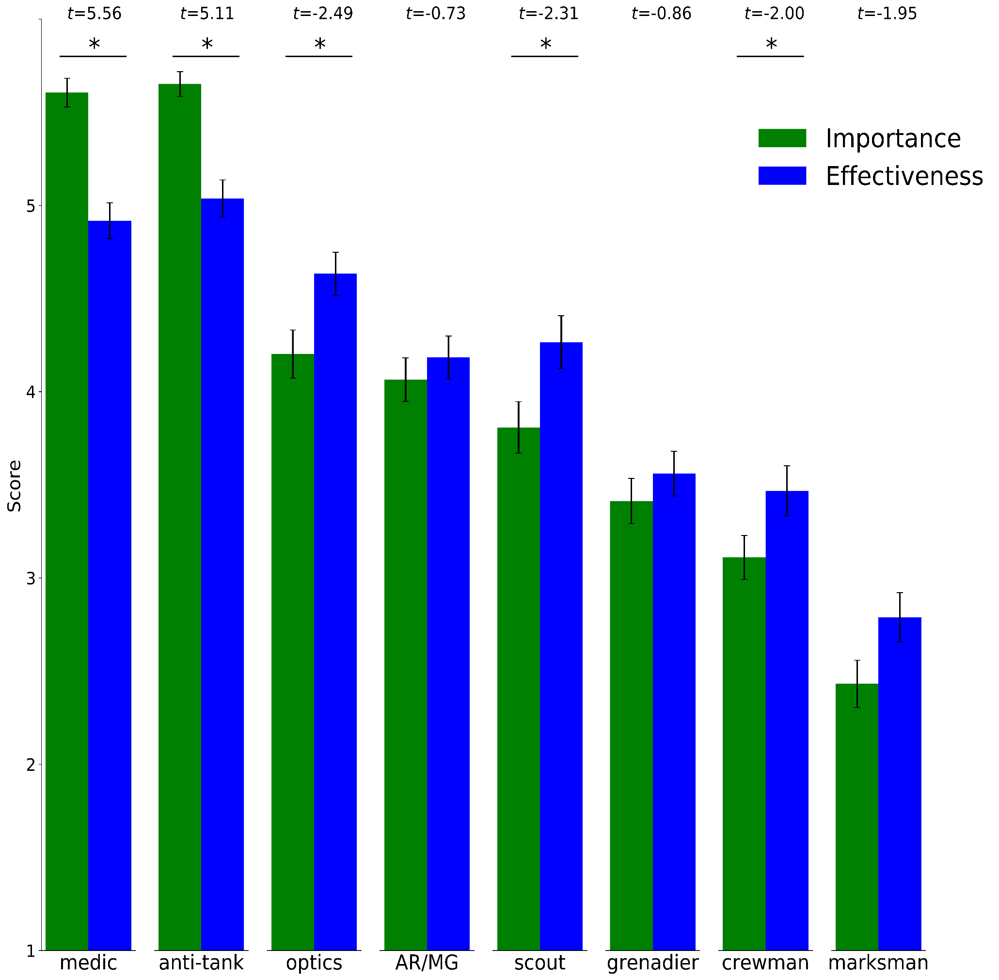
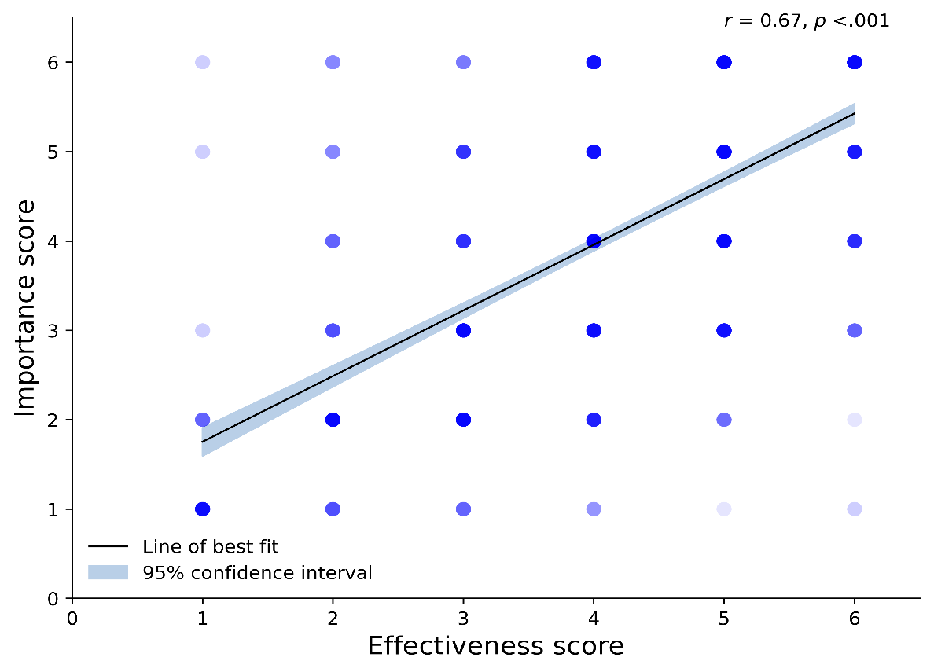
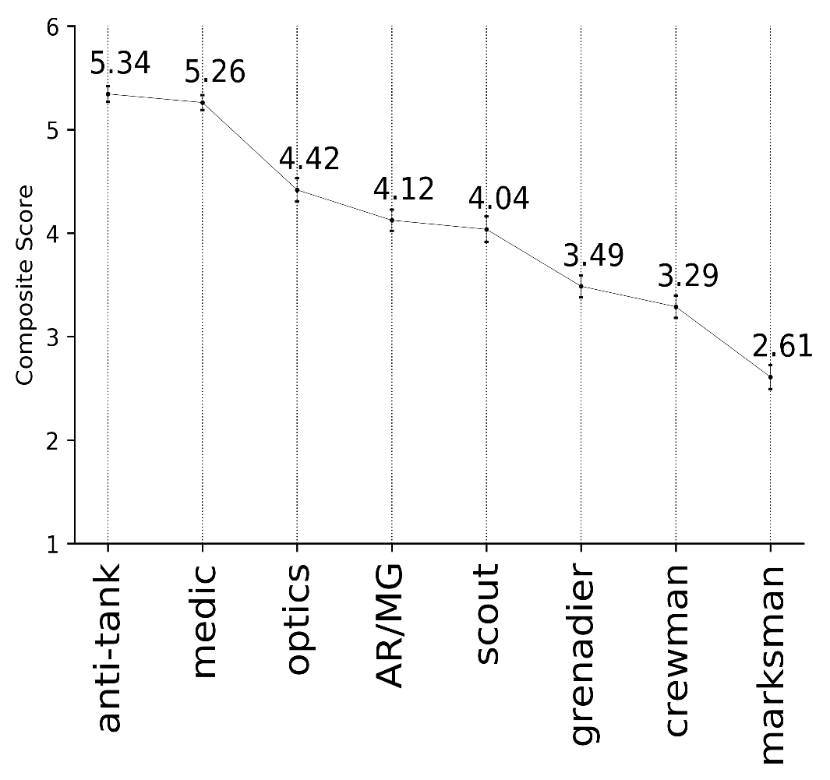
Survey Results – Squad Roles
Squad v11
Demographics (n = 109)
Mean construct scores
Survey Topic
On a scale from 1 to 6, rate the eight major squad roles on two constructs:
Importance
Effectiveness
using any criterion for any role.
*p < .05
Importance vs. effectiveness
Composite Scores
Acknowledgements
/r/joinsquad
Bella’s Battleground
/u/mrackham205

