Slide 1

Improve The Bw-tree - Epoch base Garbage Collection
2018008004 Kim Siwoo
ITE 4065: Concurrent Programming Fall 2022

Slide 2
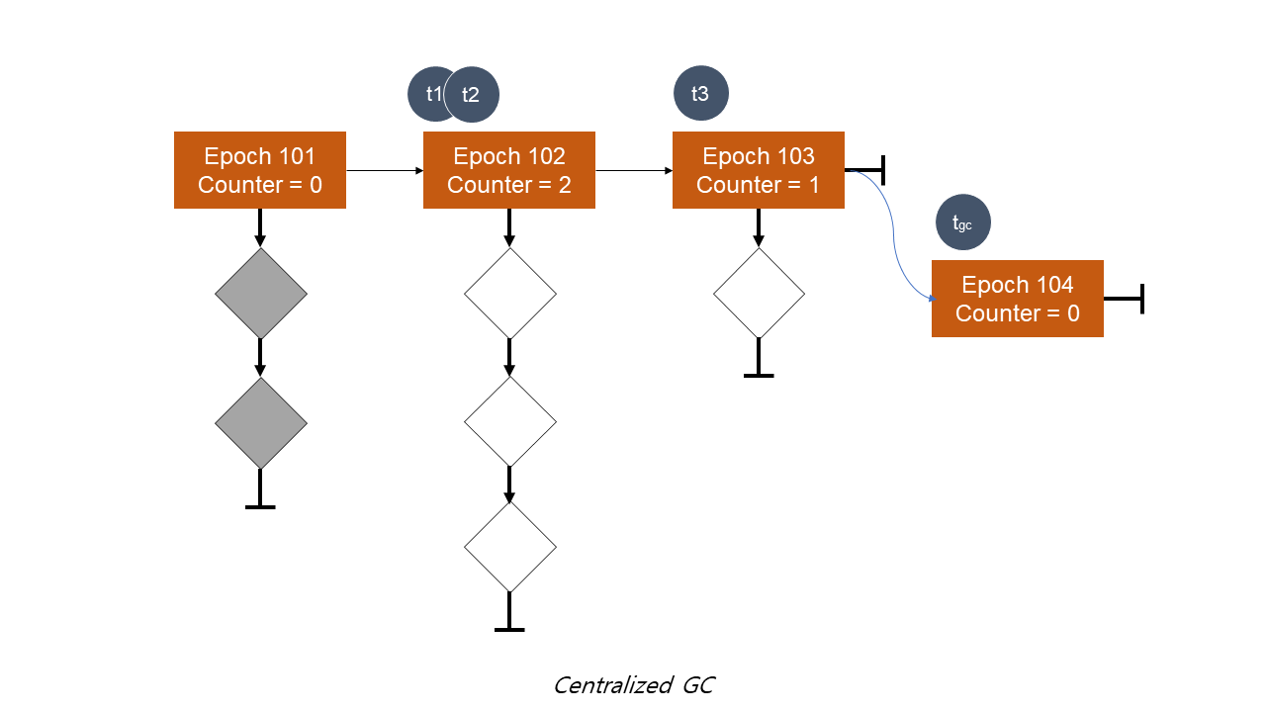
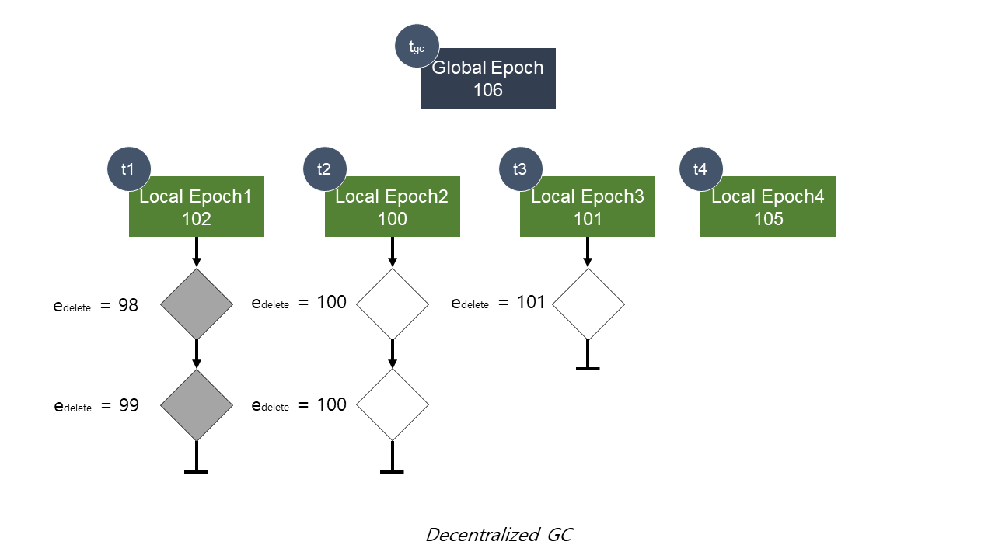
Centralized and Decentralized GC
ITE 4065: Concurrent Programming Fall 2022

Slide 3
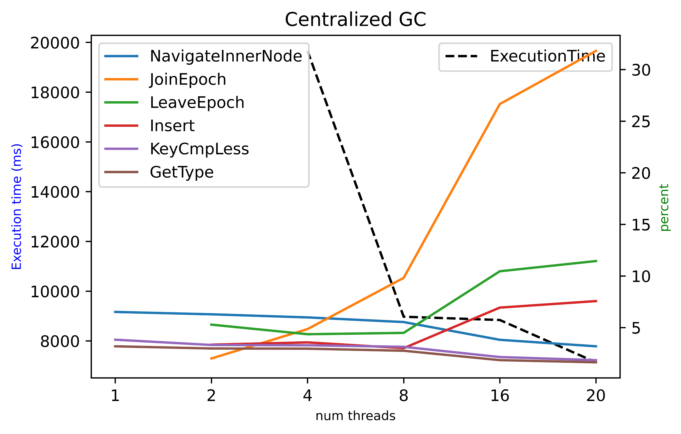
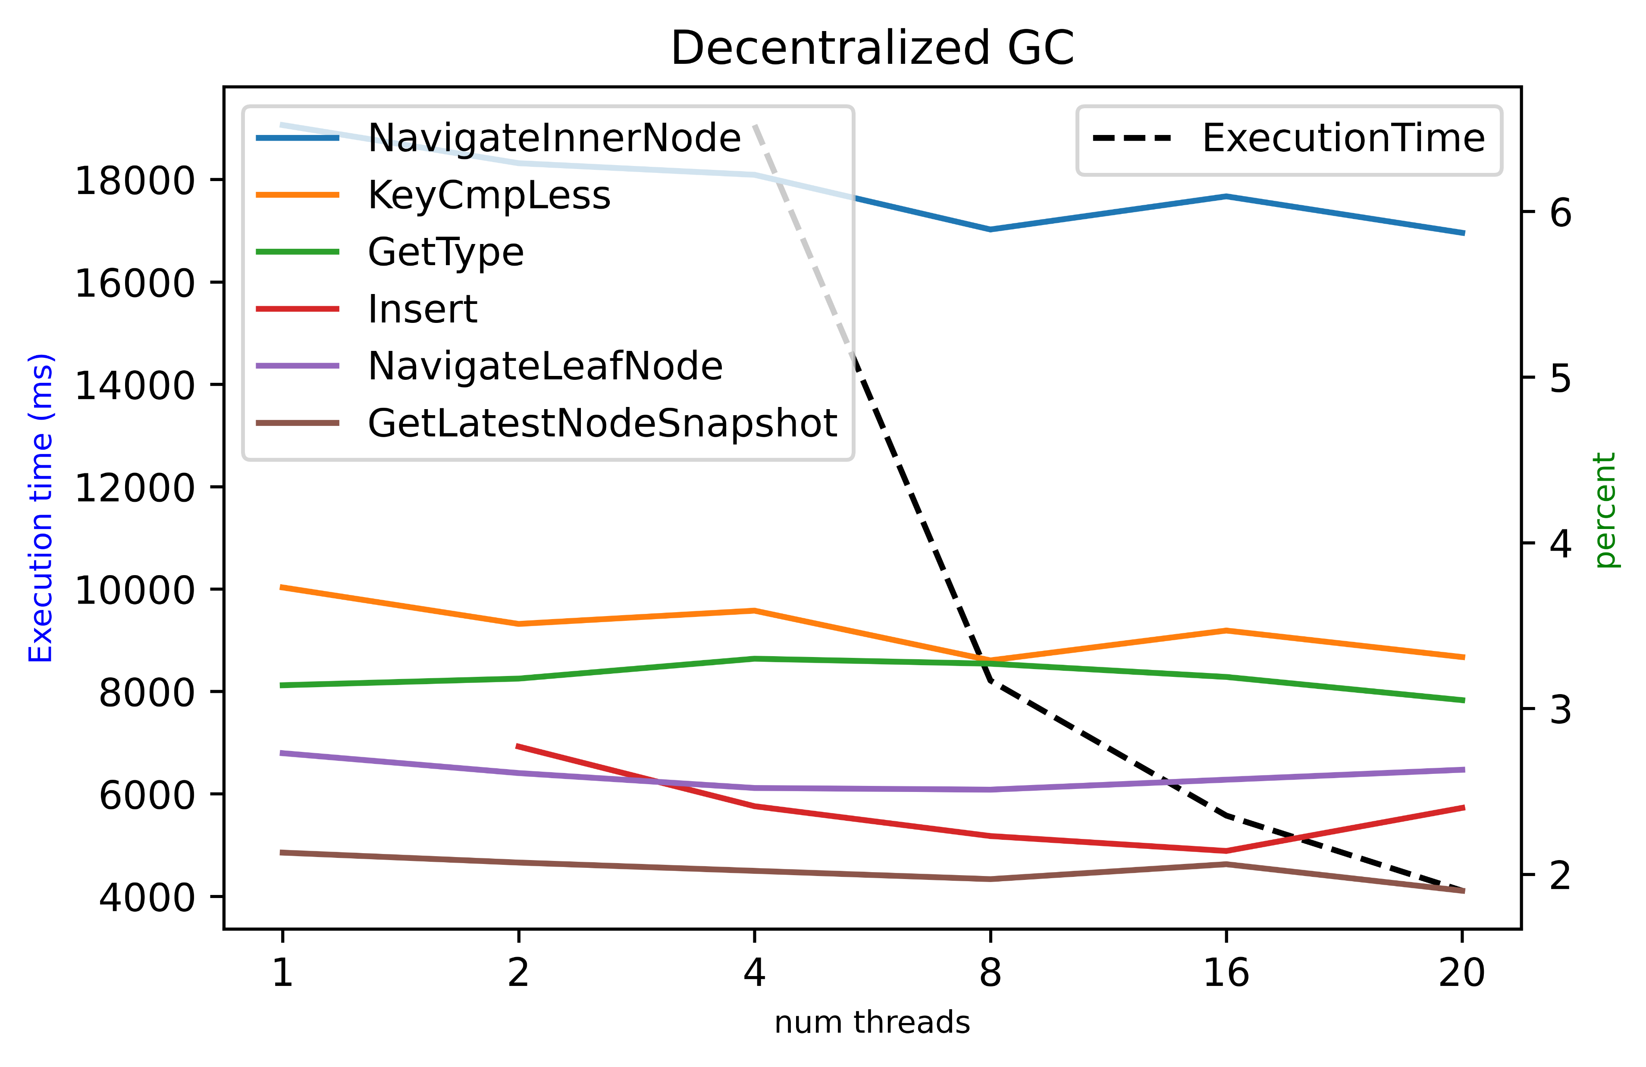
Performance Compare
ITE 4065: Concurrent Programming Fall 2022

Slide 4
Motivation
Global Epoch : 120
To perform GC, calculating minimum local epoch needs full scan.
T1
T2
T3
T4
Local epoch
Per thread
110
103
115
120
T1 Scan
ITE 4065: Concurrent Programming Fall 2022

Slide 5
Motivation
Global Epoch
107
My Expectation
tgc
e = 101
e = 102
e = 103
e = 104
e = 105
e = 106
e = 107
e = 108
e = 109
e = 110
t1
t2
t3
t4
Local Epoch1
102
Local Epoch2
105
Local Epoch3
104
Local Epoch4
107
ITE 4065: Concurrent Programming Fall 2022

Slide 6
Motivation
Global Epoch
107
Reality
tgc
e = 101
e = 102
e = 103
e = 104
e = 105
e = 106
e = 107
e = 108
e = 109
e = 110
t1
t2
t3
t4
Local Epoch1
107
Local Epoch2
107
Local Epoch3
107
Local Epoch4
107
ITE 4065: Concurrent Programming Fall 2022

Slide 7
Motivation
Global Epoch : 120
To perform GC, calculating minimum local epoch needs full scan.
Each threads read Global Epoch too much.
=> Let’s use Global min Epoch
T1
T2
T3
T4
Local epoch
Per thread
110
103
115
120
ITE 4065: Concurrent Programming Fall 2022

Slide 8
Overall Design
Global Epoch
106
Global Epochmin
105
tgc
t1
t2
t3
t4
Local Epoch1
106
Local Epoch2
106
Local Epoch3
106
Local Epoch4
105
ITE 4065: Concurrent Programming Fall 2022

Slide 9
Details
Global Epochmin
106
Woker Thread
Intention flag
GCMetadata
Global minimum epoch value
t1
Local Epoch1
106
ITE 4065: Concurrent Programming Fall 2022

Slide 10
Details, PerformGarbageCollection
Global Epoch
106
Global Epochmin
105
tgc
t1
t2
t3
t4
Local Epoch1
106
Local Epoch2
106
Local Epoch3
106
Local Epoch4
105
ITE 4065: Concurrent Programming Fall 2022

Slide 11
Details, PerformGarbageCollection
Increase Global Epoch
Global Epoch
107
Global Epochmin
105
tgc
t1
t2
t3
t4
Local Epoch1
106
Local Epoch2
106
Local Epoch3
106
Local Epoch4
105
ITE 4065: Concurrent Programming Fall 2022

Slide 12
Details, PerformGarbageCollection
min_val = 106
Global Epoch
107
Global Epochmin
105
tgc
t1
t2
t3
t4
Local Epoch1
106
Local Epoch2
106
Local Epoch3
106
Local Epoch4
105
ITE 4065: Concurrent Programming Fall 2022

Slide 13
Details, PerformGarbageCollection
min_val = 106
Global Epoch
107
Global Epochmin
105
tgc
t1
t2
t3
t4
Local Epoch1
106
Local Epoch2
106
Local Epoch3
106
Local Epoch4
105
ITE 4065: Concurrent Programming Fall 2022

Slide 14
Details, PerformGarbageCollection
min_val = 106
Global Epoch
107
Global Epochmin
105
tgc
t1
t2
t3
t4
Local Epoch1
106
Local Epoch2
106
Local Epoch3
106
Local Epoch4
105
ITE 4065: Concurrent Programming Fall 2022

Slide 15
Details, PerformGarbageCollection
min_val = 105
Global Epoch
107
Global Epochmin
105
tgc
t1
t2
t3
t4
Local Epoch1
106
Local Epoch2
106
Local Epoch3
106
Local Epoch4
105
ITE 4065: Concurrent Programming Fall 2022

Slide 16
Details, PerformGarbageCollection
min_val = 105
Global Epoch
107
Global Epochmin
105
tgc
t1
t2
t3
t4
Local Epoch1
106
Local Epoch2
106
Local Epoch3
106
Local Epoch4
105
ITE 4065: Concurrent Programming Fall 2022

Slide 17
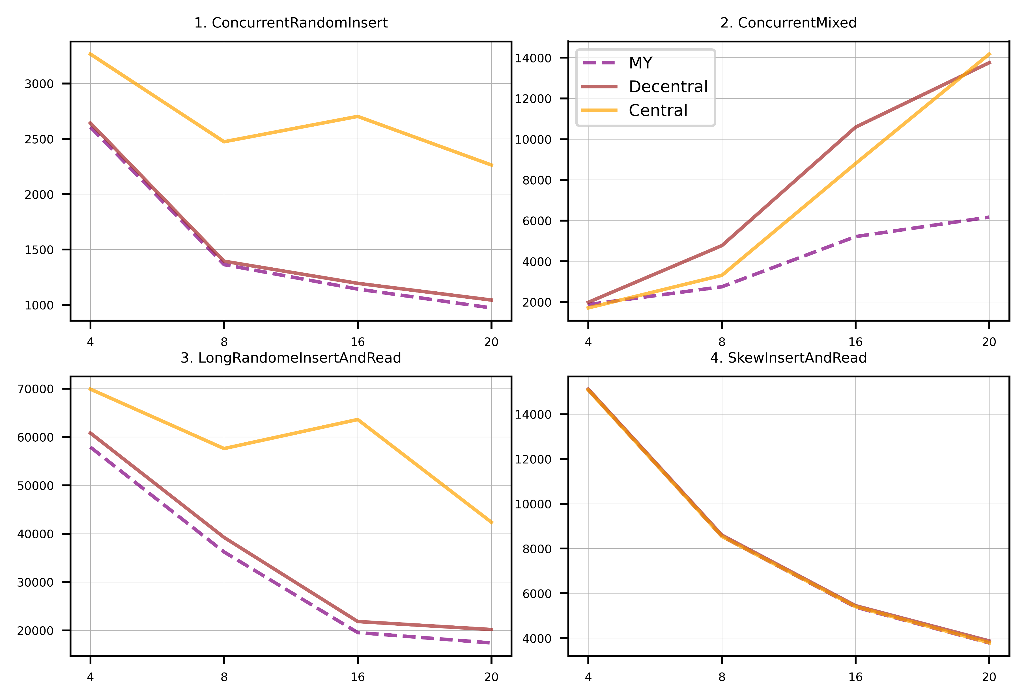
Evaluation, result
1M insert, read for validation
1M insert & 1M delete, read for validation
8M insert & read, read for validation
64K insert, read for validation. Zipf with alpha = 1
ITE 4065: Concurrent Programming Fall 2022

Slide 18
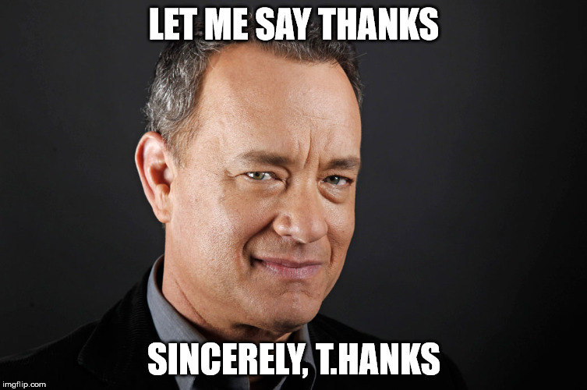
Thank you!
ITE 4065: Concurrent Programming Fall 2022

