Slide 2
7x7 = 49
7
7

Slide 3
9x6 = 54
9
6

Slide 4
7x6 = 42
7
6

Slide 5
7x8 = 56
7
8
7

Slide 6
8x7 = 56
7
8

Slide 7
8x8 = 64
8
8

Slide 8
8x9 = 72
8
9

Slide 9
9x8 = 72
8
9

Slide 10
7x9 = 63
7
9

Slide 11
8x9 = 72
8
9

Slide 12
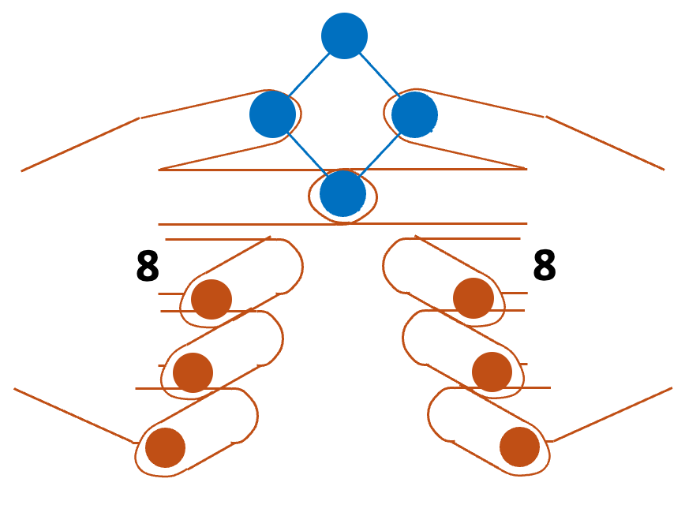
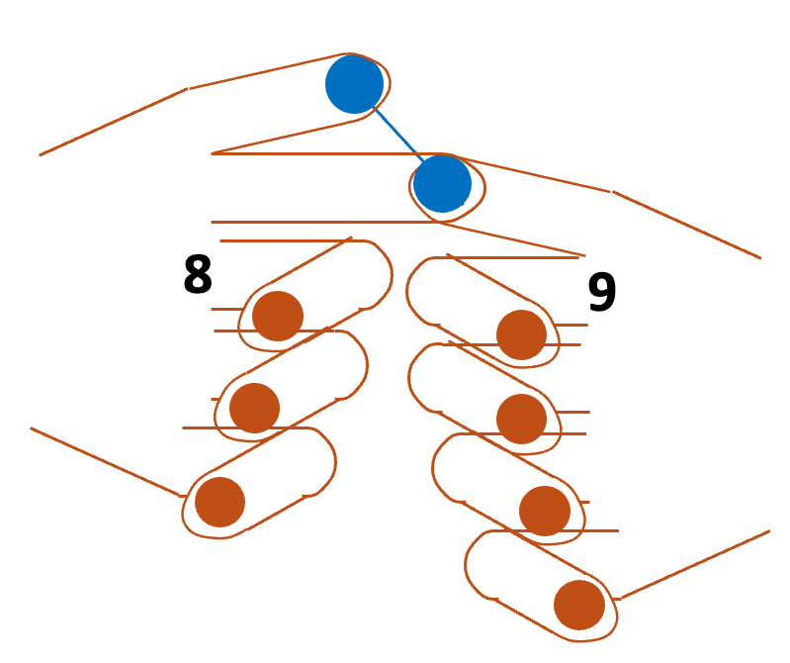
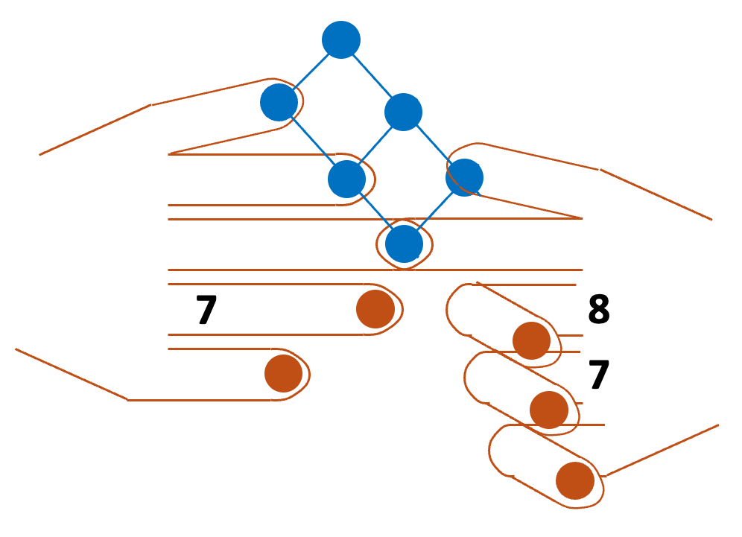
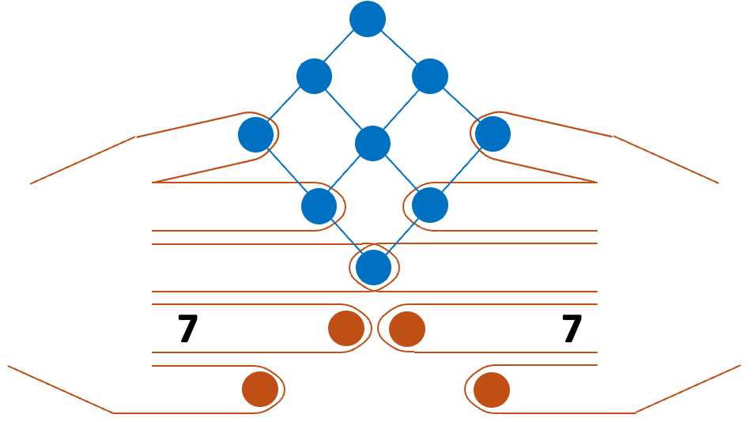
8 x 8 =
8 x 9 =
7 x 8 =
7 x 7 =

Slide 13
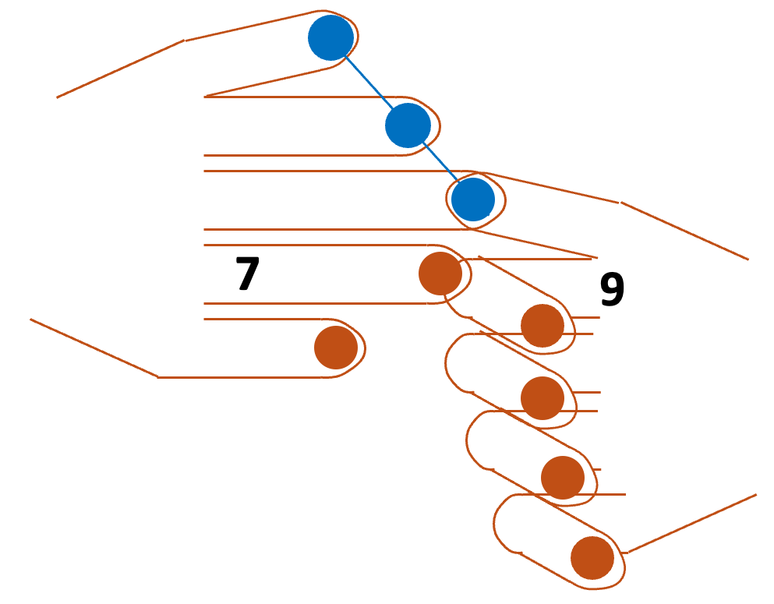
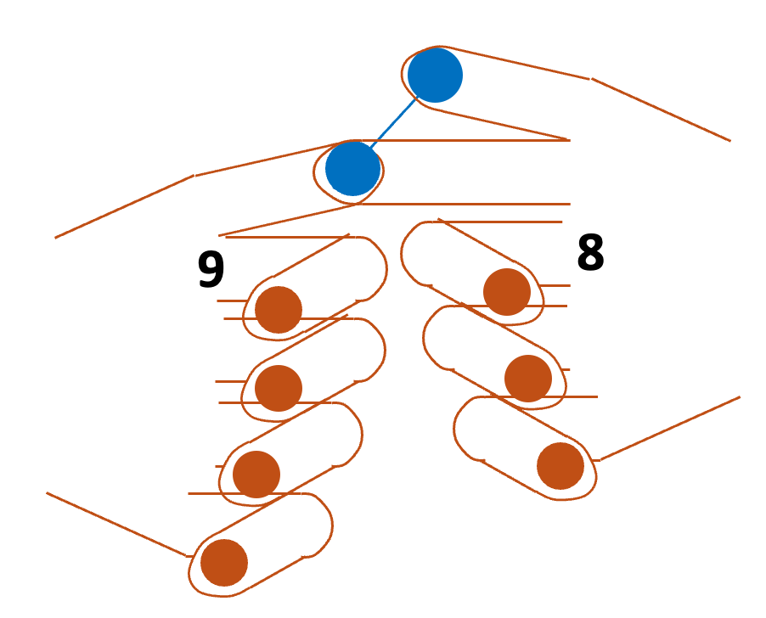
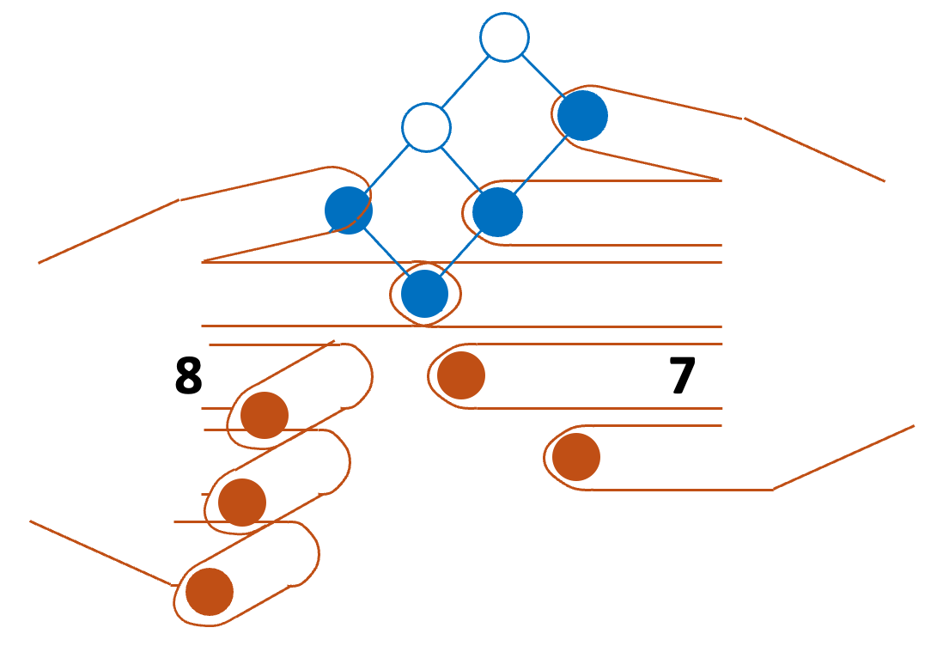
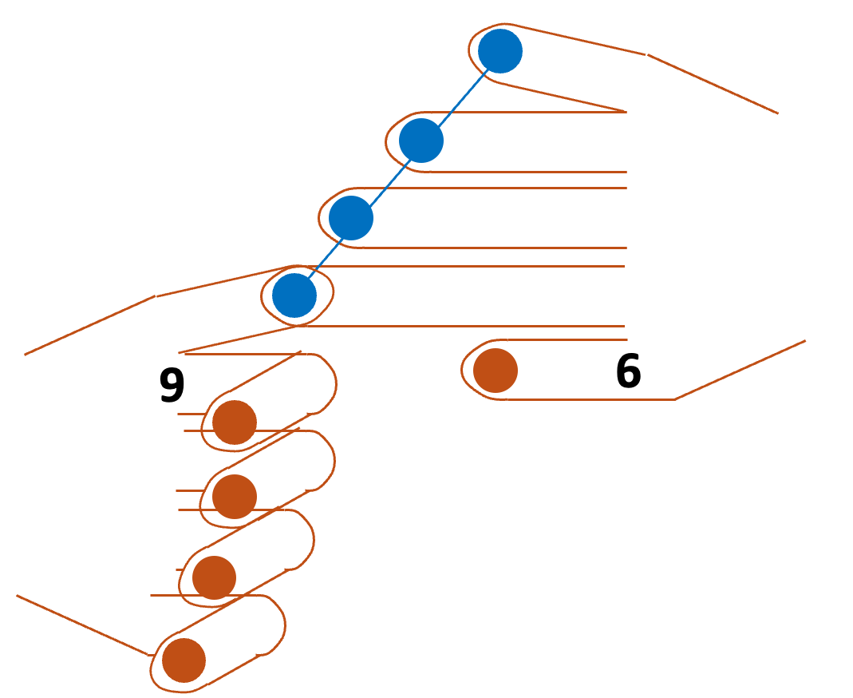
7 x 9 =
9 x 8 =
8 x 7 =
9 x 6 =

Slide 14
7x8 = 56
7
8

Slide 15
Backup

