Slide 1
Network Infrastructure & Services: Dublin Pharmaceutical Limited
BRUNO FERREIRA BORGES
STUDENT ID: 2020084

Slide 2
Planning
• Waterfall Method
• Team Gantt platform

Slide 3
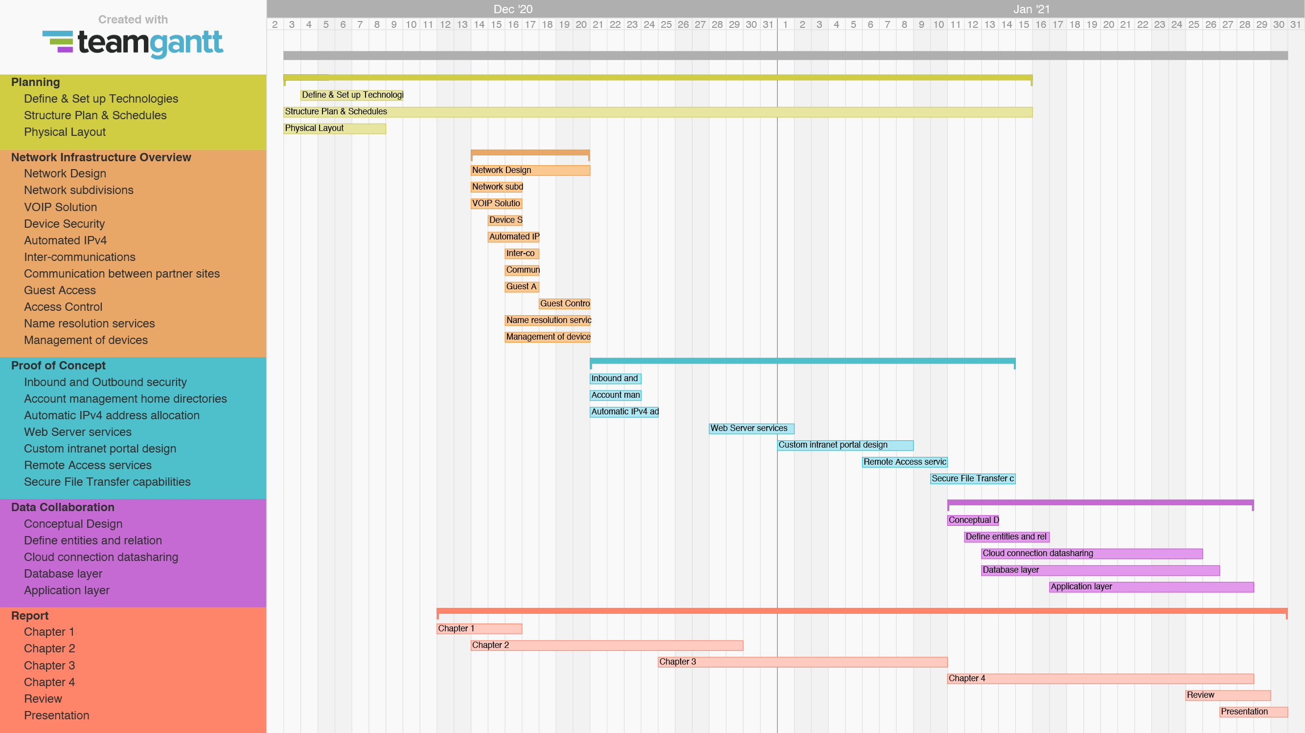

Slide 4
Project overview
Network emulation
Cisco Packet Tracer
• Design
• Configuration

Slide 5
Project overview
Network services
Virtualization Zentyal:
• Network services
VirtualBox:
• Linux and Windows VM’s
• Network (NAT and internal)

Slide 6
Project overview
Data Collaboration
Google Cloud
Network & Security
Virtual Machines
MongoDB
Database
JavaScript
Front-end and back-end for intranet portal

Slide 7
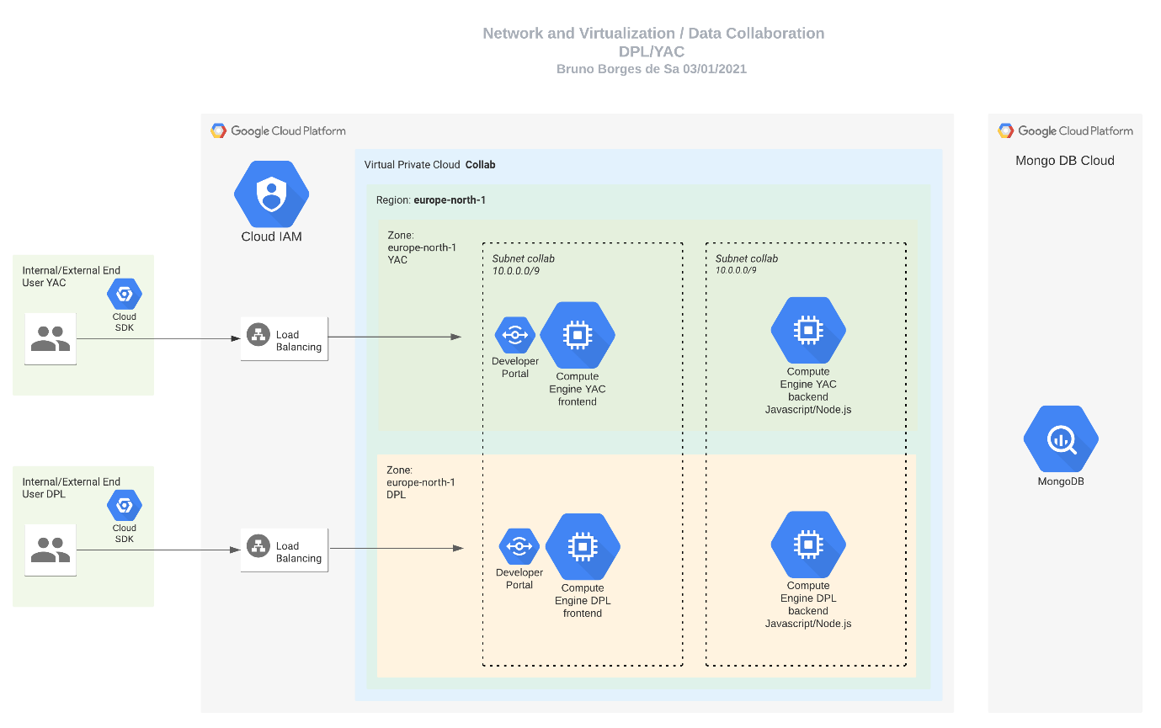

Slide 8
Thank you!

