Slide 1
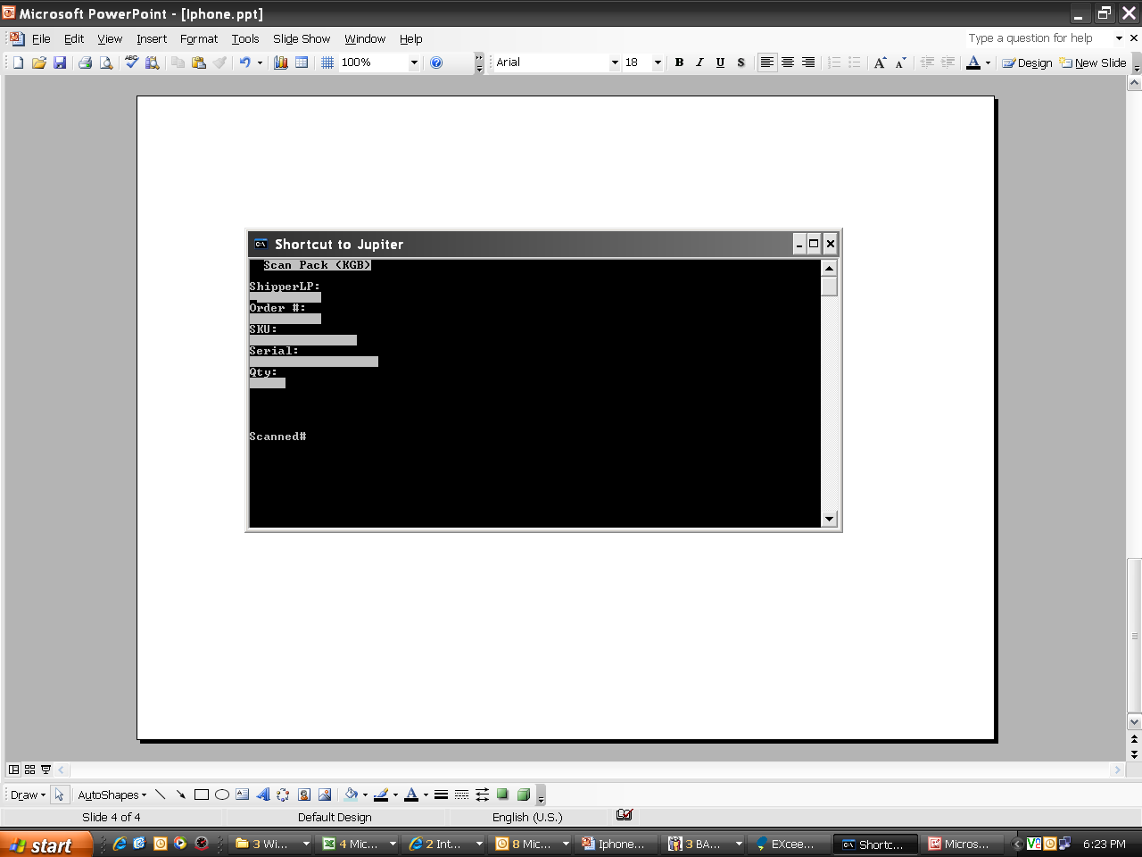
Current scan pack for normal Iphone KGB DN order is one unit and scan serial # require. For seed stock DN,operator need to scan every single serial # on the physical part/OEM overpack serial # with 1D RF scanner.

Slide 2
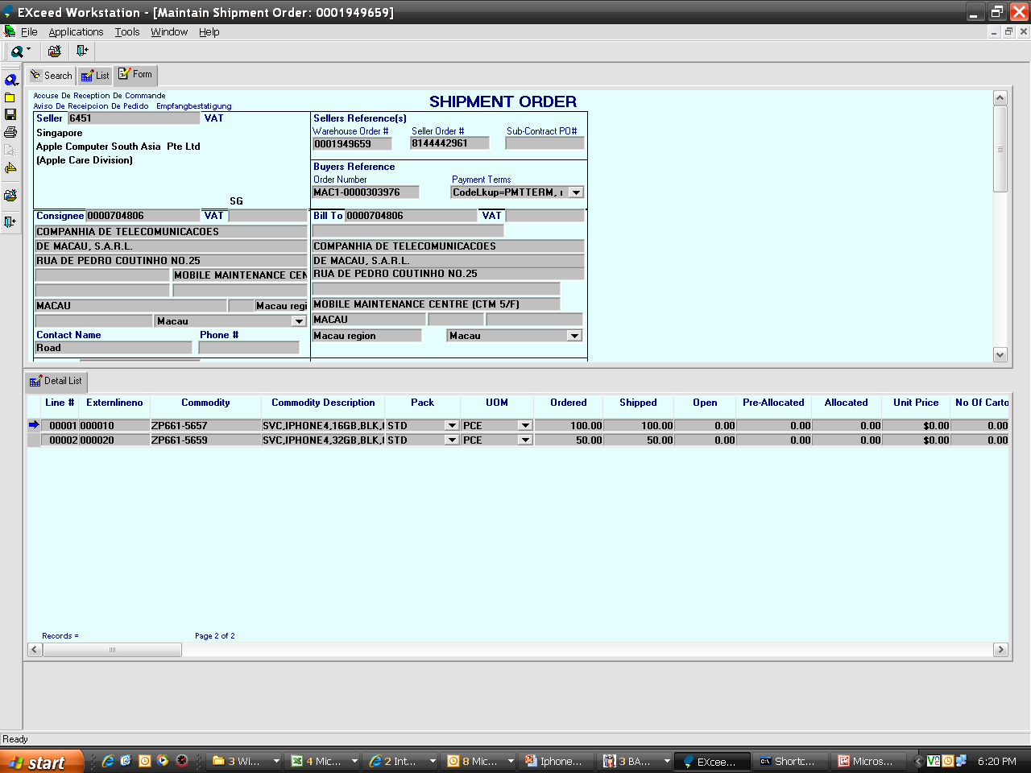
KGB Seed Stock DN consists of one line # to many units . Sample of DN .

Slide 3
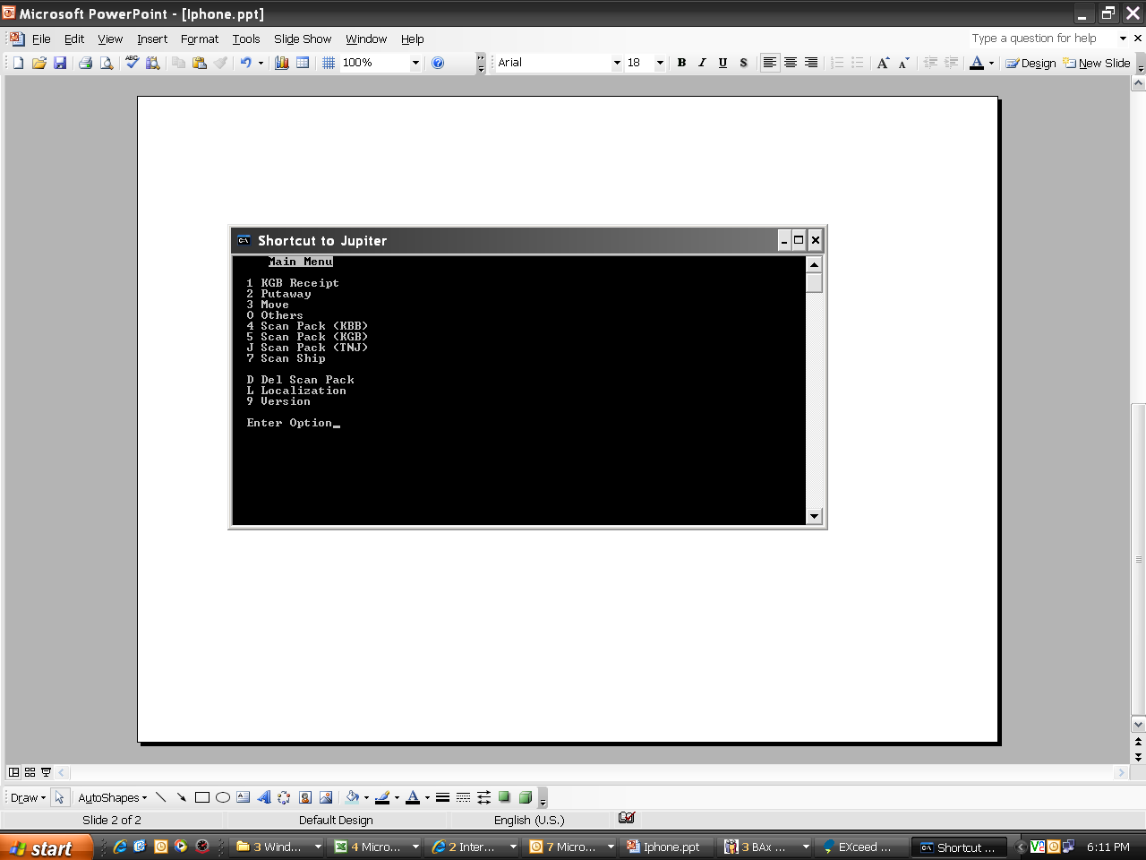
Additional RF function/program required for Iphone 2D RF KGB bulk scan pack,per one scan to capture 10 serial # .

Slide 4
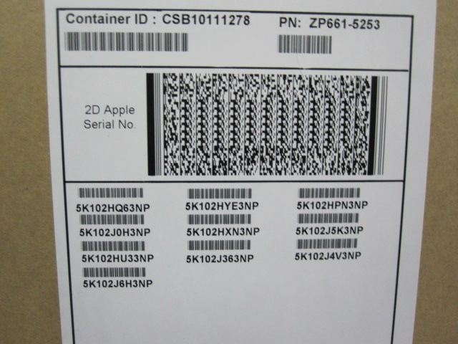
Iphone overpack 2D barcode
S5K102HQ63NP,S5K102HYE3NP,S5K102HPN3NP,S5K102J0H3NP,S5K102HXN3NP,S5K102J5K3NP,S5K102HU33NP,S5K102J363NP,S5K102J4V3NP,S5K102J6H3NP
Sample scan for the 2D barcode .

