Slide 1
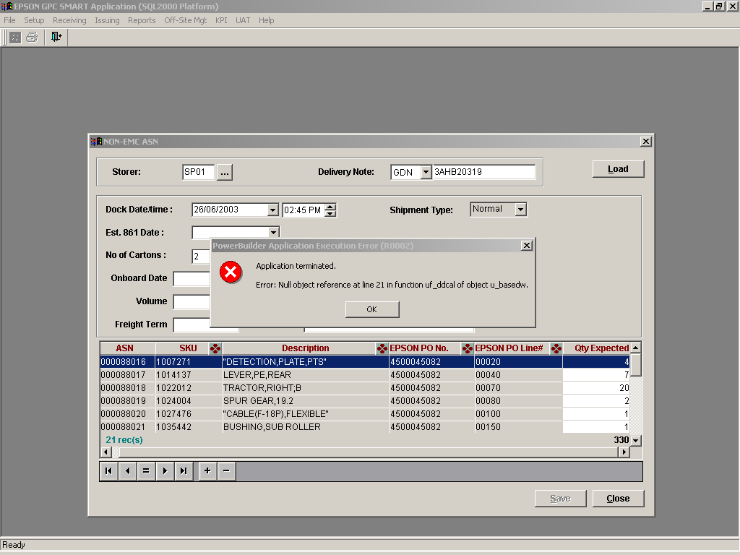
Found system prompt error message, when clicking on “EST. 861 DATE”

Slide 2
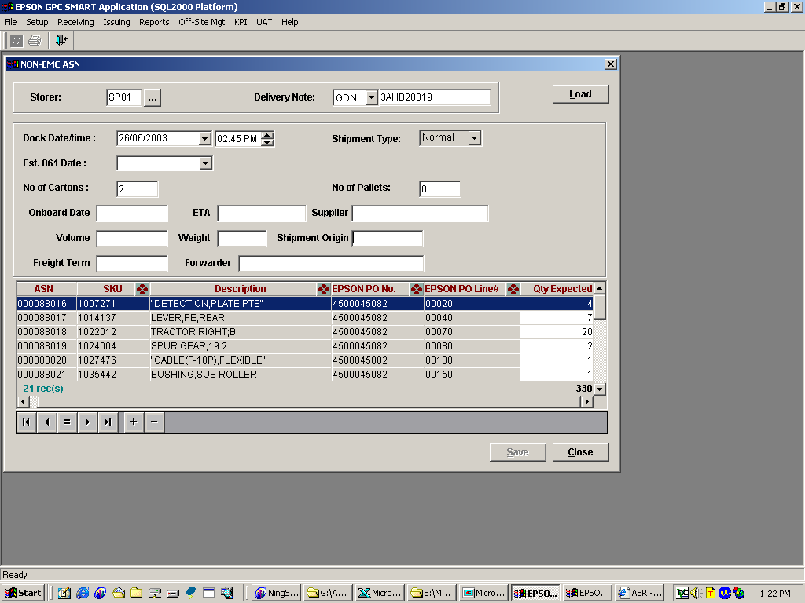
Change it to “Gross Weight(KG)”
Add: Change it as “Net Weight(KG)”
Add: REMARKS: (Free text, editable)
Add: Print

Slide 3
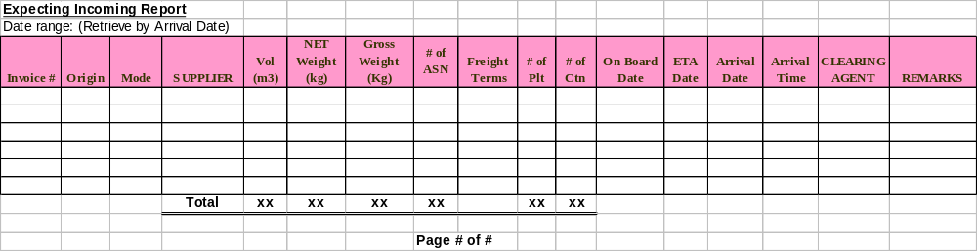
Additional requirement:
**Note: Allow user to print, save it into EXCEL & perform sorting.
**Report retrieval argument: by arrival date.

