Slide 1
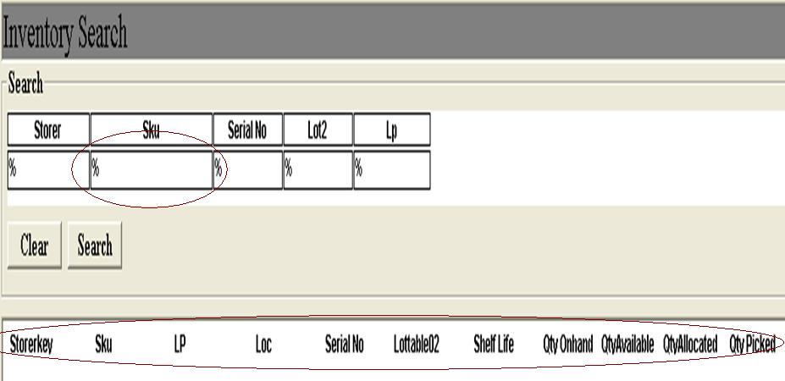
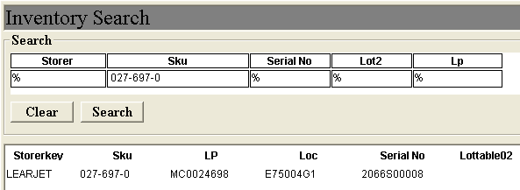
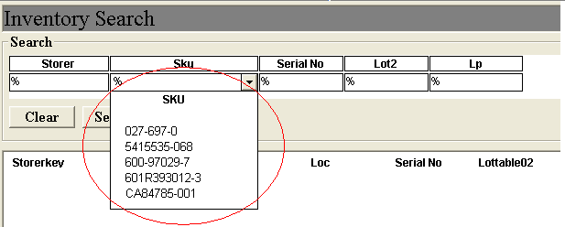
Unable to copy details
Unable to copy details
Unable to make direct and complete entries of the part number.
Also, Ops is unable to copy/paste the details of the search results.
Lastly, search options to include location and ID instead of LP

