Slide 1
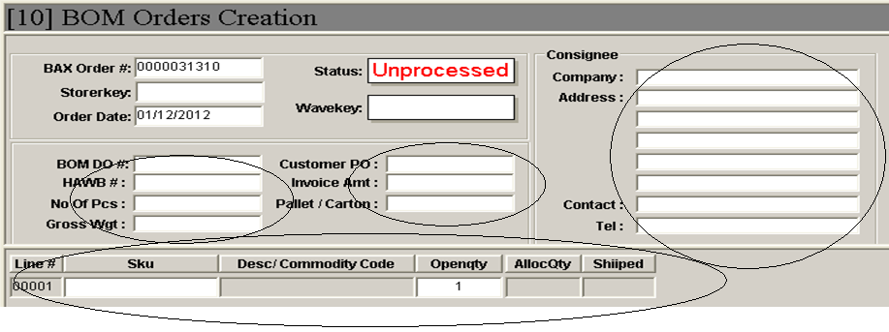
While performing order creating, details entered are not all being printed for DN and pickticket.
Rubber stamps are used on DN/picktickets to differentiate the service level and shipment cargo details are always hand-written.
There were also no indications on the DN and Pickticket for forwarder to acknowledge.
Lastly, Ops are unable to allocate stock using LP.

Slide 2
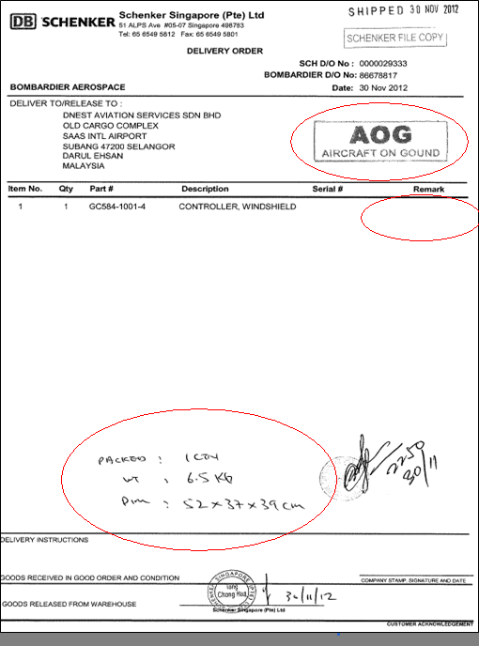
Delivery Order
While performing order creating, details entered are not all being printed for DN and pickticket.
Rubber stamps are used on DN/picktickets to differentiate the service level and shipment cargo details are always hand-written.
Lastly, Ops are unable to allocate stock using LP.
Ops required the below enhancements.
Service level options for Ops to select and to have it printed.
Cargo details such as number of carton boxes, dimensions and per carton box weight and total weight.
Able to select the LP for allocations.
Change the address of shipper to unit #05-06.

Slide 3
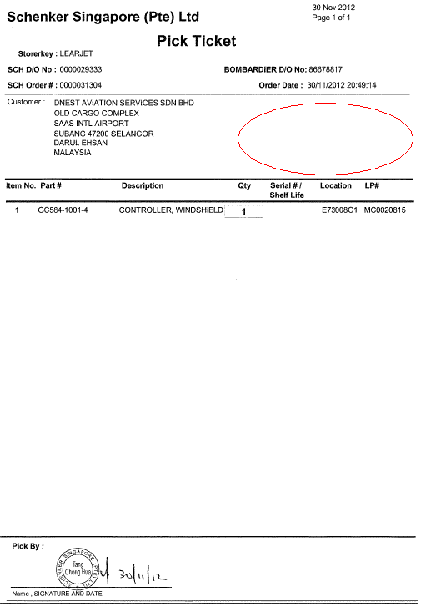
Pickticket
Ops required the below enhancements.
Service level options for Ops to select and to have it printed.
Change the address of shipper to unit #05-06.

