Slide 1
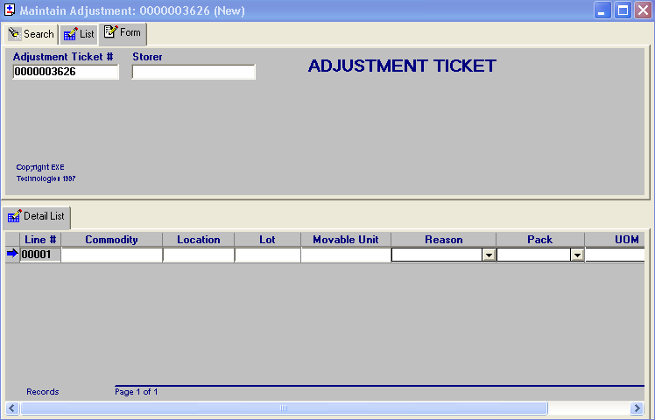
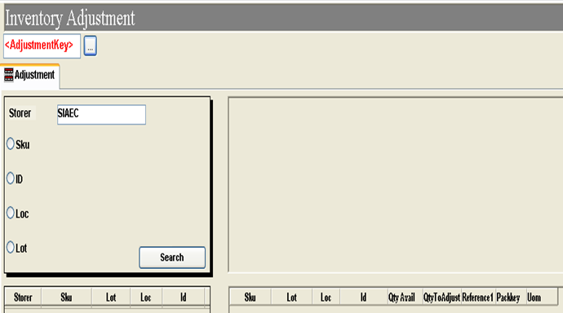
From 1st screenshot, adjustment of inventory can only be carried out in Exceed.
Add in the function of adjustment to the Bombardier Hub, similar to SIAEC program.

