Slide 1
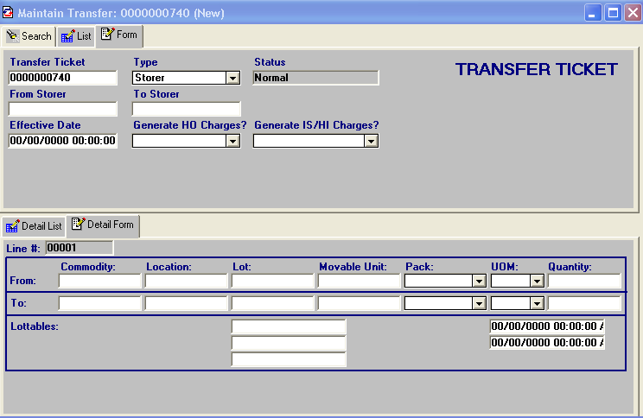
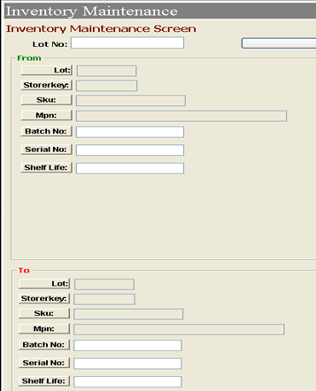
AEROMC Exceed
SIAEC Hub
Function on Amendments of wrong inputs of SN and Shelf-Life are not available in Bombardier Hub.
Currently, even in Exceed, Ops do not know how to perform the changes.
Proposing to allow only administrators / super users to perform such amendments.
And also to enhance to generate reports on amendments.

