Slide 1
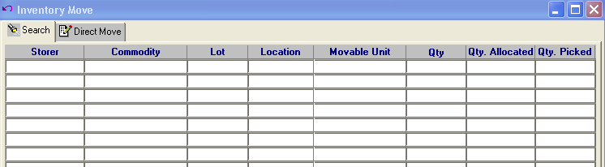
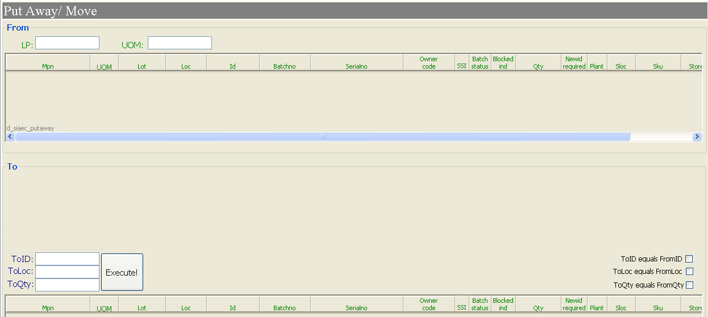
Putaway/Move function is not available in Bombardier Hub.
Currently, Ops is using Exceed to perform putaway / move as shown in first picture.
Proposing to include the function in Hub and to be similar to SIAEC program as shown in second picture.

