Slide 1
Welcome to LABC

Slide 2
LABC - administration
Teacher:
Eran Marom
TA:
Eva Kimel
Tsar:
Ohad Cohen
Lab support
Contact us ONLY via labc@cs
Website: www.cs.huji.ac.il/~labc

Slide 3
A few points about the exercises
YOU need to debug your code
Not all tests will be published
Run on school computers
Organize your time
Pre-submission script
Start with it
Design and style
No appeal bonus

Slide 4
Tirgul 1 - Agenda
Basic syntax
Primitive types
Expressions and operators
Basic Compilation

Slide 5
C and Java
Basic Types are similar to JAVA
int, double, char, …
Basic flow-control is similar –
if (condition) {… }
for (start; condition; increment){… }
while (condition) {… }
etc…
No Classes!
no methods, no packages….
No exceptions
programs usually simply crash!

Slide 6
Types
C is a “statically-typed language”
The compiler must know the type of each variable at compile-time.
The variable type determine:
Its size
Its internal representation – the exact bit pattern.
The operators that can be used with it.
Part of the above is defined by the C standard, while part of it is implementation dependent.

Slide 7
Variables types in C
Simple types:
Arithmetic types
Pointers
Enumeration types
Aggregate types:
Arrays
Structs
User can define new types (e.g. structs)
User can define new names for each type
and use ‘typedef’ to make things nicer

Slide 8
Arithmetic data types
Arithmetic data types are similar to JAVA:
Integral types:
char
int
short
long
Floating-point types:
float
double
However, unlike in JAVA, the types sizes are machine dependant!

Slide 9
Memory – few definitions
Bit – a binary digit - zero or one
Byte – 8 bits
Not C specific
0/1
0/1
0/1
0/1
0/1
0/1
0/1
0/1
0/1

Slide 10
Integral data types
Size rules (C’s standard):
Size of char = 1 byte (by definition, also if 1 byte != 8 bits).
Size of short ≤ size of int ≤ size of long

Slide 11
Undetermined type sizes
Advantage:
hardware support for arithmetic operations
Disadvantage:
problems with porting codes from one machine to another
Knowing type size is important
Watch overflow!
For dynamic memory allocation

Slide 12
The sizeof() operator
The operator sizeof (type) returns the size of the type.
It is evaluated at compile time!
Example:
printf("%lu", sizeof(char)); //charSize == 1

Slide 13
signed VS. unsigned
Each type could be signed (represent both negative and positive numbers) or unsigned (only positive numbers).
Examples:
int negNum = -3;
int posNum = 3;
unsinged int posNum = 3;
unsinged int posNum = -3;
// this would result in implicit conversion

Slide 14
Integers internal representation
unsigned integers types are represented with the binary representation of the number they stand for.
The representation range therefore is: [0,2^{x}-1] ,
Where x is the size in bits of the type.
For example, if sizeof(unsigned short) == 2 unsigned short: [0,2¹⁶-1]

Slide 15
Integers binary representation
The exact representation of signed integers types is machine dependant.
The most popular representation is, the two-complement representation (will be explained in DIGICOMP).
The representation will cause different behavior in case of overflow and conversions.
The representation range is: [-2^{x-1},2^{x-1}-1] ,
Where x is the size in bits of the type.
For example, if sizeof(short) == 2
signed short: [-2¹⁵,2¹⁵-1]

Slide 16
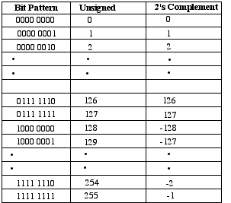
Integers binary representation (the two-complement representation)
Notes:
http://academic.evergreen.edu/projects/biophysics/technotes/program/2s_comp.htm

Slide 17
Integers binary representation
short num = -1;
printf("%u",num);
The output on the cs school machines is: 65535
What happened?
-1 -> 11111111 11111111(signed short representation).
1111111...1->65535 when interpreted as unsigned short.

Slide 18
Integral types - characters
chars can represent small integers or a character code.
Examples:
char c = ‘A’;
char c = 65;

Slide 19
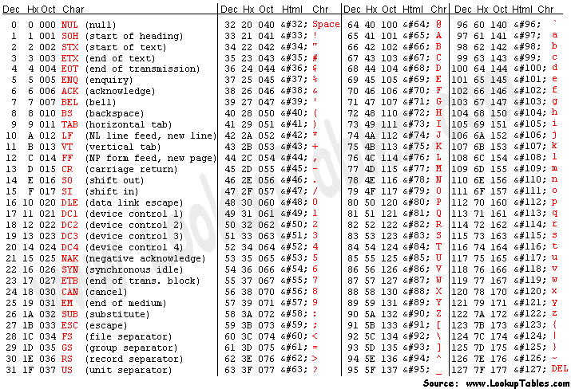
ascii table

Slide 20
Arithmetics with character variables
char ch = 'A';
printf("The character %c has the ASCII code %d.\n", ch, ch);
for ( ; ch <= 'Z'; ch++ )
{ printf("%c", ch);
}

Slide 21
Characters input and output
#include <stdio.h> int main () { char c; puts ("Enter character:"); c=getchar(); puts ("You entered:"); putchar (c); return 0; }

Slide 22
Floating Point troubles
float f;
for (f=0;f<20000000;f+=0.001);
This code will not stop. Why?
You will learn about it in digicomp, but:
Floating point numbers have adaptive "resolution" - when dealing with large numbers small numbers are insagnificant, and discarded: 1*2⁵⁰+1*2⁻⁵⁰ == 1*2⁵⁰.
The resoultion of a float is about 7 digits, and of double is about 15.
=> Don't do any calculations / comparisons that involve floating point numbers of different magnitude
A bit more in your HW

Slide 23
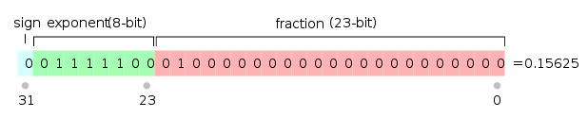
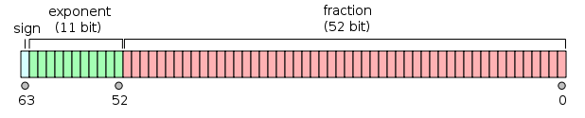
Floating point representation
Unspecified by C standard.
On most systems – IEEE-754.
float:
double:
See nice explanation here: http://steve.hollasch.net/cgindex/coding/ieeefloat.html
Notes:
http://www.cprogramming.com/tutorial/floating_point/understanding_floating_point_representation.html

Slide 24
Casting and Type Conversion
Casting possible between all primitive types.
Casting up - usually automatic:
float => double
short => int => long etc.
int i;
short s;
long l;
i=s; // no problem
l=i; // no problem
s=l; // might lose info,
// warning not guaranteed

Slide 25
Integer division
Mathematical operators on (only) int operands
The result is int
Integer numbers are treated as “int”
float f=1/3; //0 float f=1/3.0; //0.3333..
float f=(float)1/3; //0.3333..

Slide 26
Expressions as Values
Will we enter the if statement?
We probably meant “i==5” on line 2
Completely legal!
int i=0; if (i=5) { printf("hello\n"); }

Slide 27
Expressions as Values
&& - logical “and”, & - bitwise “and”
|| - logical “or”, | - bitwise “or”
int i=0; if (i==1 && x=isValid()) { … }
Might not be evaluated

Slide 28
Basic Compilation
Consider we have to compile the file hello.c:
gcc -Wextra –c hello.c Creates an object file called hello.o
hello.c
tmpXQ.i
(C code)
Preprocessor
Compiler
stdio.h
hello.o
(object file)

Slide 29
Linking
Combines object file with external references into an fully executable file, with no unresolved references
gcc hello.o –o hello
hello.c
hello.o
hello
libc.a
Preprocessor,
Compiler
Linker
Notes:
Actually a library (.a) is just a collection of object (.o) files chained together to one file.
Compiling and linking can be combined into one command (supply the c file as an input, and use –o to specify executable) some libraries are implicitly linked. (libc.a) others (e.g. math = libm.a) – need to use -l<lib name> where in linux the lib prefix and .a suffix can be omitted.

Slide 30
Basic Compilation - Summary
Consider we have to compile the file driver.c:
gcc -Wextra –c driver.c Creates an object file called driver.o
gcc -Wextra driver.o -o driver Creates an executable file called driver.
Can be done in one line:
gcc –Wextra driver.c –o driver
Running the program: Just write the executable name in the command line.

Slide 31
Basic Compilation
Compilation errors:
gcc testFile.c
gcc testFile.c: No such file or directory
the problem: wrong name of file, or compiling from the wrong directory
testFile.c: In function ‘int hello()’ testFile.c :12: syntax error before ‘;’
problem e.g.: doubl d; (in line 12)
Emacs tip: alt-g takes you to a specified line

Slide 32
Basic Compilation
Print all warnings – a must in this course!
gcc -Wextra testFile.c
“warning: suggest parentheses around assignment used as truth value”
if (i=3) // bug, we meant i==3 {
…
}
if ((i=3)) // no warning {
…
}

Slide 33
Wish you a nice course and semester ☺
Make sure to check the site
Good luck!

