Slide 1

Tirgul 4 - Agenda
Dynamic allocation!
Data structures management:
Dynamic array
Linked list
Memory errors (or common bugs)

Slide 2
Visibility, duration and linkage
Translation unit/module
a “.c” file (+ its included headers)
Visibility – the lines in the code where an object (variable, function, typedef) is accessible
Duration: the amount of time, where it is guaranteed that the memory for an object is allocated.
Functions - the entire running time of the program.
Globals - the entire running time of the program.
Locals - until their scope ends.
Dynamic - The programmer decides.
Static - the entire running time of the program.

Slide 3
Static variables in a function: visibility vs. duration
Static variables duration is the entire program running time.
Static variables in a function keep their value for the next call to the function
Memory is allocated on global space (called: static heap) int getUniqueID() { static int id=0; id++; return id; } int main() { int i = getUniqueID(); //i=1 int j = getUniqueID(); //j=2 }

Slide 4
Duration - example
int func1( void ); // all running time.
int a; // all running time.
static int c; // all running time.
static void func2() // all running time.
{
int b = 2; // until func2 ends
static int e; // all running time.
}

Slide 5
Visibility, duration and linkage
Linkage:
the association of a name (identifier of variables/ functions) to a particular entity (i.e. particular memory address).
External linkage: names are associate with the same object throughout the program.
All functions and global variables have external linkage (unless declared as static)
Internal linkage:
names are associate with the same object in the particular translation unit.
Global objects declared as “static” have internal linkage.
No linkage:
the object is unique to its scope
All locals have no linkage

Slide 6
Understanding “extern”
We must have a definition for every variable.
When “extern” is used with a variable, it’s only declared not defined.
BUT When an “extern” variable is declared with initialization, it is taken as definition of the variable as well.
We can define more than one global variable with the same name, but:
The linker will link them all to one instance only (less efficient than using “extern” keyword)
We can initialize only one of them
Notes:
http://www.geeksforgeeks.org/understanding-extern-keyword-in-c/

Slide 7
Static and extern variables, cont.
“static” variable on the global scope
Available only in the current module
“extern” variable
May be defined outside the module
file1.c
int y; static int x;
int z; int myFunc1() { x = 3; }
file2.c
extern int y; // y should be imported (from file1.c ) extern int x; // x should be imported (from file1.c) int myFunc2() {
extern int z; // z from file1.c y = 5;
x = 3; //linker error
}

Slide 8
Static functions.
“static” function - available only in the current module.
funcs.h :
static void Func1();
void Func2();
main.c:
#include "funcs.h" int main() { Func1(); //link error Func2(); }

Slide 9
Linkage – example (to read at home)
int func1( void ); // func1 has external linkage.
int a; // a has external linkage.
extern int b = 1; // b has external linkage.
static int c; // c has internal linkage.
static void func2( int d ) // func2 has internal linkage; d has no linkage.
{
extern int a; // This a is the same as that above, with external linkage.
int b = 2; // This b has no linkage, and hides the external b declared above.
extern int c; // This c is the same as that above, and retains internal linkage.
static int e; // e has no linkage.
}

Slide 10
Dynamic array
In static arrays we need to know the array size at compilation time:
_{int arr[5] = {1,2,3,4,5};}
But, this size may not be known in advance, or might be changed during the program execution.
The solution: use dynamic array:
int *arr = (int*)malloc(sizeof(int)*arraySize);

Slide 11
Array reallocation – wrong solution
int *arr = (int*)malloc(sizeof(int)*arraySize);
_{//put some values in arr}
int* newArr = (int*)malloc(sizeof(int)*(arraySize+1));
//copying values from arr to newArr
_{arr = newArr;}
// BAD: lost address of first allocation!

Slide 12
Array reallocation
Allocate array on the heap and assign a pointer to it
arr
1 | 2 | 3

Slide 13
Array reallocation
Use temporary pointer to point to the old array.
arr
temp
1 | 2 | 3

Slide 14
Array reallocation
Use temporary pointer to point to the old array.
Reallocate new array.
arr
temp
1 | 2 | 3
? | ? | ? | ? | ?

Slide 15
Array reallocation
Use temporary pointer to point to the old array.
Reallocate new array.
Copy values from the old array to the new one.
arr
temp
1 | 2 | 3
1 | 2 | 3 | ? | ?

Slide 16
Array reallocation
Use temporary pointer to point to the old array.
Reallocate new array.
Copy values from the old array to the new one.
Free the old array.
arr
temp
1 | 2 | 3
1 | 2 | 3 | ? | ?

Slide 17
Array reallocation – version 1
void reallocateMemory(int **arr, unsigned int oldSize, unsigned int newSize) { //partial example (checking alloc…) int *temp = *arr; *arr = (int*)malloc(sizeof(int)*newSize); int i = 0; while( i < oldSize) { (*arr)[i] = temp[i]; i++; }
free(temp); } int main() { int *arr = (int*)malloc(sizeof(int)*arrSize);
//do some stuff … reallocateMemory(&arr,arrSize,newSize); free(arr)

Slide 18
Array reallocation – version 2
int* reallocateMemory(int *arr, unsigned int oldSize, unsigned int newSize) { //Partial example due to space limitations int *temp = arr; arr = (int*)malloc(sizeof(int)*newSize); int i = 0; while( i < oldSize) { arr[i] = temp[i]; i++; } free(temp); return arr; }
int main() { int *arr = (int*)malloc(sizeof(int)*arrSize);
//do some stuff… arr = reallocateMemor(arr,arrSize,newSize); free(arr);

Slide 19
Array reallocation – using realloc
int * arr = (int*)malloc(sizeof(int)*oldSize);
arr = (int*)realloc(arr,sizeof(int)*newSize);
realloc tries to reallocate the new memory in place, if fails, tries elsewhere
The old data is preserved
The new cells contents is undefined
If arr=NULL, behaves like malloc

Slide 20
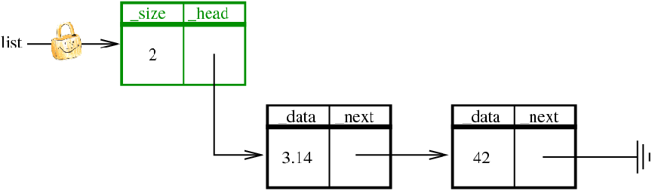
Linked List

Slide 21
Example - List Cloning
List* List_clone(const List* list)
{
List* ret= List_alloc();
const Node* old= list->_head;
Node** copy= &(ret->_head);
ret->_size= list->_size;
while(old)
{
*copy= Node_alloc(old->_data,NULL);
old= old->_next;
copy= &((*copy)->_next);
}
return ret;
}

Slide 22
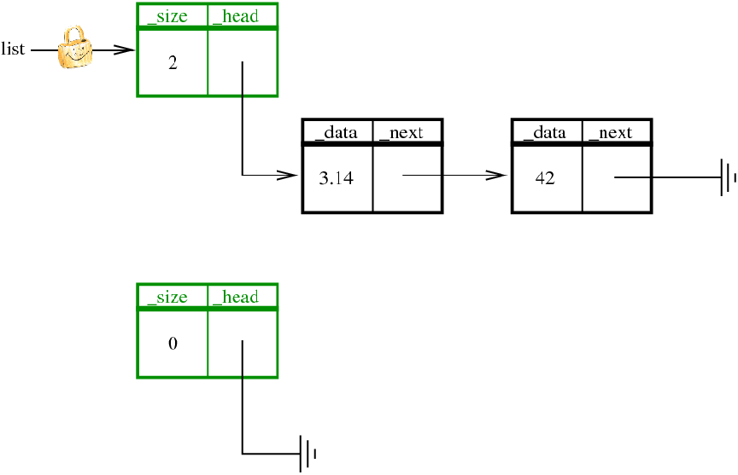
List* ret=List_alloc();

Slide 23
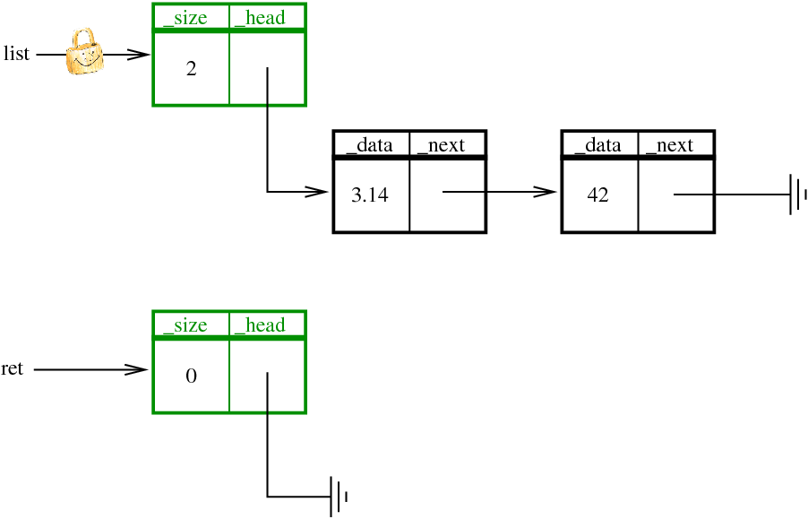
List* ret=List_alloc();

Slide 24
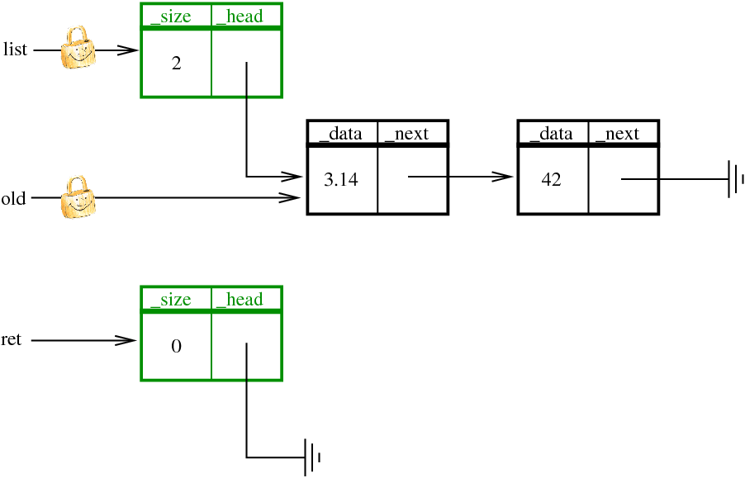
const Node* old=list->_head;

Slide 25

Node** copy=&(ret->_head);

Slide 26
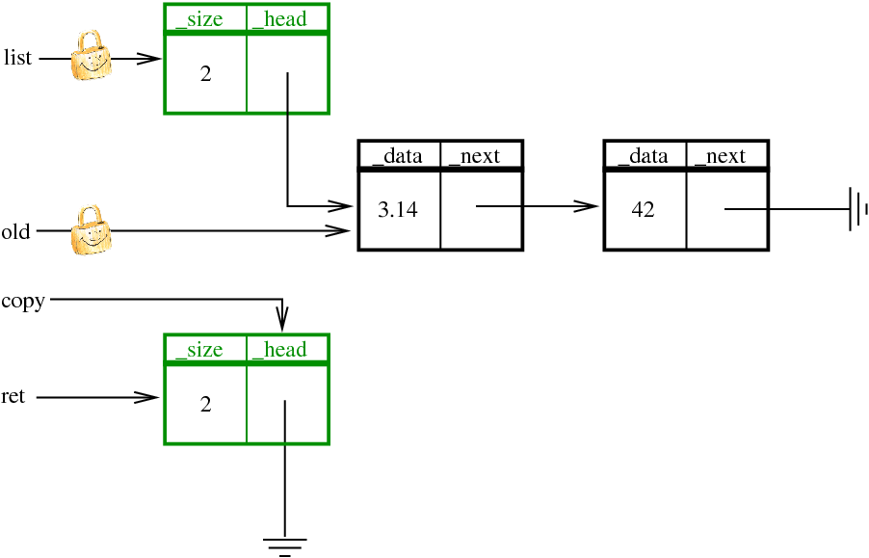
ret->_size=list->_size;

Slide 27
while(old) { …

Slide 28
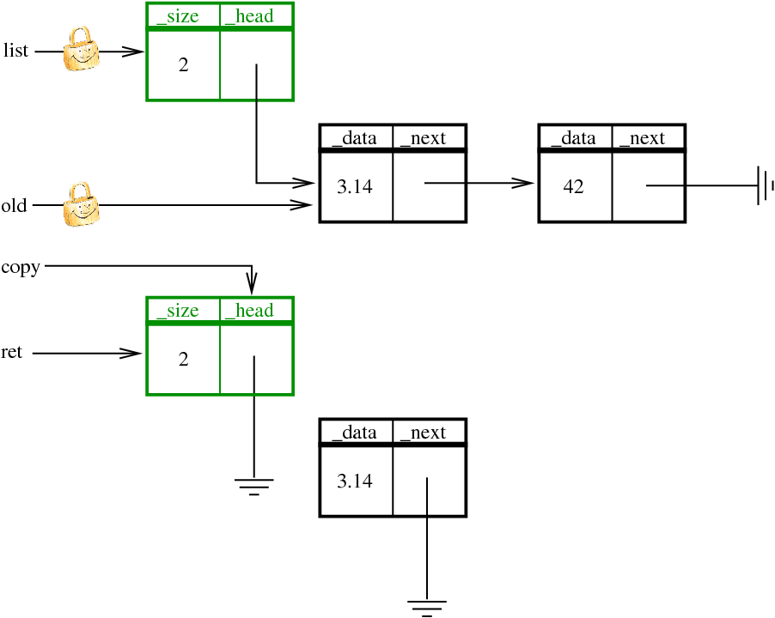
*copy=Node_alloc(old->_data,NULL);

Slide 29

*copy=Node_alloc(old->_data,NULL);

Slide 30
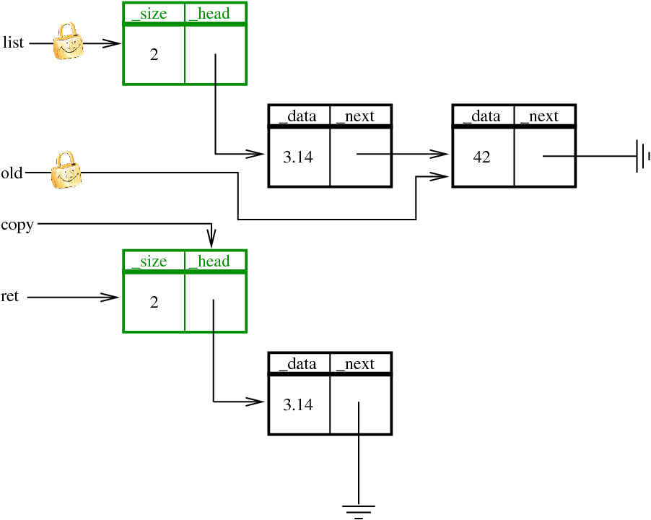
old=old->_next;

Slide 31

copy=&((*copy)->_next);

Slide 32
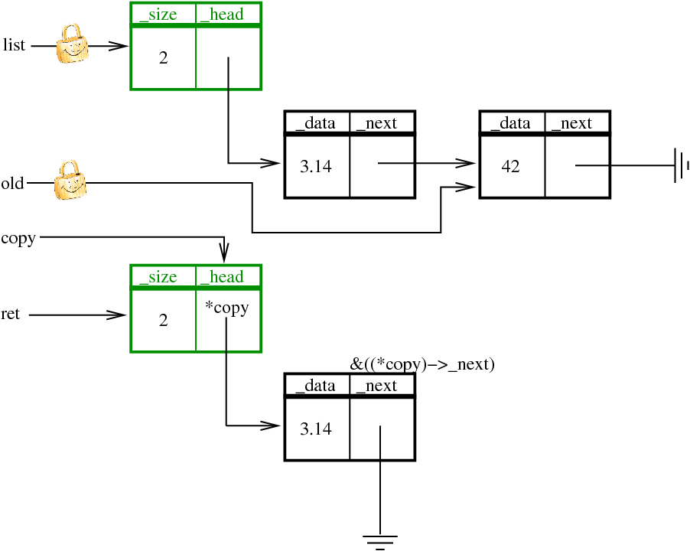
copy=&((*copy)->_next);

Slide 33
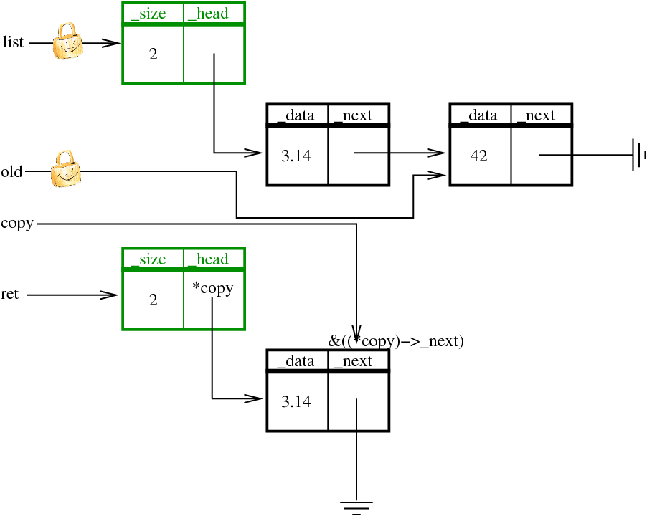
copy=&((*copy)->_next);

Slide 34
} return ret; }

Slide 35
Linked List
Take a look at the code ☺

Slide 36
To find memory bugs
Use valgrind!
Self study
See the tutorial at the course website (under TA lectures).

