Slide 1
Tirgul 5 - Agenda
Pointers (short) code
Dynamic allocation bugs examples
Generic Programming in C
Why
void*
Pointers to functions
Promo to CPP

Slide 2
C Strings Functions
An “array” version of strcpy():
A “pointers” version of strcpy():
void strcpy(char * dest, const char* src) { int i = 0; while ((dest[i] = src[i])!= '\0')) i++; }
void strcpy(char * dest, const char* src) { while ((*dest = *src)!= '\0')) { dest++;
src++; } }

Slide 3
C Strings Functions (2)
An experienced C programmer would write:
Actually the comparison against \0 is redundant:
Style note: Unlike K&R book, we do NOT encourage you to write such code. However, you should be able to read and understand it. The language features are used in any case.
void strcpy(char * dest,const char* src) { while ((*dest++ = *src++)!= '\0')); }
void strcpy(char * dest,const char* src) { while (*dest++ = *src++);
}

Slide 4
Bug 1
typedef struct _Student
{
(2) int id;
(3) char * name;
(4) } Student;
(5) Student * stud = (Student *) malloc( sizeof(Student) );
(6) stud->id = 123456;
(7) stud->name = (char *) malloc(100*sizeof(char));
…
(8) free(stud);
Memory leak of ‘name’!

Slide 5
Bug 2
void myFunc()
{
int * x = randomNumPtr();
int result = *x; // unexpected!
*x = 17; // accessing unallocated space!
}
int * randomNumPtr()
{
int j= srand( time(0) );
return &j;
}
Never return an address of a stack-variable !

Slide 6
Bug 3
void myFunc(char * input)
{
char * name;
if (input != NULL )
{
name = (char*)malloc(MAX_SIZE);
strcpy(name,input);
}
…
free(name);
}
if input is NULL => free on an address that was not allocated using malloc.

Slide 7
No bug 3
void myFunc(char * input)
{
char * name=NULL;
if (input != NULL )
{
name = (char*)malloc(MAX_SIZE);
strcpy(name,input);
}
…
free(name);
}
always initialize pointers to NULL!

Slide 8
Memory bugs
Use valgrind!
Self study
See the tutorial at the course website (under TA lectures).

Slide 9
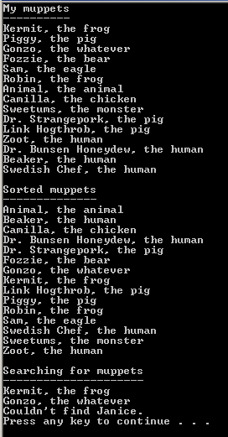
Generic Programming - Motivation
Examples:
critter.c, qsort_num.c

Slide 10
Generic Programming
The goal: To write code once that works on a variety of types
The tools in C:
pointers to functions
void*
The tools in C++:
polymorphism (not called Generic programming)
templates (“pure” Generic programming)
overloading

Slide 11
void*
A way to pass data of an arbitrary type
void* is a generic pointer capable of representing any pointer type
We saw void* usage before in stdlib – where?
int i= 5; double f= 3.14; void* p;
p= &i; // ok p= &f; // ok
malloc

Slide 12
“Rules” of void*
a void* pointer cannot be dereferenced
Why?
int i= 5; double f= 3.14; void* p;
p= &i; // ok p= &f; // ok
printf("%f\n", *p); // compilation error
Because we don’t know what is there, thus we don’t know how to read it!

Slide 13
“Rules” of void*
void* can be explicitly cast to another pointer type
int i= 5; double f= 3.14; void* p;
p= &i; // ok p= &f; // ok
printf("%f\n", *((double*)p)); // ok

Slide 14
Example – generic swap
void memswap_memcpy(void* p1, void* p2, size_t size)
See code: swap_num.c
Notes:
Make sure you understand parr0,1 new values
char*

Slide 15
Pointers to Functions
Are you serious?!
Yes!
A friendly tutorial: http://www.newty.de/fpt/index.html
Assuming that function f is defined: &f and f are pointers to the function
i.e.: The address where the function's definition begins in memory

Slide 16
Example
int avg(int num1, int num2) { return ( num1 + num2 ) / 2; }
int (* func)(int, int); // a ptr variable
func = &avg; // assignment func = avg; // same
int result = avg(20, 30); result = (*func)(20, 30); // invoke it using the ptr result = func(20, 30); // same

Slide 17
Recommendation
Use typedef
typedef int (* TwoIntsFunc) (int, int);
TwoIntsFunc f1; f1 = &avg; ... f1 = &sum;

Slide 18
What is it good for?
Generic programming - pass a function name to another function as a parameter
Once upon a time… it was a way to make a c struct kind of a poor class

Slide 19
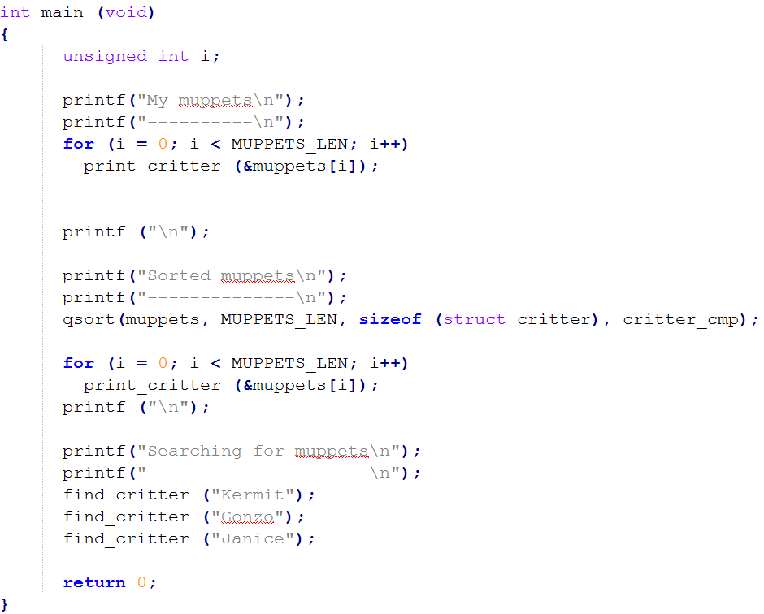
critter.c

Slide 20
Classical Example - qsort
#include <stdlib.h>
void qsort(void *base, size_t nmemb, size_t size, int(*compar)(const void *, const void *));
Array to be sorted
Number of elements in array
sizeof of each element in array
Pointer to the comparison function
Returns an integer less than, equal to, or greater than zero if the first argument is considered to be respectively less than, equal to, or greater than the second

Slide 21
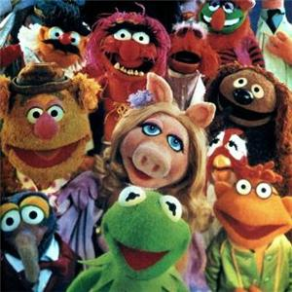
Muppets summary!
See code of critter.c
Note call to bsearch
Note call to qsort

Slide 22
qsort problems or C++ “promo”
Many parameters (function pointers)
Not user friendly
Type safety problems
C++ improves all these

