Slide 1
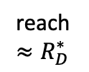



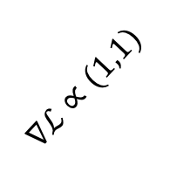

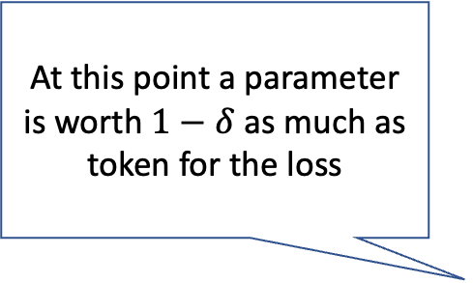
Same compute cost across dashed blue lines
At this point a parameter is worth $1−δ$ as much as token for the loss
$$\log{N}$$
$$∇ℒ∝(1,1−ε)$$
reach $≈R_{N}^{∗}$
In this regime, multiplicative factor in parameters and tokens worth same for loss
$$∇ℒ∝(1,1)$$
reach$≈R_{D}^{∗}$
$$\log{D}$$
Chinchilla Curve

