Slide 1
Objectives
Presenting each of the RDBMS(MySQL, PostgreSQL and SQL SERVER) and their functionalities
A comparison between the three RDBMS

Slide 2
1/
Presenting each of the RDBMS and their functionalities

Slide 3
MySQL
MySQL is the most popular open source SQL database. It is typically used for web application development, and often accessed using PHP.
The main advantages of MySQL are that it is easy to use, inexpensive, reliable (has been around since 1995), and has a large community of developers who can help answer questions.
Some of the disadvantages are that it has been known to suffer from poor performance when scaling, open source development has lagged since Oracle has taken control of MySQL, and it does not include some advanced features that developers may be used to.
Notes:
Data is the most important part of a database.

Slide 4
PostgreSQL
PostgreSQL is an open source SQL database that is not controlled by any corporation. It is typically used for web application development.
PostgreSQL shares many of the same advantages of MySQL. It is easy to use, inexpensive, reliable and has a large community of developers. It also provides some additional features such as foreign key support without requiring complex configuration.
The main disadvantage of PostgreSQL is that it can be slower in performance than other databases such as MySQL. It is also slightly less popular than MySQL.
Notes:
Every table is broken up into smaller entities called fields. The fields in the table are: name, email, created_at, updated_at.
A field is a column in a table that is designed to maintain specific information about every record in the table.
A record, also called a row of data, is each individual entry that exists in a table. For example there are (2) records in the table.
A column is a vertical entity in a table that contains all information associated with a specific field in a table. For example, Name represents the name of the user.

Slide 5
SQL Server
Microsoft owns SQL Server. Like Oracle DB, the code is close sourced.
Large enterprise applications mostly use SQL Server.
Microsoft offers a free entry-level version called Express but can become very expensive as you scale your application.

Slide 6
2/
A comparison between the three RDBMS (table)

Slide 7
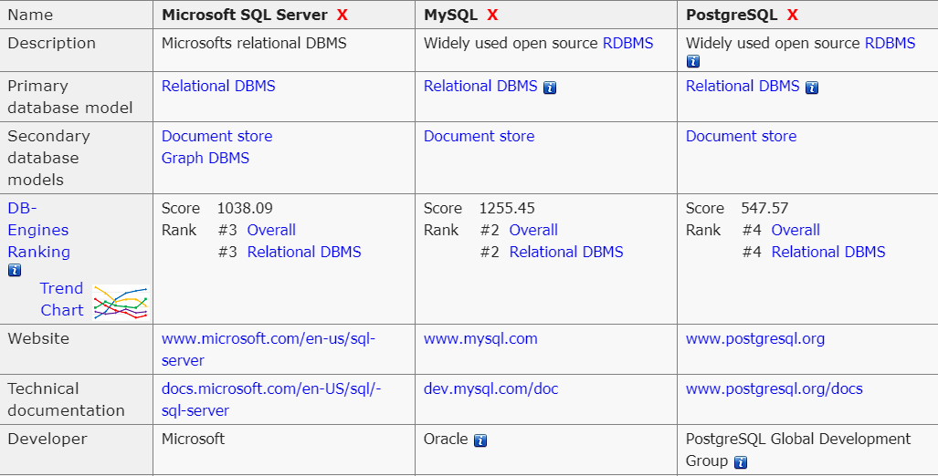

Slide 8
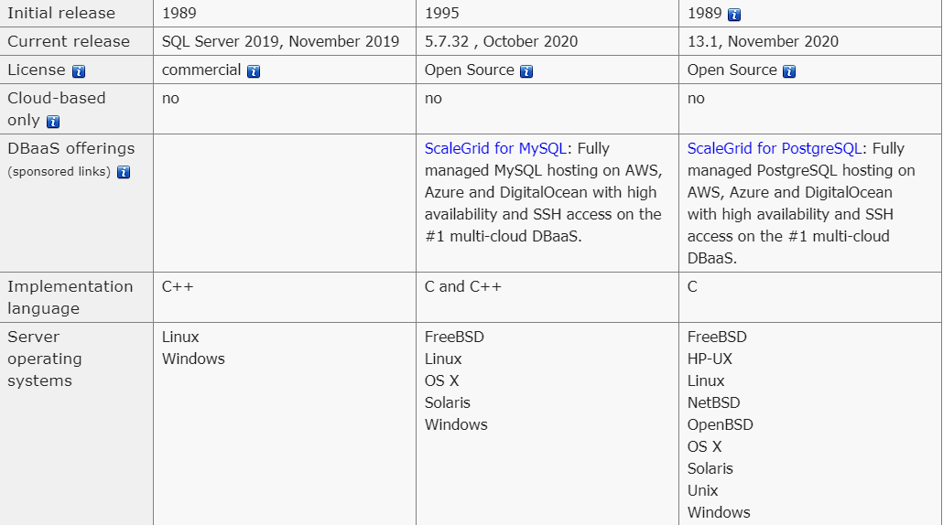

Slide 9
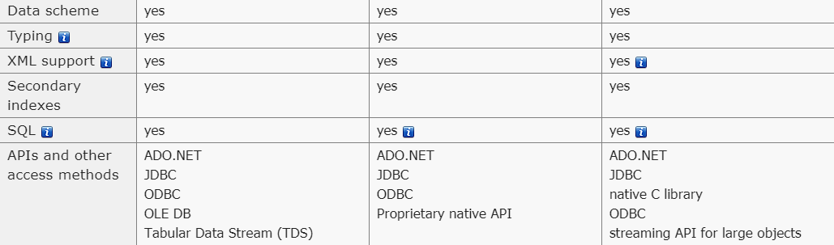

Slide 10
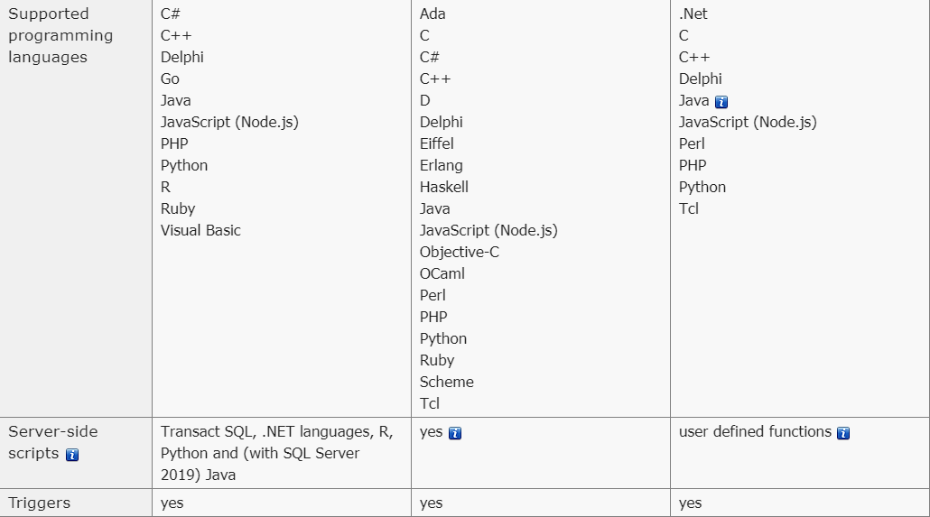

Slide 11
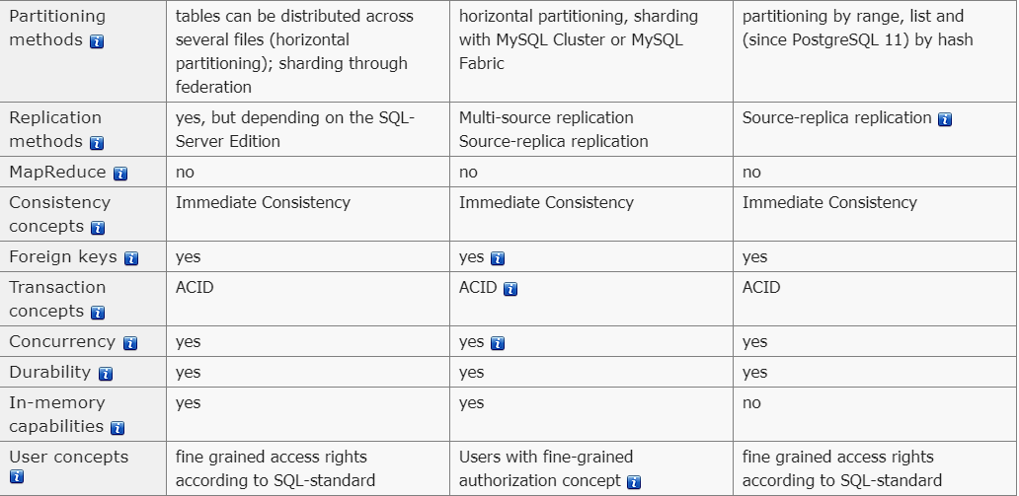

Slide 12
Conclusion
Relational databases store data in tables. Tables can grow large and have a multitude of columns and records. Relational database management systems (RDBMSs) use SQL (and variants of SQL) to manage the data in these large tables. The RDBMS you use is your choice and depends on the complexity of your application.

