Slide 1
Classes and Objects
C# Object Oriented Programming
C# & .NET Development Fundamentals
Illés Horpácsi

Slide 2
Class, type, object, instance
PrimeCounter pc = new(2, 10);
PrimeCounter: Type / Class
pc: Instance / Object
public class PrimeCounter { … }
Declaration of the Type / Class
…
Field
Property
Method
Constructor
etc.

Slide 3
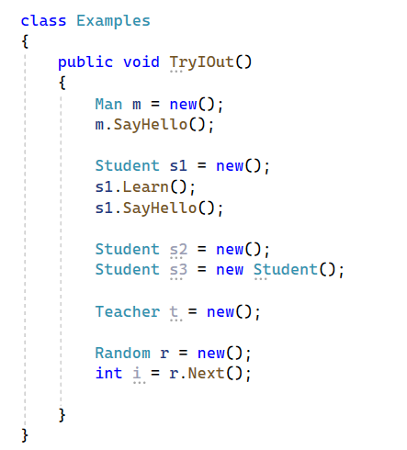
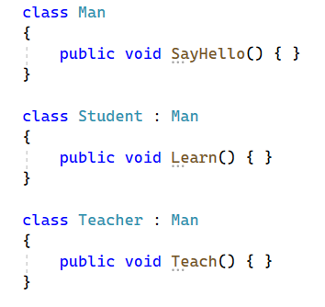
Examples

Slide 4
OOP Paradigm / Principles
Encapsulation
Keep together
Inheritance
Borrow knowledge from parent(s)
Polymorphism
Same method, own action
Abstraction
Hide complex inner logic

