Slide 1
Fields, Properties and Methods
C# Object Oriented Programming
C# & .NET Development Fundamentals
Illés Horpácsi

Slide 2
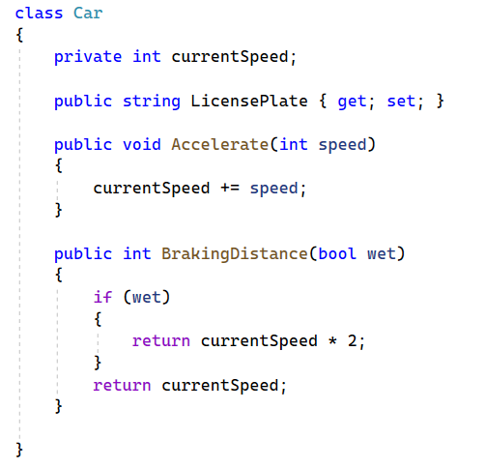
Class, type, object, instance
Field
currentSpeed
Property
LicensePlate
Method
Accelerate
BrakingDistance
Usage:
Car c = new();
Console.WriteLine(c.LicensePlate);
C.Accelerate(100);
Console.WriteLine(c.BrakingDistance(true));
currentSpeed may be used only within
Do NOT create public field!
c.LicensePlate has no parameters-> ()

Slide 3



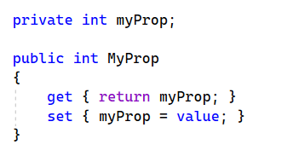
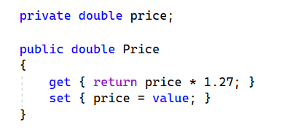
Property
Auto property
Snippet: prop
Full property
Snippet: propfull

Slide 4
Method
Complex logic
Has some paramaters (maybe 0, but has place for it!)
May have no return value (void)
If not void, every branch must have a return value
Return value’s type may differ from the type(s) of its parameter(s)
public, private, internal, …

