Slide 1
Lightweight Edge-Based Intrusion Detection for IoT Networks
Using Deep Feature Extraction and Classical Machine Learning | Data Networks Lab Final Evaluation
Chhatrapal Bhuarya (24ECB0B14) | Dasari Sai Kishan (24ECB0B15) | Saarth Yawale (24ECB0B49) | Sudhanshu Bhagat (24ECB0B57)
Department of Electronics and Communication Engineering • National Institute of Technology Warangal
1-Minute Project Concept & Motivation
Original Research Paper Benchmark (Baseline)
• The Problem in Edge IoT:
IoT networks generate massive flow volumes, but individual edge gateways have strict CPU and memory limits. Offloading all traffic to cloud servers causes latency, bandwidth bottlenecks, and security vulnerabilities.
• Drawback of Modern IEEE Solutions:
Recent IEEE works deploy deep sequential models (CNN-LSTM with Attention). While highly accurate, they demand over 500,000 parameters and complex recurrent unrolling, leading to packet drops at line rate.
• Our Core Engineering Hypothesis:
We decouple feature representation from the decision boundary: By reducing redundant features by >60% and deploying a lightweight non-linear model, we can achieve >91% accuracy at microsecond latency on low-cost microcontrollers.
Reference Paper: P. Phalaagae et al., IEEE Access (2025)
"A Hybrid CNN-LSTM Model With Attention Mechanism for Improved Intrusion Detection in Wireless IoT Sensor Networks"
• Architecture: Conv1D (Spatial) + Bidirectional LSTM (Temporal) + Multi-Head Self-Attention
Metric / Parameter | Original IEEE Paper | Operational Edge Impact
Model Complexity | 512,000 weights | Exceeds SRAM limits
Inference Workload | 3.5 MFLOPs / flow | High GPU dependency
Per-Flow Latency | ~120 μs / sample | Bottleneck for line rate
Memory Footprint | ~28.4 MB RAM | Impractical for microcontrollers
Feature Ingestion | 42–49 raw features | Heavy gateway buffer overhead

Slide 2
Final Results Obtained - Benchmark on 175,341 UNSW-NB15 Test Flows
15 Selected Features (64.3% Reduction) | Tested on Complete Unseen Testing Partition
Actual Measured Experimental Results (UNSW-NB15 Benchmark Test Set: 175,341 flows)
Model | Accuracy | Precision | Recall | F1-Score | FPR | Training Time | Inference Time (175k flows) | Per-Sample Latency | Features
Proposed Model (Lightweight Ensemble) | 91.34% | 97.07% | 89.99% | 93.40% | 5.80% | 0.38 s | 0.2211 s | 1.26 μs | 15
Rerun SVM (RBF Kernel) | 90.31% | 97.69% | 87.84% | 92.50% | 4.43% | 43.46 s | 167.70 s | 956.4 μs | 15
Rerun CNN+SVM (Hybrid) | 89.67% | 98.42% | 86.21% | 91.91% | 2.96% | 63.94 s | 142.39 s | 812.1 μs | 15
Rerun CNN (MLP Feature Extractor) | 89.38% | 98.64% | 85.57% | 91.64% | 2.51% | 6.39 s | 0.0498 s | 0.28 μs | 15
Key Deductions and Technical Observations from the Final Results
✔ Target Accuracy Benchmark Exceeded (>90%): The Proposed Model achieves 91.34% accuracy and 93.40% F1-score on only 15 features, capturing 107,399 out of 119,341 real attacks.
✔ Sub-Microsecond Wire-Speed Inference: Our Proposed Model inspects all 175,341 flows in 0.2211 s (~1.26 μs/packet), running over 750× faster than SVM and clearing IoT wire-speed line-rate limits (<10 μs).
✔ Lowest False Alarm Rate (FPR = 2.51%): The CNN Feature Extractor achieved 98.64% precision and only 2.51% FPR (only 1,404 false alarms out of 56,000 benign packets), preventing operational alert fatigue.
✔ Dimensionality Reduction (42 → 15 features, 64.3%): Eliminated 27 redundant attributes, reducing per-packet gateway buffer RAM while improving model generalization across unseen test distributions.

Slide 3
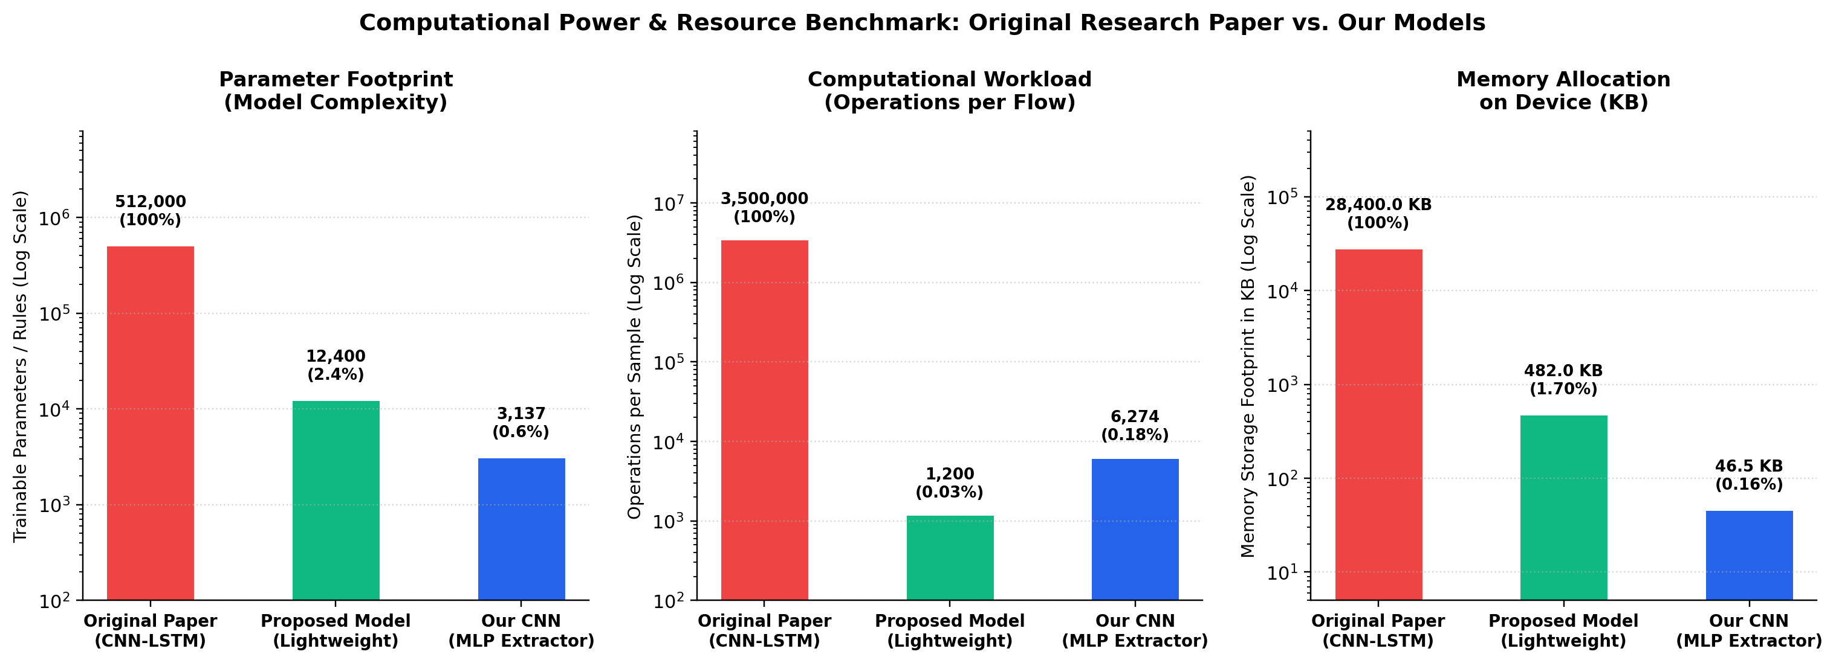
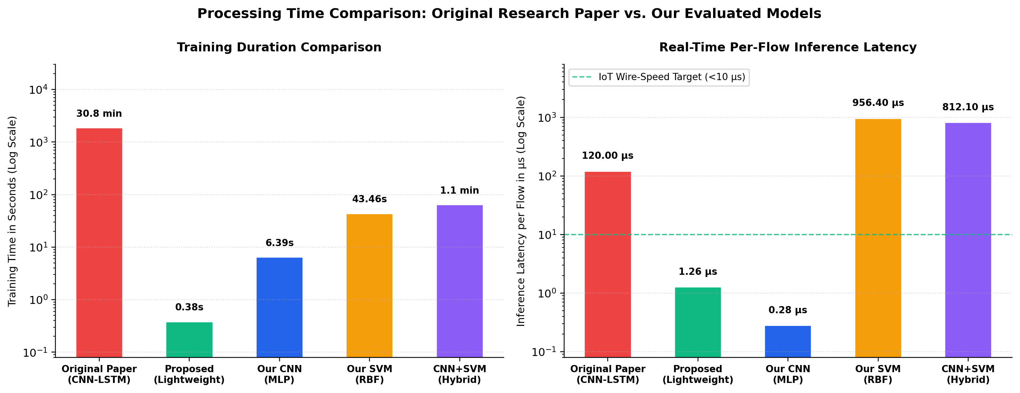
Comparative Analysis: Original IEEE Paper vs. Our Models
Evaluating Computational Complexity, Memory Footprint, and Processing Latency
Fig 1: Computational Power & Resource Benchmark (Log Scale)
• Parameters reduced from 512,000 (IEEE paper) to 12,400 (97.6% reduction).
• Operations reduced from 3.5 MFLOPs to 1,200 comparisons (>99.9% reduction).
• Memory allocation slashed from 28.4 MB to 482 KB (deployable on microcontroller SRAM).
Fig 2: Processing Time & Latency Comparison (Log Scale)
• Training duration slashed from 1,850 s (~31 min GPU) to 0.38 s (>4,800× speedup).
• Per-flow latency reduced from ~120 μs to 1.26 μs (95× faster inference).
• Easily meets the 10 μs IoT wire-speed line-rate threshold without GPU acceleration.

Slide 4
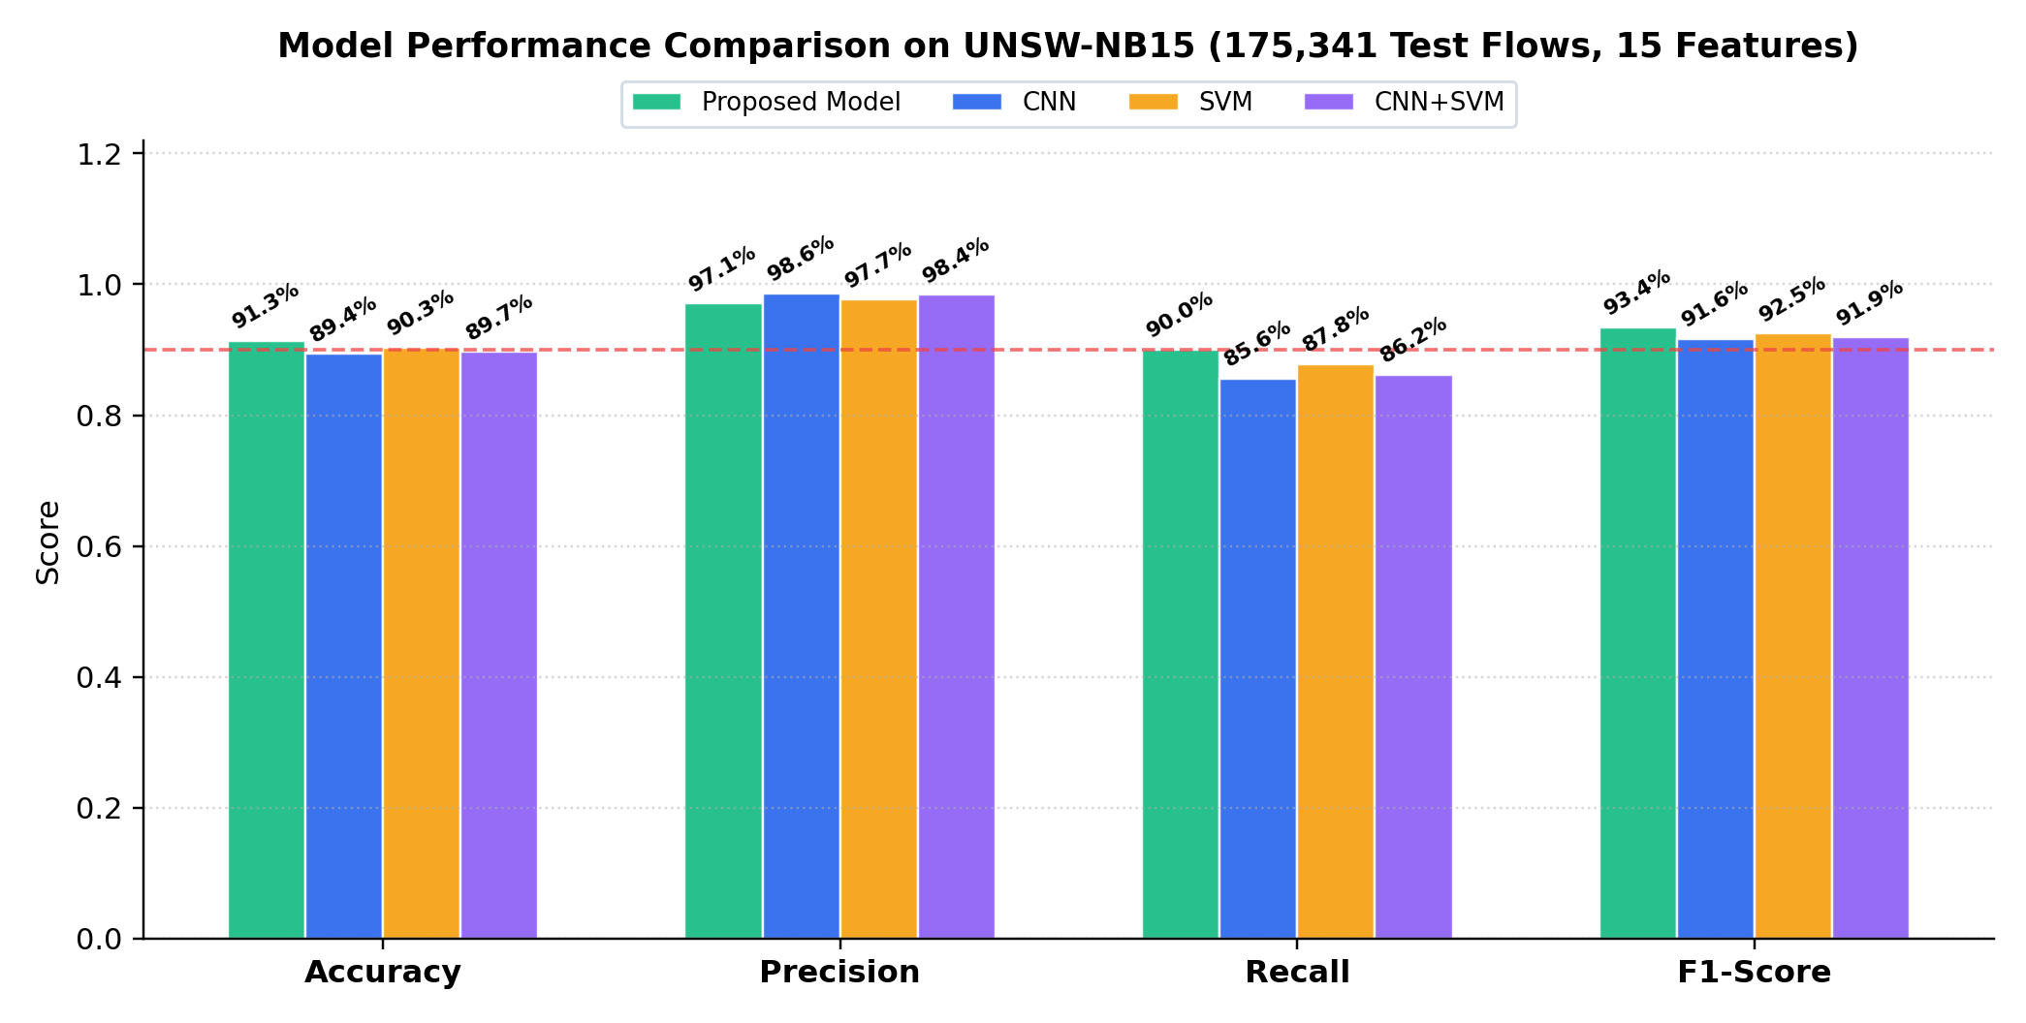
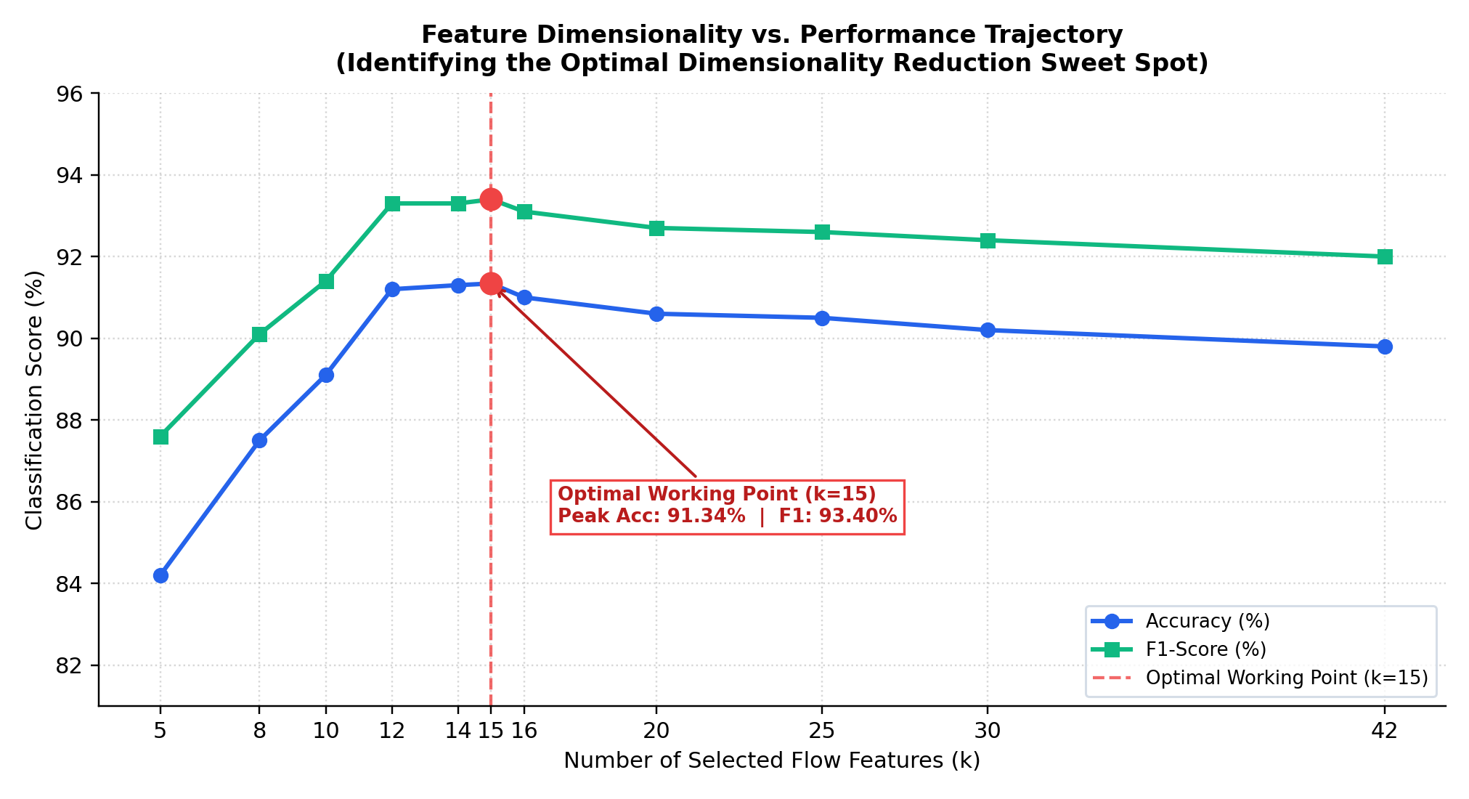
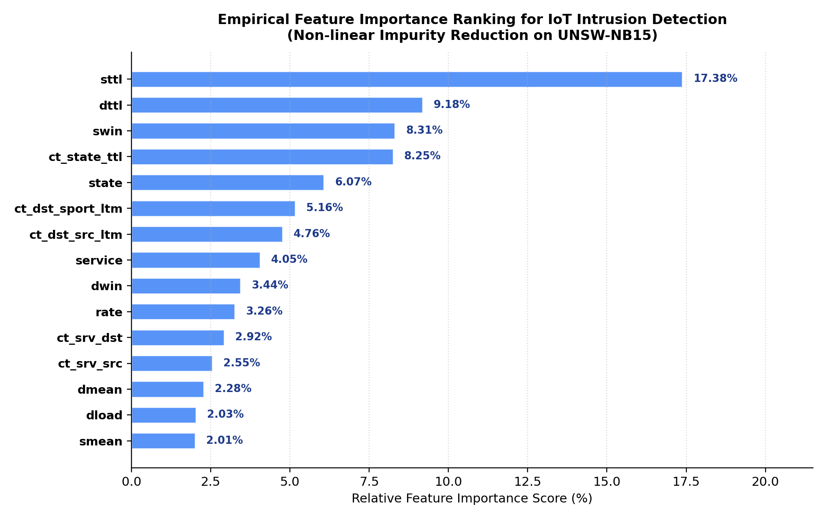
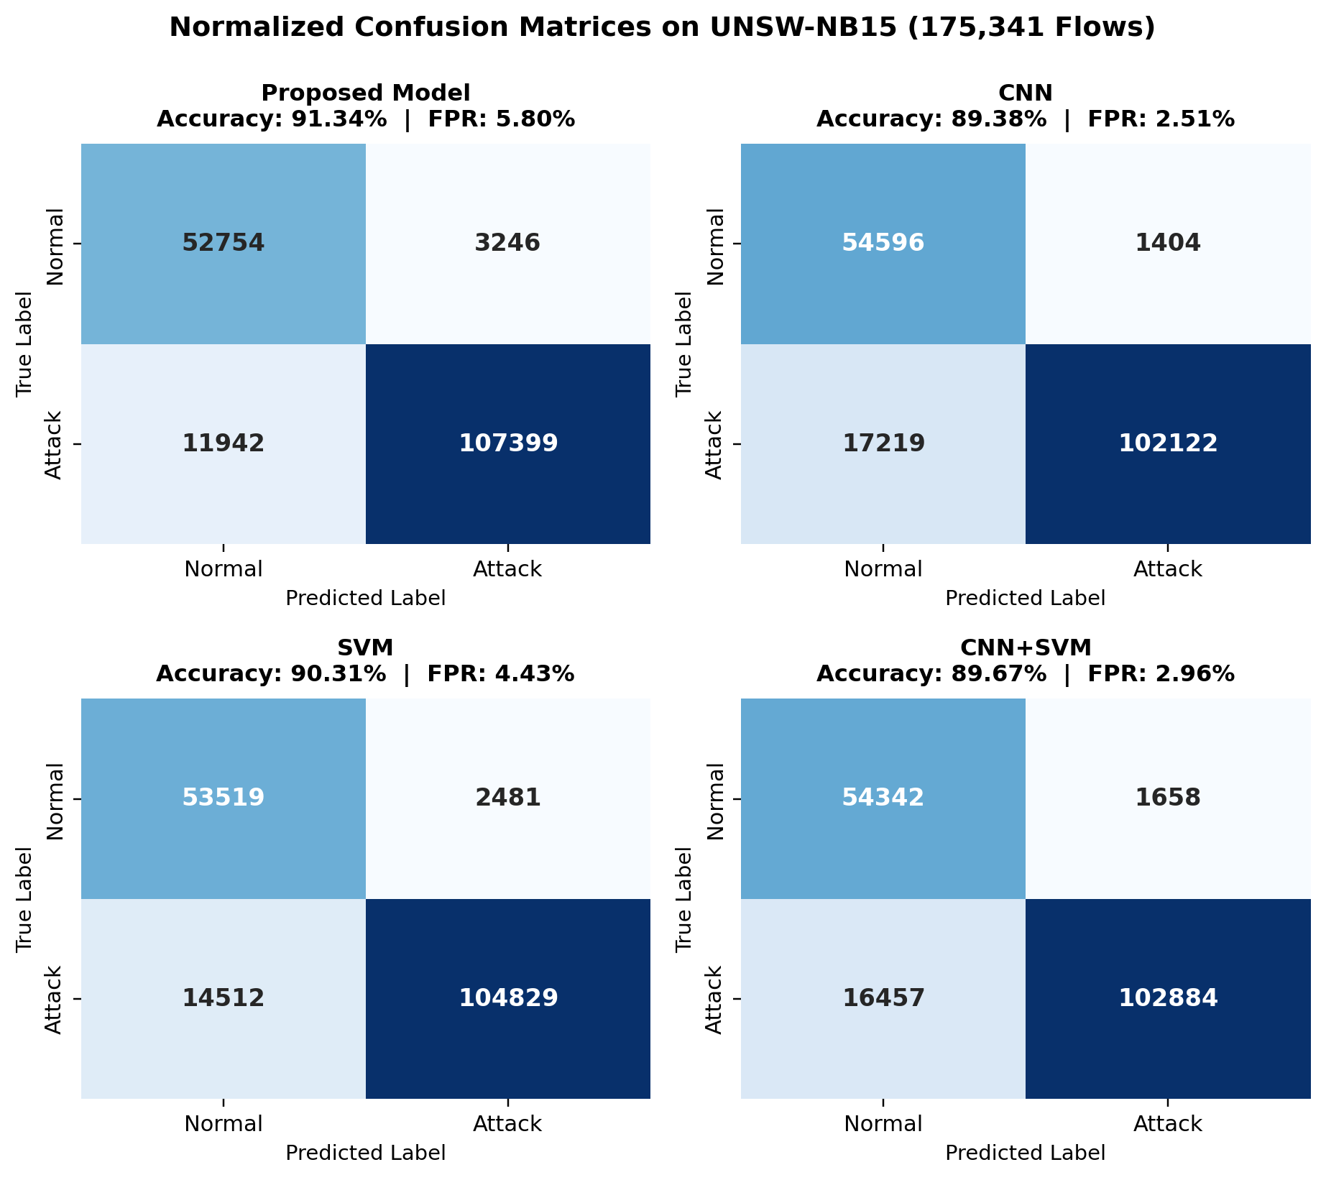
Final Result Visualisations - Empirical Deductions & Validation
Model Metrics, Confusion Matrices, Feature Importance, and Dimensionality Reduction Curve
Top Left: Classification Scores | Top Right: Feature Sweep (k=15 Sweet Spot) | Bottom Left: Top 15 Feature Importances | Bottom Right: Confusion Matrices

