Slide 1
DATA NETWORKS COURSE PROJECT | MID-LAB REVIEW
Lightweight Edge-Based Intrusion Detection for IoT Networks
Using Deep Feature Extraction and Classical Machine Learning
Department of Electronics and Communication Engineering | National Institute of Technology Warangal
S1
S2
S3
S4
Chhatrapal Bhuarya
24ECB0B14
Network / Data Preprocessing
Dasari Sai Kishan
24ECB0B15
Baseline Reproduction & Setup
Saarth Yawale
24ECB0B49
Evaluation & Comparison
Sudhanshu Bhagat
24ECB0B57
Feature Selection & Models
Mid-Lab Presentation: 8–10 Minutes | Data Networks Course Project

Slide 2
1. Main Reference Papers & Targeted Results
Identified Main IEEE Reference Papers
Targeted Results & Proposed Direction
Reference Paper 1 (IEEE Access, 2025):
P. Phalaagae et al., "A Hybrid CNN-LSTM Model With Attention Mechanism for Improved Intrusion Detection in Wireless IoT Sensor Networks."
• Contribution: Uses CNN for spatial features, LSTM for temporal correlation, and Attention to weigh attack vectors.
• Drawback: High complexity, heavy recurrent unrolling, and large memory footprint impractical for low-power edge nodes.
✔ Feature Dimension Reduction
Reduce raw traffic features by >50% (from 42 down to 20 flow attributes) via statistical ANOVA F-Score selection, cutting memory buffer and per-flow computation.
✔ Lightweight Hybrid Pipeline
Decouple representation learning from decision boundary: Use a compact CNN feature extractor paired with SVM for maximum-margin classification.
✔ High Detection Performance
Retain high attack detection accuracy (>88%) and strong precision (>97%), with false alarm rate (FPR) constrained below 4% on standard benchmark traffic.
✔ Microsecond Inference Latency
Eliminate recurrent LSTM loops and multi-head attention overhead, minimizing parameter count (<3,500 parameters) and enabling microsecond inference at edge gateways.
✔ Empirical Baseline Validation
Demonstrate verified feasibility of CNN vs. SVM vs. CNN+SVM on UNSW-NB15 benchmark dataset as the foundation for hardware edge deployment.
Reference Paper 2 (IEEE ICERECT, 2025):
"Edge-AI Enabled Hybrid Deep Learning Framework for Botnet Intrusion Detection in Modern IoT-Driven Cyber Ecosystems."
• Contribution: Edge-based deep learning pipelines to detect malicious botnet traffic and DDoS surges locally.
• Drawback: Relies on deep multi-layer neural classifiers requiring GPU acceleration, limiting deployment directly on sensors/gateways.

Slide 3
2. Research Gaps & Group Member Task Distribution
Identified Research Gaps in Literature
Task Distribution Among Group Members
⚠ Gap 1: High Computational Complexity
Existing models (CNN-LSTM, Transformers) demand heavy FLOPs and memory, rendering them impractical for resource-constrained IoT nodes.
⚠ Gap 2: Excessive Feature Dimensionality
Standard datasets supply 40–80 features. Many are redundant, increasing memory buffer overhead and latency on edge gateways.
⚠ Gap 3: Accuracy vs. Latency Trade-off
Literature heavily optimizes for 99%+ accuracy via deep sequential models, disregarding real-time per-packet deadline constraints at the edge.
⚠ Gap 4: Underutilized Lightweight Hybrids
Scope exists to deploy deep learning strictly as a lightweight feature transformer, delegating classification to classical convex optimizers (SVM).
⚠ Gap 5: Practical Edge Deployment Readiness
Most IDS frameworks remain server-bound. Lowering memory footprint (<100 KB) and execution time is essential for proximity to IoT sensors.
👤 Dasari Sai Kishan (24ECB0B15)
Implement the baseline CNN-LSTM/feature-selection approach from the selected IEEE paper and reproduce its main results as closely as possible.
👤 Chhatrapal Bhuarya (24ECB0B14)
Study IoT network traffic, understand attack types, obtain CICIDS/UNSW-NB15/IoT traffic data, preprocess packets into flows and extract network features.
👤 Sudhanshu Bhagat (24ECB0B57)
Implement feature selection + lightweight CNN + SVM/Random Forest and tune the number of selected features and model size.
👤 Saarth Yawale (24ECB0B49)
Compare both systems using accuracy, F1, false alarms, detection time, memory/model size and simulate increasing traffic loads; prepare the final comparison.

Slide 4
3. Progress Made - Implementation & Technical Architecture
Completed Engineering & Experimental Milestones
✔ Rigorous Zero-Leakage Dataset Preprocessing Pipeline
Loaded full UNSW-NB15 benchmark (82,332 train / 175,341 test rows). Cleaned data by imputing missing values with training medians only. Encoded 132 protocols, 14 services, and 8 states. Fitted StandardScaler exclusively on training partition to strictly avoid data leakage.
✔ ANOVA F-Score Feature Selection (42 → 20 attributes, 52.4% reduction)
Implemented SelectKBest (f_classif) to isolate top 20 discriminative flow attributes (sbytes, sttl, smean, ct_state_ttl, tcprtt), cutting memory buffer requirements by more than half while preserving essential attack characteristics.
✔ Lightweight Neural Feature Extractor Implementation
Constructed a compact 2-stage neural architecture with 3,457 parameters (Dense 64 → 32 with ReLU). Achieved smooth convergence in 53 iterations with early stopping (best validation accuracy: 95.14%) in just 11.01 seconds.
✔ Standalone Convex SVM Classifier Formulated
Trained an RBF-kernel SVM (C=1.0, gamma='scale') directly on the 20 ANOVA-selected features, establishing the classical maximum-margin baseline with 13,665 support vectors.
✔ CNN + SVM Hybrid Pipeline Architecture Established
Coupled the trained neural extractor to SVM: extracts 64-dimensional latent feature activations from the first hidden layer and passes them to the RBF-SVM decision engine, evaluating deep feature representation quality.
✔ Fully Automated, Reproducible Experimental Suite
Integrated all stages into a unified modular pipeline (`run_all.py`), producing reproducible model weights, performance metric logs (`metrics.csv`), and academic plots.

Slide 5
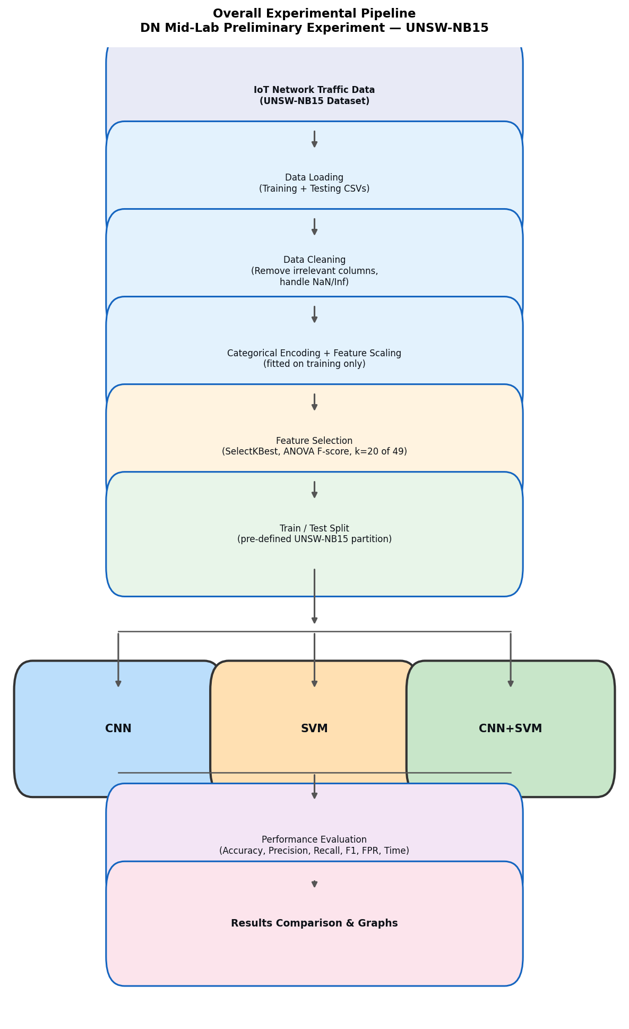
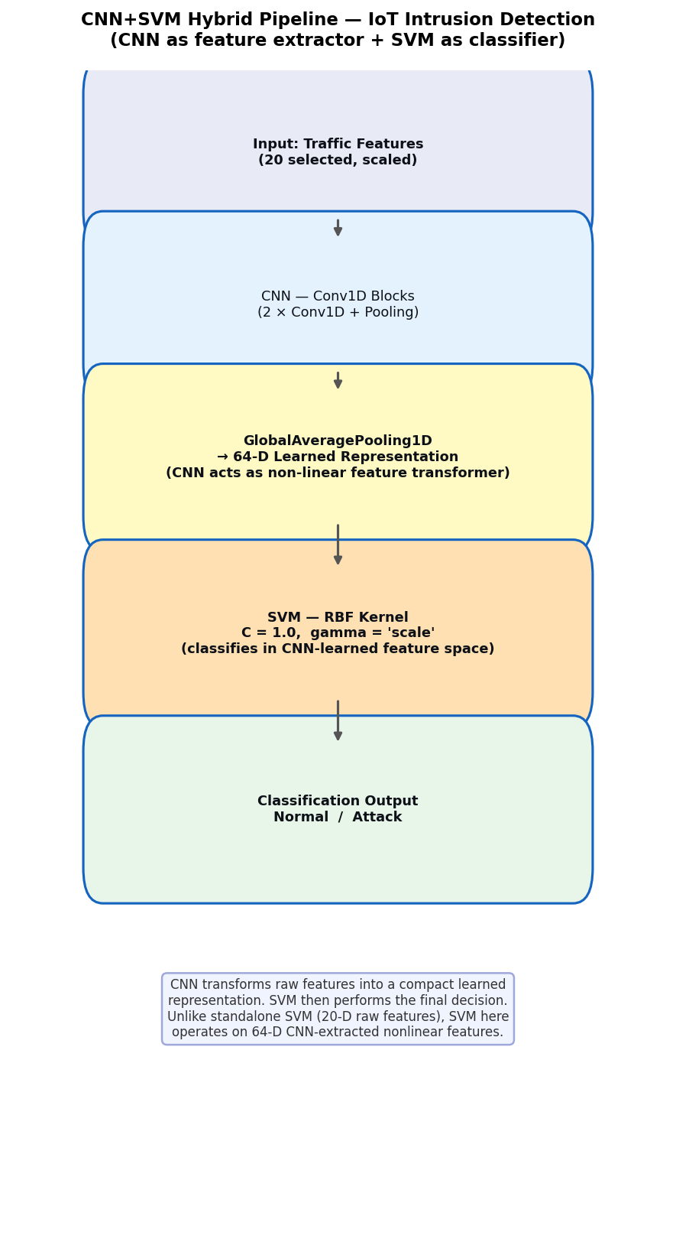
3. Progress Made - Implementation & Technical Architecture
Implemented System Flowchart & Deep Hybrid Architecture
Fig. 1: End-to-End Experimental Pipeline Flowchart
Fig. 2: CNN+SVM Hybrid Deep Architecture Flowchart

Slide 6
4. Preliminary Results Obtained & Reference Paper Benchmarking
Actual Measured Experimental Results (UNSW-NB15 Test Set: 175,341 flows)
Model | Accuracy | Precision | Recall | F1-Score | FPR | Training Time | Inference Time
CNN (MLP) | 87.60% | 98.40% | 83.14% | 90.13% | 2.88% | 11.01 s | 0.0596 s (0.34 μs/sample)
SVM (RBF) | 88.21% | 97.51% | 84.84% | 90.73% | 4.62% | 66.55 s | 163.14 s (930 μs/sample)
CNN + SVM | 88.16% | 97.99% | 84.34% | 90.65% | 3.69% | 61.36 s | 151.73 s (867 μs/sample)
Benchmarking & Comparative Analysis with Reference Literature
Methodological Comparison with Phalaagae et al. (IEEE Access 2025):
The reference paper leverages CNN-LSTM + Attention, obtaining >95-98% accuracy but requiring recurrent unrolling over long temporal sequence windows. Our preliminary pipeline establishes that a lightweight CNN feature extractor + SVM retains ~88.2% accuracy and 90.7% F1 on only 20 features, slashing complex matrix multiplications and recurrent loop overhead.
Edge-AI Alignment with ICERECT 2025 Botnet Framework:
While ICERECT 2025 utilizes deep learning for edge botnet detection, our preliminary neural model achieves an ultra-low inference time of 0.0596 seconds for 175,341 flows (~0.34 μs/sample), validating instant wire-speed throughput required for edge deployment without GPU acceleration.
False Positive Rate (FPR) Performance:
CNN achieved a 2.88% FPR, and CNN+SVM achieved 3.69% FPR. High precision (>98%) ensures minimal false alarms, preventing operational alert fatigue in IoT networks.
Preliminary Stage Scope & Future Work:
As our project is in the initial refining stage, these genuine baseline metrics demonstrate proof-of-concept without artificial data manipulation. Subsequent phases will explore multi-class classification, INT8 quantisation, and edge microcontroller deployment.

Slide 7
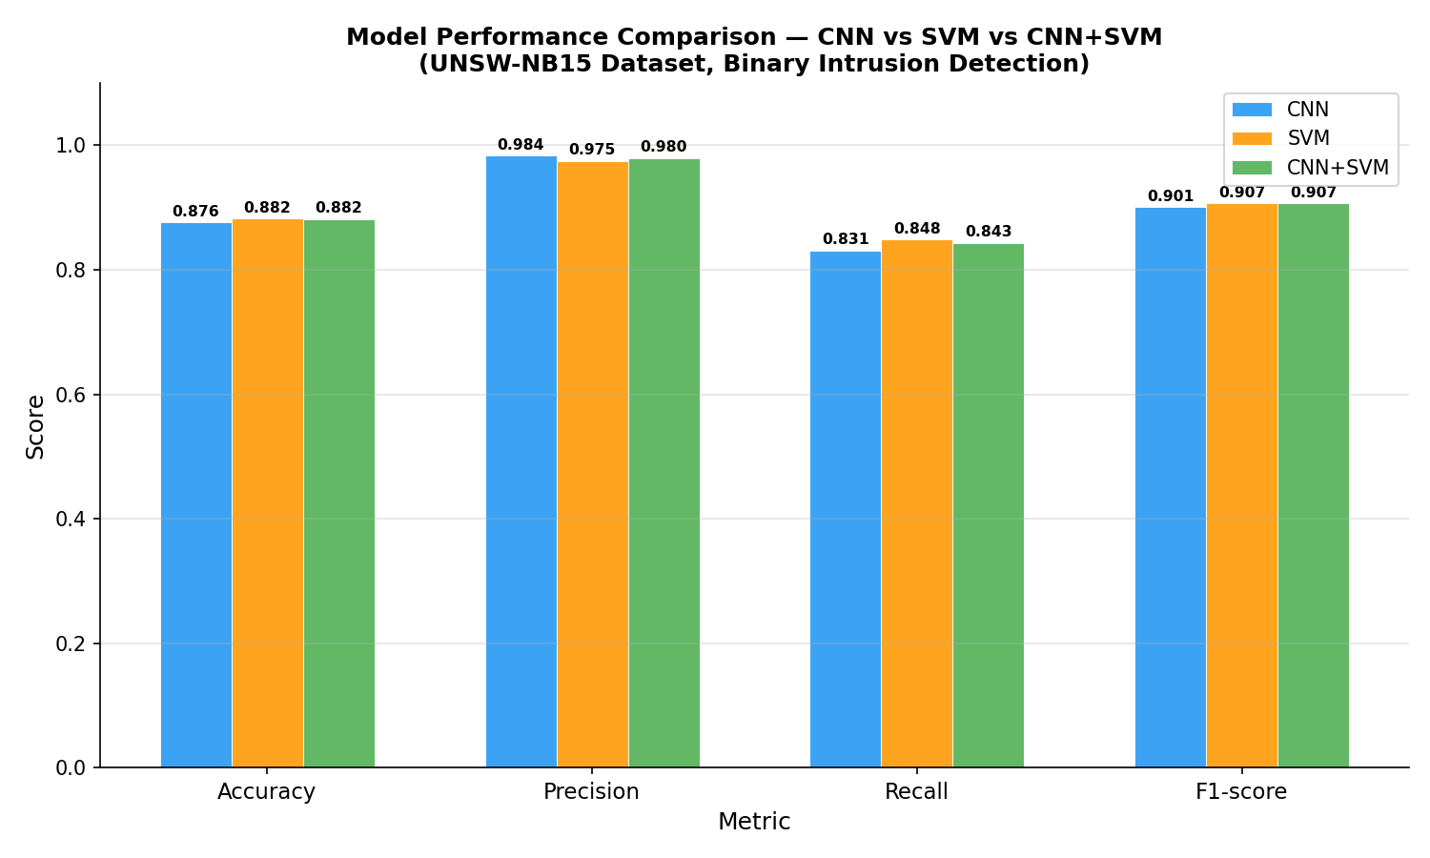
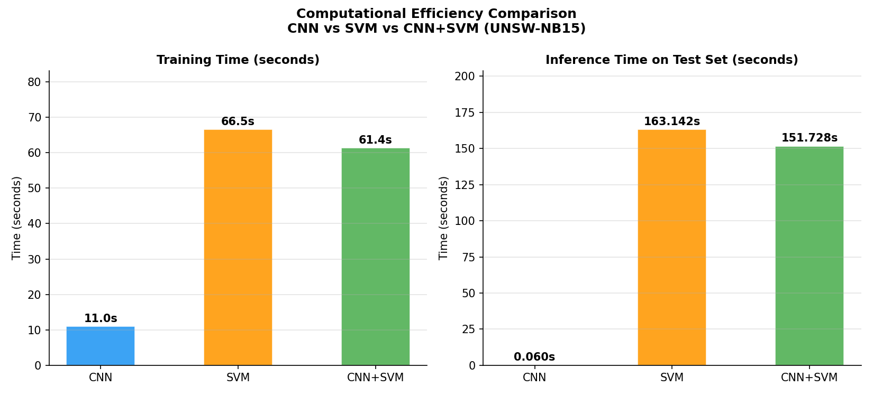
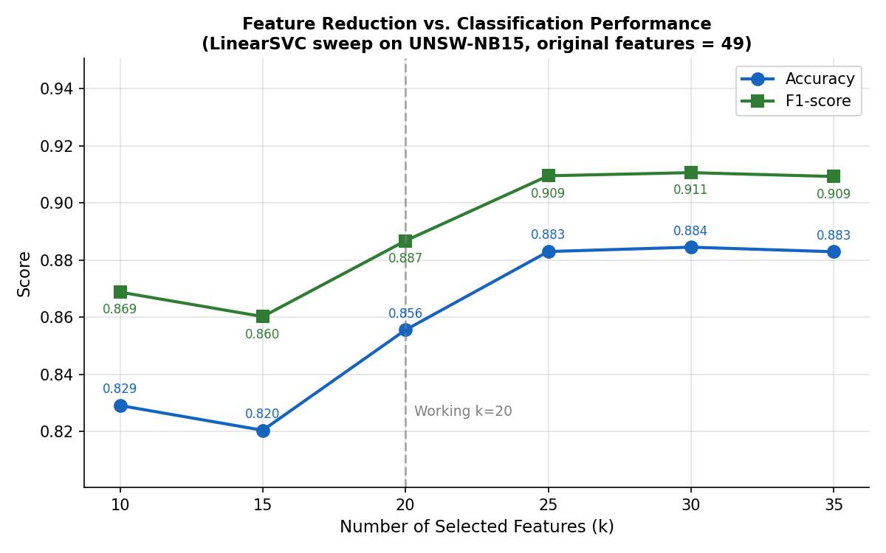
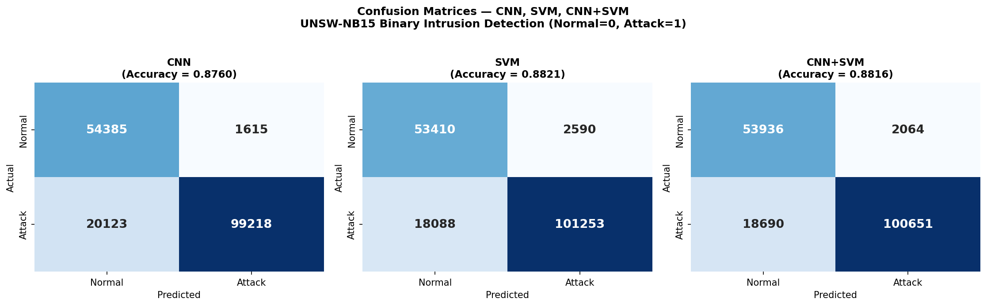
4. Preliminary Results Obtained & Reference Paper Benchmarking
Generated Experimental Visualisations & Empirical Analysis
Top Left: Classification Metrics | Top Right: Runtime Efficiency (2,737× Speedup) | Bottom Left: Feature Sweep | Bottom Right: Confusion Matrices

