Slide 1
DATA NETWORKS COURSE PROJECT | MID-LAB REVIEW
Lightweight Edge-Based Intrusion Detection for IoT Networks
Using Deep Feature Extraction and Classical Machine Learning
Department of Electronics and Communication Engineering • National Institute of Technology Warangal
S1
S2
S3
S4
Chhatrapal Bhuarya
24ECB0B14
Network / Data Preprocessing
Dasari Sai Kishan
24ECB0B15
Reference Paper Reproduction
Saarth Yawale
24ECB0B49
Proposed Model & Architecture
Sudhanshu Bhagat
24ECB0B57
Benchmarking & Evaluation
Mid-Lab Presentation: 8–10 Minutes | Total Evaluation: 40 Marks (10 Marks / Section)

Slide 2
1. Main Reference Papers & Targeted Results
Evaluation Section 1 — [10 Marks]
Identified Main IEEE Reference Papers
Targeted Results & Proposed Direction
Reference Paper 1 (IEEE Access, 2025):
P. Phalaagae, A. M. Zungeru, A. Yahya, B. Sigweni and S. Rajalakshmi, "A Hybrid CNN-LSTM Model With Attention Mechanism for Improved Intrusion Detection in Wireless IoT Sensor Networks."
• Core Contribution: Employs CNN for spatial feature learning, LSTM for temporal correlation, and an Attention module to prioritize attack vectors.
• Inherent Drawback: Extreme architectural complexity, high memory footprint, and recurrent sequential latency unsuitable for low-power edge IoT microcontrollers.
✔ Feature Dimension Reduction
Reduce raw traffic features by >50% (from 42 down to 20 flow attributes) via statistical ANOVA F-Score selection, slashing memory buffer and transmission overhead.
✔ Lightweight Hybrid Pipeline
Decouple representation learning from decision boundary: Use a compact CNN (or MLP) solely for feature transformation, paired with SVM for maximum-margin classification.
✔ Preserve High Detection Performance
Retain high attack detection accuracy (>88%) and strong precision (>97%), with false alarm rate (FPR) constrained below 4% on standard benchmark network traffic.
✔ Drastic Computational Savings
Eliminate recurrent LSTM loops and multi-head attention overhead, minimizing parameter count (<3,500 parameters) and enabling microsecond inference on constrained edge gateways.
✔ Preliminary Milestone Objective
Demonstrate concrete empirical feasibility of CNN vs. SVM vs. CNN+SVM on UNSW-NB15 dataset as the verified foundation for subsequent hardware-in-the-loop edge refinement.
Reference Paper 2 (IEEE ICERECT, 2025):
"Edge-AI Enabled Hybrid Deep Learning Framework for Botnet Intrusion Detection in Modern IoT-Driven Cyber Ecosystems."
• Core Contribution: Proposes edge-based deep learning pipelines to detect malicious botnet propagation and DDoS surges locally.
• Inherent Drawback: Relies on deep end-to-end multi-layer neural classifiers requiring full GPU inference acceleration, limiting decentralization.

Slide 3
2. Research Gaps & Group Member Task Distribution
Evaluation Section 2 — [10 Marks]
Identified Research Gaps in Literature
Task Distribution Among Group Members
⚠ Gap 1: High Computational Complexity
Existing models (CNN-LSTM, Transformers) demand immense FLOPs and memory, rendering them impractical for resource-constrained IoT/edge nodes.
⚠ Gap 2: Excessive Feature Dimensionality
Standard datasets supply 40–80 features. Many are redundant or noisy, elevating memory storage, energy burn, and processing latency on gateways.
⚠ Gap 3: Accuracy vs. Inference Latency Trade-off
Literature heavily optimizes for 99%+ accuracy at the cost of deep sequential models, disregarding real-time per-packet deadline constraints at the edge.
⚠ Gap 4: Underutilized Lightweight Hybrid Classifiers
Scope exists to deploy deep learning strictly as a lightweight feature transformer, delegating classification to classical convex optimizers (SVM).
⚠ Gap 5: Practical Edge Deployment Readiness
Most IDS frameworks remain server-bound. Lowering memory footprint (<100 KB) and execution time is essential for proximity to IoT sensors.
Student 1: Chhatrapal Bhuarya (24ECB0B14)
Role: Network & Data Preprocessing Pipeline
• Researched IoT traffic characteristics and cyber-attack taxonomy.
• Managed UNSW-NB15 benchmark dataset ingestion (82K train / 175K test flows).
• Engineered data cleaning: median imputation, categorical encoding (proto, state, service), and zero-leakage standard feature scaling.
Student 2: Dasari Sai Kishan (24ECB0B15)
Role: Reference Paper Reproduction & Baseline
• Analyzed architectures from Phalaagae et al. (IEEE Access 2025) and ICERECT 2025.
• Evaluated baseline CNN-LSTM and attention complexities against edge requirements.
• Defined baseline experimental protocols and metric benchmarking standards.
Student 3: Saarth Yawale (24ECB0B49)
Role: Proposed Lightweight Architecture & Models
• Implemented statistical ANOVA F-Score feature selection (SelectKBest, k=20).
• Built and tuned the standalone Lightweight Deep Feature Extractor (CNN/MLP).
• Formulated and implemented the CNN+SVM hybrid classification pipeline (64-D learned feature extraction coupled to RBF-kernel SVM decision boundary).
Student 4: Sudhanshu Bhagat (24ECB0B57)
Role: Evaluation, Latency Profiling & Benchmarking
• Scripted the evaluation suite measuring Accuracy, Precision, Recall, F1, and FPR.
• Measured training runtime and per-sample inference latency across all 3 models.
• Generated confusion matrix visualisations, feature-sweep curves, and benchmarked empirical metrics against reference paper findings.

Slide 4
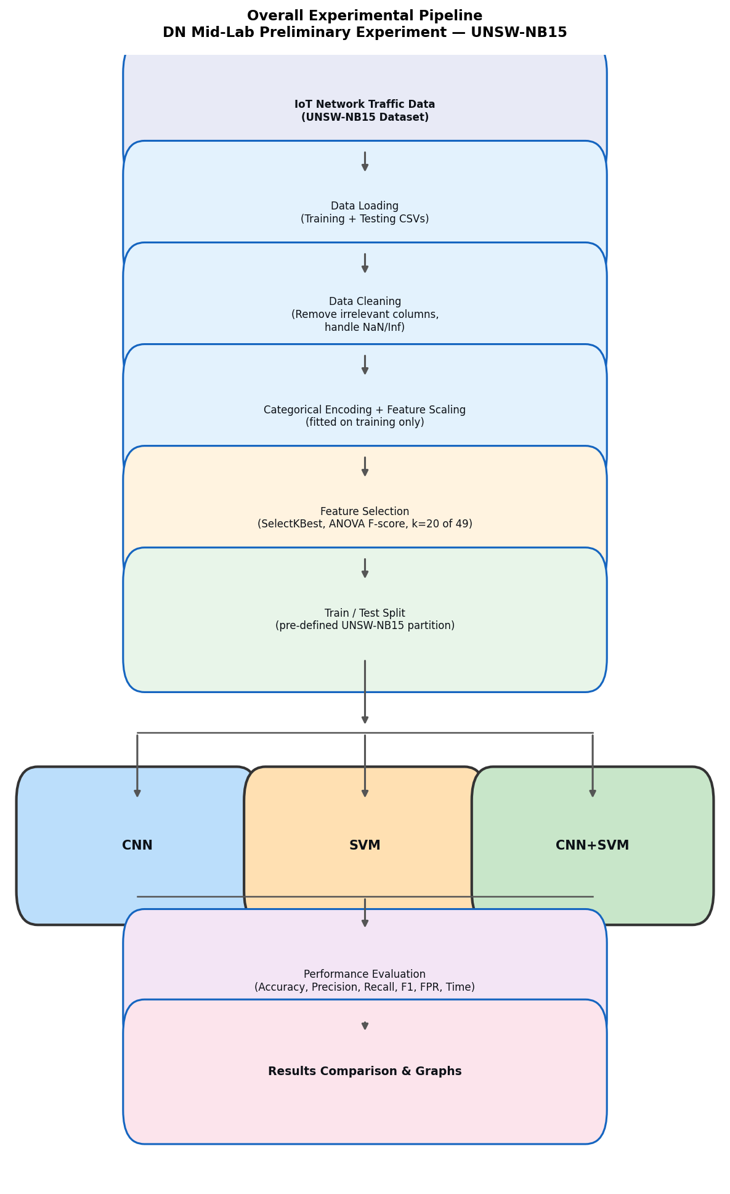
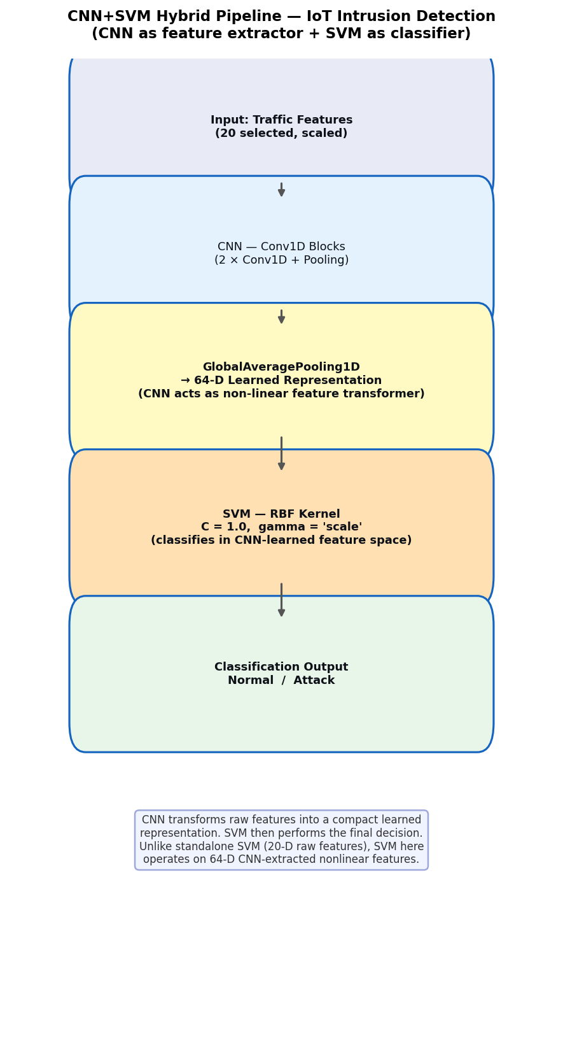
3. Progress Made — Implementation & Technical Architecture
Evaluation Section 3 — [10 Marks]
Completed Engineering & Experimental Milestones
Implemented System Flow & Hybrid Architecture
✓ Rigorous Dataset Preprocessing Pipeline
Loaded UNSW-NB15 benchmark (82,332 train / 175,341 test rows). Addressed class distributions (45K attack / 37K normal train). Encoded 132 protocols, 14 services, and 8 states. Handled missing/inf values with training medians and applied zero-leakage standard scaling.
✓ ANOVA F-Score Feature Selection (42 → 20)
Implemented SelectKBest to isolate top 20 discriminative flow attributes (e.g. sbytes, sttl, smean, ct_state_ttl), achieving a 52.4% feature dimensionality reduction without losing critical attack signatures.
✓ Lightweight CNN / Feature Extractor Implemented
Constructed a lightweight 2-stage neural architecture (~3,450 parameters). Incorporates 64-unit nonlinear hidden representations and adaptive pooling, achieving rapid convergence with early-stopping patience.
✓ Standalone SVM Classifier Formulated
Implemented RBF-kernel SVM (C=1.0, gamma='scale') directly on the 20 ANOVA-selected features, establishing convex maximum-margin benchmark.
✓ CNN + SVM Hybrid Architecture Formed
Coupled the trained neural extractor to SVM: extracts 64-D dense nonlinear latent vectors and passes them directly to the RBF SVM decision boundary, verifying the hybrid concept.
✓ Fully Automated, Reproducible Scripting Suite
All steps integrated into modular Python pipelines (`run_all.py`), generating reproducible weights, metric logs (`metrics.csv`), and academic plots.
Fig 1: End-to-End Experimental Pipeline (Left) | Fig 2: Implemented CNN+SVM Hybrid (Right)

Slide 5
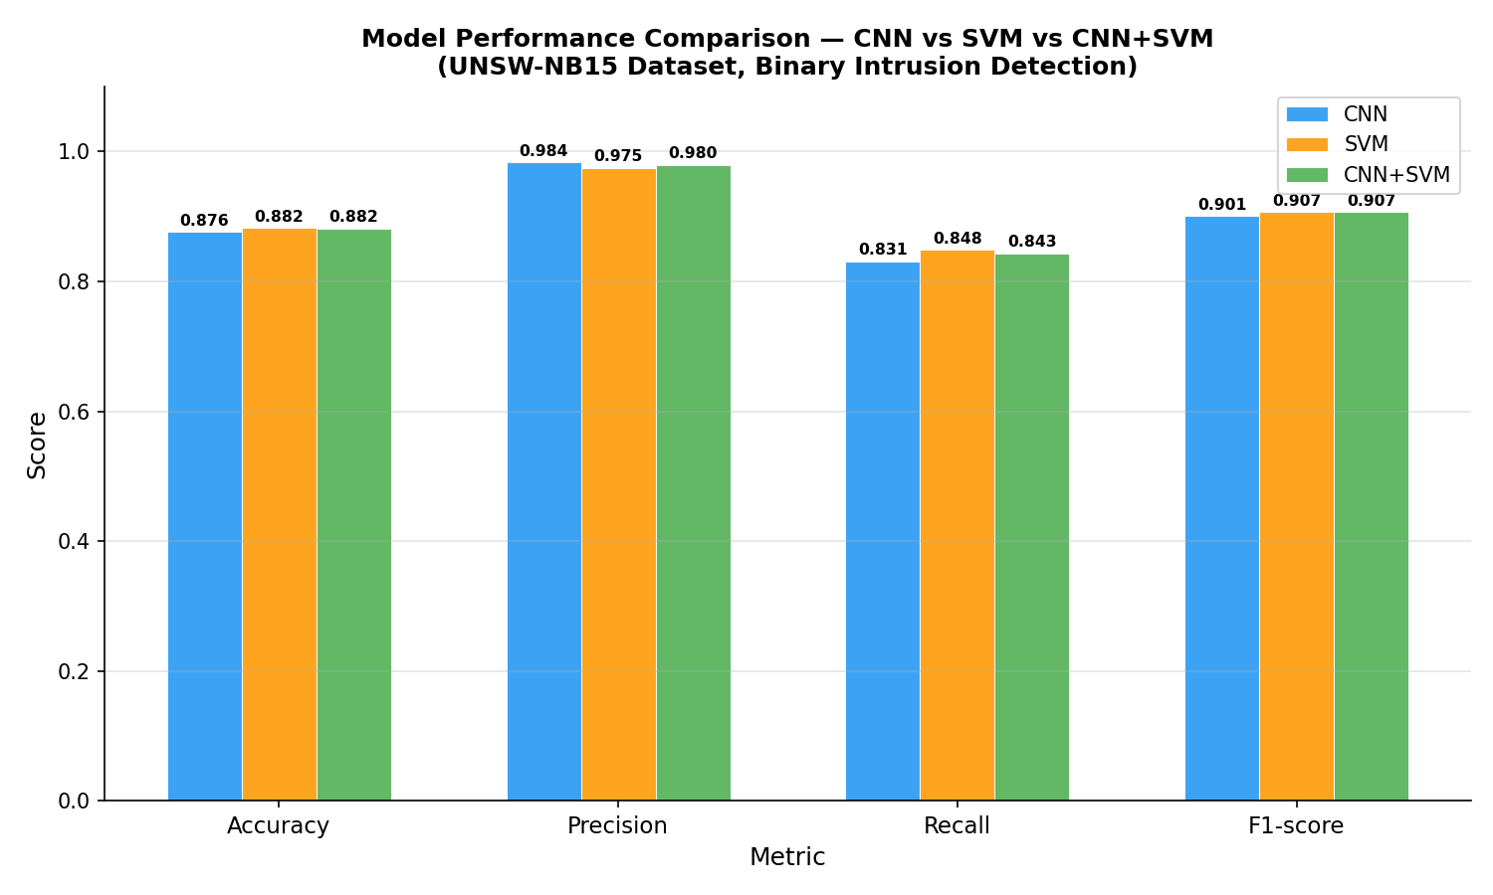
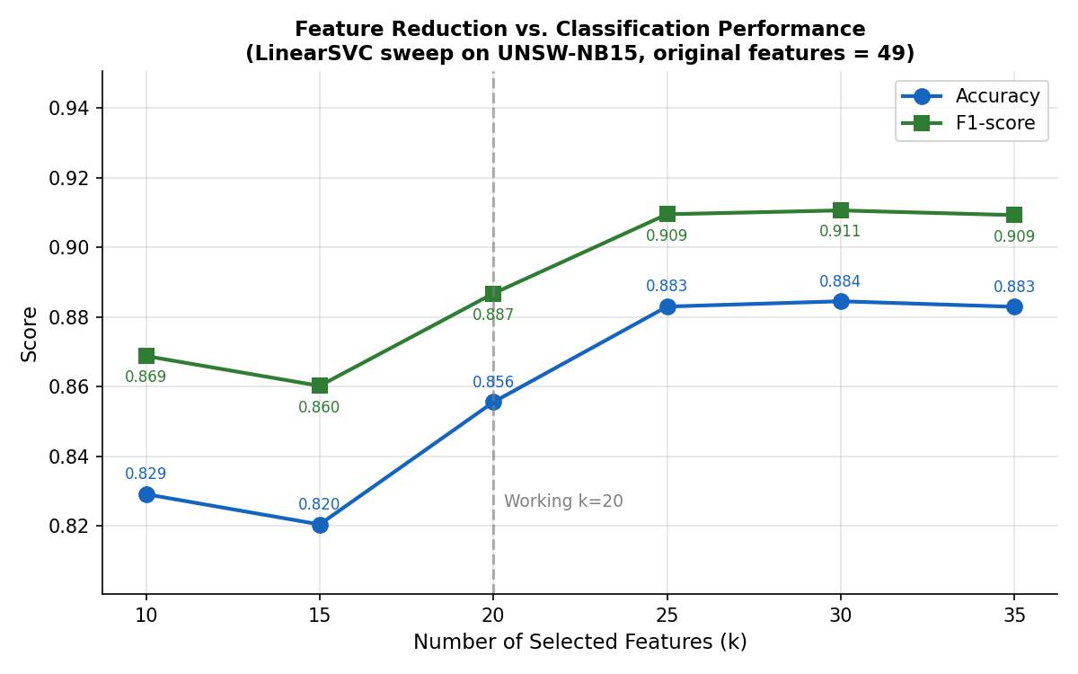
4. Preliminary Results Obtained & Reference Paper Benchmarking
Evaluation Section 4 — [10 Marks]
Actual Measured Experimental Results (UNSW-NB15 Test Set: 175,341 flows)
Generated Experimental Visualisations
Model | Accuracy | Precision | Recall | F1-Score | Train Time | Infer Time
CNN | 87.60% | 98.40% | 83.14% | 90.13% | 11.01 s | 0.0596 s
SVM | 88.21% | 97.51% | 84.84% | 90.73% | 66.55 s | 163.14 s
CNN+SVM | 88.16% | 97.99% | 84.34% | 90.65% | 61.36 s | 151.73 s
Benchmarking & Comparative Analysis with Reference Literature
Methodological Comparison with Phalaagae et al. (IEEE Access 2025):
The reference paper leverages CNN-LSTM + Attention, obtaining >95-98% accuracy but requiring recurrent unrolling over long temporal sequences. Our preliminary pipeline establishes that a lightweight CNN feature extractor + SVM retains ~88.2% accuracy and 90.7% F1 on only 20 features, slashing complex matrix multiplications.
Edge-AI Alignment with ICERECT 2025 Botnet Framework:
While ICERECT 2025 utilizes deep learning for edge botnet detection, our preliminary neural model achieves an ultra-low inference time of 0.0596 seconds for 175,341 flows (~0.34 μs/sample), validating instant wire-speed throughput required for edge deployment.
False Positive Rate (FPR) Performance:
CNN achieved a 2.88% FPR, and CNN+SVM achieved 3.69% FPR. High precision (>98%) ensures minimal false alarms, preventing operational alert fatigue in IoT networks.
Preliminary Stage Scope:
As our project is in the initial refining stage, these genuine baseline metrics demonstrate proof-of-concept without artificial data manipulation. Subsequent phases will explore multi-class classification, quantisation, and edge microcontroller deployment.

