Slide 1

_/\__
---==/ \\
___ ___ |. \|\
| __|| __| | ) \\\
| _| | _| \_/ | //|\\
|___||_| / \\\/\\
Entity Framework 7 New platforms, new data stores

Slide 2
Agenda
What is EF7?
Demos
Links

Slide 3


New platforms New data stores
01010 00100 10110 00100

Slide 4
New platforms
Full .NET Framework
Windows Phone
Windows Store
ASP.NET 5
Mac
Linux

Slide 5
New data stores
Relational & non-relational
Not a magic abstraction
High level services that are useful on all/most stores
Non-common concerns handled by provider extensions
Example providers
SQL Server
SQLite
Azure Table Storage
Redis
In Memory (for testing)

Slide 6
Challenges with current code base
Long history going back ~15 years
Older APIs and design patterns
Uses APIs not available on all platforms
Seldom used code/features
Monolithic implementation
Unintuitive behaviors throughout code
Not optimized for density/devices
High memory footprint
Tight coupling to relational concepts

Slide 7
EF7 is a lightweight and extensible version of Entity Framework

Slide 8
Part v7 and part v1
EF6.x code base not setup to achieve goals
Same top level experience as EF6.x
Still DbContext/DbSet etc.
Built over a new lightweight and extensible core
Just the commonly used features
Plus many new features
Code-based modelling only
Still supports creating model from existing database

Slide 9

Demo
Phone/Store with SQLite

Slide 10
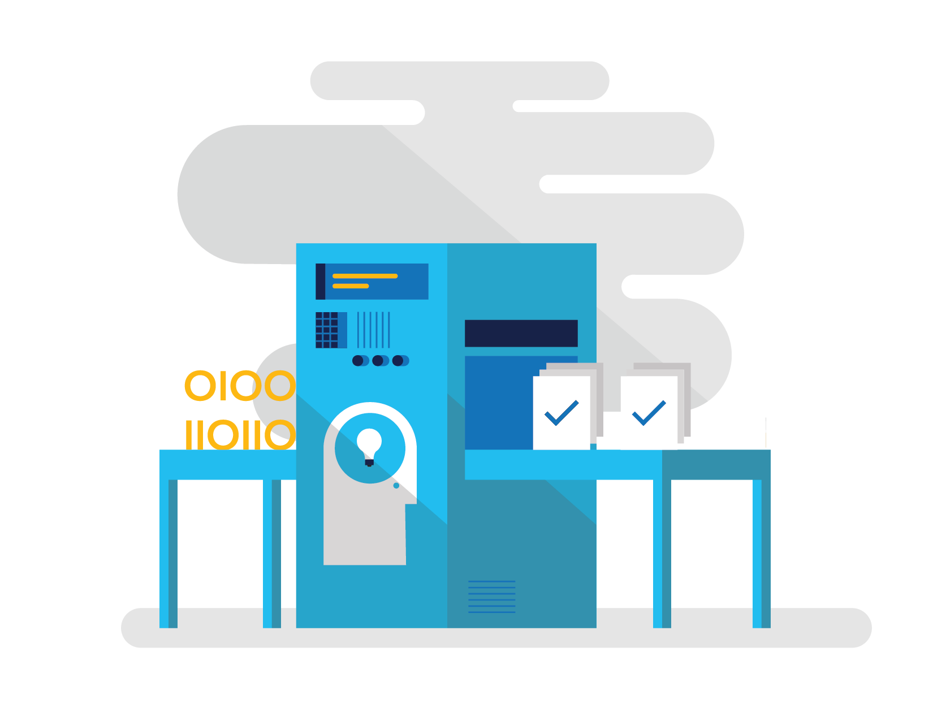
Demo
SQL generation improvements

Slide 11

Demo
Testing with InMemory data store

Slide 12

Demo
Azure Table Storage

Slide 13
Links
EF7 info | aka.ms/AboutEF7
EF Project | github.com/aspnet/EntityFramework
Demo code | github.com/rowanmiller/Demo-EF7

