Slide 1
Object-oriented modelling
of multi-rotor vehicle dynamics
Metodologie ICT per i Sistemi di Controllo – A.A. 2013/2014
March 26th, 2014
Marcello Pogliani – Davide Tateo
Notes:
Good morning, my name is Marco Bergamasco and today I’ll show
you the work that I’ve done with Prof. Marco Lovera and Fabio Beltramini about the “Experiment Design for MIMO Model Identification with Application to Rotorcraft Dynamics”

Slide 2
Objectives
This project
Design and implementation of basic components
for the particular case of fixed pitch (variable rpm) quadrotor
Tool: OpenModelica [1]
In particular:
Modelica Multibody library (basic rigid body dynamics, gears, etc)
Modelica Electrical library for motors
Simple models for rotor force/torque generation mechanisms [2]
Existing implementations for control algorithms (PI control)

Slide 3
Approach
1. Familiarisation with the system
2. Hierarchical breakdown into subsystems and definition of interfaces
3. Development of models for individual components
4. Development and testing of simulator

Slide 4
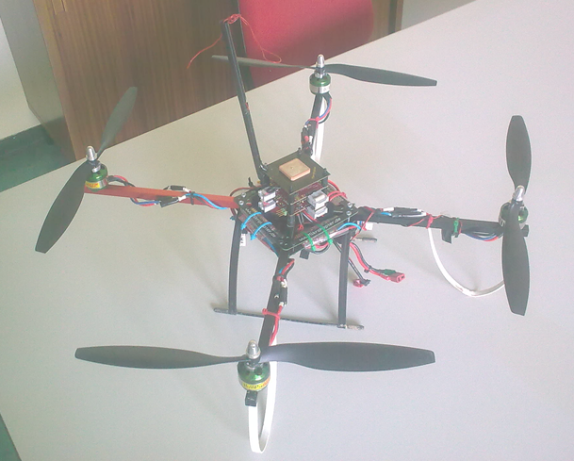
Familiarisation with the system
Main components
Structure (metallic tubes)
Power system (battery, power
electronics)
On-board computer (including
sensors)
Motor drivers
Motors
Propellers

Slide 5
Hierarchical breakdown into subsystems and definition of interfaces
PI controller set point
(target ω for each arm)
Frame interface
+ signal bus
Chassis
& controller
Rotor
Flange + frame
Arm
Quadrotor (variant for n-rotor)

Slide 6
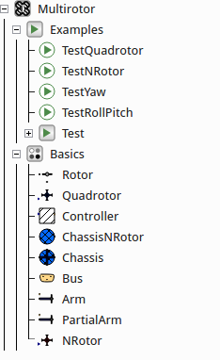
The Multirotor package

Slide 7
Models for individual components
Rotor
Leverages a simple model from [2] to compute lift and drag
Incorporates the model of an inertia (from the Modelica standard library)
Interfaces:
Frame to the rigid body of the arm
(transmit the lift)
Flange to the motor
(transmit the torque)
Parameters:
α = 10°
bd[] = {9.96e-09,2.46e-10,4.33e-07}
bl = 3.88e-07
Jr = 3.5e-05 kg · m² (rotor inertia)

Slide 8
Models for individual components
PartialArm
Rigid body (from the Multibody library)
Gear (ideal)
Bus connection: speed sensor signal [rad/s] + control signal [V]
Signal-controlled voltage generator
Arm extends PartialArm with:
Connection to a DC_PermanentMagnet motor
Connection to a Rotor model (see previous slide)
Arm (rigid body):
length = 0.2 m
diameter = 0.01 m
mass = 0.18 kg
Gear:
gearRatio = 1
Motor:
motorVoltage = 12 V
motorResistance = 0.3 ohm
motorInductance = 0.0015 H
motorVelocity = 1100 rad/s
motorInertia = 3.5e-05 kg · m²
rotorInertia = 3.5e-05 kg · m²

Slide 9
Models for individual components
Chassis / ChassisNRotor
Rigid body to model the weight of the central support + microcontroller + …
Connect all the arms through Frames, taking into account the correct orientation (using a FixedRotation component)
Controller
A set of PI controllers, one per arm
Directly connected to the arms through Bus connections
Set point: the desired angular speed

Slide 10
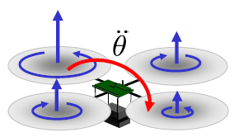
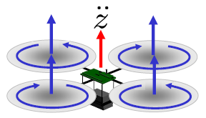




Development and testing of the simulator
Developed simulations (package Examples):
Notice: the set point is the angular velocity of each arm; it is easy to attach a more complex control system to the simulator in order to provide a more significant input (set point) in terms of roll\pitch\yaw
TestQuadrotor
TestRollPitch
TestYaw
Notes:
It has four independent rotors and you can see how it is possible to combine the rotors to obtain collective, pitch, roll and yaw motions

Slide 11
References
[1] OpenModelica, https://www.openmodelica.org/
[2] M. J. Cutler, Design and Control of an Autonomous Variable-Pitch Quadrotor Helicopter, Master's Thesis, Massachusets Institute of Technology, September 2012
[3] P. Fritzson et al., OpenModelica Users Guide, March 2014
[4] P. Fritzson and O. Rogovchenko, Introduction to Object-Oriented Modeling, Simulation and Control with Modelica, Tutorial at MODPROD, February 2012
[5] Modelica® - A Unified Object-Oriented Language for Physical Systems Modeling, Language Specification, Version 3.2, March 2010

