Slide 1
Canada Car Accident 1999 - 2014
Boris Korotkov
Chaewon Kim
Patricia Luo
Ryan He

Slide 2
Canada Car Accident 1999 - 2014
Overview
Analysis and Conclusions

Slide 3
Data Source
Canada, 1999 – 2014, CSV from Kaggle
Collision data: Date, Time, Severity, Road condition, Weather, etc.
Vehicle data: Type, Model year
Person data: Sex, Age, Position, Treatment, Safety device, etc.
C_YEAR | C_MNTH | C_WDAY | C_HOUR | C_SEV | C_VEHS | C_CONF | C_RCFG | C_WTHR | C_RSUR | C_RALN | C_TRAF | V_ID | V_TYPE | V_YEAR | P_ID | P_SEX | P_AGE | P_PSN | P_ISEV | P_SAFE | P_USER
1999 | 1 | 1 | 20 | 2 | 2 | 34 | UU | 1 | 5 | 3 | 3 | 1 | 6 | 1990 | 1 | M | 41 | 11 | 1 | UU | 1
About 6 million registered collisions
Most are numbers in string
Special values: e.g., not applicable, unknown

Slide 4
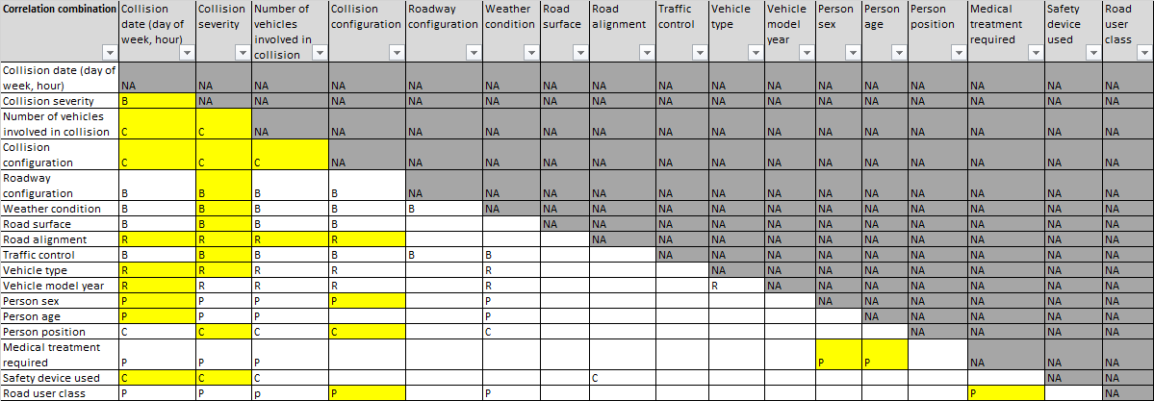
Data Loading & Preparation
Load data through pandas.read_csv, all cleanup/analysis in Python
Team analyzed all fields, each analysis covers relationship of two

Slide 5
Canada Car Accident 1999 - 2014
Overview
Analysis and Conclusions

Slide 6
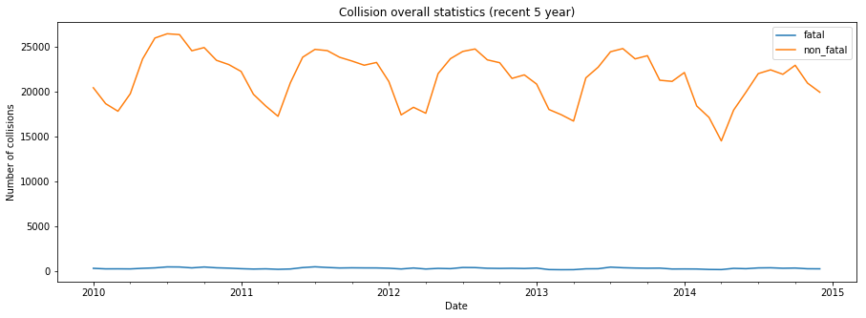
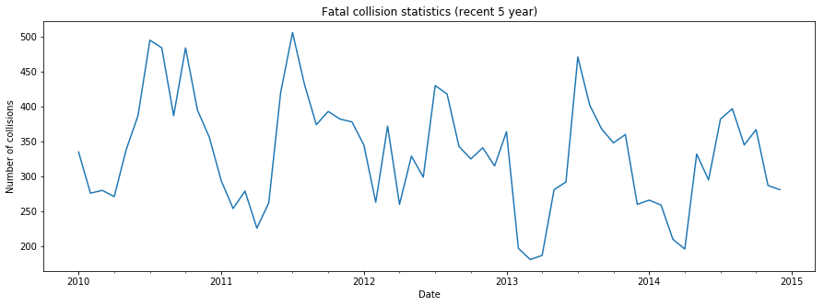
1. Fatal and Non-fatal Collision

Slide 7
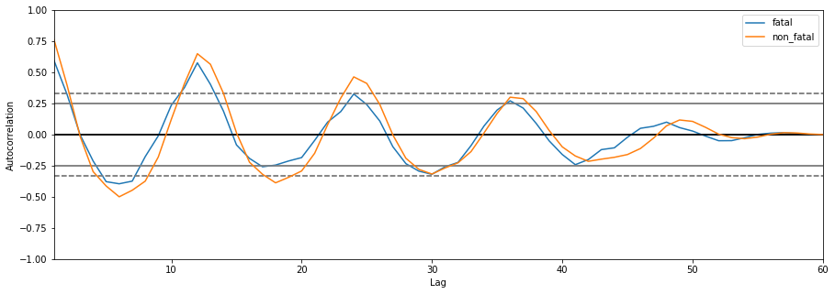
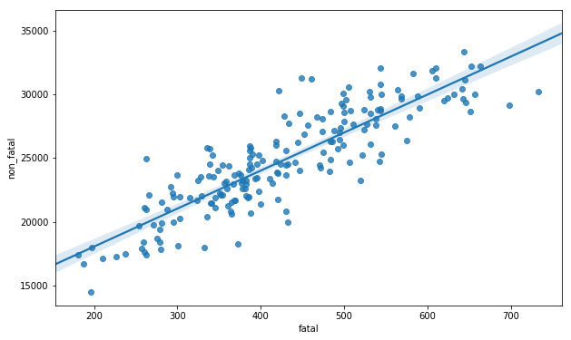
1. Fatal and Non-fatal Collision (cont’)
The autocorrelation of fatal and non-fatal collisions both follow a similar pattern, which is a seasonal cycle of 12-month period.
The distribution of fatal and non-fatal collisions show a strong linear correlation.

Slide 8
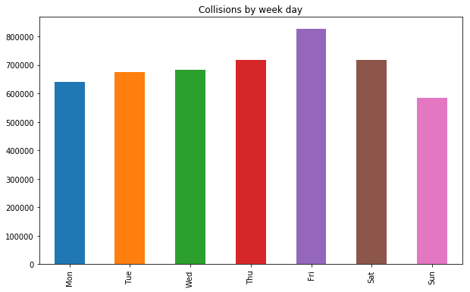
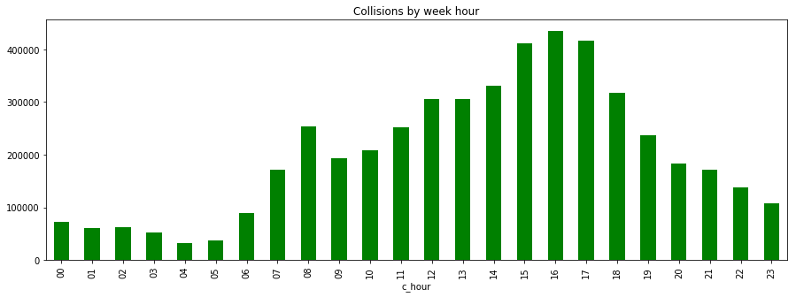
2. Collision Distribution by Week Day and Hour
Day Hour
Week Day

Slide 9
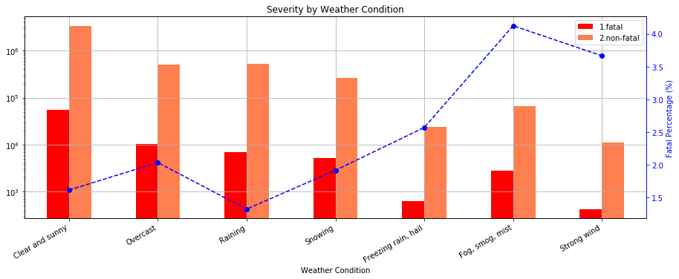
3. Weather and Collision Severity
The majority of collisions took place on clear and sunny days.
Drivers driving with limited visibility such as fog, smog and mist with strong wind were prone to highest fatality rate.

Slide 10
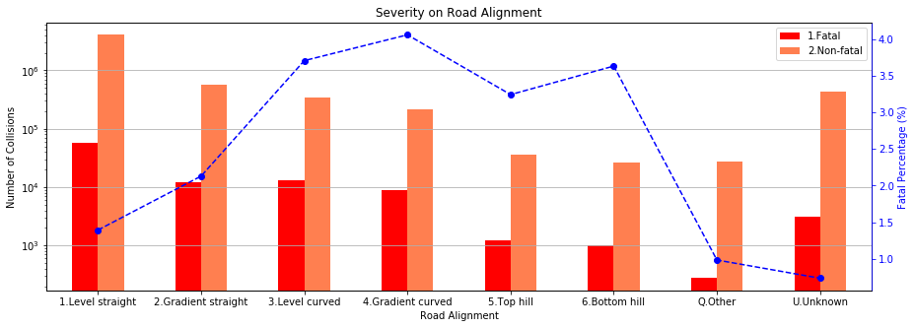
4. Road Alignment and Collision Severity
Most collisions happened in level and aligned road.
Bad road alignment may lead to higher risk of fatal accidents.

Slide 11
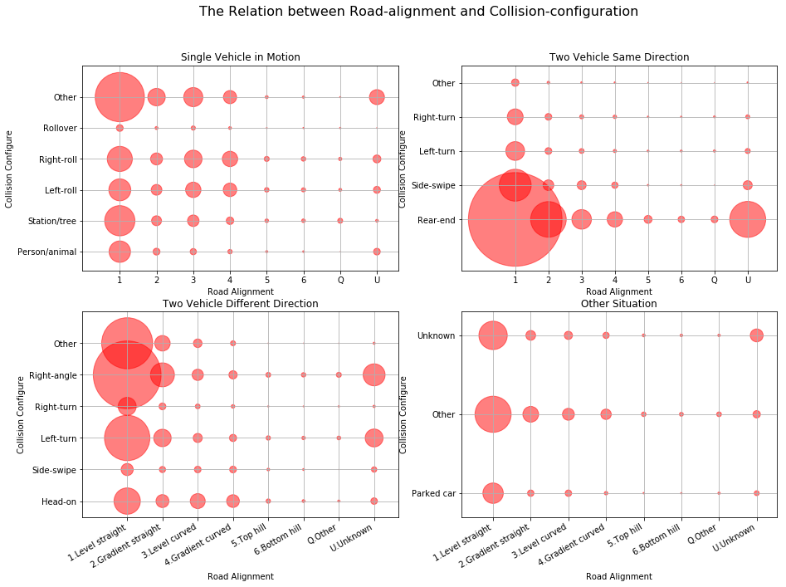
5. Road Alignment and Collision Configuration
Rear-end collision is the most frequent collision type followed by right-angle collision.

Slide 12
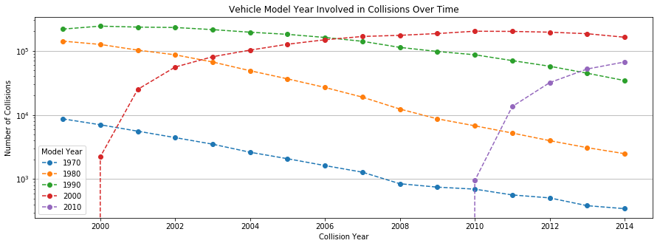
6. Vehicle Model Year Involved in Collision
The collision rate for vehicle models peaks in their 10th year.

Slide 13
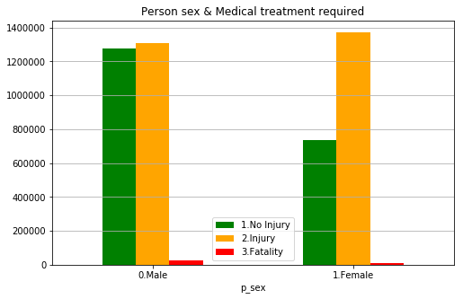
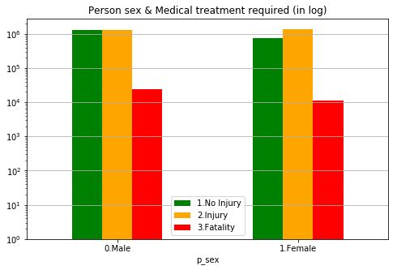
7. Person Sex
Females are more likely to get injured in an accident.
Males are more likely to be involved in fatal accidents.

Slide 14
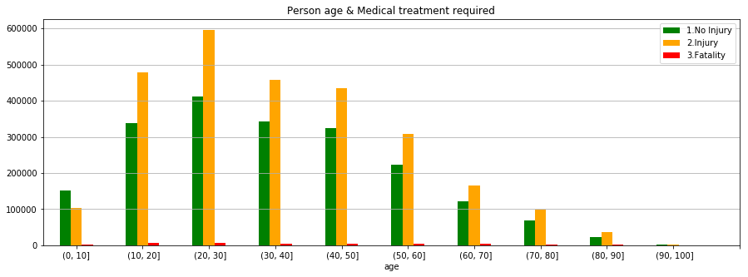
8. Person Age
People aged from 21 to 30 are most prone to accidents.
Probability of accidents decreases while age increases.

Slide 15
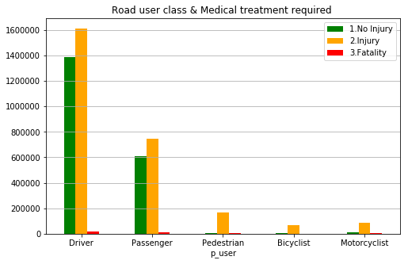
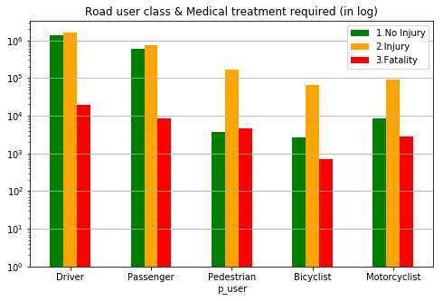
9. Road User Class
Drivers are twice as likely to get hurt or die than that of passengers.
Bicyclists are relatively safer.

Slide 16
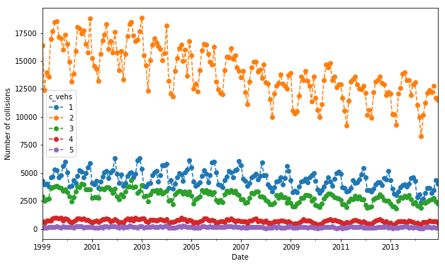
10. Number of Vehicles Involved in Collision
Most frequent number of vehicles involved in collisions at all time was 2.

Slide 17
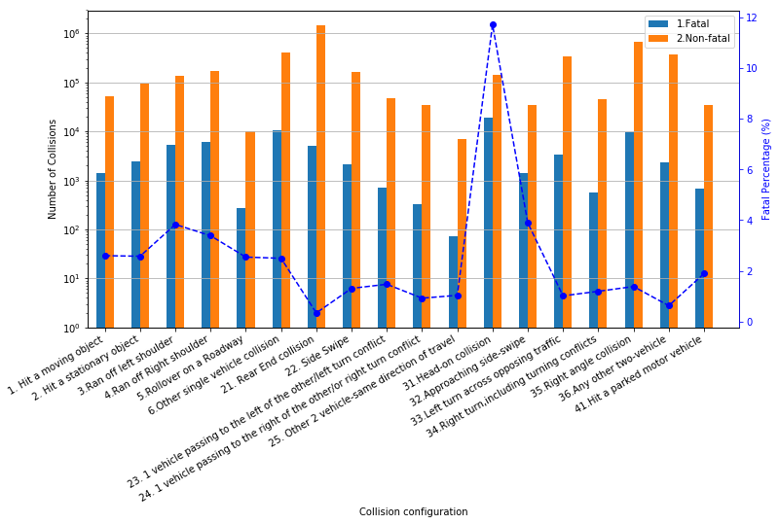
11. Collision Configuration and Severity
Rear-end collision is the most common type of collision.
Head-on collision has the highest fatality rate.

Slide 18
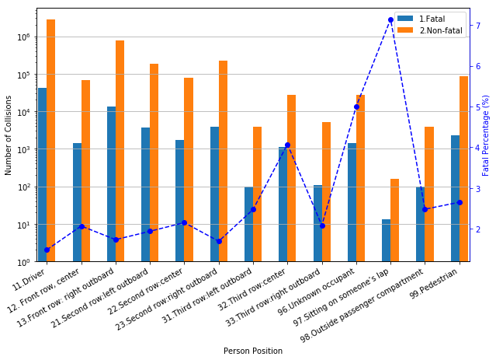
12. Person Position and Collision Severity
Drivers are more likely to be involved in collisions, but surprisingly, the fatal rate is the lowest.
Sitting on someone’s lap has the highest fatality rate.

Slide 19

Canada Car Accident 1999 - 2014

Slide 20
Canada Car Accident 1999 - 2014
Thank You
GitHub link
Kaggle link

