Slide 1

Resource Monitor
WELCOME
Sathya Prakash.K
www.boris-info.co.cc

Slide 2
Requirements
It should not consume huge resource on the server where it is listening
Availability of the program even during updating the program
Client-Server model
Threshold time
Security
Crash proof

Slide 3
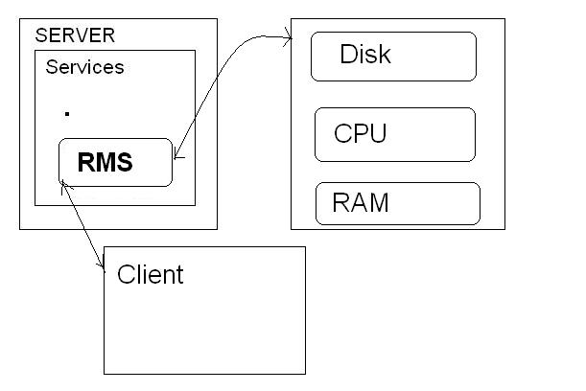
Architecture

Slide 4
Resource Monitor Server(RMS)
Instead of running all the monitoring services, which might consume more resources we apply the client - server model
The Resource Monitor Server listens on a particular port of the server machine
RMS handles the request from the client

Slide 5
Object Oriented Approach
Whenever the RMS is started it creates a object of those monitoring scripts locally
Hence in case of software updates, the local object will not face any problems
And when the RMS is restarted after update, objects of new updated monitoring scripts are created

Slide 6
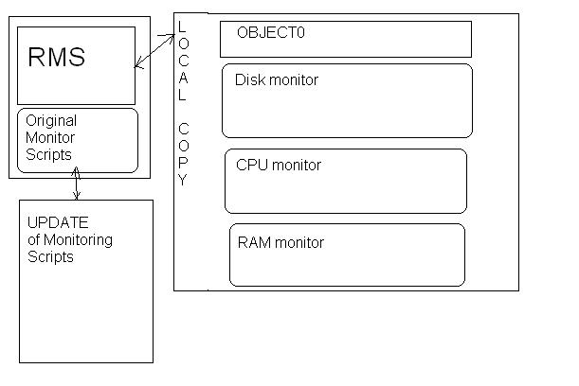
OO Approach

Slide 7
Server Side Config
Listening port
Threshold time for each resource monitor modules
When the threshold time is crossed the RMS kills the running instance of the object

Slide 8
Security
Last but not the least
Without guessing or testing the type of attacks that could be carried on a infrastructure, deploying various security functions,cipher algorithms makes the server bulky
Authentication passwords are md5 encrypted

Slide 9
Attacks
What kind of attacks could be carried on ?

Slide 10
Attacks on Authentication
Brute Forcing
FPGA brute forcer
GPU brute forcer
Sniffing the network (MITM)

Slide 11
Brute Forcing
Olden method of Attack
Slight changes in the authentication program can completely avoid this attack

Slide 12
Sniffing-MiTM
MiTM is carried out by arp spoofing
I'm not going to use any cryptographic functions
Just setup static arp entry on both the sever & client the machines
"arp -s 192.168.1.5 ff-ae-be-ef-ca-fe"

Slide 13
Deployed Security Measures
Md5 encryption on password transfer
Secured authentication coding to prevent brute forcing
Static arp entries
Displaying Fake Banner
Skiddy Baiting

Slide 14
Thank You

