Slide 1

Welcome

Slide 2
Denial of Service Attacks
One of the attack which causes more losses to the victim
Easy to carry out by skiddies due to the presence of a lot of point and click tools
Clogs the Bandwith and results in Network Conjection
Productivity gets disturbed

Slide 3

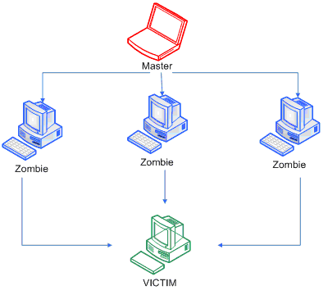
DDoS Attacks
Highly Profitable attacks
Group of hacked computers called Botnets (Zombies)
Yahoo,ebay,Paypal etc. had been DDoSed

Slide 4
BANDWIDTH EXHAUTION
Smurf
Spoofed ICMP is sent to Broadcast device
Victim receives huge amount of traffic from the network.
R

Slide 5
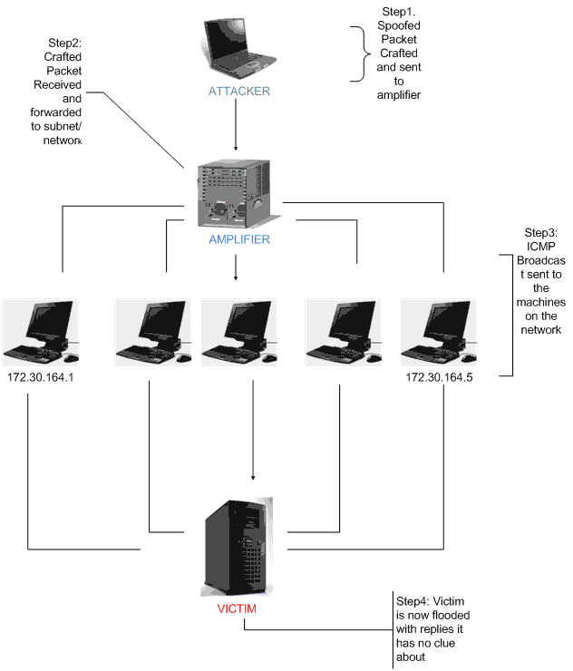

Slide 6
Network Connectivity Attacks
SYN-FLOODING

Slide 7
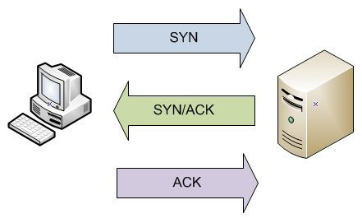
SYN Flooding
Basic Flaws in Implementation of TCP/IP
Retransmission of Packets which is due to Error correcting & Error detecting

Slide 8
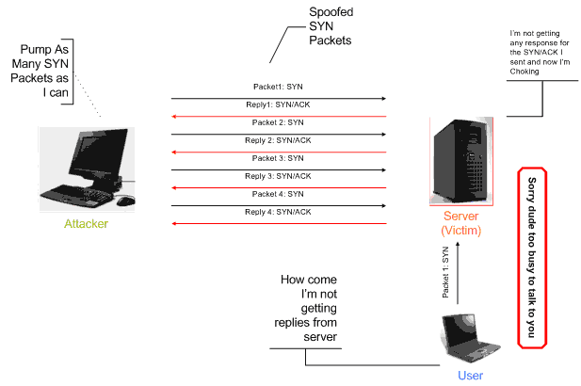
A Typical SYN FLOODING scenerio

Slide 9
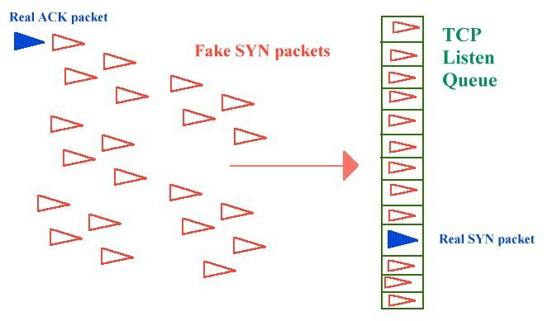
Backlog Queue

Slide 10
Built in Schemes
SYN Cookies in Linux
SYNAttackProtect in Microsoft Server 03

Slide 11
Our Solution

Slide 12
SYN_Handler
Identifying the Attacker's SYN Packet from a group of legitimate Packets
Backup checking
Isolating the Attacker
QoS is unaltered
Using Limited resources to prevent the attack

Slide 13
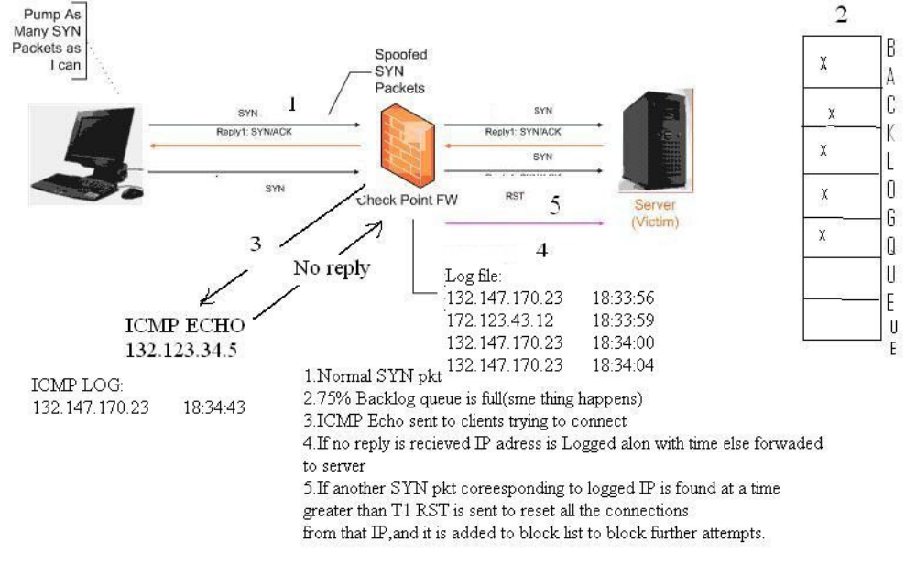
SYN_Handler

Slide 14
Algorithm
Backlog queue triggers the Transparent firewall
Firewall logs the incoming requests in logfile
ICMP request is sent to all clients in the logfile
If it obtains a valid reply connections takes place as usual
If reply is not obtained it is logged in ICMP Log

Slide 15
Algorithm
When ICMP log is not empty firewall monitors for incoming requests from clients in ICMP log
The time function checks the time in ICMP Log,Log file

Slide 16
THANK YOU
REFRENCES:
Computer Networks By Andrew.S.TanenBaum
PacketStrorm [http://www.packetstorm.com]
SecurityFocus[http://www.securityfocus.com]
Hacking Exposed 5 By StuartMcClure
Bugtraq mailing list.

