Slide 1
NaYaBoh
Open Source Internet Gateway
Boris Däppen
Oktober 2010, NaYaBoh v0.4.2, GUI v0.1

Slide 2
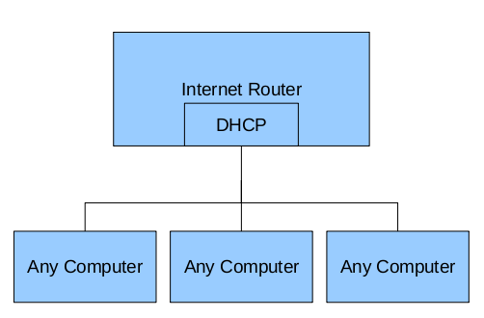
Typical Cybar / Office

Slide 3
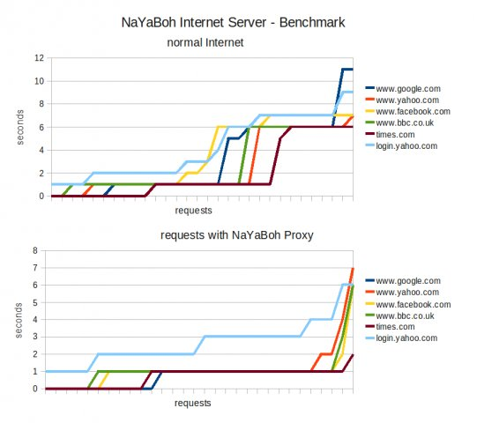
Effect of a Proxy

Slide 4
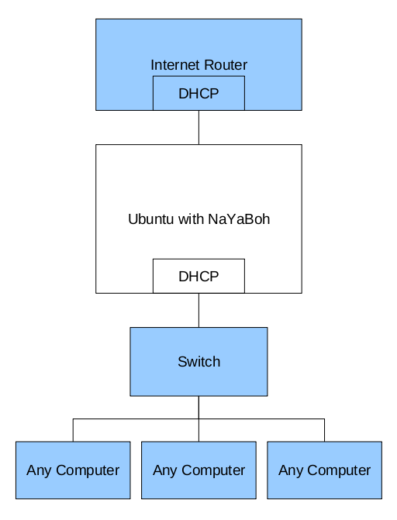
A Proxy Server
Routing
iptables
Web cache:
Squid
Ad filter:
Adzapper
DHCP server +
DNS cache:
dnsmasq

Slide 5
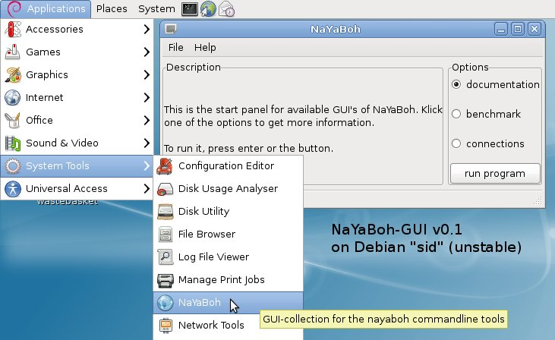
Introducing NaYaBoh

Slide 6
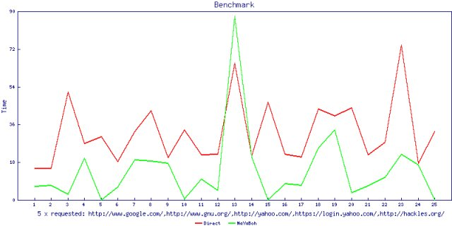
Live Measurement

Slide 7
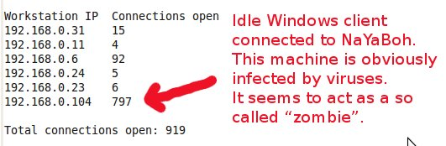
Simple Information

Slide 8
NaYaBoh does not... (yet?)
… protect you from viruses
… block local scammers
… restrict/control access to web
… run on windows

Slide 9
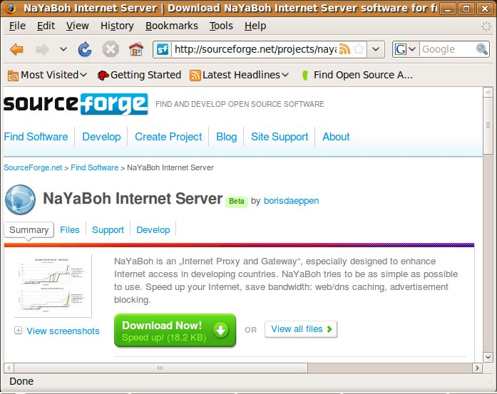
Deployment
Project hosted at:
github.com
sourceforge.net
Free download and participate!

